Slide 1
Installation scheme (1)
Installation practice has been carried out to examine our installation scheme and jigs in-situ and to feed back what we will learn to them.
Installation of a single module.
To examine the basic procedure without adjacent modules.
To measure/correct the sag and alignment of the module in-situ.
Sequential installation of three modules.
To examine the procedure with a realistic situation, i.e. having an adjacent module.
To examine z-beam joints and removal of the strong back of the center module.
Installation of the “last” module.
To examine the procedure for the last module, i.e. having adjacent modules at both sides.
Installation at the bottom, side and top slots.
To experience the slot-dependent work environment.
Useful info. to decide the first and last slots to be installed.

Slide 2
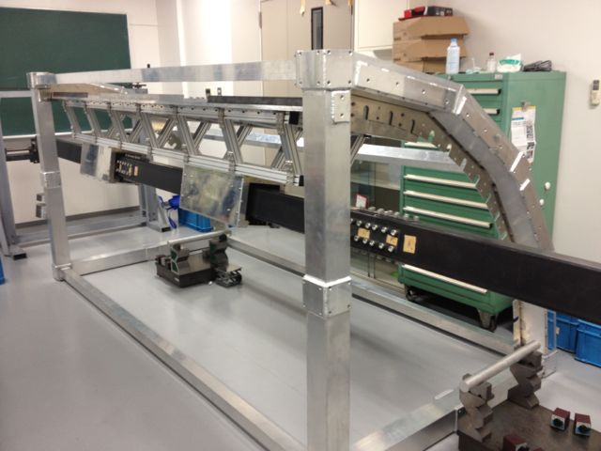
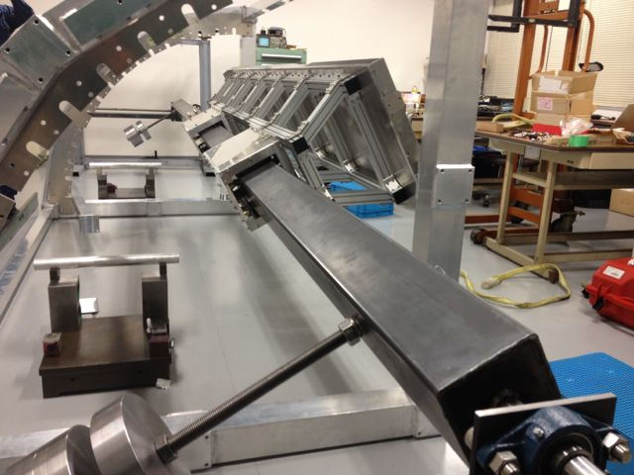
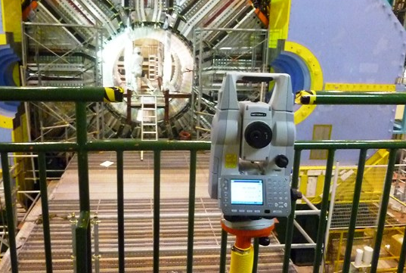
Installation scheme (2)
Tools used in the practice.
Installation jigs,
¼ ECL mock-up,
strong backs,
dummy module/QBBs,
laser transit, etc.
XY-stage
Module + Strong back
Guide pipe
Slider
Counter weight

Slide 3
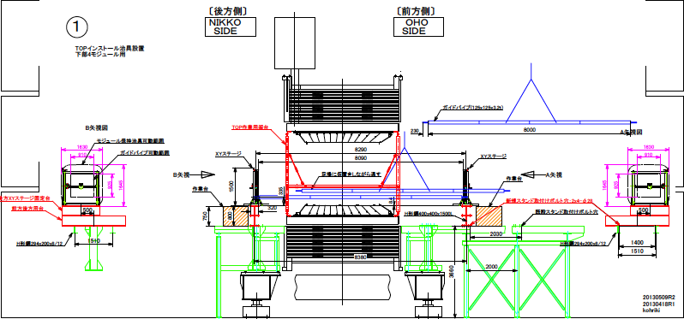
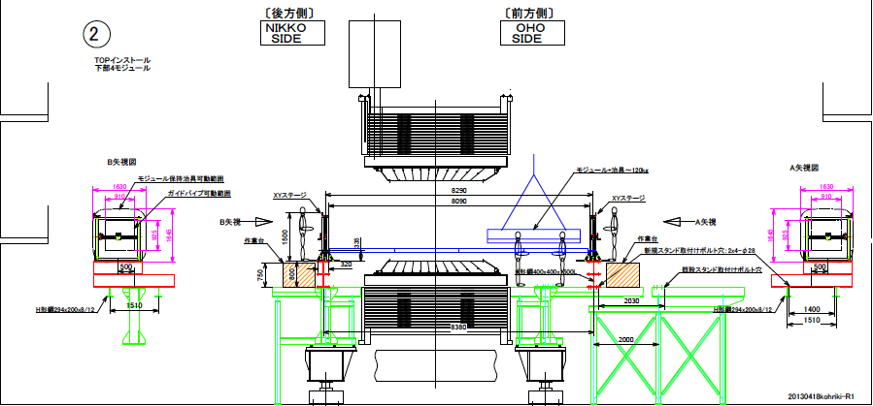
Installation scheme (3)
Set up the XY-stages, scaffolds and guide pipe.

Slide 4
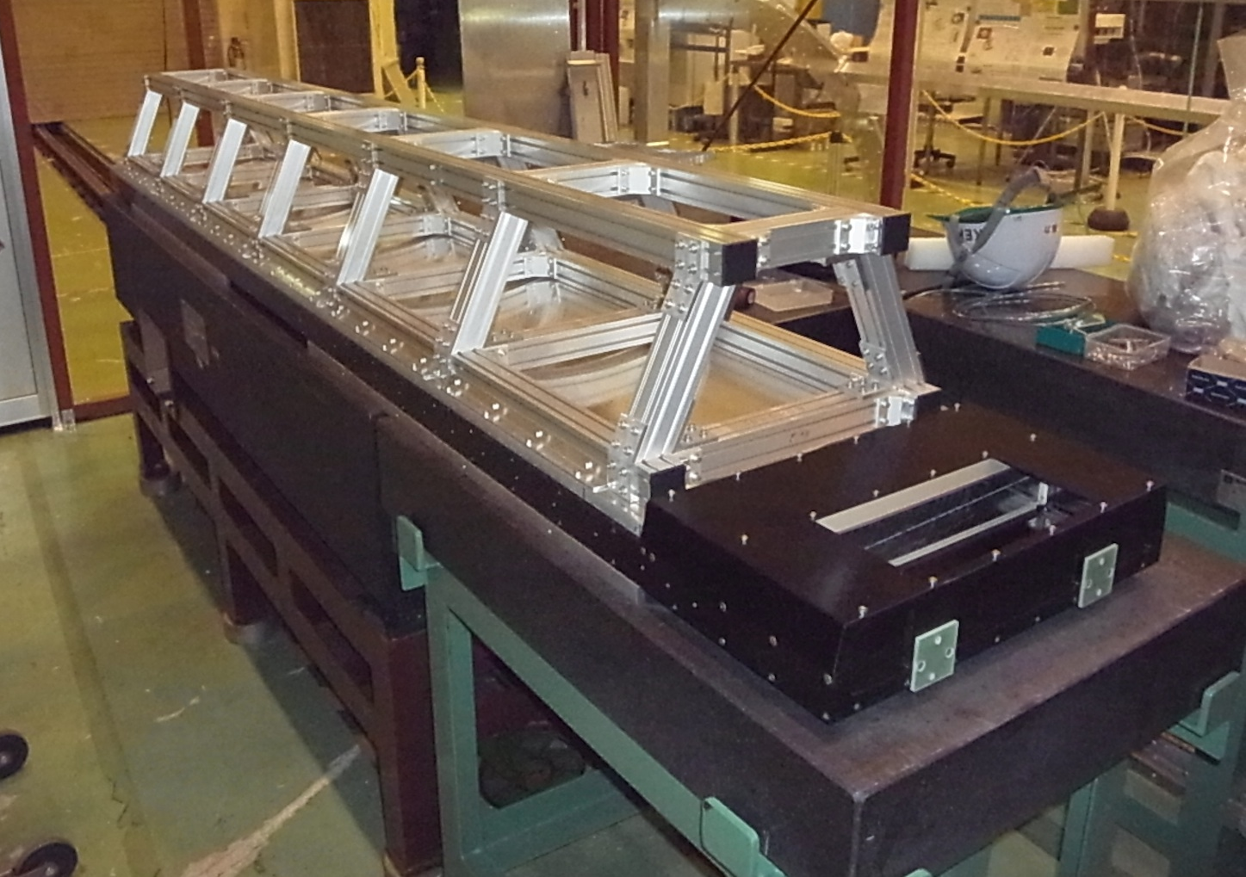
Installation scheme (4)
Module sag measurements
Strong backs (SBs) seem to work well.
Strong back
Simple supports
Prototype3
Granite table

Slide 5
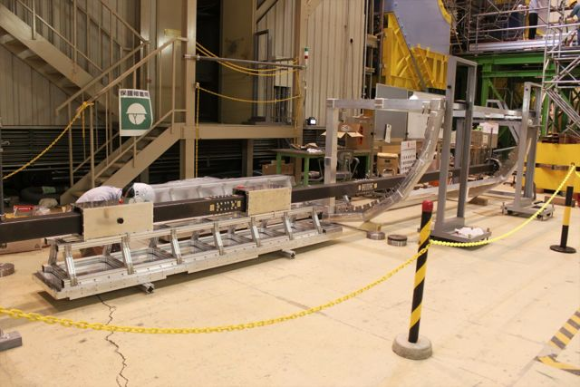
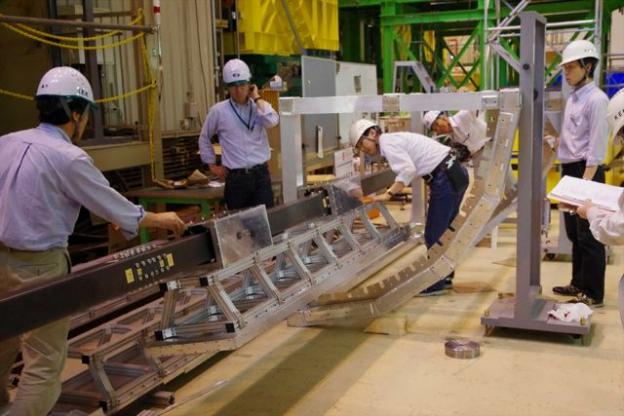
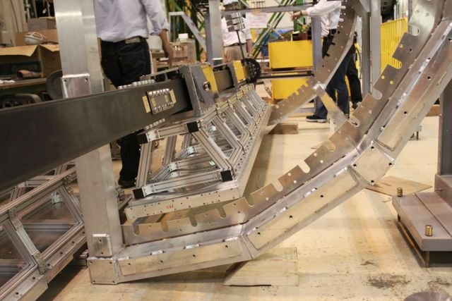
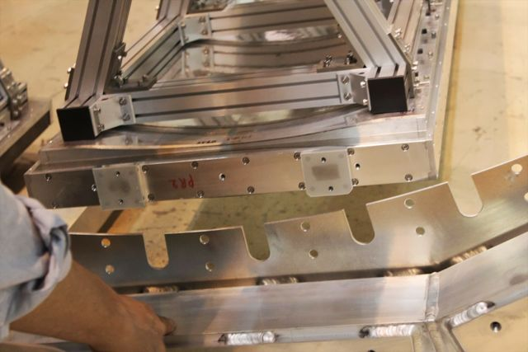
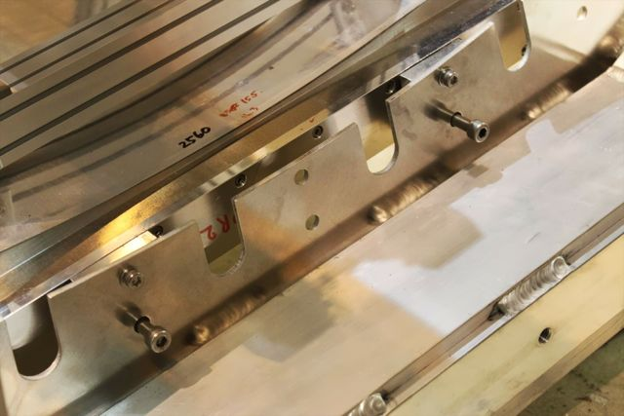
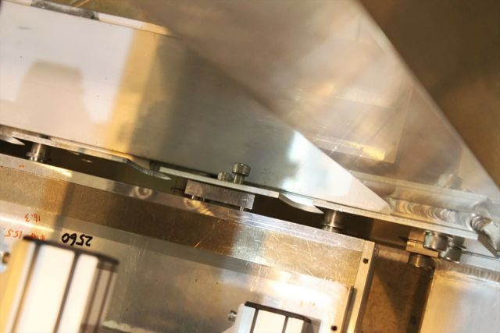
Day 1 (3)
Single module installation at the lowest slot.
Rotate the guide pipe with balance weights and lock at the target angle. Then slide the module into the slot.
Connect the sliders and the SB.
Fix the module at the target z-position using the slider break.
The forward fixtures have pin joints with 1 mm gap (to deal with thermal expansion and the installation clearance).
Set the forward fixtures and lower the module toward the target holes of the ECL flanges.
Fine adjust the rotation angle and fix the forward end with bolts and washers.

Slide 6
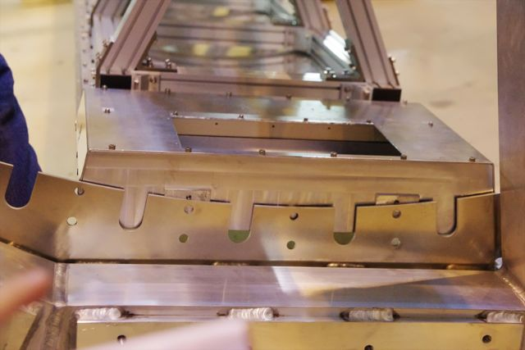
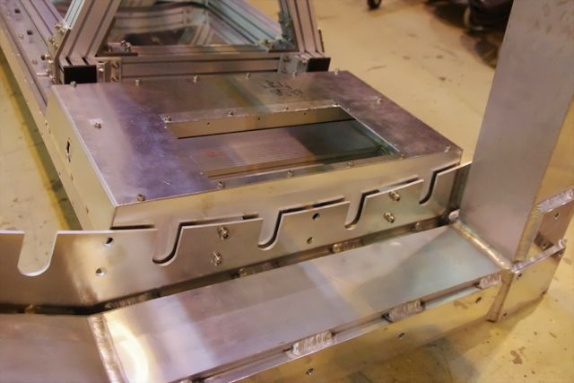
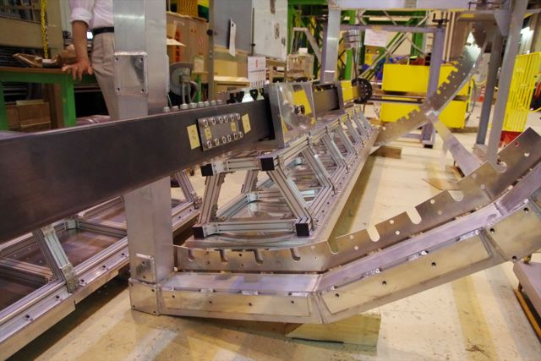
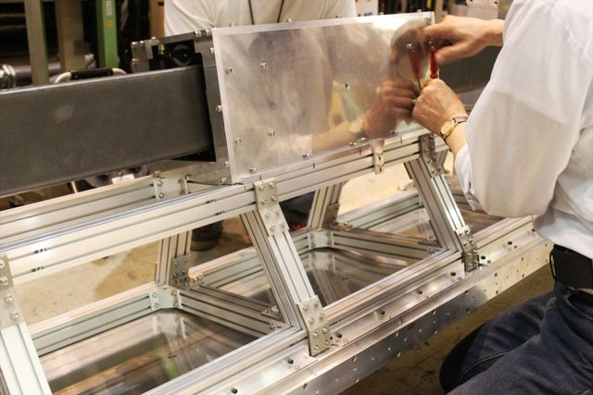
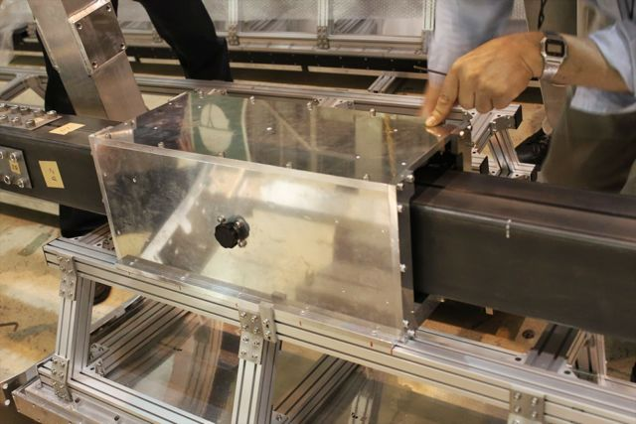
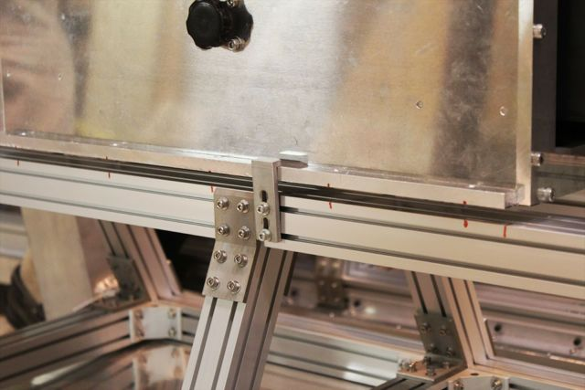
Day 1 (4)
Single module installation at the lowest slot. (cont’d)
Fine adjust the rotation angle and lower the backward end to align the module and flange holes.
Fix the backward end with bolts and washers.
Both the fwd and bwd ends are fixed to the ECL flanges.
Gentle removal of the sliders can be accomplished by loosening the L fixture screws gradually and sliding them at the “long” screw holes.
Remove the slider-SB joint screws, keeping the L fixtures.
The L fixtures prevent from having stuck screws and a spring-like rebound of the guide pipe.

Slide 7
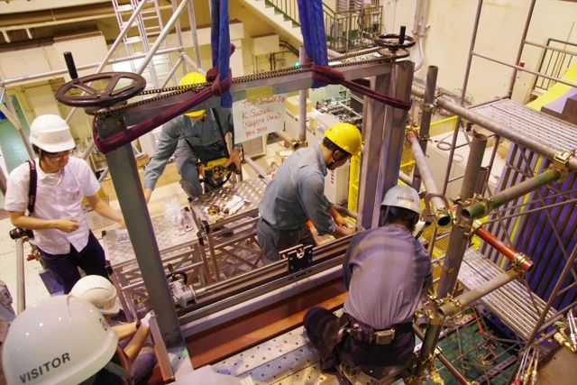
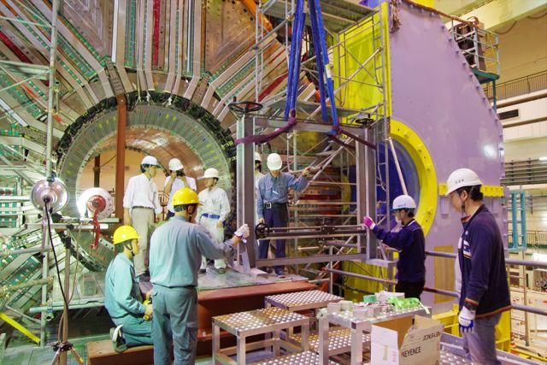
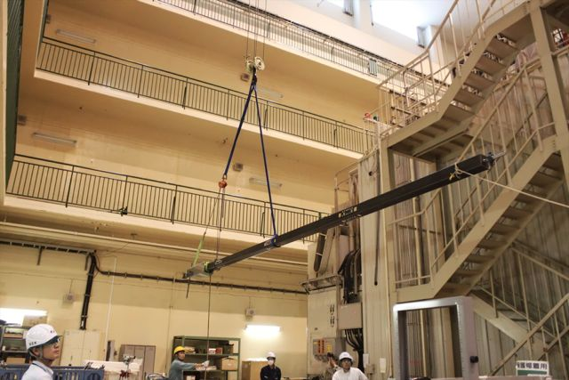
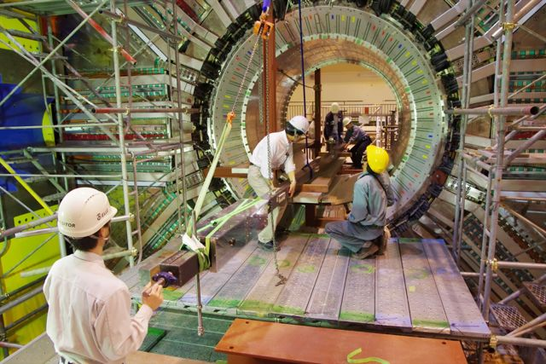
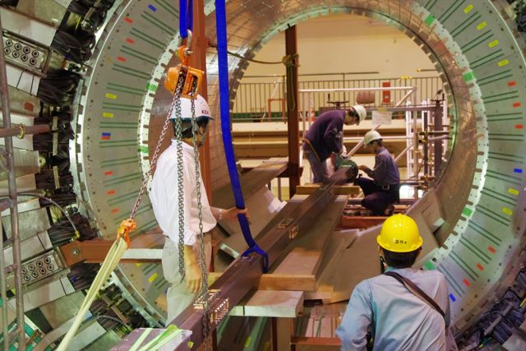
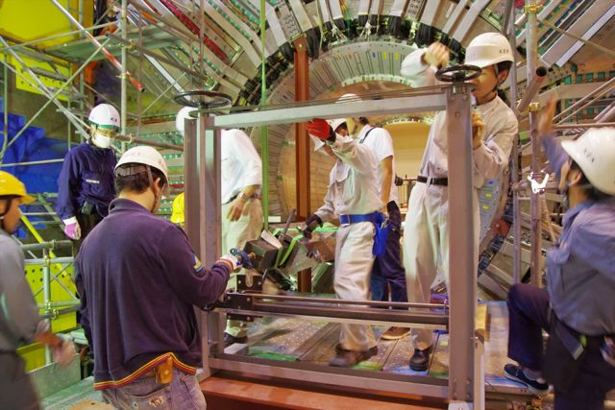
Day 2 (1)
Intended to start the in-situ practice.
Set an xy-stage in the Nikko side.
Move the other xy-stage in the Oho side and set it temporary.
Move the guide pipe into the barrel cylinder directory from the Oho side.
Put the guide pipe on the scaffold and move step-by-step to the Nikko side semi-manually adjusting the chain block length.
Join a guide pipe end to the xy-stage in the Nikko side; the 4π-rotational bearing can accept a certain tilt of the guide pipe.
Join the other guide pipe end to the xy-stage in the Oho side; fix the xy-stage at the target position after then.

Slide 8
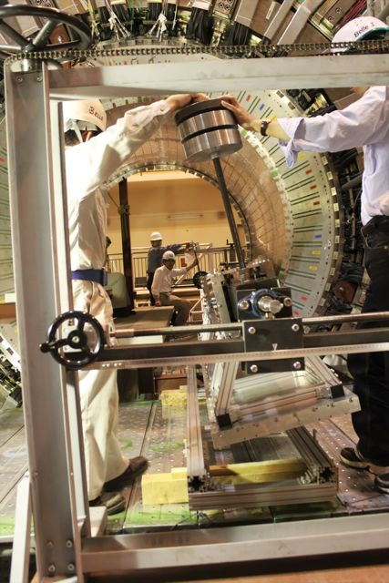
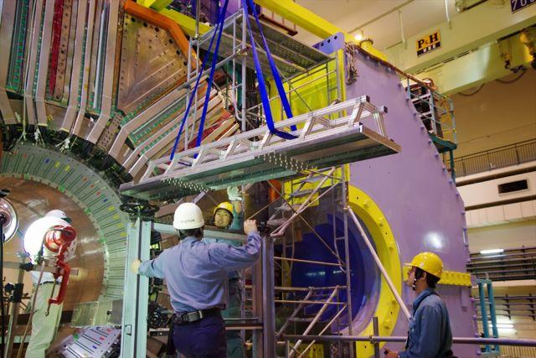
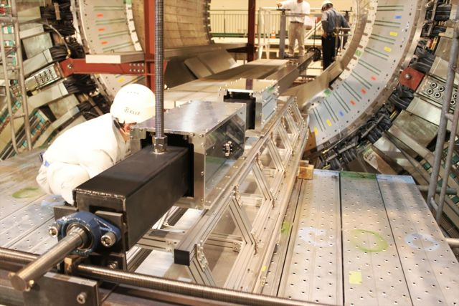
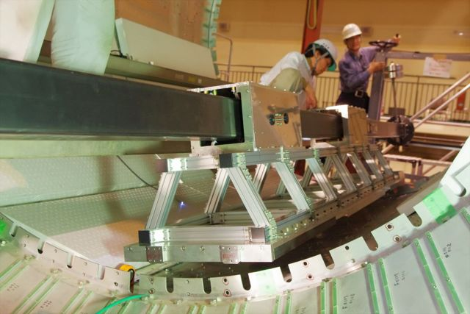
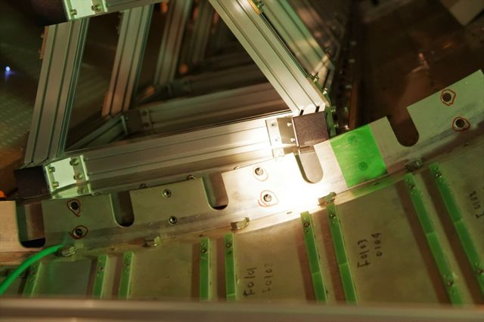
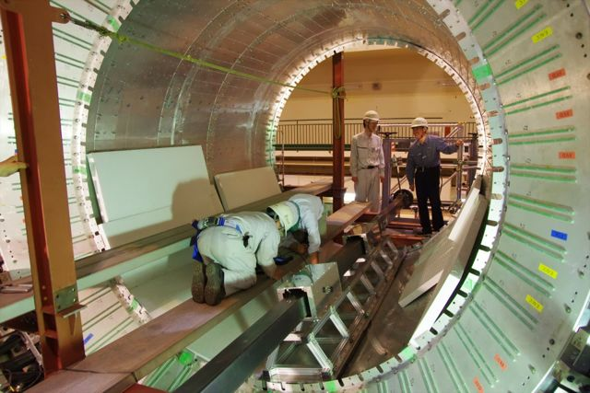
Day 2 (2)
First in-situ trial using the dummy module.
Following the procedure exercised at the ECL mock-up.
The xy-stages vibrated during the operation; reinforcement or modification of the I-beam shims are necessary.

Slide 9
Day 2 (5)
Guide pipe sag and slider tilts
The sliders were tilted and the tilts were propagated to the module.
The slider wheels have no clearance to keep themselves flat.
The sliders were tilted following the guide pipe sag.
For the self load with simple supports, the guide pipe sag is 8.5 mm.
In reality, there are various effects on the sag.
The module deflection with the guide will be measured.
After implementing the wheel clearance.
xy-stage
(Bwd)
4360
xy-stage
(Fwd)
1250
L= 8 m, W= 96 kg
E= 200 GPa, I= 3.76 x 10⁶ [mm⁴]
8.0 mm @center
Trimmed and leveled to the module region.
Expectation considering the weights of sliders, SB and module and their rigidities.

Slide 10
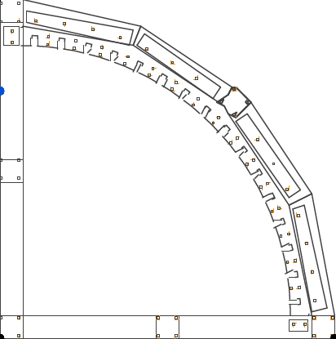
Day 3-5 (1)
We concluded that we should have better understanding on a module position variation during the installation.
Concerning the safety for the detector and team with the current apparatus.
We decided to have practices and measurements using the ECL mock-up at the Tsukuba B4 floor.
Bwd view
xy-stage
(Bwd)
xy-stage
(Fwd)
8000
L
4000
Slot-C
R
2870
L
Slot-B
“More
vertical”
R
Slot-A
L
1250
R
Bwd
Mid
Fwd
“More
horizontal”

Slide 11
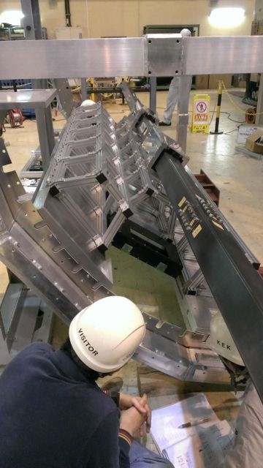
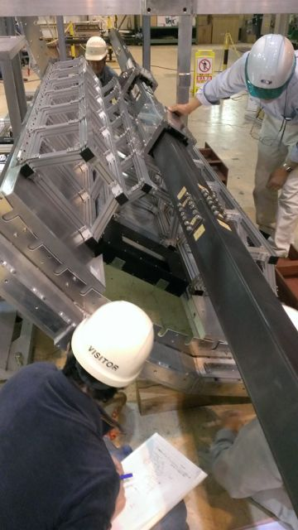
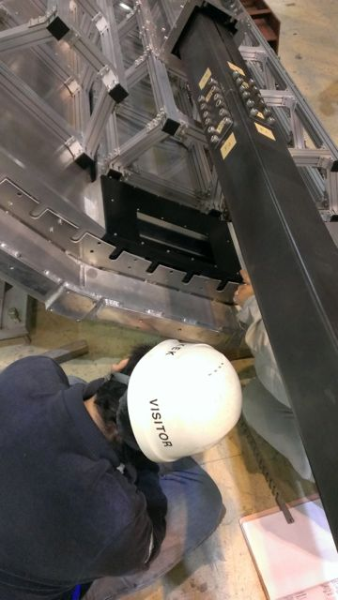
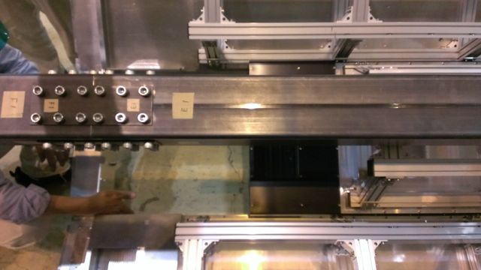
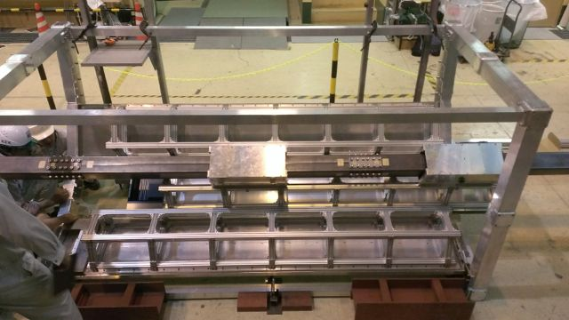
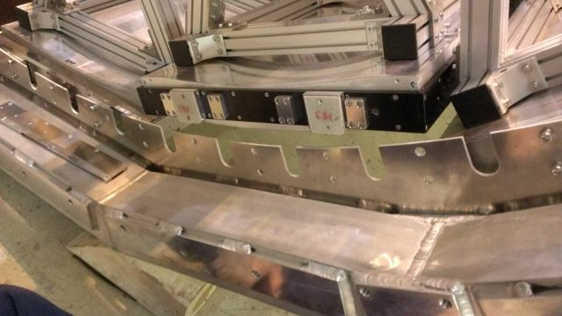
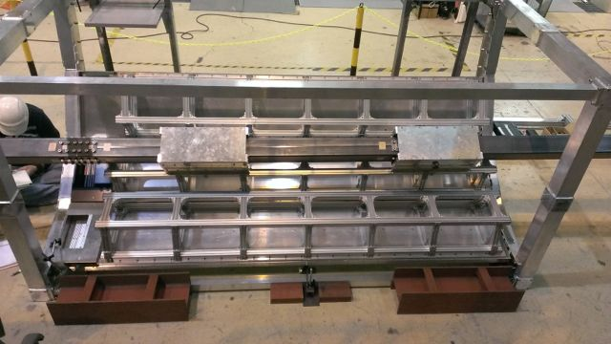
Day 3-5 (4)
The “last module” installation at slot-B. (cont’d)
Need to install with a tilt not to interfere the readout part.

Slide 12
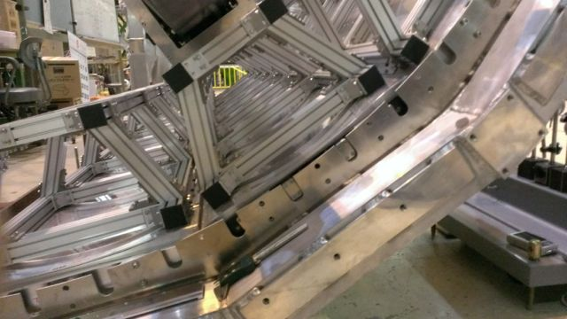
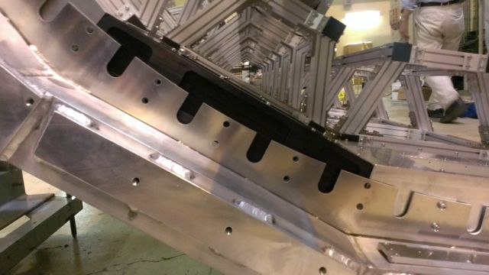
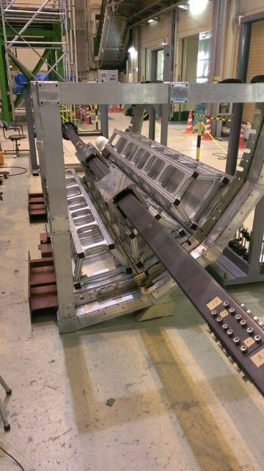
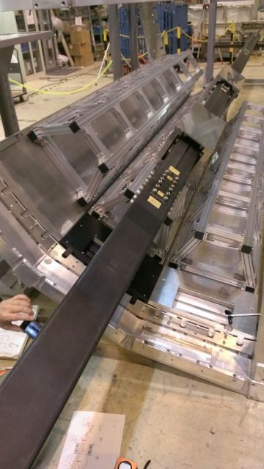
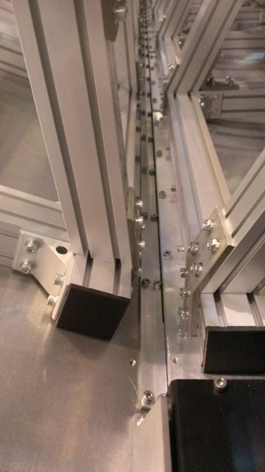
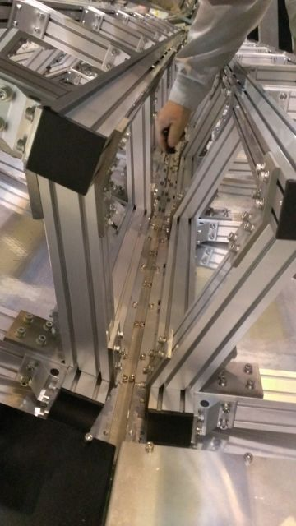
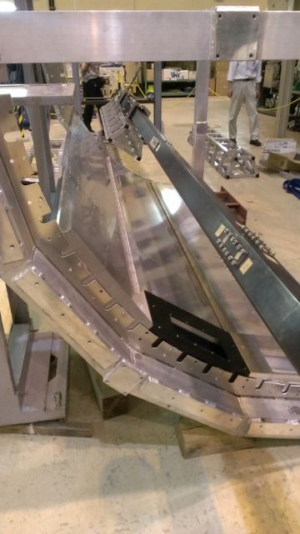
Day 3-5 (5)
The “last module” installation at slot-B. (cont’d)
Iterating the process of lowering the fwd and lifting the bwd.
z-beams joints were also tested w/ and w/o SBs.

Slide 13
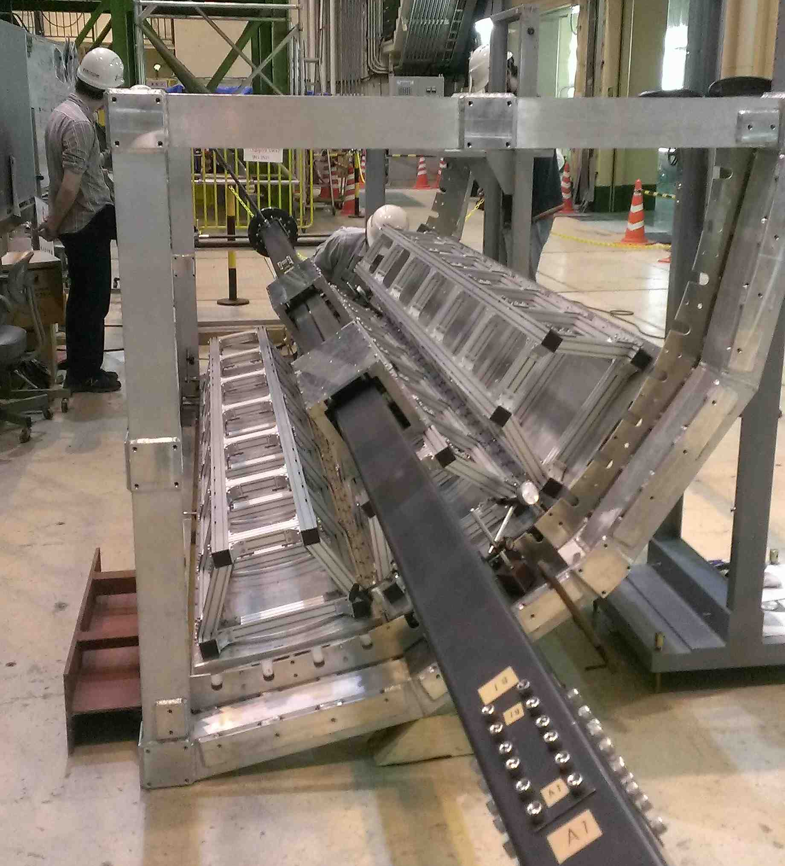
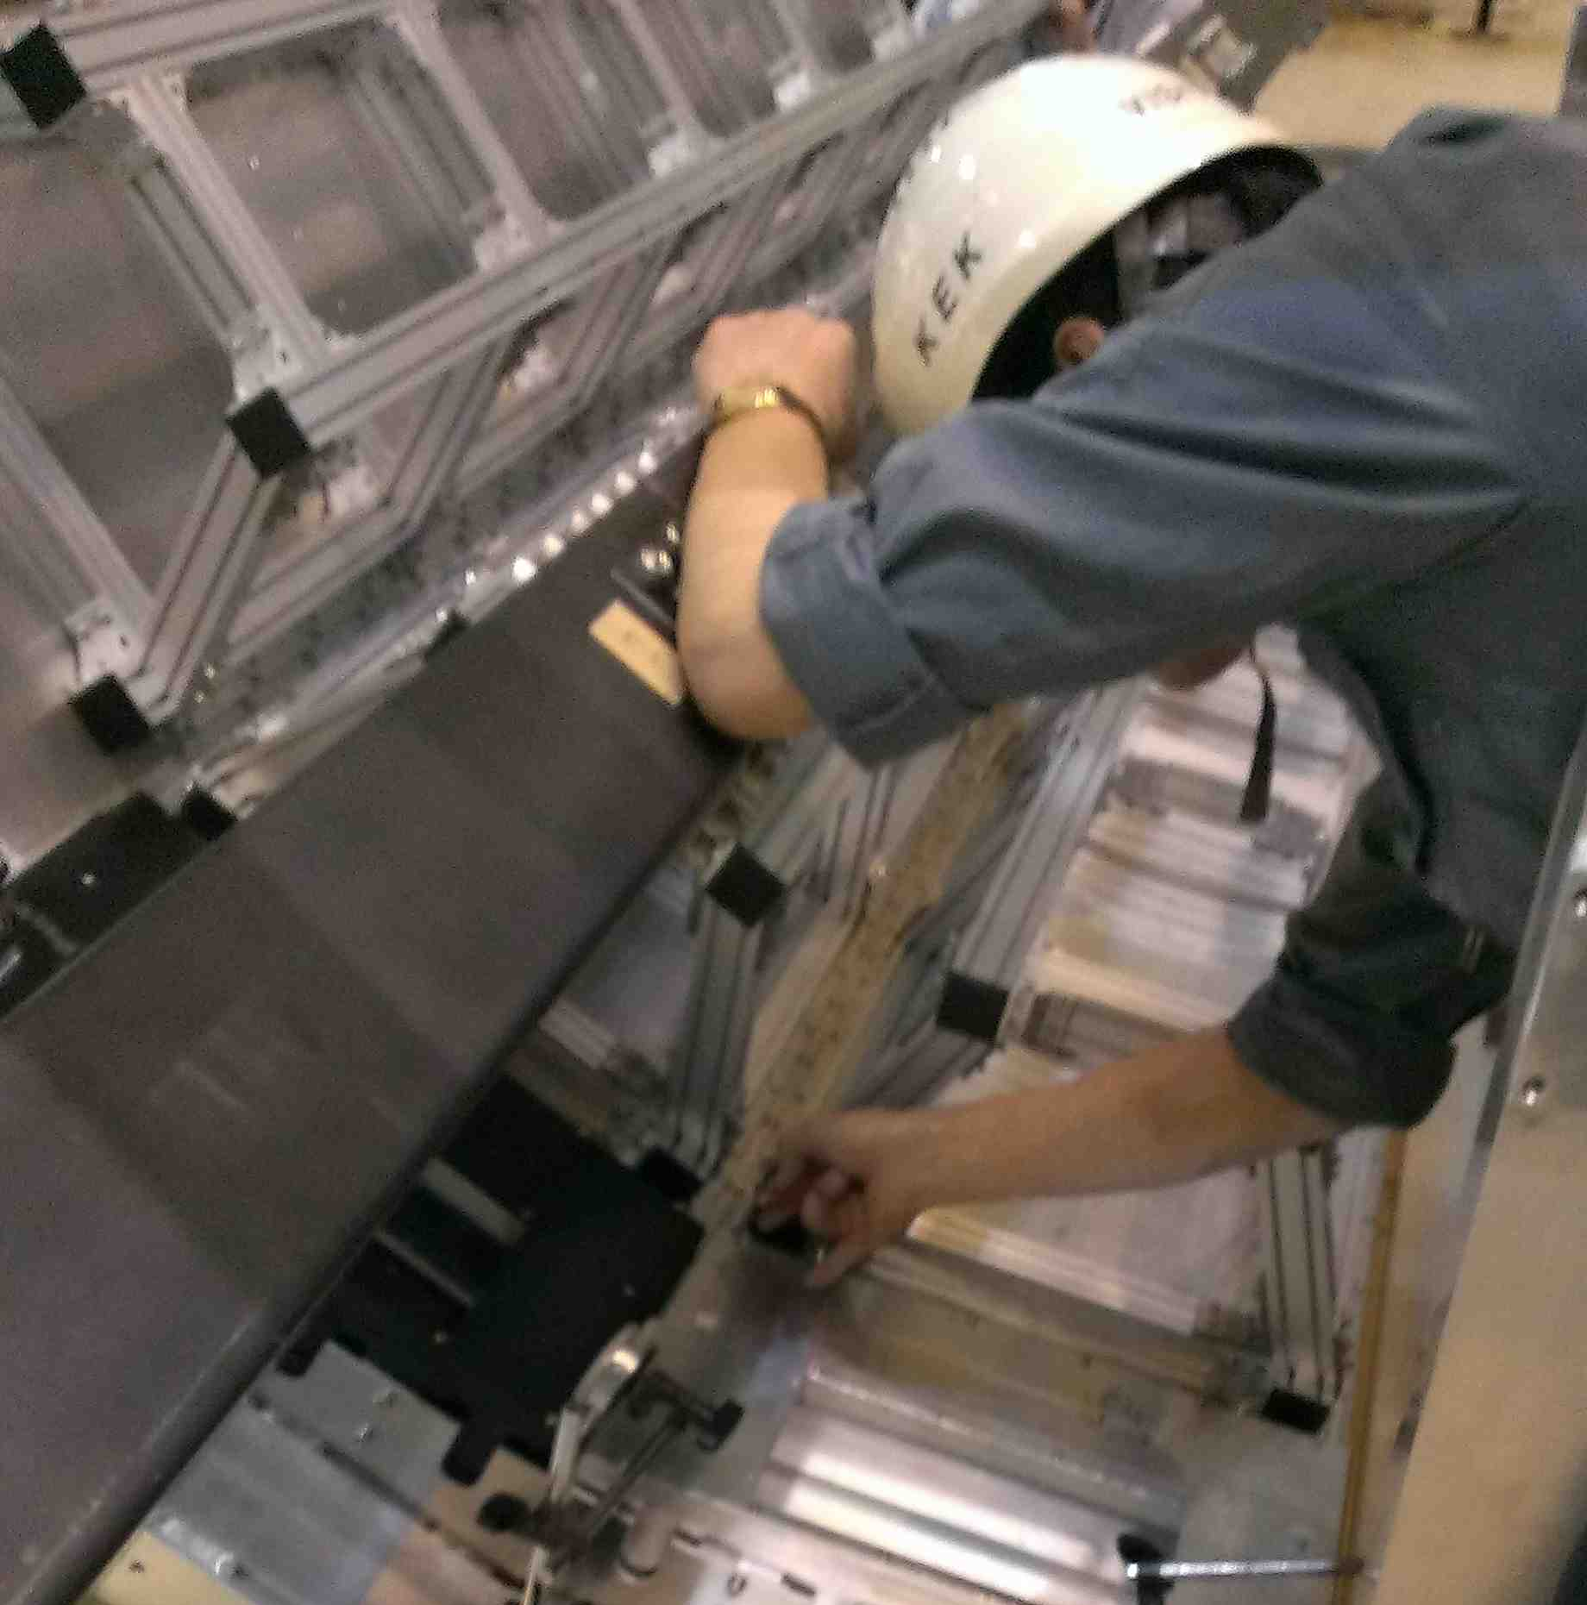
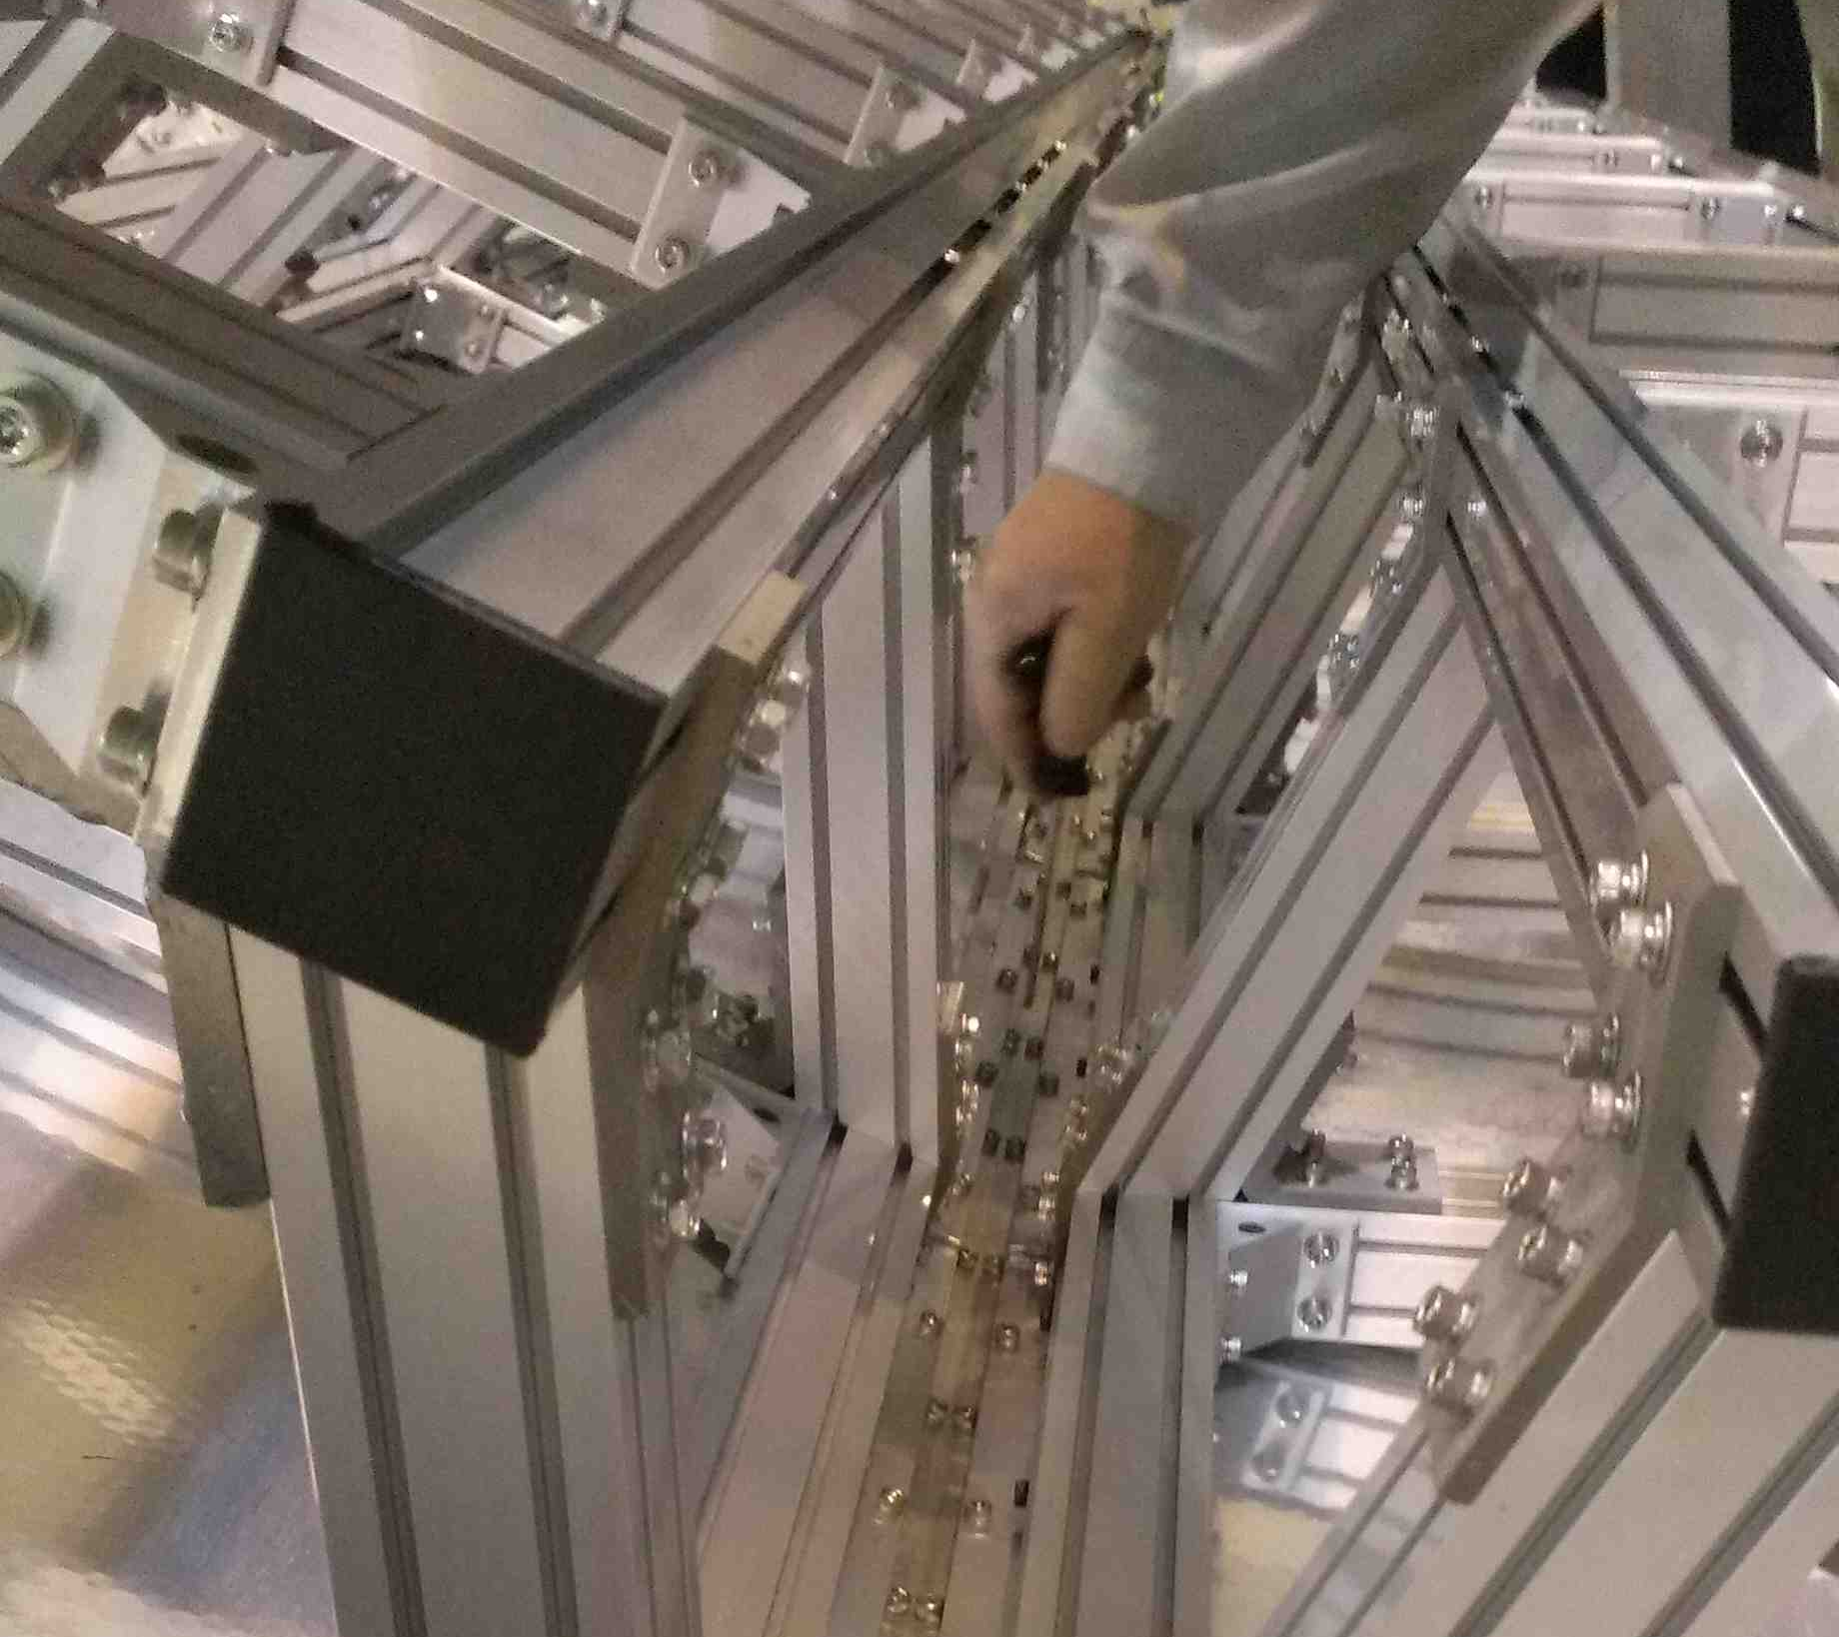
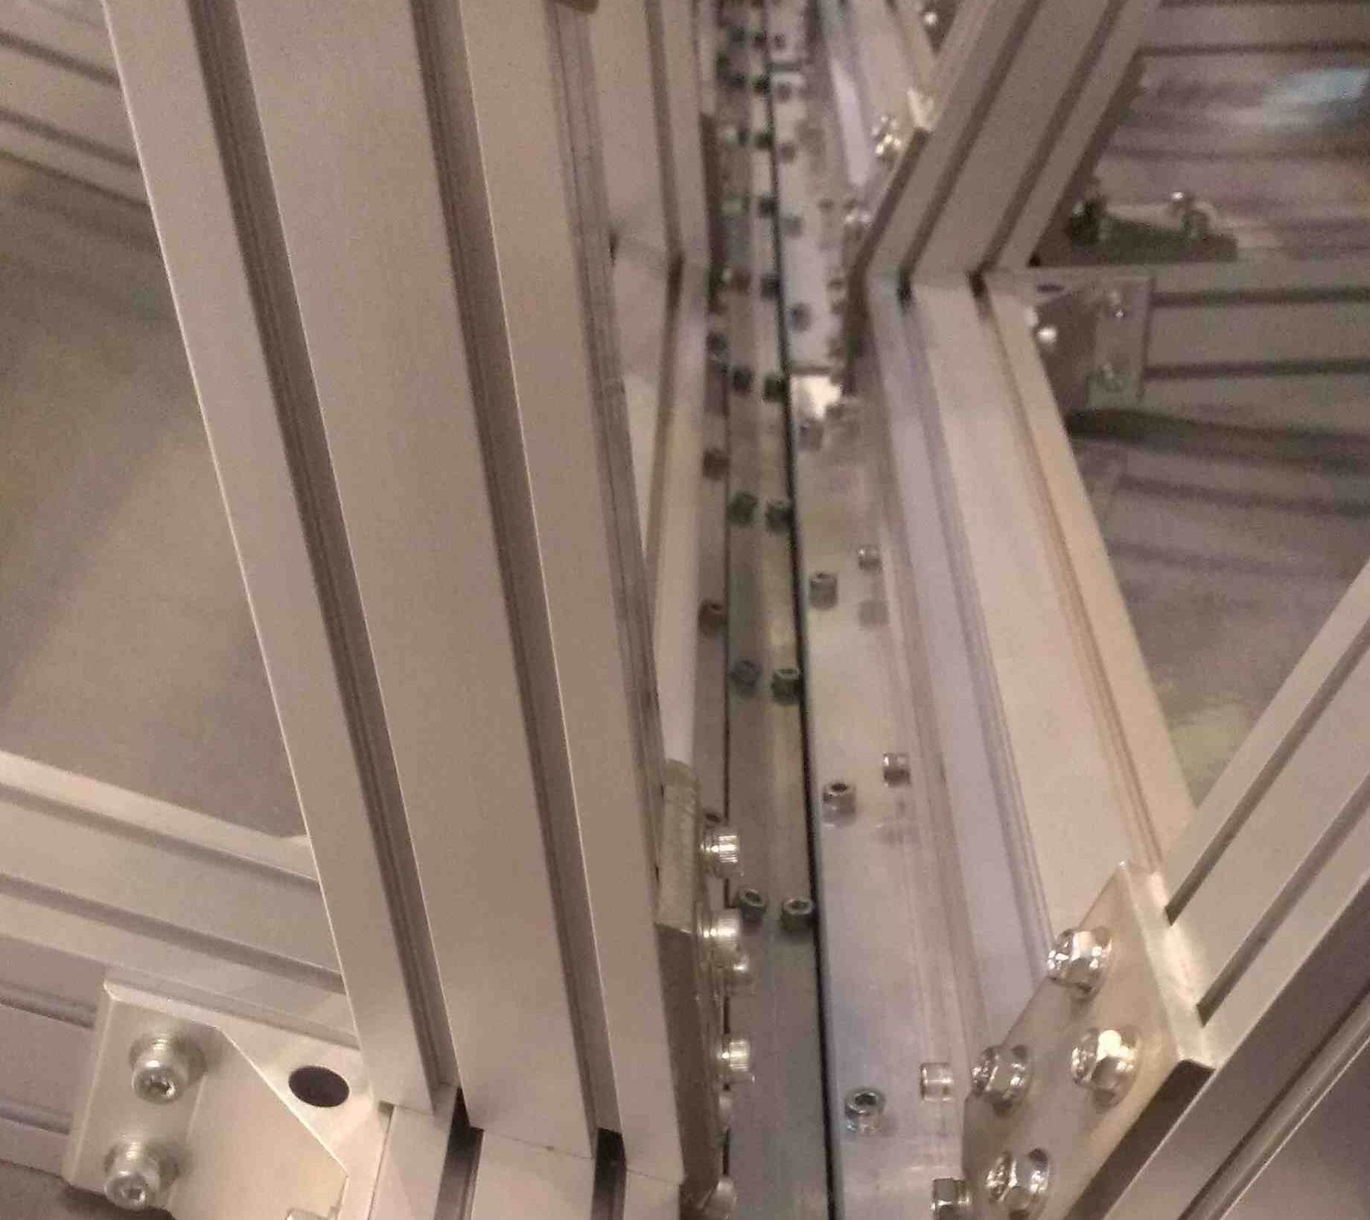
Prototype-III @ Slot-B (1)
Module position variation
As a function of the installation step.
ID=0
ID | Action
0 | Fix the TOP module to the ECL flanges.
1 | Remove the counter weights.
2 | Remove the screws between the SB and sliders. (They are still joined by L-angle fixtures.)
3 | Remove the sliders (and guide pipe) from the SB.
4 | Re-measure 19 hours later with the same condition.
The “z-beam scheme” was tested.
ID=7-a
ID | Action
5 | Set z-beams putting the screws loosely.
6 | Tighten the z-beam screws.
7 | Loosen the screws between the SB and the Prototype-III.
8 | Remove the SB from the Prototype-III.
ID=8
ID=7-b
ID=5
ID=6

Slide 14
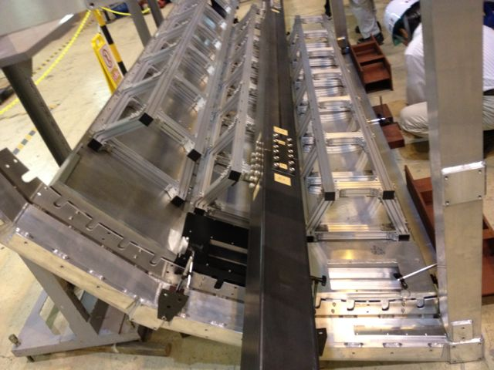
Prototype-III @ Slot-B (2)
Module position variation (cont’d)
Mimic studies were also done.
ID=9
ID | Action | Mimicked case
9 | Remove the screws between the SB and Prototype-II at the Slot-B side only. | Further z-beam joints w/o an open edge (toward the Slot-A side only).
10 | Remove the screws between the SB and dummy QBB at the Slot-B side only. | Further z-beam joints w/o an open edge (toward the both sides).
11 | Remove the SB from the Prototype-II. | Further z-beam joints w/ an open edge (toward the Slot-A side only).
12 | Remove the SB from the dummy QBB. | Further z-beam joints w/ an open edge (toward the both sides).
SB-module screw joints to be removed (“near-side” only).
ID=10
ID=11
ID=12
For the Prototype-II, the SB was removed attaching to the sliders.

Slide 15
Prototype-III @ Slot-B (3)
Module position variation (cont’d)
Measured at 10 points.
BwdL
BwdR
MidH
BwdL
MidH
BwdR
Frame
MidL
MidL
The same ones used for the Prototype-II @ Slot-A.
Flange
MidR
MidR
FwdL
MidA
FwdR
FwdR
FwdL
Frame

Slide 16
Prototype-III @ Slot-B (4)
Module position variation (cont’d)
Measured results.
Scaling up the Y-axis
Bending limits of the quartz optics
Typical
procedure
z-beam
scheme
Mimic studies
Significant variatinos in MidR, MidL and MidA.
MidR: +0.87 mm @ ID=2,
MidL: -0.51 mm @ ID=7
(~-0.5 mm @ ID=7-12),
MidA: -1.09 mm @ ID=11
(<-0.5 mm @ ID=7-12).
Strong correlations among MidR, MidL and MidA.
Except ID=1, MidR and MidL are almost 100% correlated.
MidA starts correlated @ ID=5 due to the z-beam joint.
Most of the positions are stable @ ID≥7.
z-beams seem working.

Slide 17
Prototype-III @ Slot-B (5)
Module position variation (cont’d)
For the typical installation procedure.
Scaling up the Y-axis
Bending limits of the quartz optics
ID | Action
0 | Fix the TOP module to the ECL flanges.
1 | Remove the counter weights.
2 | Remove the screws between the SB and sliders. (They are still joined by L-angle fixtures.)
3 | Remove the sliders (and guide pipe) from the SB.
4 | Re-measure 19 hours later with the same condition.
The same features as seen in Slot-C appear here, too.
Anti-correlated behaviors between the R and L gauges @ ID=1 can only be seen here due to the gauge configuration.
Frame lowered @ ID=3; because of the closeness to the measured point?

Slide 18
Prototype-III @ Slot-B (6)
Module position variation (cont’d)
For the z-beam scheme.
Scaling up the Y-axis
Bending limits of the quartz optics
ID | Action
5 | Set z-beams putting the screws loosely.
6 | Tighten the z-beam screws.
7 | Loosen the screws between the SB and the Prototype-III.
8 | Remove the SB from the Prototype-III.
MidL, MidR and MidA are correlated and significantly lowered.
They are furthermost from the ECL flanges.
The load distribution through the z-beams; the “more horizontal”, larger the sag becomes.
Reconnecting to the sliders (and guide pipe) might have contributed @ ID=7, 8; similar but tiny behaviors can be seen in FwdR and Frame.

Slide 19
Prototype-III @ Slot-B (7)
Module position variation (cont’d)
For the z-beam scheme. (cont’d)
Scaling up the Y-axis
Bending limits of the quartz optics
ID | Action
5 | Set z-beams putting the screws loosely.
6 | Tighten the z-beam screws.
7 | Loosen the screws between the SB and the Prototype-III.
8 | Remove the SB from the Prototype-III.
Variations in FwdR, FwdL and BwdR would be just reflections of the adjacent modules.
No clear reason to produce (anti-)correlations.
Flange (at Slot-A) slightly bended outside.
Load transfer through the z-beams, resulting the increase of the bending moment?
BwdL, MidH and Frame were rather stable.

Slide 20
Prototype-III @ Slot-B (8)
Module position variation (cont’d)
For the mimic studies.
MidR and MidA lowered @ ID=11, but not @ ID=12.
Removal of the SB at “more horizontal” Slot-A affected the R-side gauges.
No such effect from the removal of the SB at “more vertical” Slot-C.
The others seem very stable.
Regardless of an open edge.
The z-beam scheme seems working very well.
Bending limits of the quartz optics
ID | Action | Mimicked case
9 | Remove the screws between the SB and Prototype-II at the Slot-B side only. | Further z-beam joints w/o an open edge (toward the Slot-A side only).
10 | Remove the screws between the SB and dummy QBB at the Slot-B side only. | Further z-beam joints w/o an open edge (toward the both sides).
11 | Remove the SB from the Prototype-II. | Further z-beam joints w/ an open edge (toward the Slot-A side only).
12 | Remove the SB from the dummy QBB. | Further z-beam joints w/ an open edge (toward the both sides).

Slide 21
Summary of the position variation (1)
In general, significance of the module position variation is as follows.
R > L.
“R” and “L” were the higher and lower side edges, respectively, looking from the bwd end.
Mid > Fwd > Bwd.
“Mid” was furthermost from the ECL flanges while “Fwd” and “Bwd” were fixed at the flanges.
Reaction of loosening the torque would be larger at “Fwd” than at “Bwd”.
Bwd view
L
Slot-C
R
Slot-B
“More
vertical”
L
R
Slot-A
L
R
“More
horizontal”
8000
xy-stage
(Bwd)
4000
xy-stage
(Fwd)
2870
1250
Bwd
Mid
Fwd

Slide 22
Summary of the position variation (2)
Removal of the balance weights
Reaction to loosening the rotation moment can be seen.
Because of the rotation lock at the bwd and the distance from it, Fwd > Bwd.
Making an “R” side up and an “L” side down.
Removal of the SB-slider joint screws
“Mid” positions raised largely.
While the others seem quite stable.
Indicating the sliders were not flat, giving an extra (~0.5 mm) sag to a SB.
The sliders did not have enough clearance to absorb the guide pipe sag. Need to modify shortly.
Reaction to loosening the rotation moment (when weights are removed).
Removing the screws

Slide 23
Summary of the position variation (3)
Removal of the sliders (and guide pipe)
The guide pipe has been lifting up a module.
Most of the positions lowered after the removal.
The effect seems clearer at a “Mid” positions (ex. ~0.8 mm @ Slot-A, C)
Such an effect would be different in the upper half of the cylinder.
What happens when rejoin the sliders to remove a SB or to uninstall a module? Need to check.
The z-beam scheme seems working very well.
All the monitored positions were stable even w/o a SB.
If there is no “open edge” in a “more horizontal” slot.
The procedure to remove the center SB out of the three “SBed-modules” seems promising.
An “open edge” in Slot-A lowered MidL (@Slot-B) and MidA (@Slot-A), but not MidL (@Slot-B), though.
Is this generic to a “lower adjacent” slot?

Slide 24
Summary of the position variation (4)
The installation to Slot-C did not affect the module in Slot-A.
Good information for the 2nd last module installation?
Should check when an adjacent module is installed.
At any installation actions, “Mid” positions were very sensitive and could easily exceed the “quartz bending limits”.
Improvement on the procedure or relaxing the limits seem necessary.
Next SB prototype will adopt welding to improve the rigidity.
Expecting the sag reduction to 1/3.
Next campaign is planned to be held in Oct.
Using the ECL mock-up and improving the installation jigs.

Slide 25
Near term plan
Finalize the design validation for QBB production in September – October.
Installation practice in October.
QBB production from January. 2014.

Slide 26
Summary
QBB design is being finalized except the front end part.
Design details are being validated using the latest prototype.
Out-gas analysis and glue strength tests are on going to be fed back to the final design.
Various efforts are made to the current design issues.
The first realistic design for the front end support is proposed.
Based on the semi-final design of the front end board stack.
Development of the optical coupling scheme has been progressed.
Both in the optical cookie production and mechanical support.
The module assembly scheme is being optimized.
Managing the quartz gluing and bar flatness.
All the ideas will be validated using a prototype and mock-up.
Installation scheme seems working well.
Especially the z-beam scheme works very well.
Further tests will be carried out to ensure the perfect operation.

