Slide 1
Upgrade of LHCb-RICH Detectors
LHCb-RICH collaboration
RICH-2013 Conference
Shonan, Kanagawa, Japan
Sajan Easo
December 02, 2013
RAL

Slide 2
Outline
LHCb upgrade
Optimization of RICH optics for upgrade
Photodetector and its readout
Technical design
Summary and Plans
LHCb physics at high luminosity from 2019
Trigger and detector upgrades
RICH performance from simulations
Optimization of various components of the RICH

Slide 3
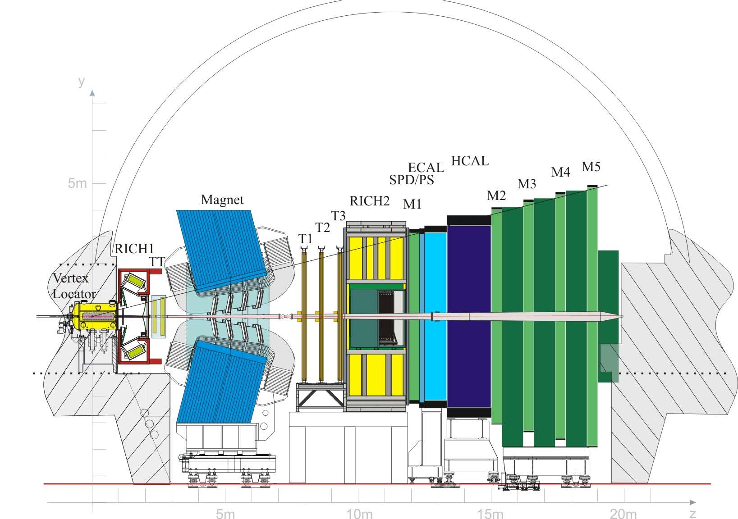
The LHCb Experiment
RICH1 : aerogel+ C₄F₁₀ gas
RICH2 : CF₄ gas
Photodetector: HPD
Operation of the two RICH detectors : Talk by A.Papanestis today
RICH performance in real data: Talk by C.Matteuzzi on Thursday

Slide 4
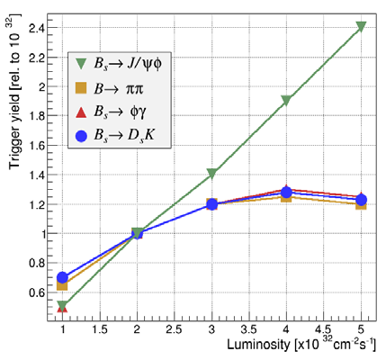
LHCb upgrade
Search for New Physics beyond standard model (SM)
From the measurements so far, it appears that
Need very high precision measurements to observe small deviations from SM
In the decays of hadrons with b and c quarks , study CP violation and rare decays.
Flavour changing processes are consistent with CKM mechanism in SM
Large sources of flavour symmetry breaking are excluded at the TeV scale
LHCb upgrade is needed to increase the statistical precision significantly.
Main bottlenecks for going to high luminosity in LHCb:
Front End max readout rate = 1.1 MHz
Limited discrimination power of
Level0 hardware trigger (E_{T} , P_{T} > thresholds).
→ Saturates yield from hadronic channels

Slide 5
LHCb upgrade
For upgrade
Read out all detectors at 40 MHz
Low level hardware trigger :
lower E_{T} , P_{T} thresholds
tunable output rate 1-20 MHz
Use software trigger
cuts on IP , tracking , vertex and PID etc.
Final output bandwidth ~20 kHz
For the RICH detectors this upgrade requires:
Replace HPDs since they have the pixel readout chip encapsulated ,
whose maximum readout rate is 1 MHz
Current base line : Hamamatsu R11265 PMTs , read out with CLARO chip
HPD Operation in current RICH : Talk by S.Eisenhardt on Wednesday

Slide 6
LHCb upgrade
Period | Detector | Collision energy in TeV | Luminosity in 10 ³² cm⁻² s⁻¹ | # of bunches (bunch spacing in ns) | Data in fb⁻¹
2010-2011 2012 | current | 7 8 | 3.2 3.9 | < 1300 (50 ) | 1 + 2
2015-2017 | current | 13 → 14 | 4 | ~ 2400 (25) | > 5
2019 – | upgrade | 13 → 14 | 10 → 20 | ~ 2400 (25) | 5 / year Total=50
For the RICH detectors, high luminosity from 2019 onwards implies:
Remove aerogel radiator
Improve the optics to achieve optimal PID performance at high luminosity
PID is difficult even at current luminosity
New ideas to improve PID up to 10 GeV/c : TOF detector ? Talk by M.V.Dijk Today
Current baseline: use the gas radiator as a threshold counter at low momentum

Slide 7
RICH Photodetectors
R11265-103-M64
8 X 8 pixels in 23 X 23 mm² , total size 26.2 X26.2 mm²
Active area fraction = 77 %.
For R&D the version with
SBA photocathode, borosilicate window used
UV glass/borosilicate option under consideration
Compared to the S20 of HPD, the bialkali of PMT
has the QE peak at larger wavelength →lower chromatic error
Typical collection efficiency assumed = 90%
Approx. 4500 PMTs for RICH1+RICH2
Looking into reducing this number to reduce cost:
Backup option: HPDs with external readout (SALT chip)
Proof of principle already established with lab tests.
Lenses in the outer regions
Use H12700 PMTs in the outer regions
(pixel size 6 X6 mm² )

Slide 8
RICH upgrade : Simulation studies
LHCb full simulations using PYTHIA + EVTGEN + GEANT4
Studies using signal events in a typical upgrade physics channel: B_{s}→φφ
Luminosity Label | Luminosity 10³² cm-²s⁻¹ | # of bunches | E TeV | ν
Lumi4 | 3.9 | 1300 | 8 | 2.5
Lumi10 | 10 | 2400 | 14 | 3.8
Lumi20 | 20 | 2400 | 14 | 7.6
E=Collision energy
ν=average number
of pp interactions
per bunch crossing
Lumi4: 2012 conditions
Current geometry | Optics used in current RICH1
Upgrade geometry | Improved RICH1 optics for upgrade
Average number of tracks per event, reconstructed from simulations :
Lumi4 | 140.5
Lumi20 | 317.7

Slide 9
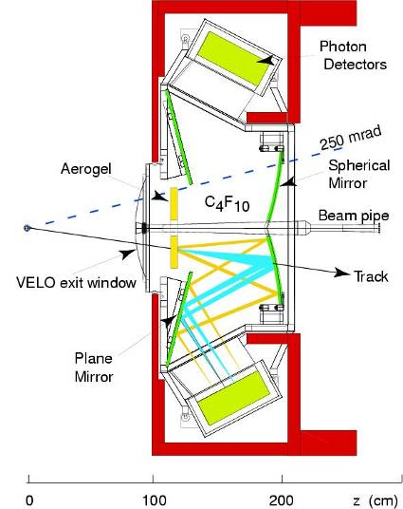
RICH1: Current optics
XY coordinates of hits on detector plane
Lumi4
Aerogel
removed
Lumi20
At Lumi20, the peak occupancy exceeds 35%.
The increase in occupancy from luminosity ,
degrades PID performance
Solution: Increase Radius of Curvature (ROC) of spherical mirror
to spread out hits on detector plane

Slide 10
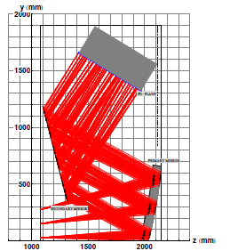
RICH1 optics upgrade
Different configurations attempted. The current ‘Two RICH’ system
with ‘vertical RICH1’ optics was found be the optimal and safer
compared to the alternatives.
Constraints to RICH1 optics modification:
Main Changes:
Detector plane size:
Build by 2018 and install in the 18 months of shut down from 2018.
Overall magnetic shielding unchanged to expedite the installation.
Size of RICH1 along beam line unchanged to avoid interference with
neighbouring detectors.
Spherical mirror ROC : 2710 → 3800 mm.
(Reduction of occupancy )
The rest of the optics (flat mirror, detector plane)
modified accordingly.
Spherical mirror moved downstream
by ~ 86 mm to increase radiator length.
( Increase the amount of signal from each track)
Decrease with aerogel removal, increase with
ROC increase. Net increase by small amount.

Slide 11
RICH1 and RICH2 : Occupancy after upgrade
XY coordinates of hits on detector plane
RICH1
RICH2
Lumi20: Upgrade conditions
Upgrade geometry for RICH1

Slide 12
Resolutions and yields
Single photon resolutions from full simulations:
RICH1 | RICH2
Resolution (in mrad) | RICH1- Current HPD | RICH1- Current PMT | RICH1-Upgrade PMT
Chromatic | 0.84 | 0.58 | 0.58
Pixel | 0.6, PSF=0.79 | 0.61 | 0.44
Emission Point | 0.61 | 0.63 | 0.37
Overall Overall+Track | 1.45 1.50 | 1.05 1.12 | 0.78 0.88
RICH2- Current HPD | RICH2- Upgrade PMT
0.48 | 0.31
0.19 PSF=0.29 | 0.19
0.27 | 0.27
0.65 0.76 | 0.45 0.60
Yield | 34 | 32 | 40
24 | 22
Yield = Number of detected hits per isolated track.
Tracking resolution used: 0.4 mrad
Radiators: RICH1 gas (C₄F₁₀), RICH2 gas (CF₄)
Resolutions improved
for upgraded geometry

Slide 13
PID performance from simulations
The tracking detectors are kept same as those in current LHCb for the results shown here.
Reconstructed tracks and RICH hits subjected to a Log-Likelihood algorithm for PID .
It gives likelihoods for each track to be pion, kaon, proton, muon and electron hypothesis.
To distinguish among these, the difference (DLL) in the log-likelihood between
each of these hypothesis and pion hypothesis is used.
Here DLL(K-π) used for illustration.
For the tracks in B_{s}→φφ signal events, the probability to mis-identify a pion as kaon
and the efficiency to identify kaon as kaon are evaluated for different DLL cuts.

Slide 14
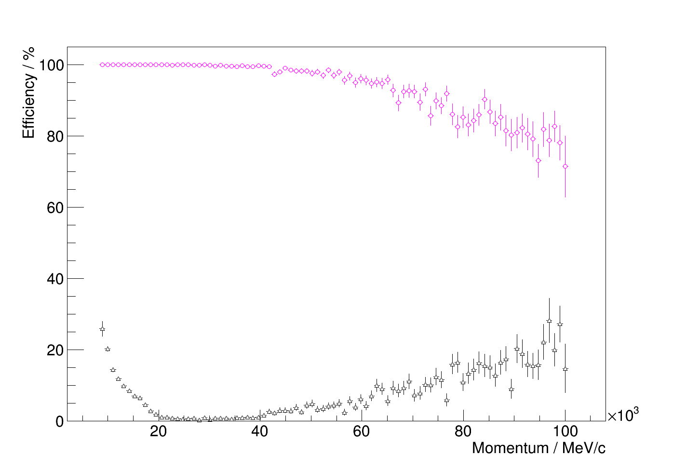
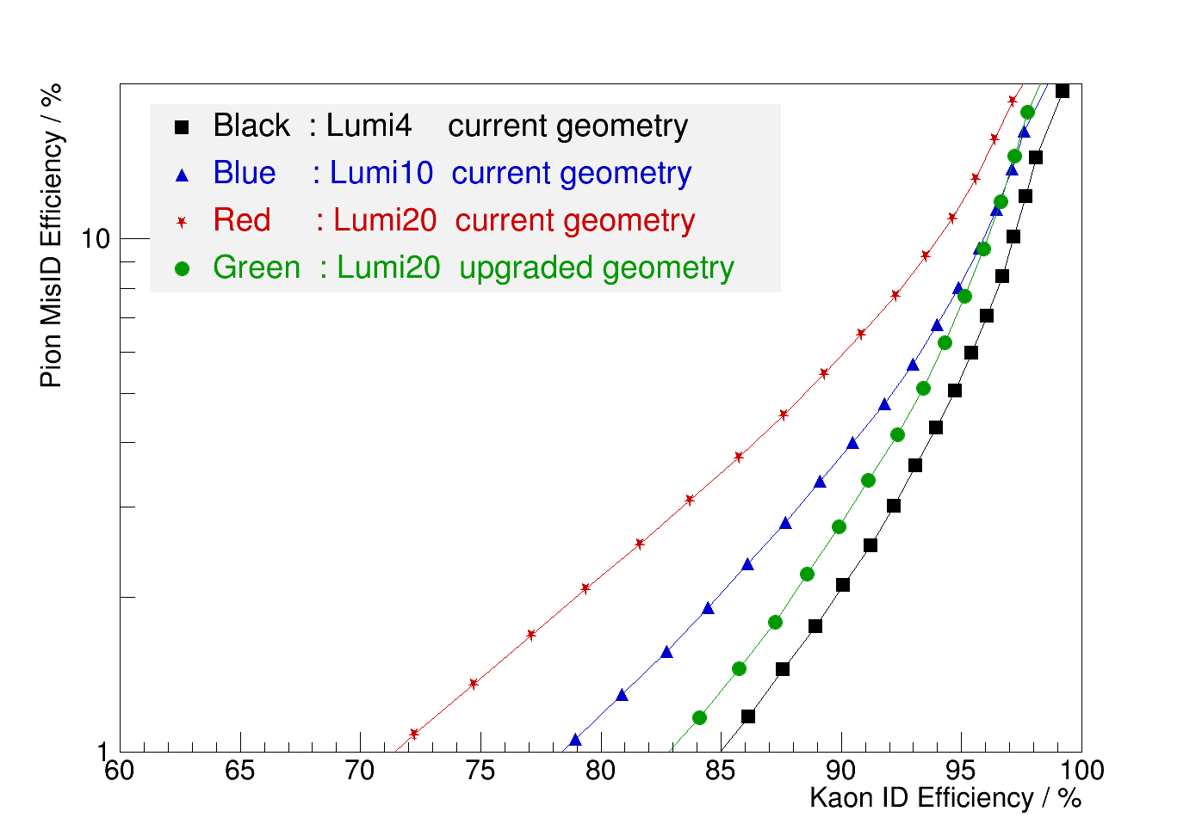
PID performance
DLL >0
Kaon Efficiency
Pion mis-ID probability
PID performance vs. momentum
Average PID in momentum range 1.5-100 GeV/c,
for different DLL cuts
Lumi20 , upgraded geometry
Tracks with:
P_{T} > 0.5 GeV/c
Polar angle range 0-300 mrad
PID improved with upgraded geometry
All PID performances using PMTs.
Physics analysis: normally pion mis-ID < 1% level

Slide 15
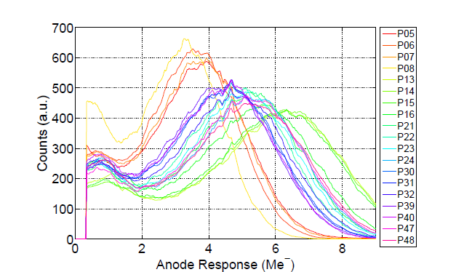
Testing MaPMTs
Poster by M.Maino at this conference
Tests with commercial LED and optical fibre to sample single photons
Gain variations, cross-talk:
Single photon pulse height
spectra of different pixels
Channel to channel gain variation up to a factor of 2.3 observed
Max. measured cross talk < 1% between adjacent pixels
Magnetic field tolerance:
Poster by S.Eisenhardt at this conference
Max field in the photodetector region : RICH1: 30 Gauss, RICH2: 15 Gauss
Effect of the field: loss of gain and reduction in detection efficiency
Sensitivity to longitudinal field measured, using a PMT inside a solenoid
PMTs need to be shielded from the field in the RICH1 and RICH2

Slide 16
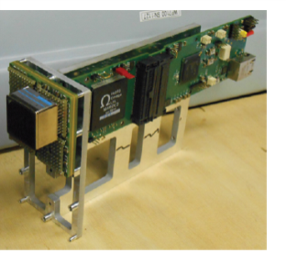
Photodetector Readout
Front end ASIC: Custom made CLARO chip
Poster by M.Fiorini at this conference : “ Radiation hardness tests
and characterization of the CLARO-CMOS”
Per channel gain adjustable with 3 bits
Discriminator threshold adjustable with 5 bits.
1 chip for 8 channels, 8 chips for a PMT. Prototype with 4 channels.
peaking time < 5 ns, recovery time < 25 ns for single photon
0.35 μ m CMOS technology
Verified for radiation tolerance at LHC by doing irradiation tests using neutrons and X-rays
Backup Option: MAROC4 Chip
Some tests to be done from 2015 by
installing few PMTs in the RICH2 outer region.

Slide 17
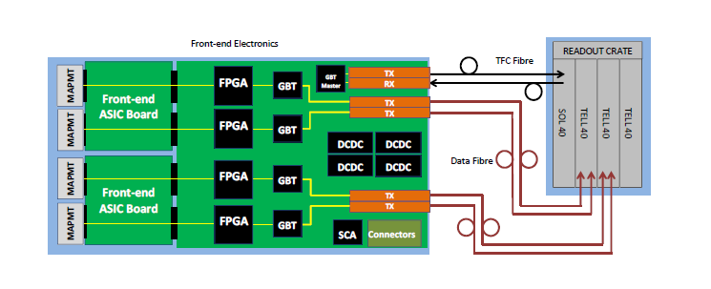
Technical Design: Readout chain
For data transmission from the detector to the readout units and then to storage.
The readout scheme conforms to the standard specified in
“Electronics architecture of the LHCb upgrade” : LHCb-PUB-2011-01
Reprogrammable FPGA on the digital board next to the FE ASIC board.
Occupancy variation large on the detector plane (1-25 %) →
FE boards with/without zero suppression for low/high occupancy regions.
Typical FE board bandwidth:
All these are radiation hard
40 Gb/s (3 Gb/s) per module in high (low) occupancy region .
(1 Module : 4X4 PMTs)

Slide 18
Technical Design: MaPMT modules
To provide:
PMTs are kept inside modules :
Local magnetic shielding to the PMTs
Heat dissipation into the cooling system
Possible mounting of lenses
Provide insulation, interface to readout and detector controls
Ease of access, structural stability
2X 2 PMTs in a cell,
2X2 cells in a module
Walls made of a shielding
material like mu-metal

Slide 19
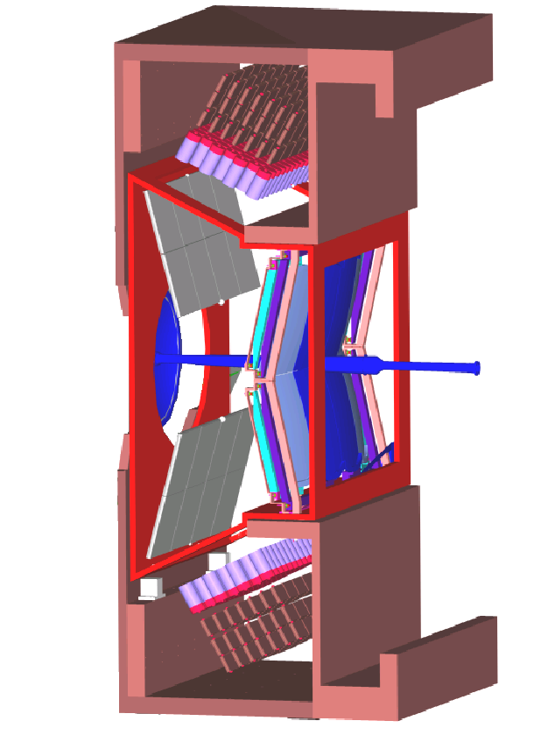
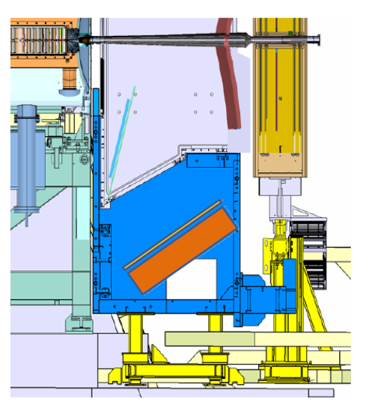
Technical Design: RICH mechanics
Spherical mirror moved downstream
compared to current RICH1. All mirror
mounts to be replaced.
Photodetector plane moved for the
new optics.
Magnetic shielding unchanged
Sizes of almost everything inside RICH1
is changed and are to be re-built.
Gas enclosure and quartz windows to be rebuilt.
New spherical mirrors using the same
carbon fibre technology (CMA) used now,
to be made.
(RICH-2007: NIMA 595 (2008)197-199 )
New flat mirrors to be made, using the
same technology (Simax glass) used now.
New Photon detector assembly for both RICH detectors
For RICH2, most of the rest of the current mechanics
is retained.

Slide 20
SUMMARY
We expect excellent performance from the new RICH at high luminosity.
Most parts of the RICH1 will be re-built. For RICH2 only the photon
detector assembly will be re-made.
MaPMTs are the baseline solution for photodetectors.
Tests with prototypes are under way.
Main aspects of the re-design of the RICH system are complete.

Slide 21
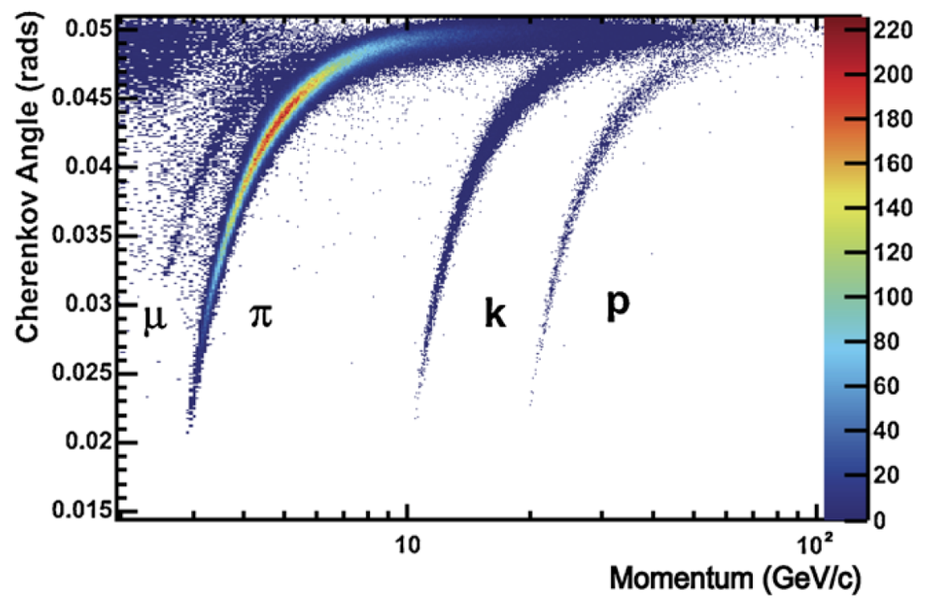
PLANS
Technical Design Report submitted last week.
Engineering design and construction expected in the coming years
2019: Commissioning of the new RICH system so that we can achieve
excellent PID capability similar to that obtained from current RICH.
This upgrade would enable us to measure parameters sensitive
to the New Physics with sufficient precision.
EPJC (2013) ,73:2431
From RICH1 Gas

Slide 22
BACKUP SLIDES

Slide 23
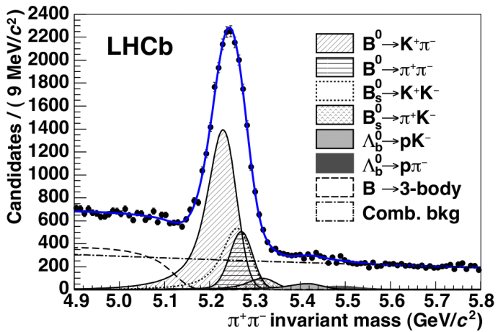
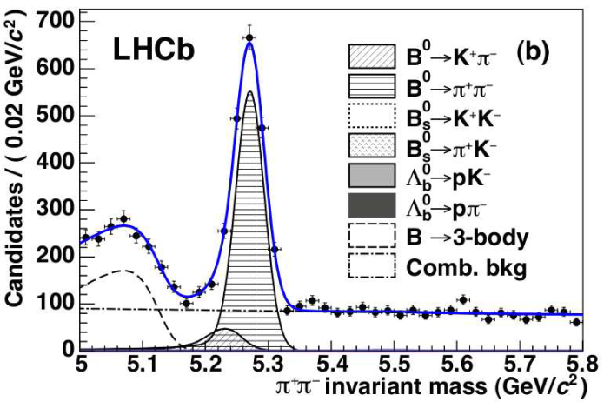
RICH in LHCb
Without RICH
With RICH
JHEP 10 (2012) 037
Without RICH PID, the is completely dominated by
We would like to be able to maintain excellent PID capability during LHCb upgrade

Slide 24
PID performance
The upgrade luminosity expected to gradually increase to Lumi20.
Performance from upgraded geometry at difference luminosities.
Tracks with:
Momentum range 1.5-100 GeV/c
P_{T} > 0.5 GeV/c
Polar angle range 0-300 mrad

Slide 25
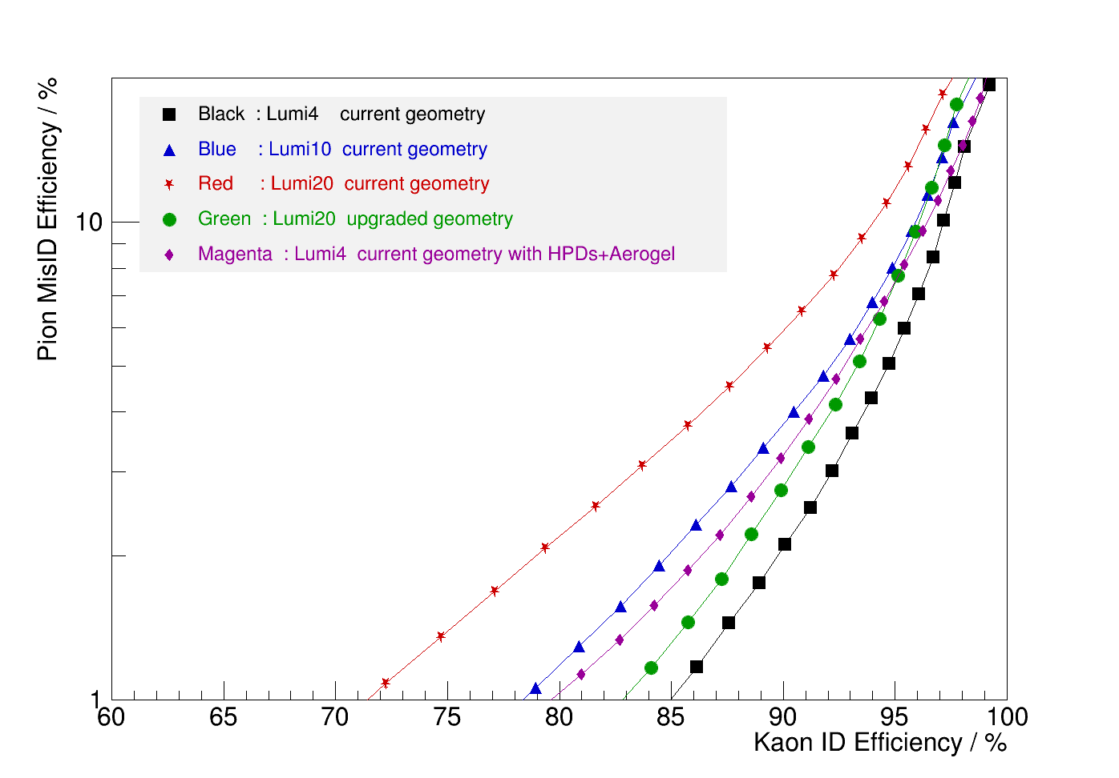
PID performance

Slide 26
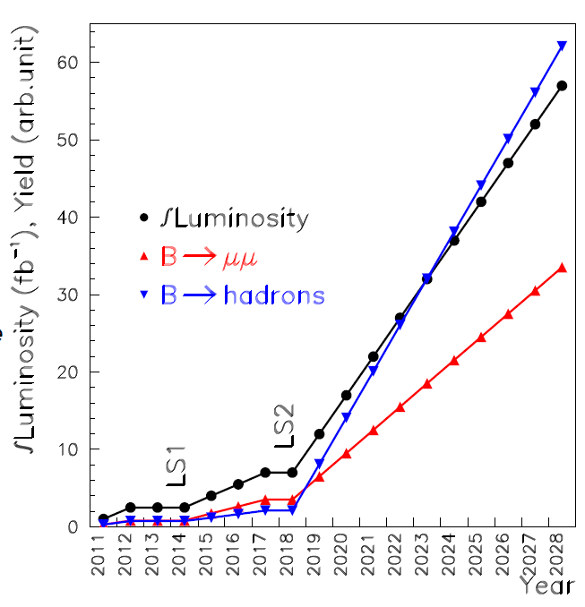
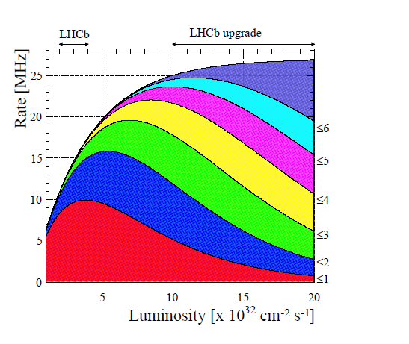
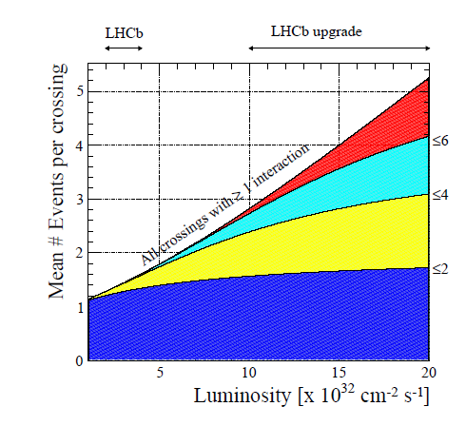
LHCb Event rates and yield
Yield with LHCb upgrade
Pile up vs. luminosity

Slide 27
Single Event Hit distribution: RICH1 Simulation
Lumi4: RICH1
Upgrade geometry
Lumi20: RICH1
Upgrade geometry

Slide 28
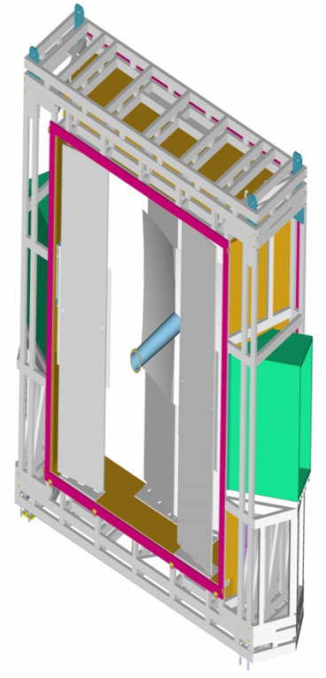
Single Event Hit distribution: RICH2 Simulation
Lumi4
RICH2
Lumi20
RICH2

