Slide 1
A plan for the installation practice
T. Kohriki (KEK), K. Suzuki and K. Tachibana (Nagoya Univ.)

Slide 2
Goals of the practice
To examine our installation scheme and jigs in-situ and to feed back what we will learn to them.
Installation of a single module.
To examine the basic procedure without adjacent modules.
To measure/correct the sag and alignment of the module in-situ. (No realistic idea has been given yet, though).
Sequential installation of three modules.
To examine the procedure with a realistic situation, i.e. having an adjacent module.
To examine z-beam joints and removal of the strong back of the center module.
Installation of the “last” module.
To examine the procedure for the last module, i.e. having adjacent modules at both sides.
Installation at the bottom, side and top slots.
To experience the slot-dependent work environment.
Useful info. to decide the first and last slots to be installed.

Slide 3
Strategy of the practice (1)
Using only the right half of the barrel (from the fwd view).
Optimize the gain-vs-effort for given various resources.
Man-power, time, cost to hire company people, etc.
Using the lower half of the barrel, firstly and mainly.
Would be the easiest region for the practice.
Near-bottom slots may need to put a low-density material, as like TOF, if the sag correction scheme is not established with strong backs and z-beams.
The upper half will be used after then.
Need to raise the level of the XY-stages.

Slide 4
Strategy of the practice (2)
Set up the XY-stages, scaffolds and guide pipe.

Slide 5
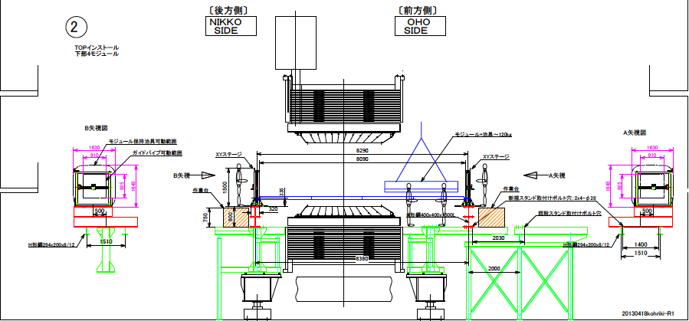
Strategy of the practice (3)
Practice with the lower right slots.

Slide 6
Strategy of the practice (4)
Practice with the upper right slots.

Slide 7
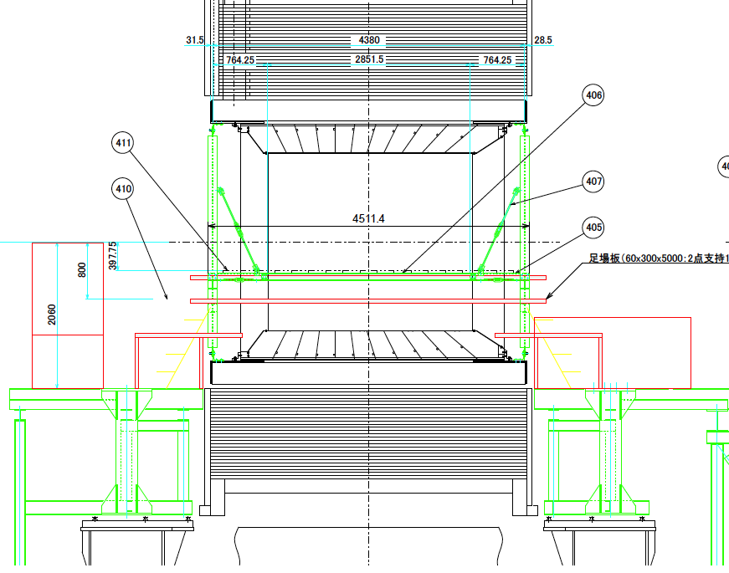
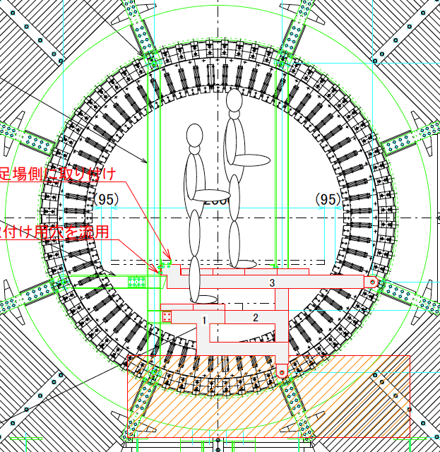
Strategy of the practice (5)
Scaffolds inside the barrel, access steps, operation stages and associated structures.

Slide 8
Man power
Need five people at least.
XY-stage operators at Oho and Nikko sides (2 people),
Monitors/directors at Oho and Nikko sides (2 people),
Taking care of the module mount on the guide pipe as well.
Photographer/logger (1 person).
Currently available man power.
T. Kohriki (KEK),
K. Suzuki, K. Tachibana and T. Kawai (Nagoya),
One more engineer might be available.
Two people (Futaba)
Main crane operators as well.

Slide 9
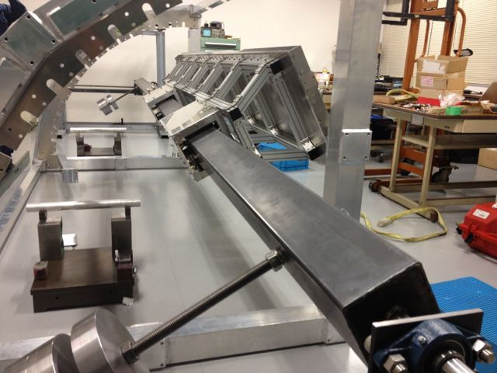
Apparatus from Nagoya Univ.
Installation jigs, strong backs and dummy module/QBBs.
New implementations and various upgrades are being done.
Being done by Tachibana-san.
Some assembly can be done at KEK in the week for preparation.
To be transported to KEK on May 23rd.
To be validated with a ¼-ECL-mockup until then.
XY-stage
Module + Strong back
Guide pipe
Slider
Counter weight
Apparatus | Qty | Comments
XY-stage | 2 | Various minor upgrades have been made.
Guide pipe | 4 | 2 m x 4 = 8 m (with 0.23 m x 2 of end joins).
Rotation break | 1 | To be newly integrated at the joint of the guide pipe end and the fwd XY-stage.
Counter weight | 6 | 12 kg x 6 = 72 kg (discs).
Slider | 2 | Breaks have been implemented.
Strong back | 3 | Prototypes for the installation.
Dummy module | 1 | Joined aluminum plates having fwd/bwd end plates (L = QBB, W = QBB + optics).
Dummy QBB | 2 | Joined aluminum angles (L = QBB).

Slide 10
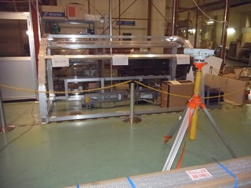
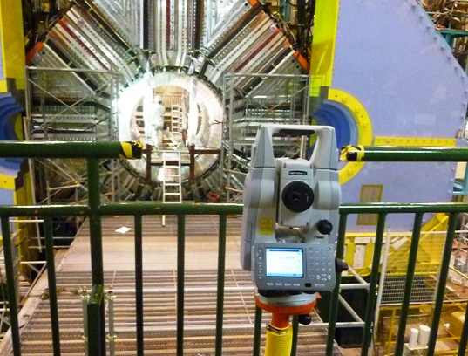
Apparatus from Fuji Hall/company
Apparatus | Qty | Comments
QBB prototype | 2 | Round-shape and square shape.
Dummy weight | 2 | Aluminum plates as dummy optics.
ECL mock-up | 1
Leveler | 1 | To be newly integrated at the joint of the guide pipe end and the fwd XY-stage.
Laser transit | 2 | Being used at Tsukuba Hall.

Slide 11
Schedule (1)
The slot given is Jun. 3rd – 7th.
With a spare slot of Jun. 10th – 14th.
Our plan intends to finish by 7th, though.
Sun | Mon | Tue | Wed | Thu | Fri | Sat
5/12 | 13 | 14 | 15 | 16 | 17 | 18
19 | 20 | 21 | 22 | 23 | 24 | 25
26 | 27 | 28 | 29 | 30 | 31 | 6/1
2 | 3 | 4 | 5 | 6 | 7 | 8
9 | 10 | 11 | 12 | 13 | 14 | 15
Delivery of our apparatus from Nagoya Univ. and Fuji Hall to Tsukuba Hall.
Belle roll-out
EKLM test installation
Preparation for the practice.
Assembly and inspections of the apparatus,
Remaining machining and tuning,
Methodology checks of some measurements.
Common platform integration
TOP installation practice
(TOP installation practice)

Slide 12
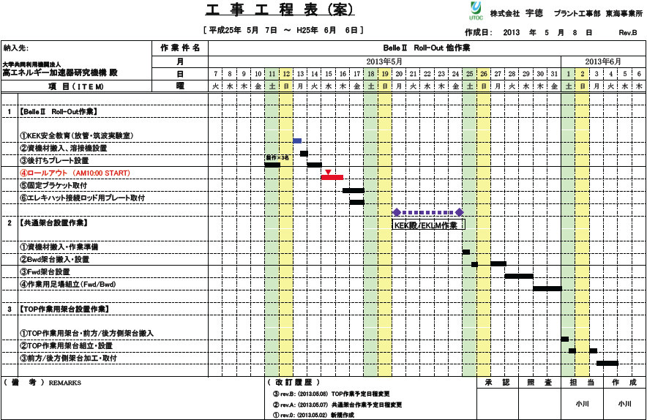
Schedule (2)
Unexpected conflict with company’s schedule.
We are trying to fix it, but may have ~0.5 days delay.
Belle roll-out work
Common platform work
Installation practice
TOP work
Under negotiation not to delay our schedule.

Slide 13
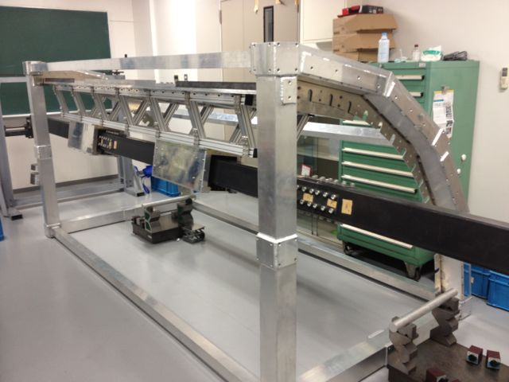
Installation jigs and scheme (1)
XY-stage
A set of the engineering models has been tested on the ¼-ECL-mockup.
No critical failure on the jigs and scheme.
The “strong back” seems working, but need further tests to finalize the design.
Reduced the sag of a dummy module from 7.5/9 mm to 0.5/2 mm.
Depending on the “up”/”down” configurations.
Need to evaluate the “assembly deformation”.
The XY-stages are being upgraded.
To improve the operation.
Smaller resistance on the Y-translation wheel, more stable counter weight mounting, X-position meter.
Further tests will be done in April.
Emulating the on-site environment.
A longer guide pipe (6m → ~8.5m), “adjacent modules”, various configurations to the mock-up.
Need to solve a space issue at Nagoya Univ.
Module + Strong back
Guide pipe
Slider
Counter weight

Slide 14
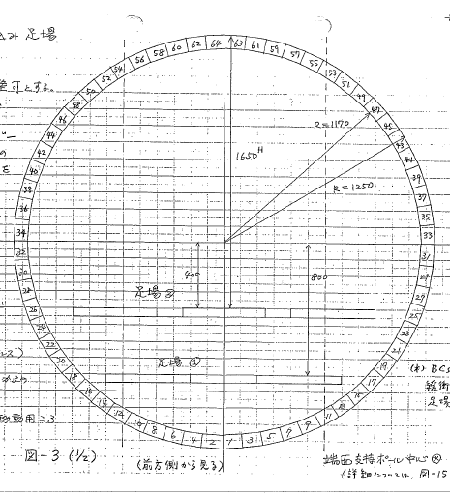
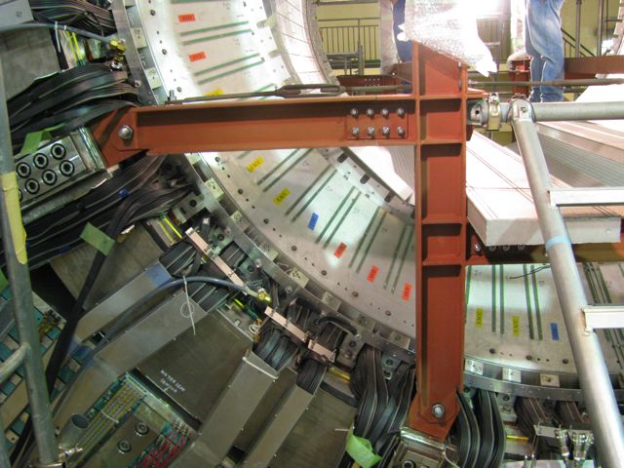
Installation jigs and scheme (2)
The 1st in-situ practice of the TOP installation is scheduled in the week of June 3rd.
To-do list is being made.
Test items and procedure,
Set-up scheme and procedure,
Preparation of dedicated jigs,
Man power requirement.
For details, see my slides at B2GM13.
Mon | Tue | Wed | Thu | Fri | Sat | Sun
5/20 | 21 | 22 | 23 | 24 | 25 | 26
27 | 28 | 29 | 30 | 31 | 6/1 | 2
3 | 4 | 5 | 6 | 7 | 8 | 9
10 | 11 | 12 | 13 | 14 | 15 | 16
EKLM installation
Common platform integration (Schedule is TBC.)
TOP installation practice
Common platform segregation (Schedule is TBC.)
~6300
~1600
~1700
1650
8300
~800
~150 kg
650
900
400
解体仕様書
「添付資料-V」
14

Slide 15
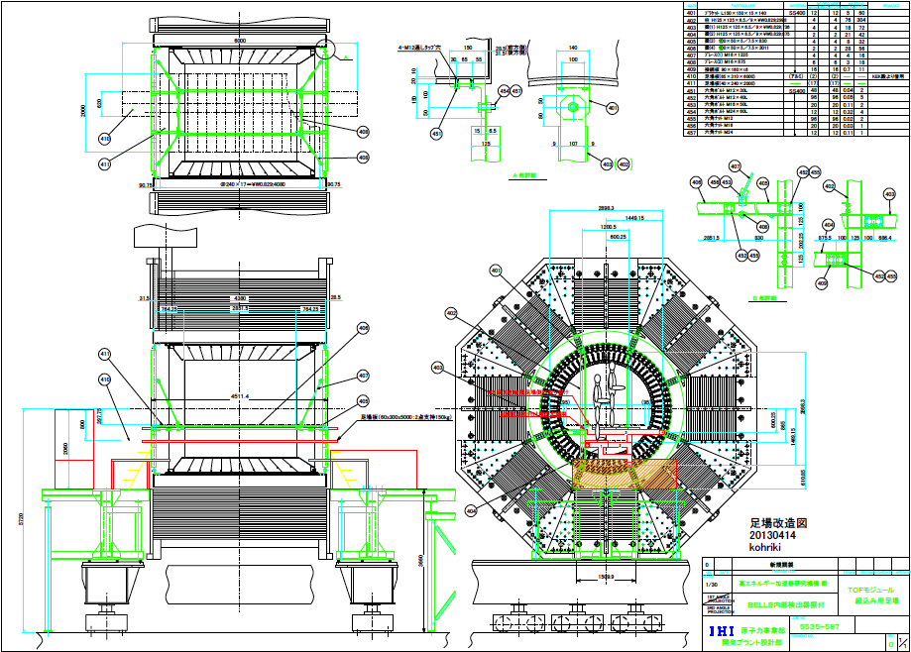
Strategy of the practice (5)

