Slide 1
Status and perspectives of gaseous photon detectors
Antonello Di Mauro (CERN, Switzerland)
Shonan, 03/12/2013
Disclaimer:
The talk reflects mainly the speaker’s experience and taste and does not pretend to be an exhaustive overview …

Slide 2
Introduction
J. Va’vra, NIMA 371(1996), 33:
” Recently, many non-gaseous devices have appeared on the market. It remains to be seen how successful they will be in replacing gaseous detectors. If they do work they will remove the great fun some of us have had doing it on our knees at home.”
Can we still have fun?
Notes:
I’d like to start with a sentence Jerry wrote in the conclusions of a review paper on photon detectors in 1996….

Slide 3
Introduction
The photon detector plays a crucial role in the design of a RICH counter since it affects the overall performance (Cherenkov angle resolution)
Basic requirements:
Single photon sensitivity
High photoconverter quantum efficiency (QE)
Low FEE noise
Large packing factor
High spatial resolution
Depending on application and experimental conditions: high rate capability (+ no ageing)
Gaseous photon detectors (GPDs) advantages:
Best cost-effectiveness for large area coverage
Insensitivity to B
Low material budget

Slide 4
Introduction
Conference Year | Main R&D topics/novelties on photon detectors and RICH systems | RICH in operation in H.E.P. experiments/ photo detector type | % of talks on GPD-based RICH
Bari 1993 | CsI-MWPC (PPAC); CsI characterization; DIRC | OMEGA, DELPHI, SLD, CERES: TMAE-GPD | 91% no astroph. talks
Uppsala 1995 | TMAE/TEA –MWPC (HERA-B, CLEOIII); CsI-MWPC (ALICE, HADES); DIRC-PMT (BELLE) | OMEGA, DELPHI, SLD, CERES: TMAE-GPD; NA44 (TIC): CsI-MWPC | 84% few astroph. talks
Ein-Gedi 1998 | CsI-MWPC (COMPASS); CsI-GEM (PHENIX); DIRC-PMT (BABAR); HPD (LHCb); APD; aerogel | DELPHI, SLD: TMAE-GPD; HERMES, SELEX: PMT | 41% few astroph. talks
Pylos 2002 | CsI-MWPC; CsI-GEM; HPD; MAPMT;MCP; APD; SiPM; aerogel | CLEOIII:TEA-MWPC; HADES, STAR: CsI-MWPC; HERMES, SELEX, BABAR: PMT; HERA-B: MAPMT; | 42% from here: astoph. session
Playa del Carmen 2004 | CsI-MWPC; CsI-GEM; CsI-THGEM; HPD; MAPMT; MCP; APD; SiPM; aerogel | CLEOIII:TEA-MWPC; COMPASS, HADES, J-LAB: CsI-MWPC; HERMES, SELEX, BABAR(DIRC): PMT; HERA-B: MAPMT; | 23%
Trieste 2007 | CsI and Bialk -GEM/THGEM/μMEGAS; DIRC (PANDA); FDIRC (BABAR); TOP (BELLEII); MCP; MAPMT; HAPD; SiPM; F-aerogel; NA62 (PMT) | CLEOIII:TEA-MWPC; COMPASS, HADES, J-LAB: CsI-MWPC; BABAR(DIRC): PMT; COMPASS, HERA-B: MAPMT; | 13%
Cassis 2010 | CsI-GEM/THGEM/μMEGAS; Bialk-MPGD; FDIRC; MCP, MAPMT; HAPD; SiPM; F-aerogel; TORCH (LHCb); CBM (PMT); CLAS12(MAPMT) | ALICE, COMPASS, HADES: CsI-MWPC; PHENIX: CsI-GEM; BABAR(DIRC): PMT; COMPASS, HERA-B: MAPMT; LHCb: HPD | 15%
Shonan 2013 | CsI-HMPGD; Bialk-MGPD; FDIRC; MCP; MAPMT; HAPD; SiPM; F-aerogel; TOP; TORCH (LHCb); CBM (PMT); CLAS12(MAPMT) | ALICE, COMPASS, HADES: CsI-MWPC; PHENIX: CsI-GEM; COMPASS: MAPMT; LHCb: HPD | 14%

Slide 5
Introduction
The choice of a particular photon detector is naturally driven by the experiment's requests.
In the last two decades →
Gaseous photon detectors operating in the UV allowed the construction of first large systems used in HEP or NP experiments, bringing to maturity the RICH technique
The development of large area CsI photocathodes (PC) by the CERN/RD26 project in the 1990’s represented a breakthrough in Cherenkov photodetection allowing the transition from “slow” gas photoionization to “fast” photoelectron extraction from solid PC in MWPC
There has been a strong effort to push the RICH detectors to work in the visible wavelength region to limit the chromatic error contribution;
The majority of new systems or upgrades (e.g. in B-factories, HL-LHC,…) have to satisfy constraints in terms of high rate capability, integration into limited space, etc…. The DIRC-like approach, with all various flavours (F-DIRK, TOP, TORCH,…) is the winning solution, clearly shifting the interest towards non-gaseous photon detectors with time resolution < 100 ps

Slide 6
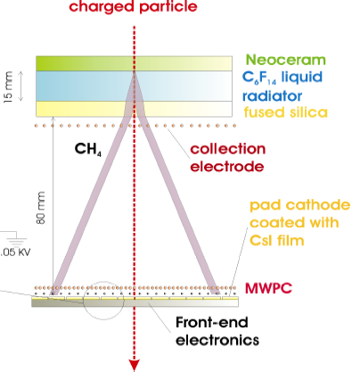
The rate issue
HMPID RICH
Single photon detection in CsI-MWPC
SINGLE PHOTON
detector instability
CsI PC QE
ageing
SINGLE PHOTOELECTRON
photoelectron backscattering (GAS, E, P)
hν
TOWNSEND AVALANCHE
gas gain (GAS, E, P)
ion bombardment
photon feedback
FRONT-END ELECTRONICS (ions signal)
increase gain
$ε_{det}$= $e^{− \frac{A_{th}}{A_{0}}}$
Reduce i.t.
integration time → visible gain A₀
noise → zero suppression thresh. A_{th}
rate requirements
SINGLE PHOTON HIT
spatial resolution worsening

Slide 7
The “fast” RICH dream
Fast-RICH proposal (J. Seguinot et al., NIM A 371 (1996), 64):
CsI-MWPC with thin gap (0.5 mm) to minimize ion collection time
very fast front-end electronics with ~ 20 ns integration time
stable operation not possible at the needed 10⁵ gain (photon feedback, space charge, sparks)
In parallel the RD26 project launched at CERN in 1992 to develop large area CsI photocathodes for Cherenkov ring imaging, focused on “not so fast” devices (gain ~ 5x10⁴, Gassiplex FEE peaking time 0.7-1.1 μs, 1000 e⁻ noise on detector )

Slide 8
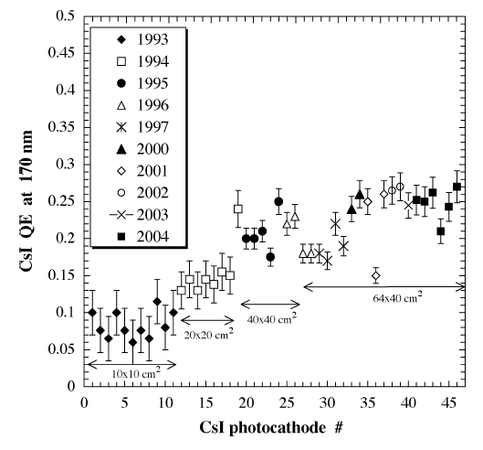
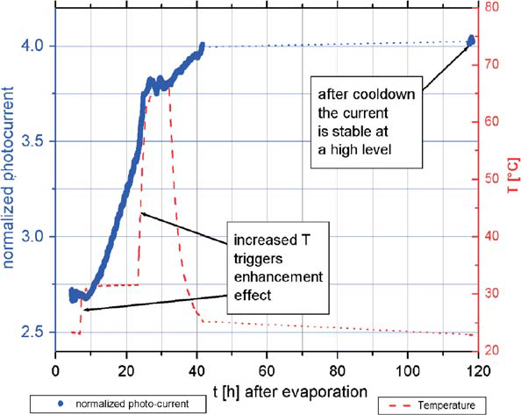
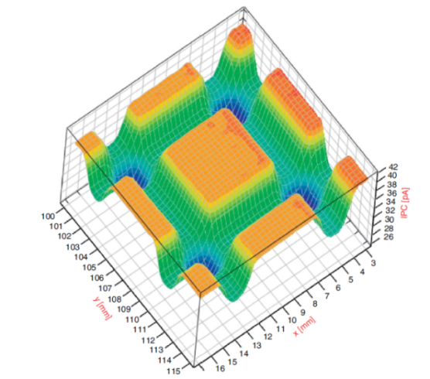
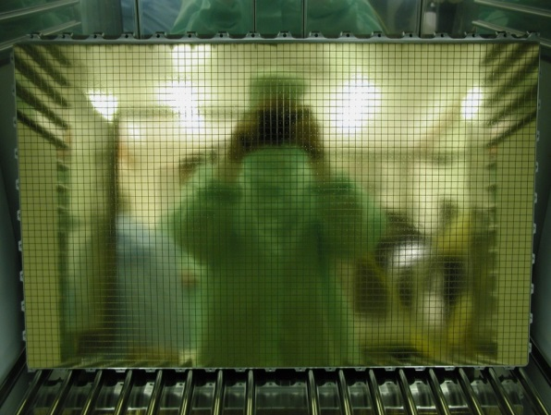
RD26 in one slide
CsI processing for reproducible high QE over large area (~ 0.3 m²):
Substrate preparation: double layer Cu clad PCB with metalized holes coated by Ni (7 μm) and Au(0.5 μm), surface polishing + various cleanings in ultrasonic baths, outgassing at 60 ºC for 1 day
Slow deposition rate of 300 nm CsI film at 1 nm/s (by thermal evaporation or e⁻-gun), at a vacuum of ~ 10⁻⁷ mbar, systematic monitoring of residual gas composition by RGA system
Heat enhancement: thermal treatment at 60 ºC for 8 h
Handling: in situ measurement of PC response and encapsulation under dry Ar, mounting by glove-box
A. Di Mauro et al., IEEE TNS NS52(2005), 972
nickel barrier layer (7μm)
gold front surface (0.5 μm)
multilayer pcb with metalized holes
^{40 cm}
^{60 cm}
H. Hoedlmoser et al., NIM-A 566(2006), 338 and 351

Slide 9
CsI-based RICH in operation
Experiment | RICH configuration/ Cherenkov radiator | PID | Trigger rates | Photodetector type/ area
HADES @ GSI | Mirror focusing/ C₄F₁₀ gas | e+/e- 0.1-1.5 GeV/c | ~ 10⁵ Hz | MWPC/ 1.5 m²
COMPASS @ CERN/SPS | Mirror focusing/ C₄F₁₀ gas | π/K 3-55 GeV/c | ~ 5x10⁴ Hz (beam rate 40 MHz) | MWPC/ 5.5 m²
HALL-A @ JLAB | Proximity focusing/ C₆F₁₄ liquid | π/K 0.8-2.4 GeV/c | 10⁵ Hz | MWPC/ 1.2 m²
ALICE @ LHC | Proximity focusing/ C₆F₁₄ liquid | π/K 1.5-3 GeV/c K/p 2-5 GeV/c | 10⁴ Hz | MWPC/ 10.5 m²
PHENIX @ RHIC | Proximity focusing/ CF₄ gas | e+/e- 0.1-1.5 GeV/c | 10⁴ Hz | GEM/ 1.5 m²

Slide 10
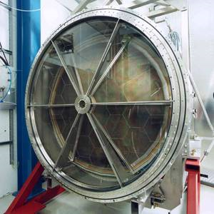
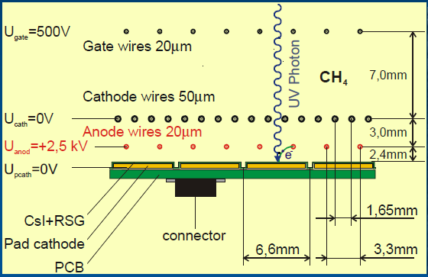
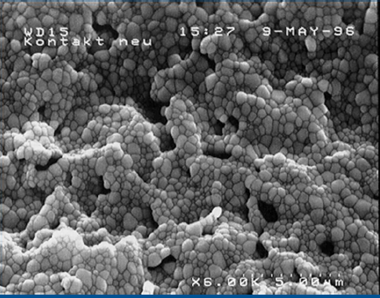
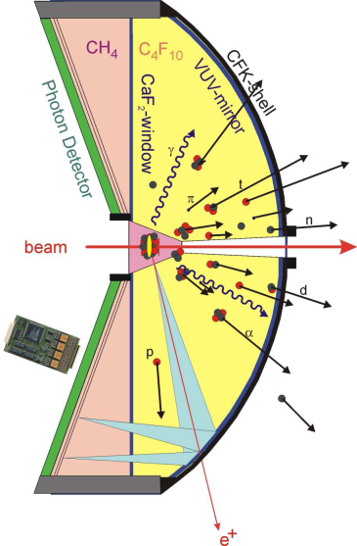
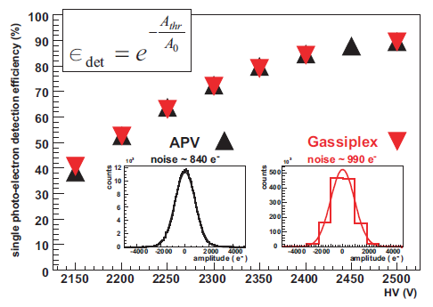
Status of HADES RICH
e+/e- identification (+ trigger)
hadron blind
low material budget (X/X_{o}~3%)
K. Zeitelach et al., NIM-A 433 (1999), 201
J. Friese et al., NIM-A 438 (1999), 86
PC substrate: SS+ RSG graphite spray
Running since 1999: pp, p-Nb, Ar-KCl, Au-Au (in 2012)
FEE upgrade from GASSIPLEX to APV25-S1 in 2008: peaking time reduction to 0.2 μs to increase trigger rate capability
No estimate of accumulated charge available, QE drop of ~ 20% after the first year, then rather stable performance, but Au-Au data analysis in progress
Possible upgrade for FAIR: not hadron blind, change radiator gas, replace MWPC with MAPMT
(J. Friese, private communication)
M. Bohmer et al., MLL TUM Annual Report 2008, 89

Slide 11
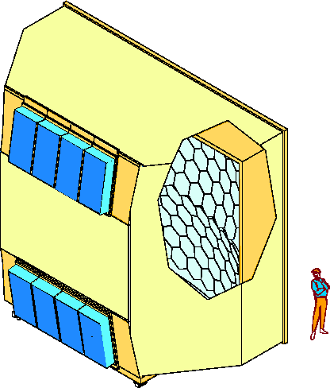
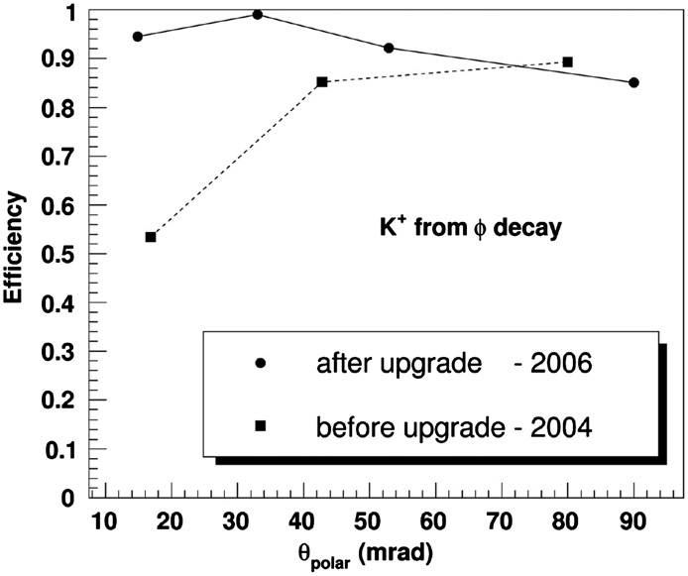
Status of COMPASS RICH
RICH in operation since 2002, upgraded in 2006 with:
Hamamatsu R7600-03-M16 MaPMTs in the central region ( 25% of active area) to cope with large uncorrelated background ~ 1 MHz/channel
Replacement of FEE GASSIPLEX with APV25-S1, to improve time resolution (peaking time reduction from 0.6 to 0.4 μs) and reduce deadtime from 3 μs (baseline recovery) to ~ 0 at 40 kHz and 15% at 80 kHz R/O rate
3 m
6 m
Al vessel
MWPC’s + CsI
UV mirror
wall
5 m
PMT’s
radiator gas: C₄F₁₀
No ageing observed on CsI-MWPC operated at < 5 x 10⁴(see details in S. Dalla Torre’s talk)
R&D for upgrade based on THGEM or hybrid THGEM (see details in S. Levorato’s talk)
P. Abbon et al., NIM A 567 (2006), 104, NIM A 623 (2010), 330, NIM A 639 (2011), 15

Slide 12
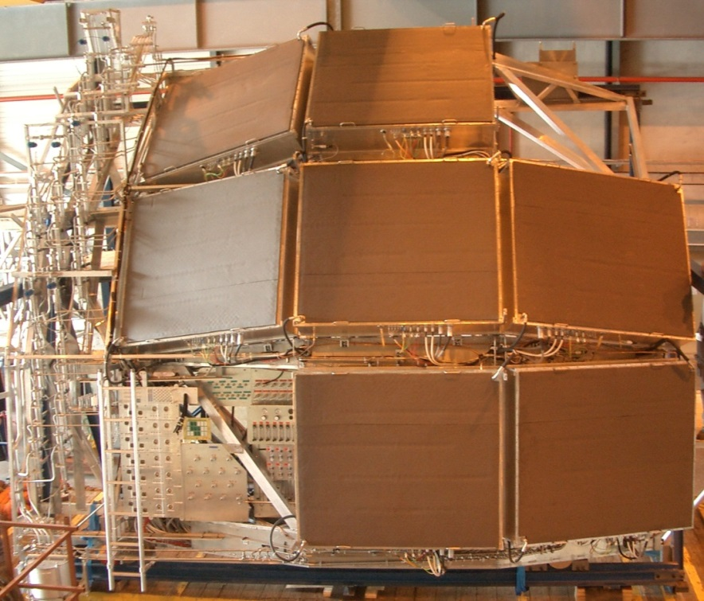
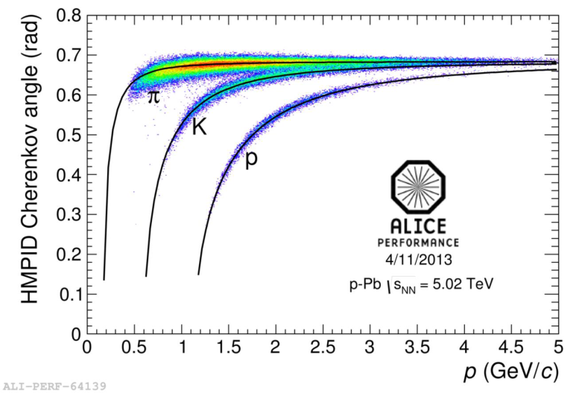
Status of ALICE HMPID RICH
Installed in 2006, in operation since 2009
Largest CsI-MWPC based RICH, 42 CsI PC for a total active area of 10.5 m²
Stable operation with CH₄ at a gain of ~ 4 x 10⁴ up to 500 Khz pp collision rate
No CsI QE degradation observed (low accumulated charge ~ 0.02 mC/cm²)
G. De Cataldo’s talk

Slide 13
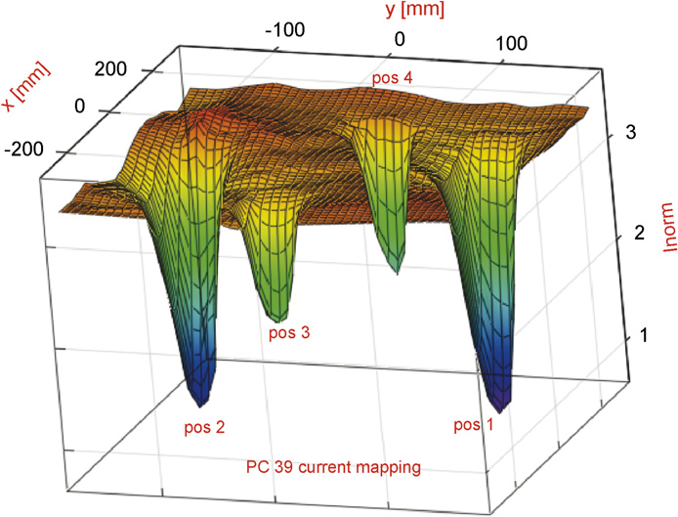
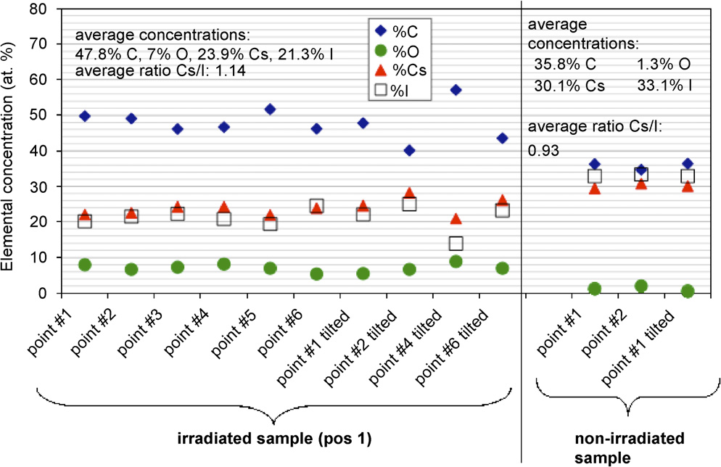
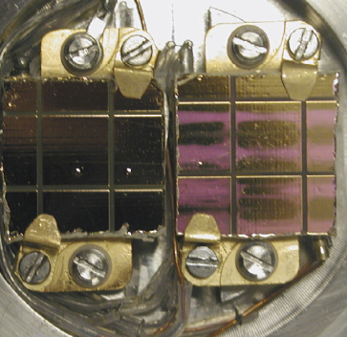
CsI ageing studies
~ 70 %
~ 70%
~ 30%
~ 20 %
0%
~ 50%
0%
QE drop
SEM analysis
Irradiation using Sr source on CsI PC in MWPC operated with CH₄
large concentrations of C and O on the irradiated sample: deposits of hydrocarbons (polymers)
ratio Cs/I systematically higher on the irradiated sample
H. Hoedlmoser et al.: NIM A 566 (2006), 338; NIM A 574 (2007), 28;

Slide 14
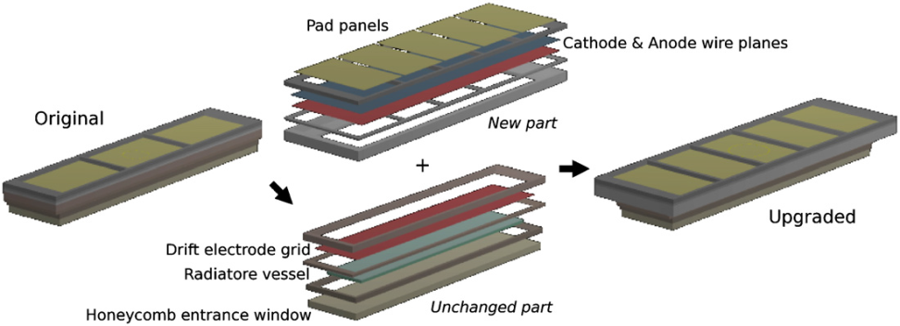
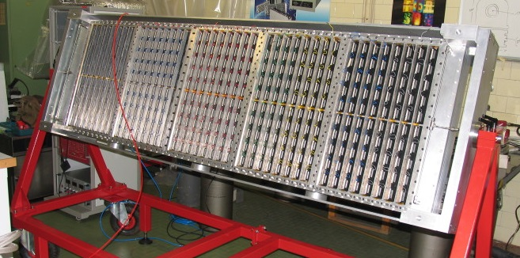
Status of Hall A – JLAB RICH
Operated in 2004 and 2005
Upgraded in 2007: increase of photon detector size (from 3 to 5 CsI PCs) to increase proximity gap and angular resolution
Long breaks without gas flushing between running periods: CsI PC are re-coated before each run
Advantage of CsI-based GPD in case of ageing: refreshing of CsI PC quite simple depending on detector modularity and accessibility
E. Cisbani et al., NIM-A 595 (2008), 44

Slide 15
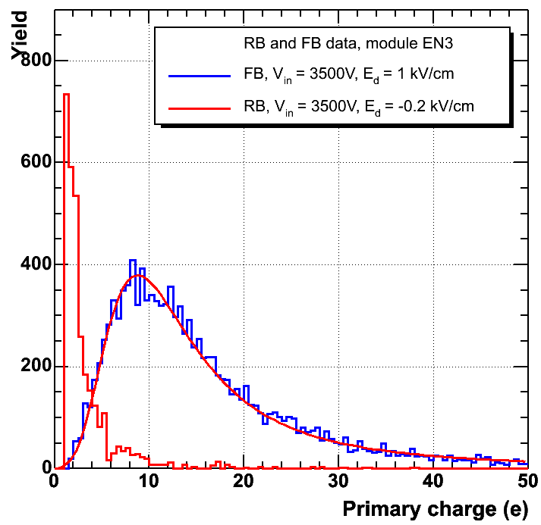
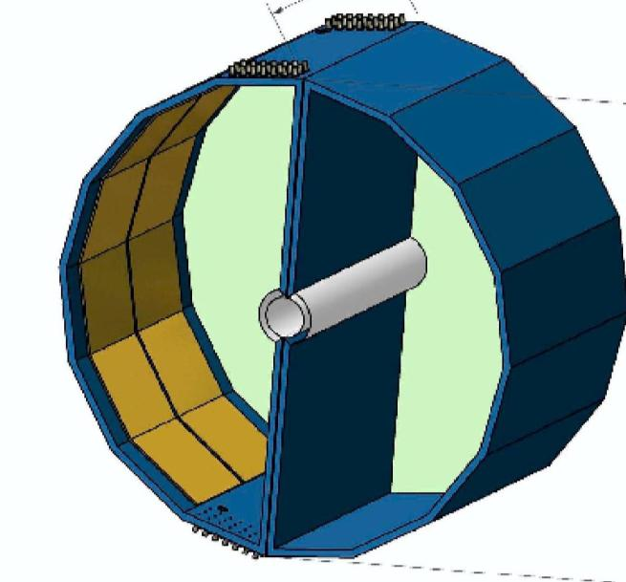
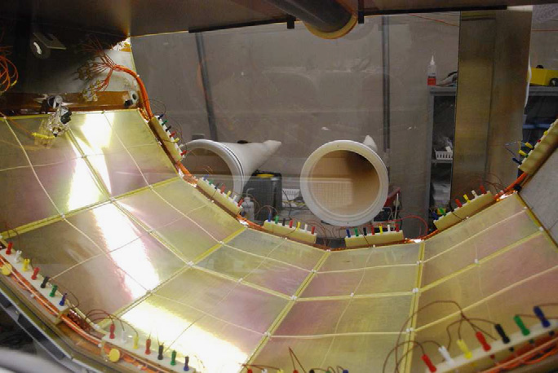
Status of PHENIX HBD
0.65 m
mesh
E_{drift}
photo
electron
primary ionization from dE/dx
θ_{pair}
opening angle
Cherenkov
blobs
e⁻
e⁺
1.21 m
B≈0
pads
X/X₀=2.4 %
First example of CsI-GEM based photon detector in HEP
Hadron Blind Detector, 50 cm CF₄ gas radiator, proximity focusing, photon blobs imaging by CsI/3-GEM operated with same CF₄ (windowless detector, record N₀ ~ 800 cm⁻¹)
Reverse bias in drift region for “hadron blindness”, detect only e+/e-
Operated at a gain of 5000, not a real single photon application
Some ageing observed in a few modules, probably related to different CsI processing (I. Tserruya, private communication)
Pulse height
W. Anderson et al., NIM A 646 (2011), 35

Slide 16
From MWPC to μ-pattern GPDs
CsI-MWPC photon detectors employed in HEP RICHs are doing their job: stable operation and good performance over many years; however, as demonstrated by COMPASS, when operated in harsh environment or high rate capability is required, they show their limits:
Even using a fast and low-noise FEE (e.g. APV25-S) there is an intrinsic limit in the rate capability related to:
the slow motion of ions on which the signal R/O is based (detector “memory”)
the CsI ageing induced by ion bombardment
instabilities due to secondary effects in “open” geometry
Moving to MPGD, a necessary step forward:
Increased rate capability
Absence of photon feedback and reduced ion bombardment: larger gain (hence larger ε_{det}), stable operation and improved CsI lifetime
Better timing properties due to exploitation of electrons motion for signal formation

Slide 17
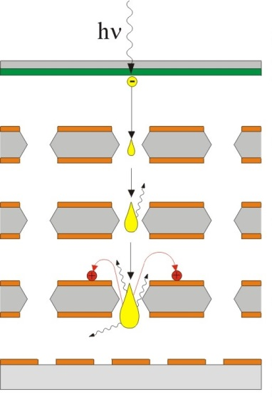
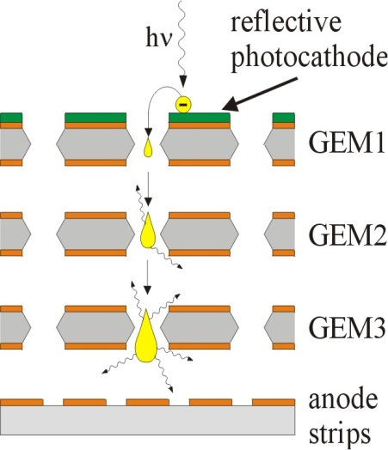
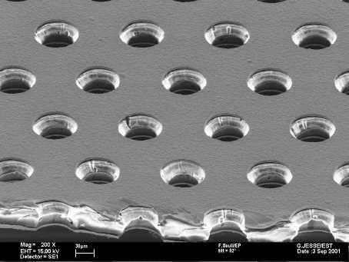
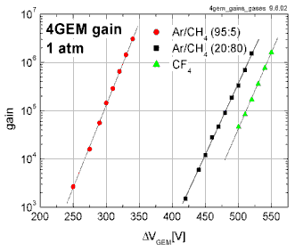
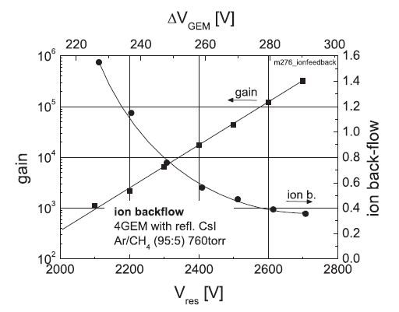
CsI + GEMs
70 µm
140 µm
Chemically etched kapton foil with 5 μm Cu
semi-transparent
photocathode
50 µm
Single photon time resolution of ~ 2 ns, spatial resolution of 100 μm , gain up to 10⁶ , ~ MHz/mm² photon fluxes
Manufacturing up to 140x50 cm²
No photon feedback, ion backflow (IBF) 10% with reflective PC, 2% with semi-transparent PC
R. Chechik, A. Breskin, NIM A 595 (2008), 116 ; D. Mormann et al., NIM A 516 (2004), 315

Slide 18
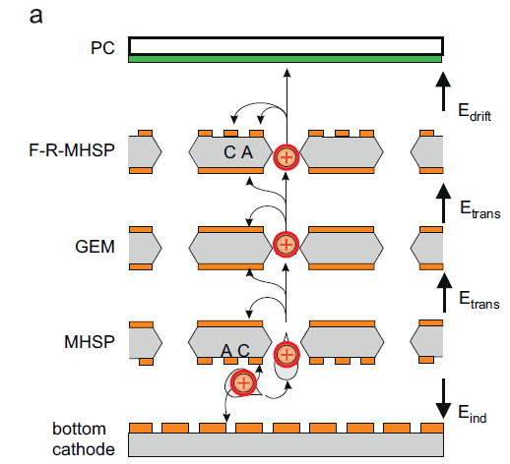
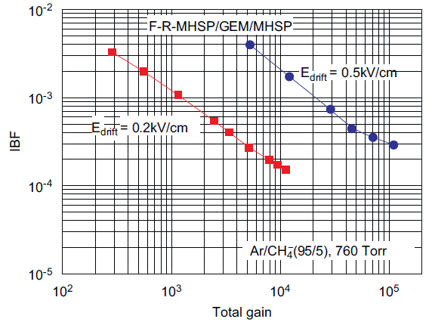
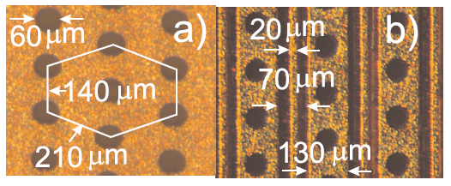
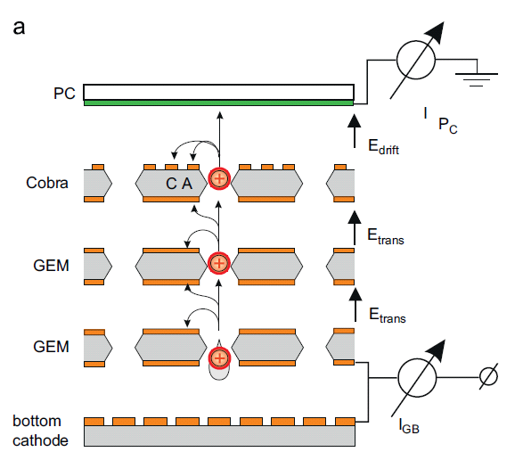
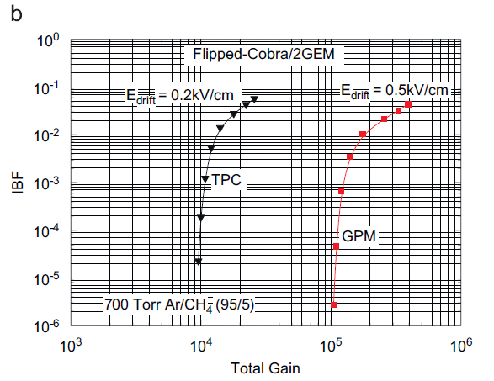
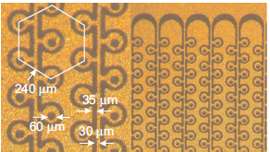
Ion backflow reduction
Flipped-Reversed bias
Micro-Hole and Strip Plate
COBRA
A.V. Lyashenko et al., JINST 2 (2007) P08004
A.V. Lyashenko et al., NIMA 598 (2009) 116

Slide 19
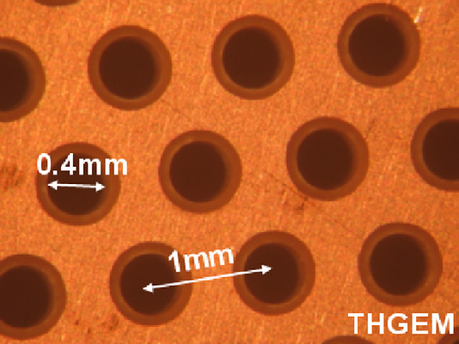
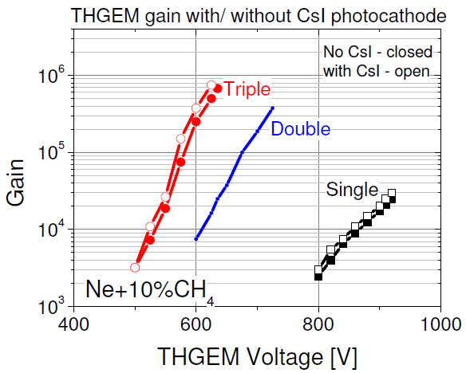
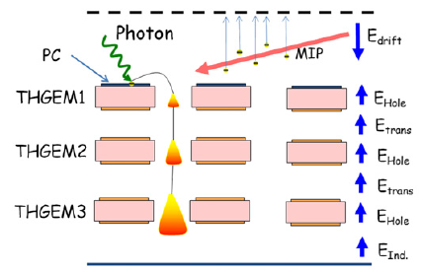
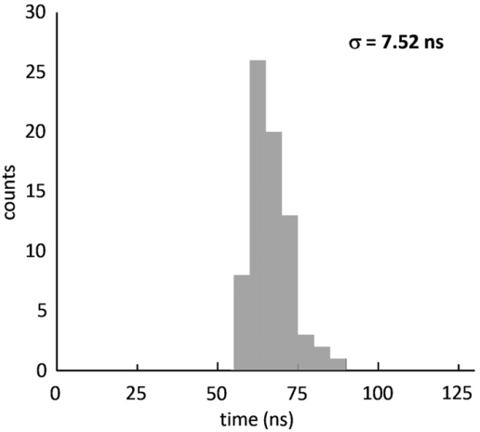
CsI + THGEM
GEMs operated in HEP experiments as tracking devices at gain ≤ 10⁴ (not enough for single photon)
Thick-GEMs →
simple manufacturing (mech. drill. of PCB) and assembly
Hole diameter : 0.2 – 1 mm
Pitch : 0.5 – 5 mm
Thickness : 0.4 – 3 mm
Rim: 0 – 0.1 mm
mechanical robustness (also against sparks)
optimal alternative for single photon detection ( spatial resolution ≤ 1 mm)
large gain (~ 10⁴ /stage), 7-8 ns time resolution
Extensive characterization by WIS, COMPASS, ALICE
rim
0.1 mm
4-THGEM , UV-led
R. Chechik et al., NIM A535 (2004) 303
C. Shalem et al.: NIM A558 (2006) 475 and NIM A558 (2006) 468
A. Breskin et al. ,NIM A598 (2009) 107
V. Peskov et al., JINST 5 (2010) P11004
M. Alexeev at al., NIM A 617 (2010) 396

Slide 20
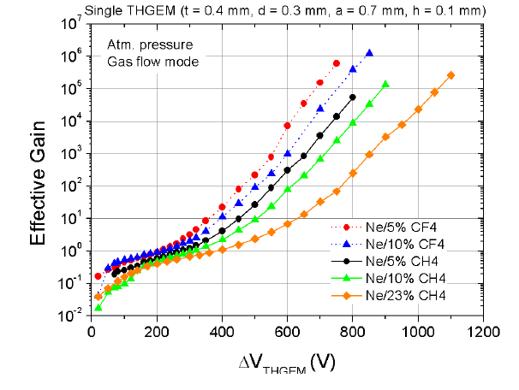
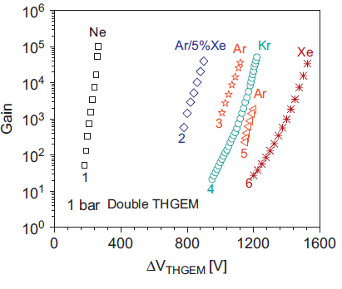
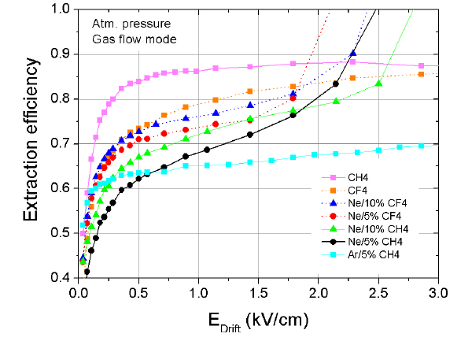
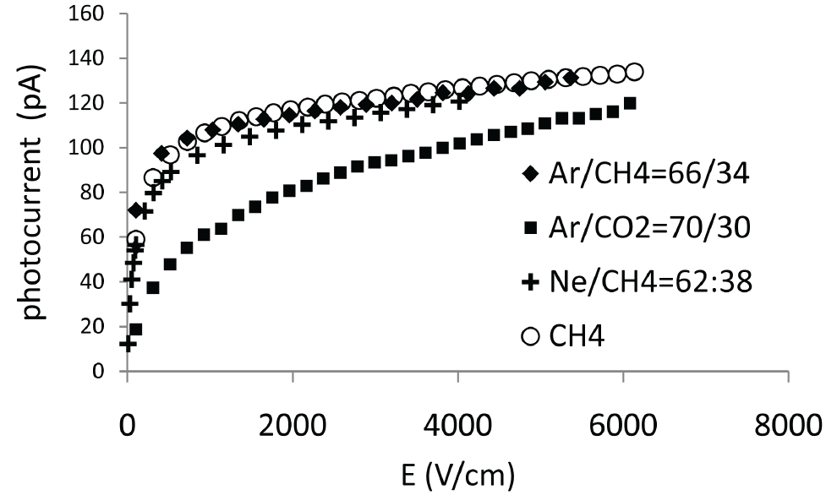
CsI/THGEM: photoelectron extraction
Single THGEM, X-rays
Ne larger Townsend coefficient →
mixtures with CF₄ and CH₄ : large gain and reduced photoelectron backscattering
A. Breskin et al. NIM A598 (2009) 107
C.D.R. Azevedo et al., JINST 5 (2010) P01002
J. Escada et al., JINST 4 (2009) P11025
(with ΔV=0)
M. Alexeev et al. NIM A 623 (2010), 129

Slide 21
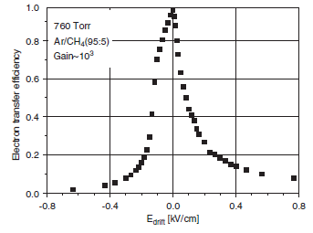
CsI/THGEM: photoelectron transfer
Refl PC, dependence on E_{drift}
E_{drift}~ 0 , E on PC surface proportional to ΔV and diam/pitch
Compromise:
Maximize active area to increase QE
Reduce active area to increase Ez (lower backscattering)
For example: d=0.4, p=0.8 → Ez~ 700 V/cm, active area 78%
ΔV = 1500 V
C. Shalem et al.: NIM A558 (2006) 475
S. Dalla Torre, talk @ RICH2010

Slide 22
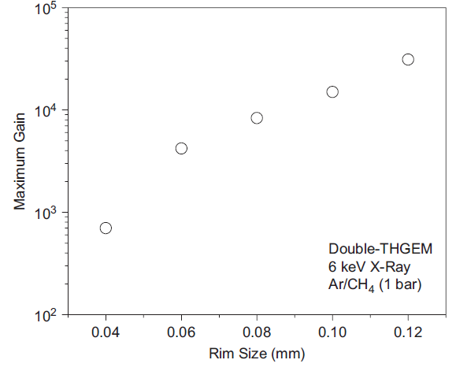
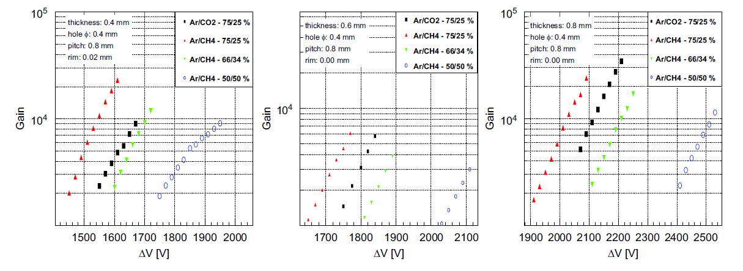
CsI/THGEM: the role of rim
Larger rim allows larger gain, but above 10 μm large gain instabilities have been observed
Increase of thickness: larger and stable gain (but also larger HV needed)
C. Shalem et al. NIM A558 (2006) 475 ; M. Alexeev et al. NIM A639 (2011) 130; M. Alexeev et al. NIM A695 (2012) 159

Slide 23
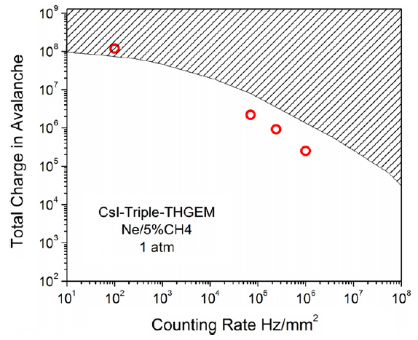
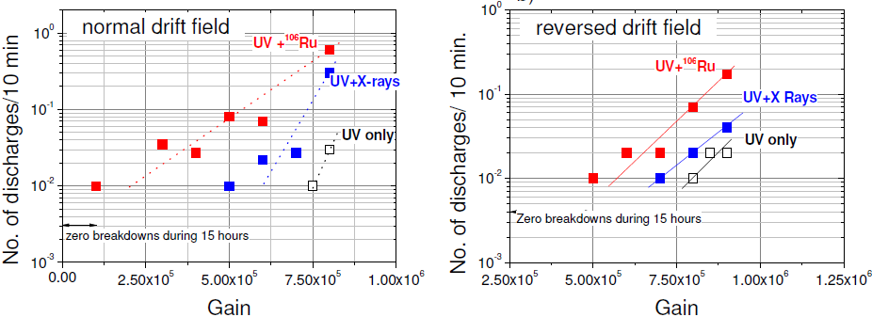
CsI/THGEM: rate capability
Simultaneous irradiation with UV and X-rays (Mo), normal drift field
Breakdown rate in CsI-triple-THGEM
sparks region
Ne/10% CH4
Ne/10% CH4
A. Breskin et al. NIM A598 (2009) 107
V. Peskov et al., JINST 5 (2010) P11004

Slide 24
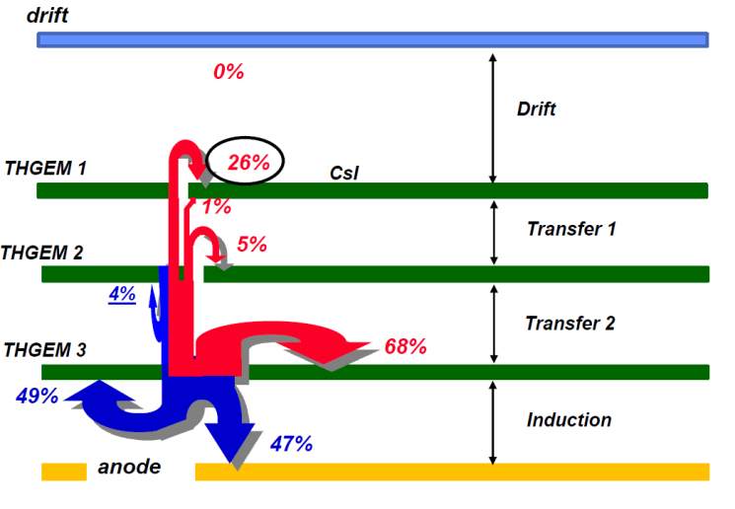
CsI/THGEM: IBF
THGEMs
Dim: 0.4 mm
Pitch: 0.8 mm
Thickn.: 0.4mm
Max improvement by field value optimization ~ factor 2 .
New structures needed for factor 10 improvement
F. Tessarotto, talk at MPGD 2013 – Zaragoza 02/07/2013

Slide 25
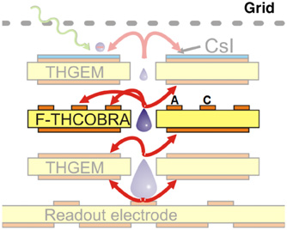
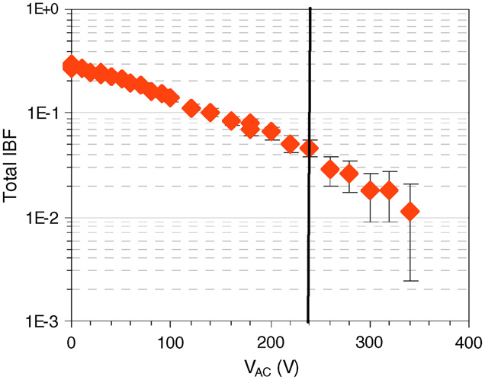
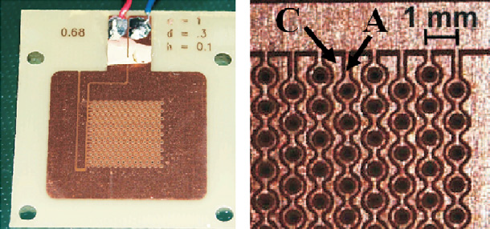
CsI/THGEM: IBF
1mm pitch, 0.3 mm hole diameter, 0.4 mm thick and 0.1mm rim
IBF 5%
Max V_{AC} before
p.e. collection degradation
J. Veloso et al. NIM A639 (2011) 134
T. Lopes et al., JINST 8 (2013) P09002
Best IBF limited to 20% but spatial resolution of 300 μm !

Slide 26
CsI/THGEM: IBF
COBRA-like structure not compatible with optimised COMPASS geometry due to constraints in width/pitch for lines etching
Staggering of THGEM2 wrt THGEM1/3
Impact on gain reduction (- 50%), recovered by larger ΔV:
obtained IBF ~3% with gain ~ 2 x10⁵
M. Alexeev et al., JINST 8 (2013) P01021

Slide 27
R&D for COMPASS RICH-1 upgrade
RICH-1 upgrade approved, MWPCs will be replaced by THGEMs
Optimised detector layout
THGEM_1 (with CsI): thickn. = 0.4 mm, hole diam. = 0.4 mm, pitch = 0.8 mm
THGEM_2 and THGEM_3: thickn. = 0.8 mm, hole diam. = 0.4 mm, pitch = 0.8 mm
Rim size < 10 μm,
thickness of THGEM1 is halved to achieve large E on PC surface keeping active area at 80%
methane-rich gas mixture to reduce backscattering ( > 30% CH₄)

Slide 28
R&D for COMPASS RICH-1 upgrade
300x300 mm prototype
polishing (Hinrichs Pumice Powder)
cleaning with high pressure water to remove all pumice residuals
ultrasonic bath (~1 h) @ 50-60 ºC in Sonica PCB solution (pH11)
washing with demineralized water plus
oven at 180 ºC for 24 h
F. Tessarotto, talk at MPGD 2013 – Zaragoza 02/07/2013

Slide 29
R&D for COMPASS RICH-1 upgrade
Issue with PCB material selection, test with machineable Permaglas

Slide 30
R&D for COMPASS RICH-1 upgrade
Hybrid THGEM/MM
IBF ~ 4%
Positive experience with large area MicroMegas
Large suppression of IBF ( ~ E_{mult}/E_{drift} )
Spread of avalanche from THGEM pre-amplification → sharing of final amplification in various cells of MM, spark-free operation
In Ar/CH4 total ΔV ~ 4 kV instead of 8 kV with triple THGEM + smaller no. of electrodes
F. Tessarotto, talk at MPGD 2013 – Zaragoza 02/07/2013
S. Levorato, proceedings IEEE 2013

Slide 31
R&D for ALICE VHMPID upgrade
Triple-THGEM (t=0.45, d=0.4, p=0.8)
G ~ 7x10⁴
RICH prototype with C₆F₁₄ radiator, stable operation in testbeam, performance ~ 60% of HMPID with CsI-MWPC, not optimal layout for max p.e. collection efficiency + FEE
MWPC with variable gap (0.8-2 mm), layout studies to optimize performance for smaller ring imaging wrt HMPID RICH
Pad cathode before CsI coating
60x16 pads, 4x8 mm²
V. Peskov et al. NIM A695 (2012) 154, A. Agocs et al. NIM A732 (2013) 361, M. Weber’s talk

Slide 32
CsI+InGrid
InGrid technology: application of techniques used in Integrated Circuit and MEMS manufacturing (wafer post-processing) to produce an Al micro-grid directly integrated onto a CMOS pixel chip
High precision of grid geometry and alignment of holes and pixels which act as readout of the avalanche charge
The Al grid with the CMOS pixel chip constitutes an integrated device that forms the complete readout system of a gas-filled detector with pixel-like spatial resolution
M. Chefdeville et al. NIM A556 (2006) 490
V. M. Blanco Carballo et al., IEEE Electr. Dev. Letter 29 (2008) 585

Slide 33
CsI+InGrid
Best gain in He/i-C₄H₁₀ , not optimal for extraction ~50%
6E4
R&D ongoing on gas mixture and IBF, possible application in visible GPD (UHV materials)
J. Melai et al.: NIM A628 (2011) 133, NIM A633 (2011) S194

Slide 34
GPDs for visible light
Operation in GPD of photoconverters sensitive in the visible range (e.g. alkali-antimony: Cs-Sb; bi-alkali: K-Cs-Sb, Na-K-Sb) is affected by:
very high reactivity with O₂ and H₂O (QE degradation)
large probability of ion-induced secondary electron emission: γ⁺ ~ 10⁻²
Usage of very high purity gas systems, UHV material selection, operation in sealed mode, protective “nanofilms”
Gas gain in “open geometry” detectors (MWPC) limited to ~10² for stable operation:
γ⁺ G < 1
In “close geometry” of hole-type MPGD with reduced IBF:
γ⁺ IBF G < 1 → G ~ 10⁵ requires IBF ~ 10⁻⁴
Low QE, works for O₂
E. Shefer et al.: NIM 433 (1999), 502; J. Appl. Phys 92 (2002), 4758

Slide 35
μ-pattern GPDs for visible light
Flushed with gas
QE reduction wrt vacuum due to backscattering in gas
A.V. Lyashenko et al.: JINST 2 (2007) P08004; NIMA 598 (2009) 116 ; NIM A 610 (2009) 161; A. Breskin et al, NIM A 623 (2010) 318

Slide 36
μ-pattern GPDs for visible light
Double MICROMEGAS, sealed
K-Cs-Sb
Ni mesh
~ 30 % QE drop after 182 h, accumulated dose on PC ~ 0.4 μC/mm²
F. Tokanai et al, NIM A 639 (2011) 121
T. Moriya et al, NIM A 732 (2013) 269
F. Tokanai, poster session on Photon Detectors
F. Tokanai et al, NIM A 610 (2009) 164
IBF ~ 3 x 10⁻³

Slide 37
μ-pattern GPDs for visible light
Pyrex glass capillary plate
Photoelectron collection efficiency
230 μm
126 μm
300 μm
80 μm
Better compatibility than lead glass
F. Tokanai et al, NIM A 639 (2011) 121
IBF ~ 20% !
F. Tokanai, poster session on Photon Detectors

Slide 38
μ-pattern GPDs for visible light
Staggered micromeshes, flat panel visible GPMT
Photocathode
Mesh1
Mesh2
Anode
Ne/10% i-C₄H₁₀
G ~ 10⁴
Mesh1
100 mmφ
Electron
Electron + Ion
Mesh2
190 mmφ
IBF ~ 5 x 10⁻⁴
K. Matsumoto et al, Phys. Procedia 37 (2012) 499
F. Tokanai, poster session on Photon Detectors

Slide 39
Summary and perspectives
Single photon imaging in large RICH systems has been (and is being) successfully performed by CsI-GPDs which represent the most cost effective solution to instrument large surfaces
New requirements in terms of improved rate capability and ageing properties are driving a large R&D effort on Micro-pattern GPDs (key role of RD51 in the progress of the various technologies)
After many years of characterization studies of CsI-THGEMs, recipes to build detectors have been worked out, some “manufacturing” issues encountered moving from small scale to large scale prototypes
New developments of hybrid layouts, combining best features of different technologies, are very promising
Despite the effort in solving fundamental issues related to the operation of visible photocathodes in GPD there are limitations in performance and large area coverage

Slide 40
Summary and perspectives
About the fun…
Gaseous photon detectors are clearly alive and needed !

