Slide 1
Muon Acceleration for Muon g-2 Experiment at J-PARC
M. Otani ¹
Y. Kondo², R. Kitamura³, Y. Nakazawa⁴, Y. Sue⁵, S. Bae⁶, H. Choi⁶, S. Choi⁶, K. Futatsukawa¹, K. Hasegawa², K. Inami⁵,T. Iijima⁵, H. Iinuma⁴, N. Kawamura¹, B. Kim⁶, H.S. Ko⁶, Sirui Li³, T. Mibe¹, Y. Miyake¹, T. Morishita², G.P. Razuvaev⁷, N. Saito¹, K. Shimomura¹, E. Won⁶, T. Yamazaki¹, H. Yasuda³,M. Yotsuzuka⁵
¹ KEK
² JAEA
³ Univ. of Tokyo
⁴ Ibaraki Univ.
⁵ Nagoya Univ.
⁶ SNU
⁷ BINP

Slide 2
Contents
Introduction
Muon linac design
Muon acceleration experiment
Prospects
Summary

Slide 3
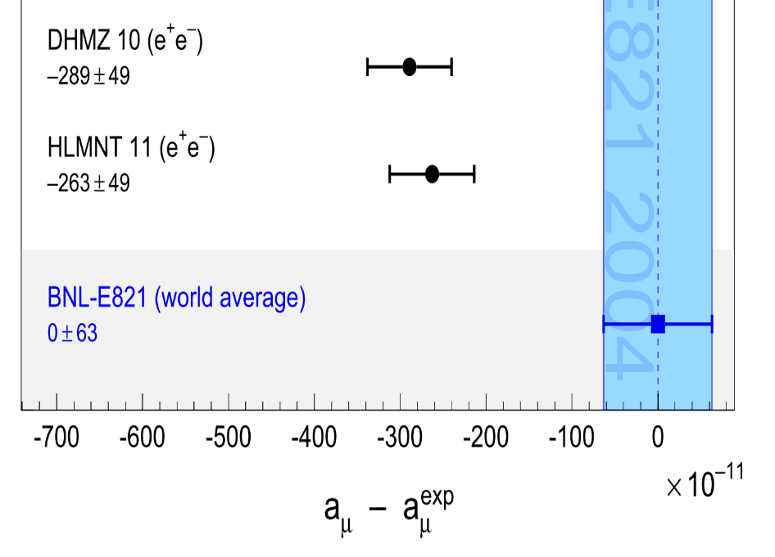
Muon Anomalous Magnetic Moment (g-2)
More than 10 years, muon g-2 anomaly has not been solved.
Needs more precise measurement with, if possible, completely different method.
Systematic [ppb]
B field | 170
Lost muons | 90
CBO | 70
E and pitch | 50
Gain changes | 120
Pileup | 80
Standard Model
Related to beam
BNL E821 (2006)
~3σ
Low emittance muon beam offers new method.

Slide 4
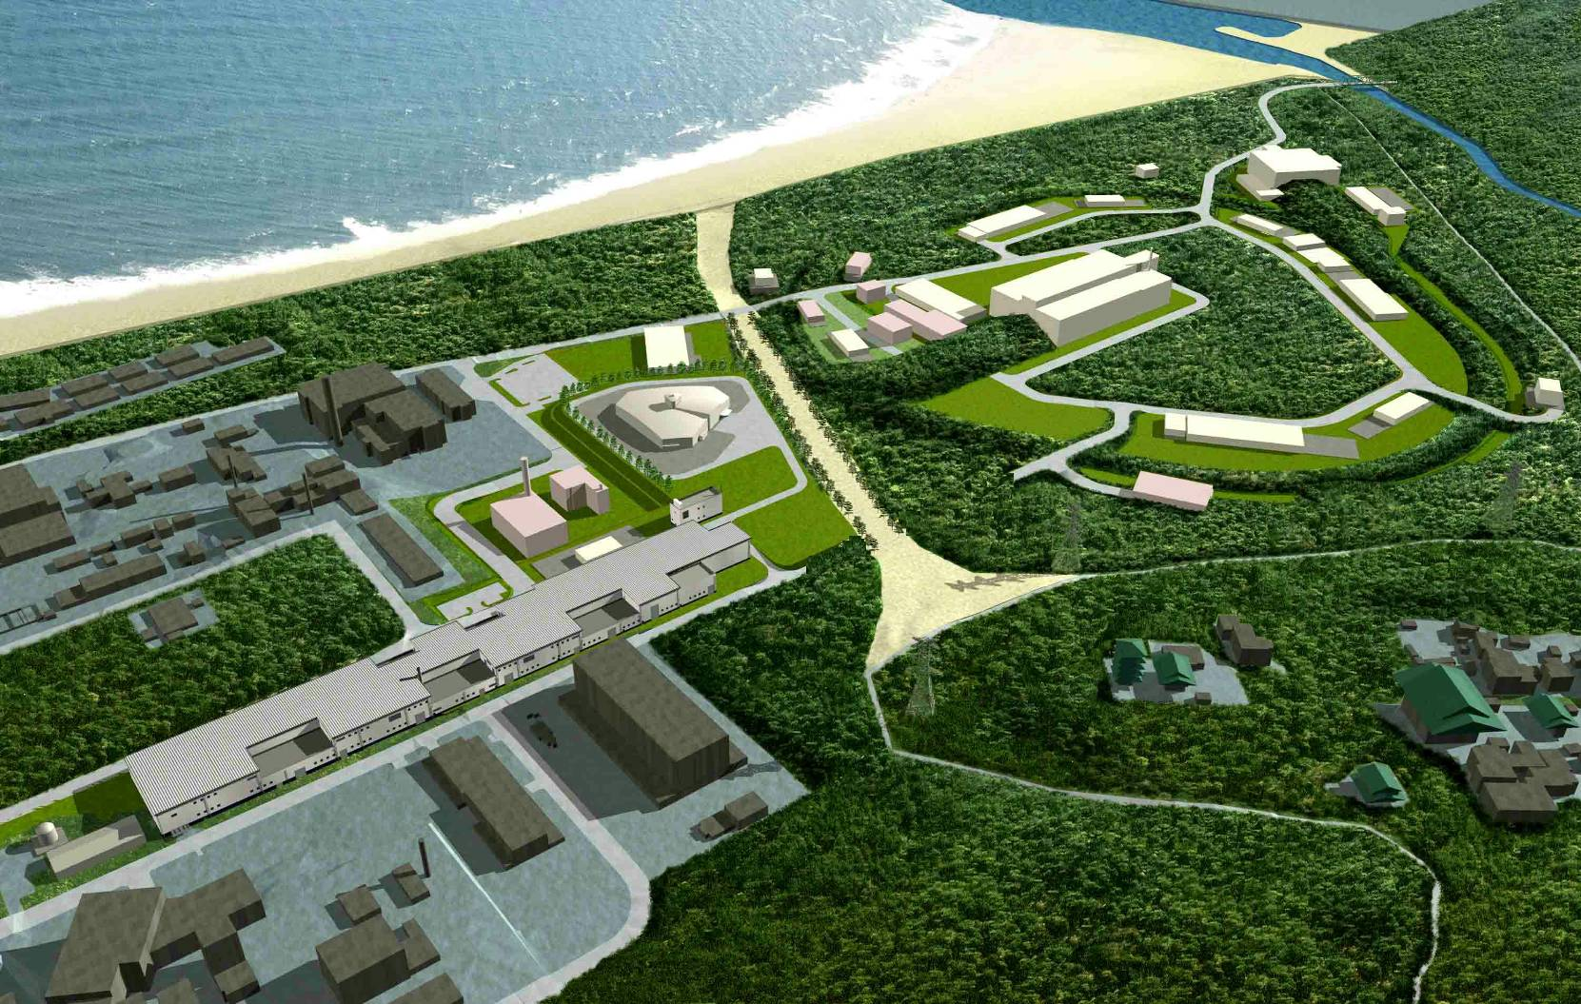
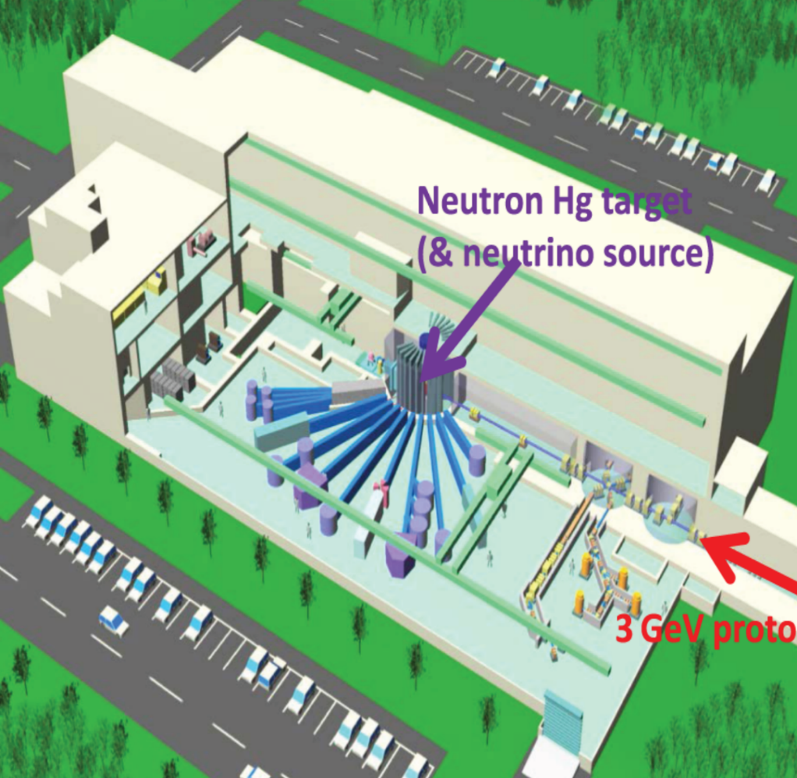
Contents
Experimental site J-PARC MLF Materials and Life science Facility
3GeV RCS
MLF
Neutron target
400MeV linac
Muon target
3GeV proton

Slide 5
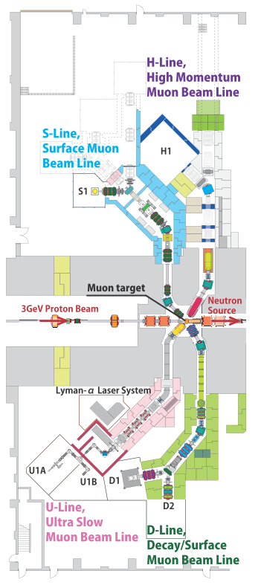
Contents
J-PARC MLF Materials and Life science Facility
H-line

Slide 6
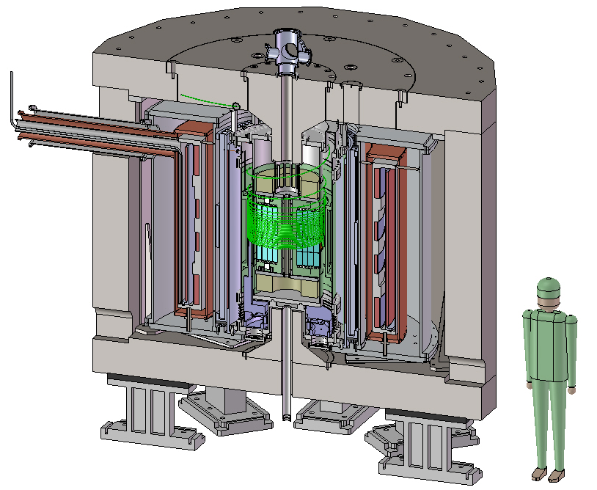
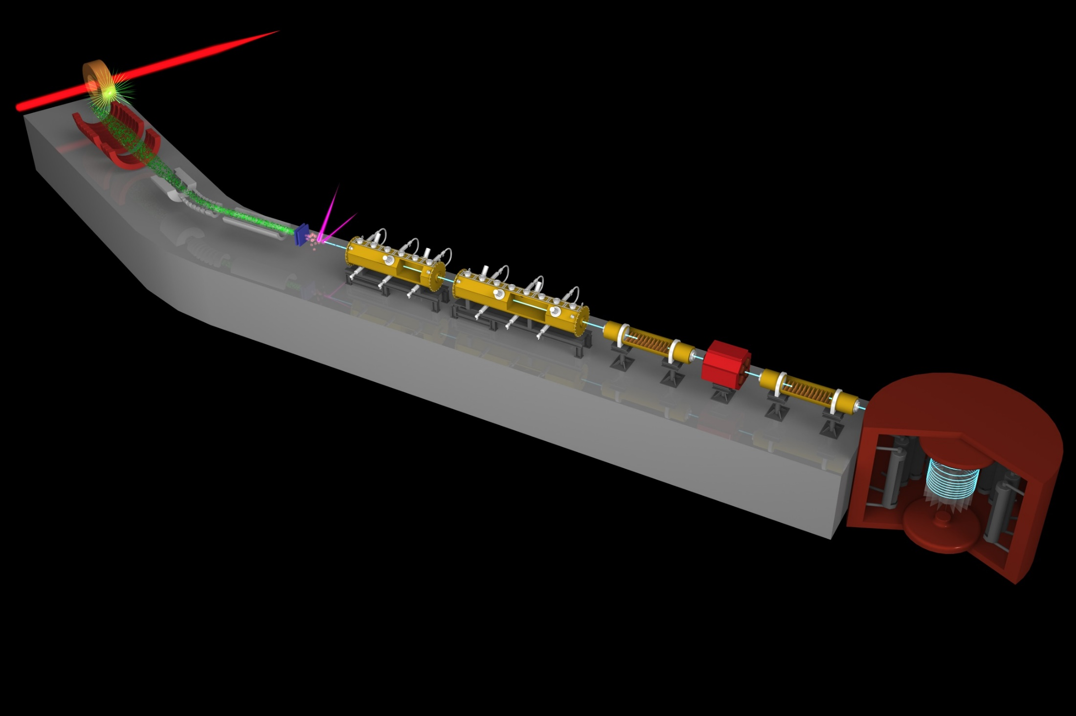
Muon g-2/EDM Experiment at
J-PARC with Ultra-Cold Muon Beam
Silicon
Tracker
3 GeV proton beam
( 333 uA)
Production target
(20 mm)
Surface muon beam
(28 MeV/c)
Muonium Production
(300 K ~ 25 meV⇒2.3 keV/c)
66 cm
Surface muon
Super Precision Storage Magnet
(3T, ~1ppm local precision)
Ultra Cold μ+ Source
Features:
No strong focusing
Super-low emittance muon beam
Compact storage ring
Full tracking detector
Completely different from BNL/FNAL method
Muon
storage
Muon LINAC (300 MeV/c)

Slide 7
Muon linac
5.6 keV
β=0.01
0.3 MeV
β=0.08
4.5 MeV
β=0.3
40 MeV
β=0.7
212 MeV
β=0.9
USμ
RFQ
IH-DTL
DAW CCL
Disk-loaded (DL)
3.2 m
324 MHz
1.4 m
16 m
1296 MHz
15 m
~40m
Utilize resources and experiences at J-PARC H⁻ linac and KEK
324 MHz RFQ
1.3 GHz high power klystron
Low current and duty
IH-DTL with alternative phase focusing.
Energy [MeV] | 212
Intensity [/s] | $${10}^{6}$$
Repetition [Hz] | 25
Pulse length [nsec] | 10
Normalized ε_{t} [π mm mrad] | 1.5
Δp [%] | 0.1

Slide 8
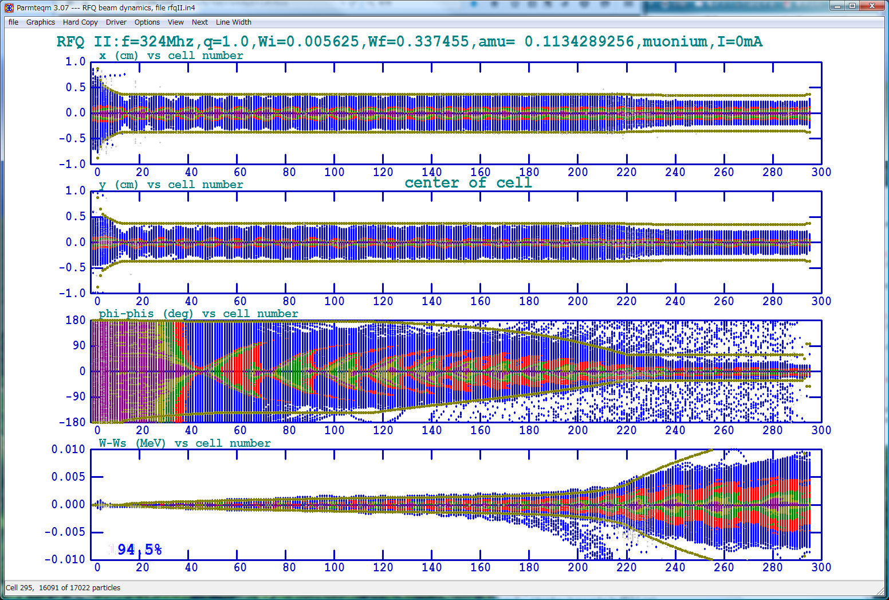
RFQ
J-PARC H⁻ spare is used.
Inter-vane voltage is scaled by mass
Simulation shows good transmission to muon.
Δx (cm)
f [MHz] |  | 324
Length [m] |  | 3.2
Energy [keV] | In | 5.6
 | Out | 340
Inter-vane V [kV] |  | 9.3
Power [kW] |  | 4.2
Δy (cm)
ΔΦ (deg)
ΔE (MeV)
Cell#
Good transmission (95%).

Slide 9
IH-DTL
Interdigital H-mode DTL
TE11 mode and π mode acceleration
Alternative phase focusing
f [MHz] |  | 324
Length [m] |  | 1.3
Energy [MeV] & β | In | 0.34 (0.08)
 | Out | 4.5 (0.28)
# of cells |  | 16
Φ_{s} [deg.] |  | -44 ~ 48
$$φ_{s}<0$$
$$φ_{s}>0$$
Transverse: defocus longitudinal: focus
focus defocus
Finish design and fabricate proto-type [M. Otani et al., Phys.Rev.AB 19, 040101, 2016]

Slide 10
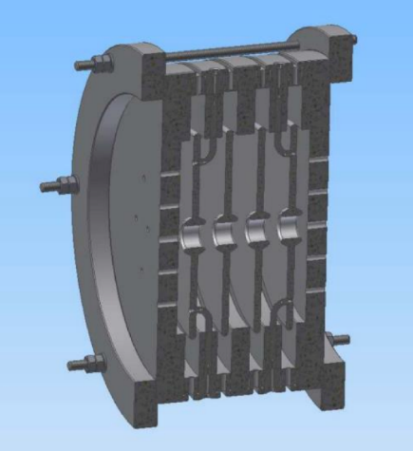
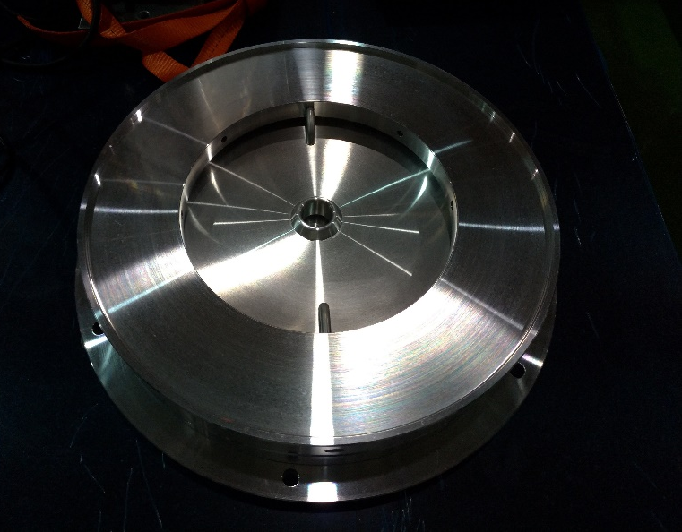
DAW-CCL
Disk and Washer Coupled Cell Linac
Simple structure and high coupling
f [MHz] | 1296
Length [m] | 16
Output Energy[MeV] | 40 MeV (β=0.7)
# of cells | 16
Φ_{s} [deg.] | -30
Power [MW] | 4.5
Finish cavity and dynamics design

Slide 11
DLS
Disk-loaded travelling wave structure.
High-gradient acceleration.
Due to β≠1, synchronized β cell design is conducted.
f [MHz] |  | 1296
Energy [MeV] | In | 40
 | Out | 212
E₀ [MV/m] |  | 20
Φ_{s} [deg.] |  | -10
# modules |  | 4
Finish reference design [Y. Kondo et al., J. Phys. :Conf. Ser. 875, 012054 (2017).]

Slide 12
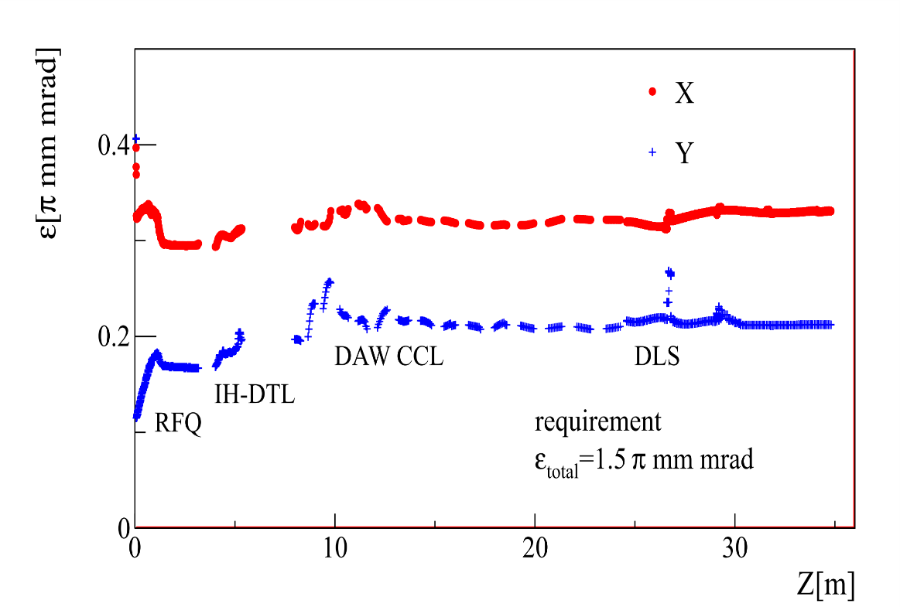
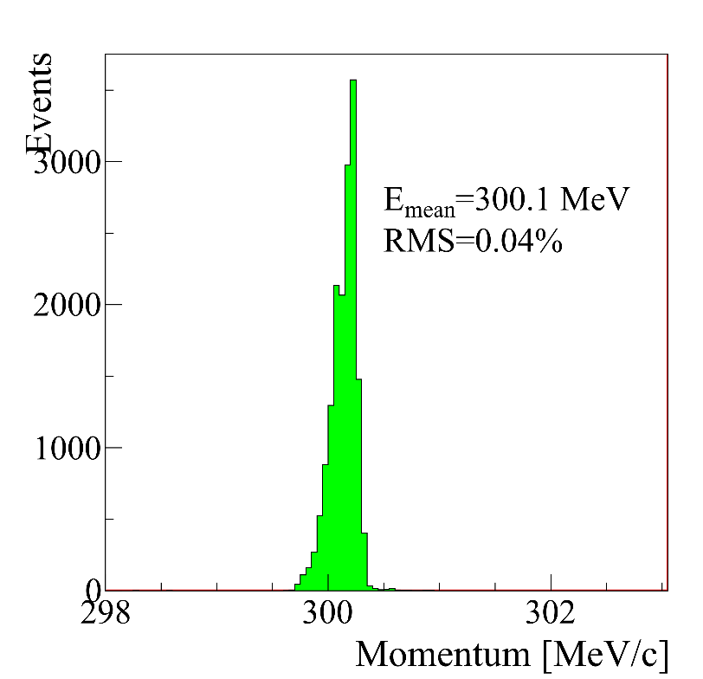
Design Summary
Emittance evolution
Momentum spread
Δp_{design} = 0.1%
 | Init. | RFQ | IH | DAW | DLS
Decay survival [%] | 83 | 81 | 98 | 96 | 99
Transmission [%] | 87 | 95 | 99.9 | 99.5 | 99.9
Satisfy the requirement.

Slide 13
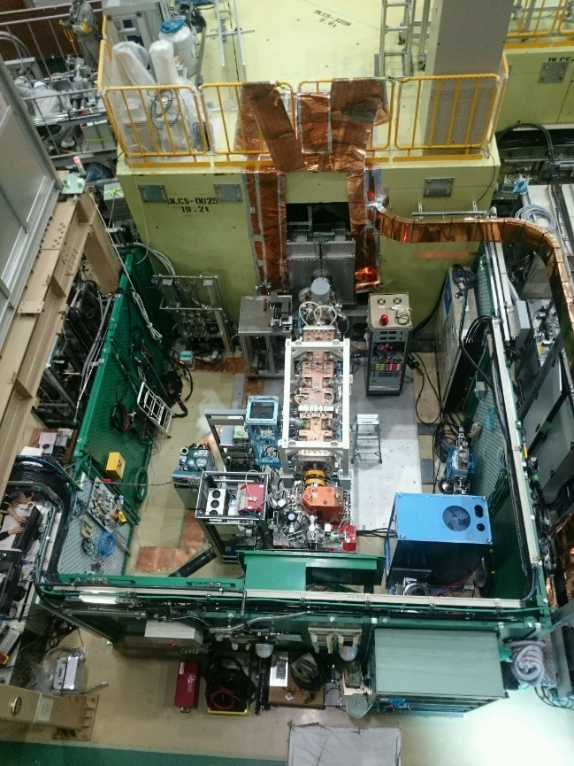
Contents
J-PARC MLF Materials and Life science Facility
Muon Acceleration Experiment @ D-line
H-line

Slide 14
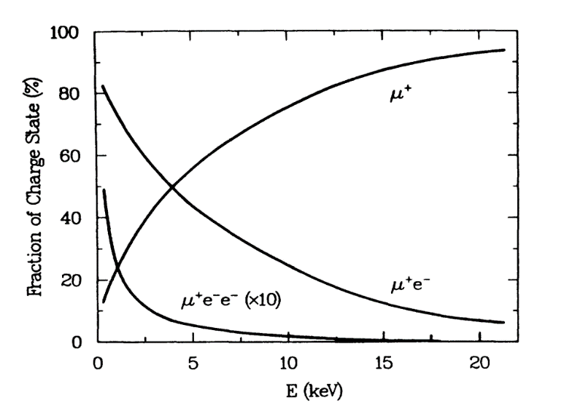
Muon Cooling for Acceleration Experiment
First observation in late 1980’s [Phys.Rev.A, 39, 6109]
Mu (μ⁺ e⁻)
μ⁺ (~3 MeV)
μ⁺
Mu⁻ (μ⁺ e⁻ e⁻)
Easy & cheaper cooling method
Acceleration after cooling by Mu⁻ generation

Slide 15
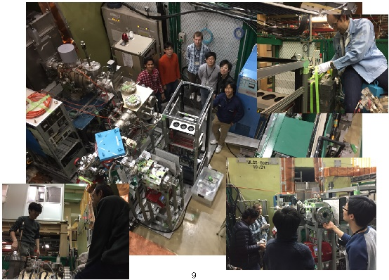
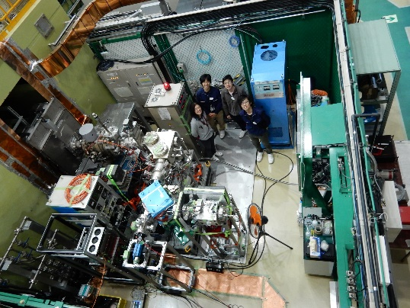
History for the Experiment
2014
2015
2016
2017
acceleration test (2017/10)
assmbly@J-PARC (~2015/5)
Mu⁻ observation (2016/12)
slow μ⁺ &BPM test (2016/2)
Transportation (2014/8)
slow μ⁺ profile (2017/3)
Lead by RIKEN-RAL group

Slide 16
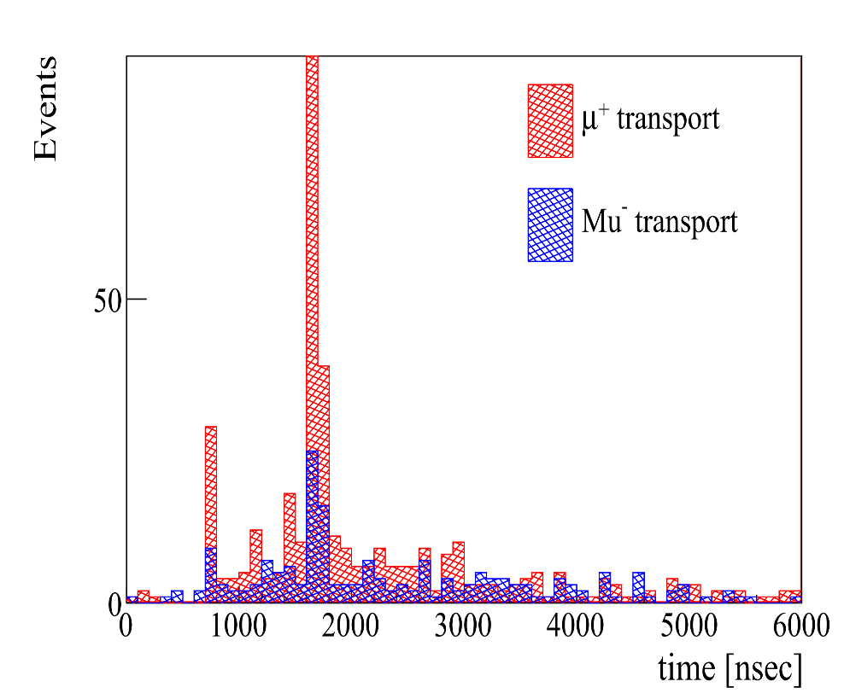
Observation of Mu⁻
Dec. 2016@MLF
Result
signal region
Al foil(Mu⁻generation)
Electric deflector
μ⁺ (~3MeV)
Electric quadrupole
Magnetic bend
detector

Slide 17
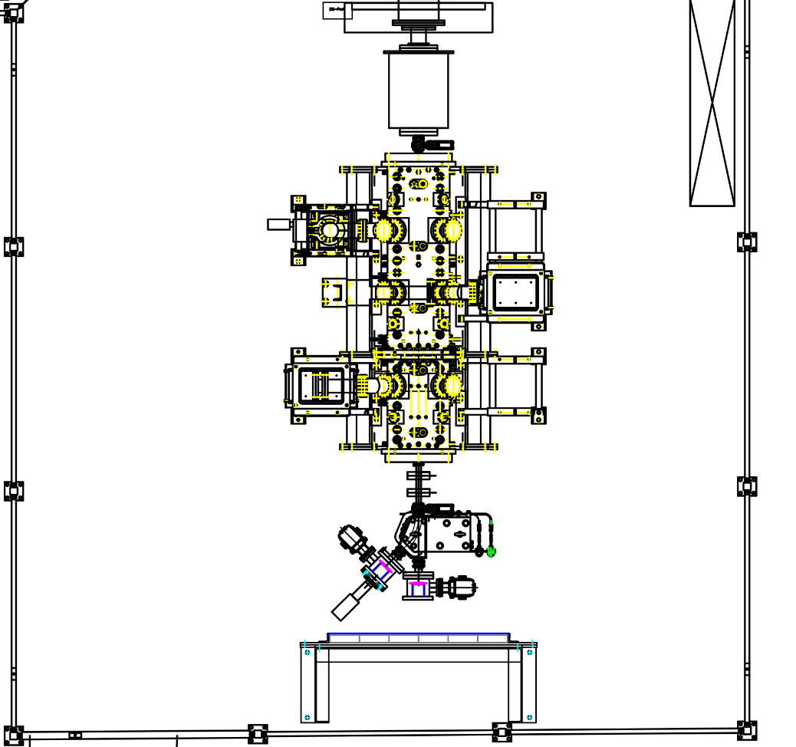
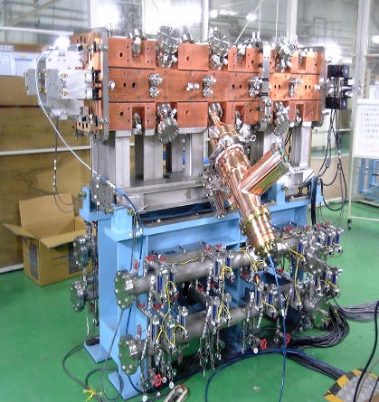
RFQ Acceleration Setup
@J-PARC MLF test muon beamline(D2)
μ⁺ (~3MeV)
Mu⁻ generation (3 MeV→<keV)
Electro-static (5 keV)
RFQ (90 keV)
 | H- | μ
Injection (keV) | 50 | 5.6
Extraction | 810 | 89
IntervaneV(kV) | 81 | 9.1
Power (kW) | 180 | 2.3
2 m
4.3 m
Diagnostic beamline
(Q-pair and bending magnet)
MCP detector

Slide 18
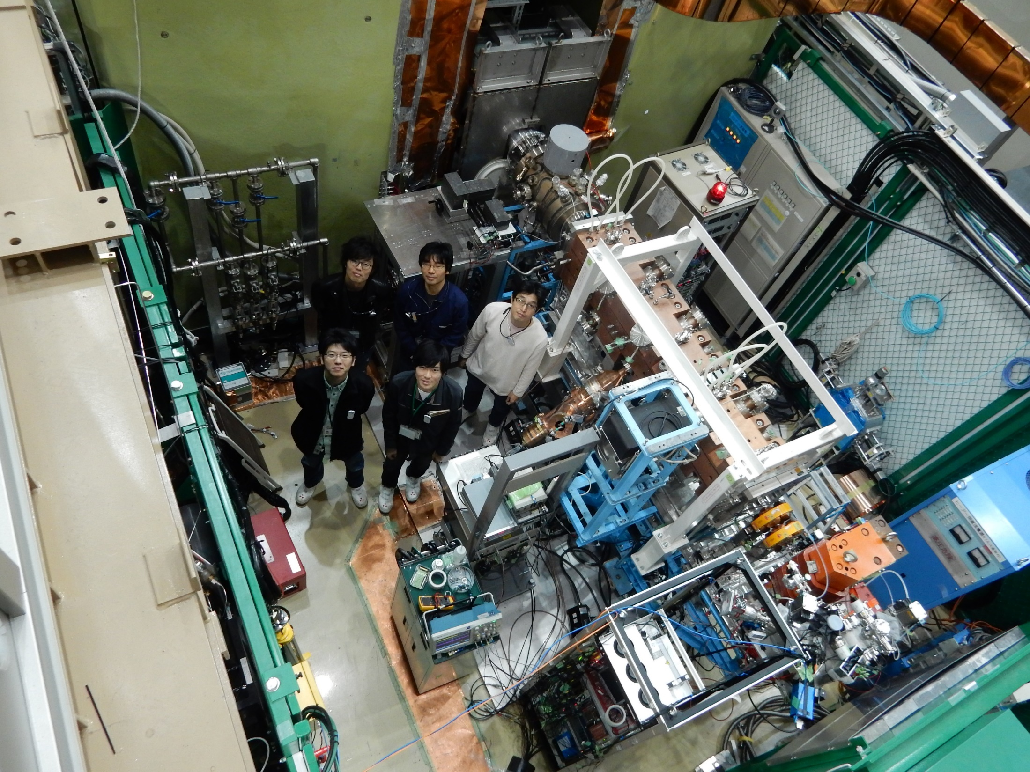
Acceleration test (Oct. 24th – 30th ,2017)
μ⁺ (~3MeV)
Mu⁻ production
5.6 keV
RFQ
90 keV
Diagnostic beamline
MCP
18

Slide 19
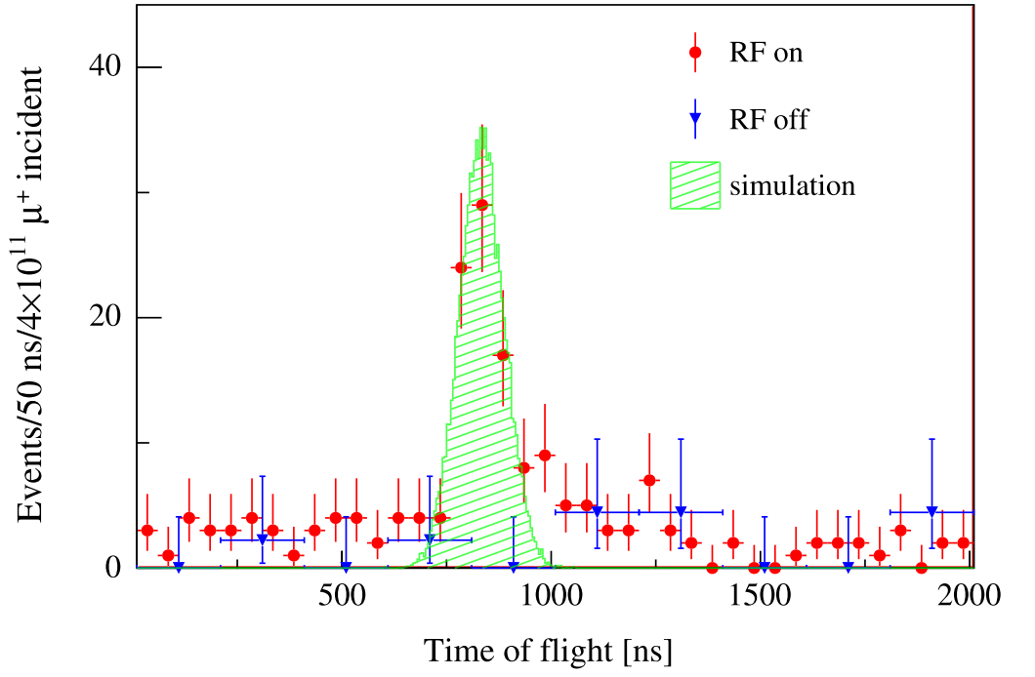
Result
World first muon acceleration [ S. Bae et al., Phys. Rev. AB 21, 050101, 2018. ]

Slide 20
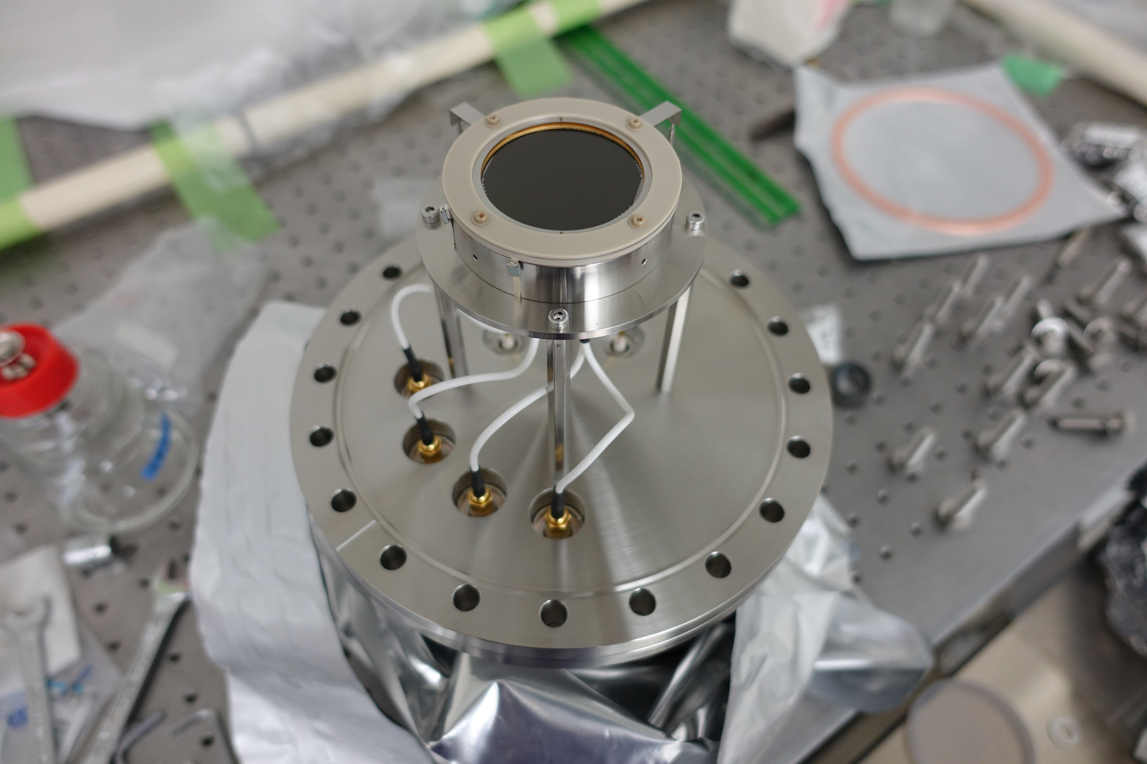
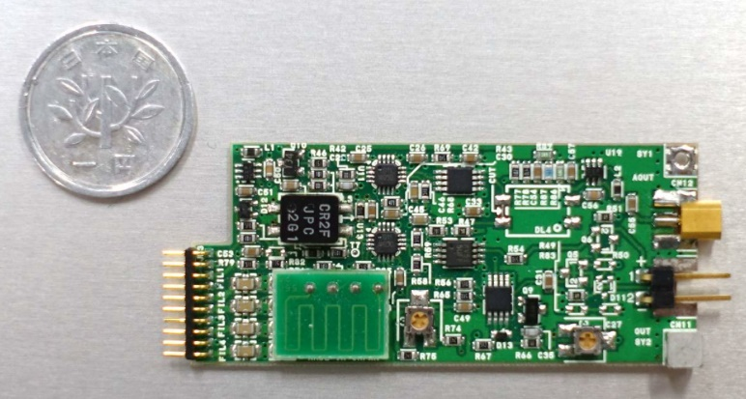
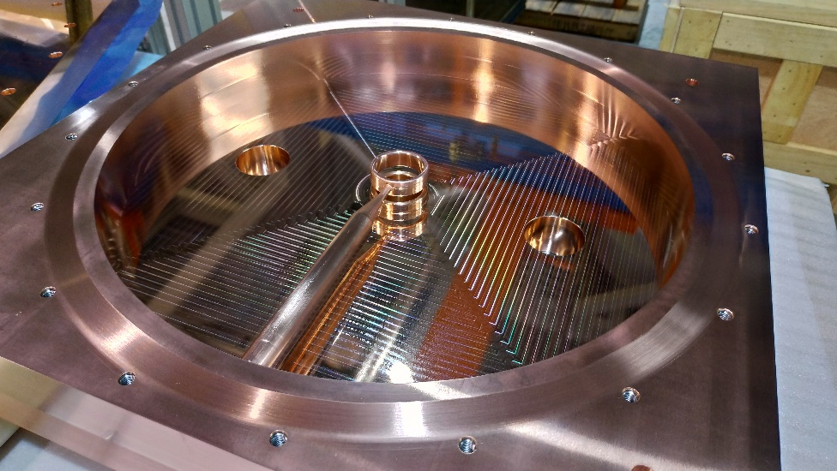
Acceleration this year (Nov. 2nd – 8th)
Muon bunch measurement with buncher and new detectors
20

Slide 21
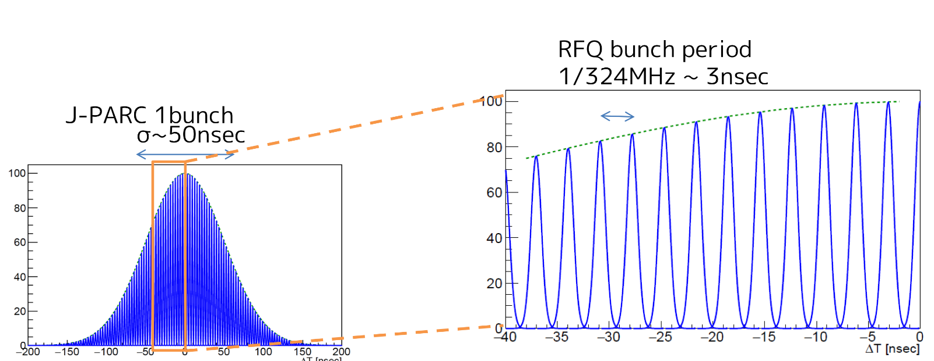
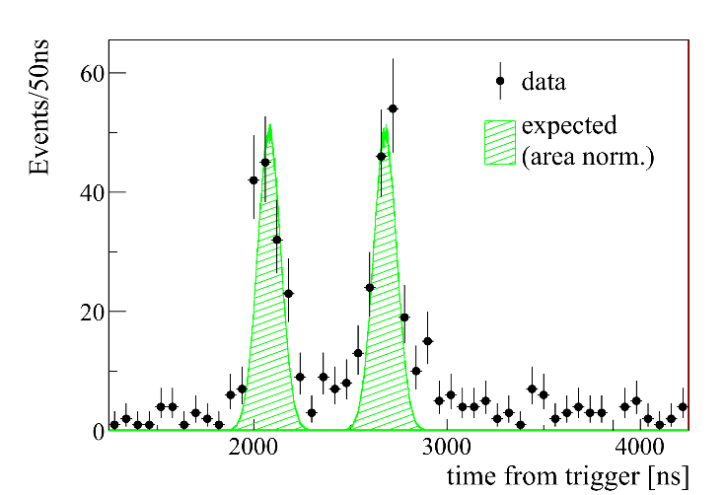
Some plots
Expected
Data in Nov.
Will be released by Y. Sue (Nagoya Univ.) soon.
Stay tuned!
By Y. Sue (Nagoya Univ.)
Notes:
カプラ、セラミックにTiNコーティング、初めはでる

Slide 22
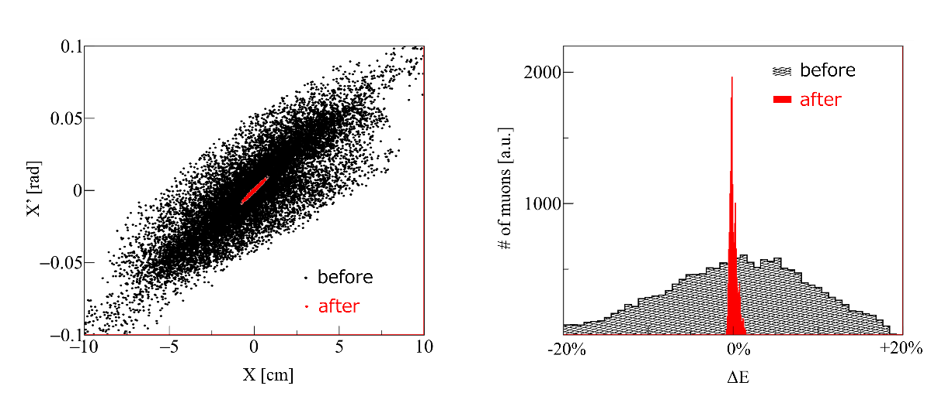
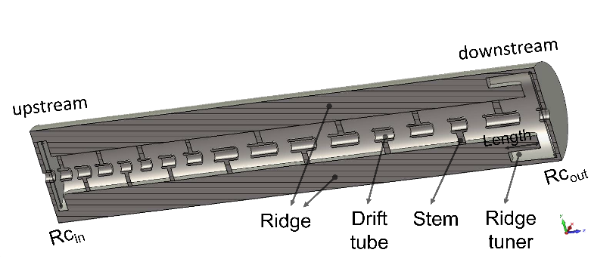
Prospect
Acceleration with RFQ and IH @ H-line
MuSEUM DeeMe
Mu⁻ generation
OK
μ
RFQ
OK
μ⁺ (~4 MeV)
IH-DTL
design
g-2
~4 MeV
MuSEUM DeeMe
Detector
OK
M. Otani et al., Phys. Rev. AB, 19, 040101, 2016.

Slide 23
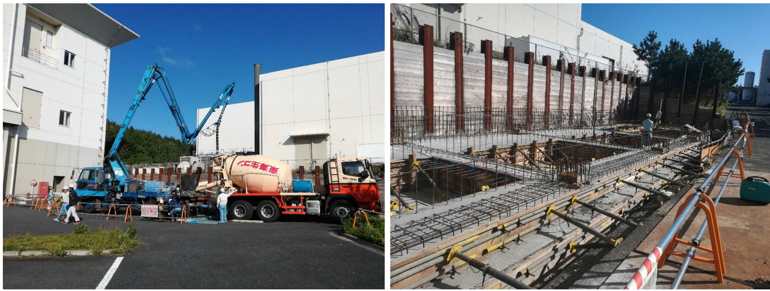
H-line Status
Beamline components are almost ready.
Electric sub-station is being constructed.
Will be ready in the end of next fiscal year.

Slide 24
Summary
Basic design of the muon linac completed.
We succeeded in accelerating muon using rf accelerator for the first.
H-line is getting ready for accelerating more muons.
This work was supported by JSPS KAKENHI Grant Numbers JP15H03666, JP16H03987, JP18H03707.

