Slide 1
Search for ⁶_{Λ}H hypernucleus by the (π⁻,K⁺) reaction at p_{π}-=1.2GeV/c
Hitoshi Sugimura (Kyoto University)
H. Sugimura et al, Phys. Lett. B 729 (2014) 39.

Slide 2
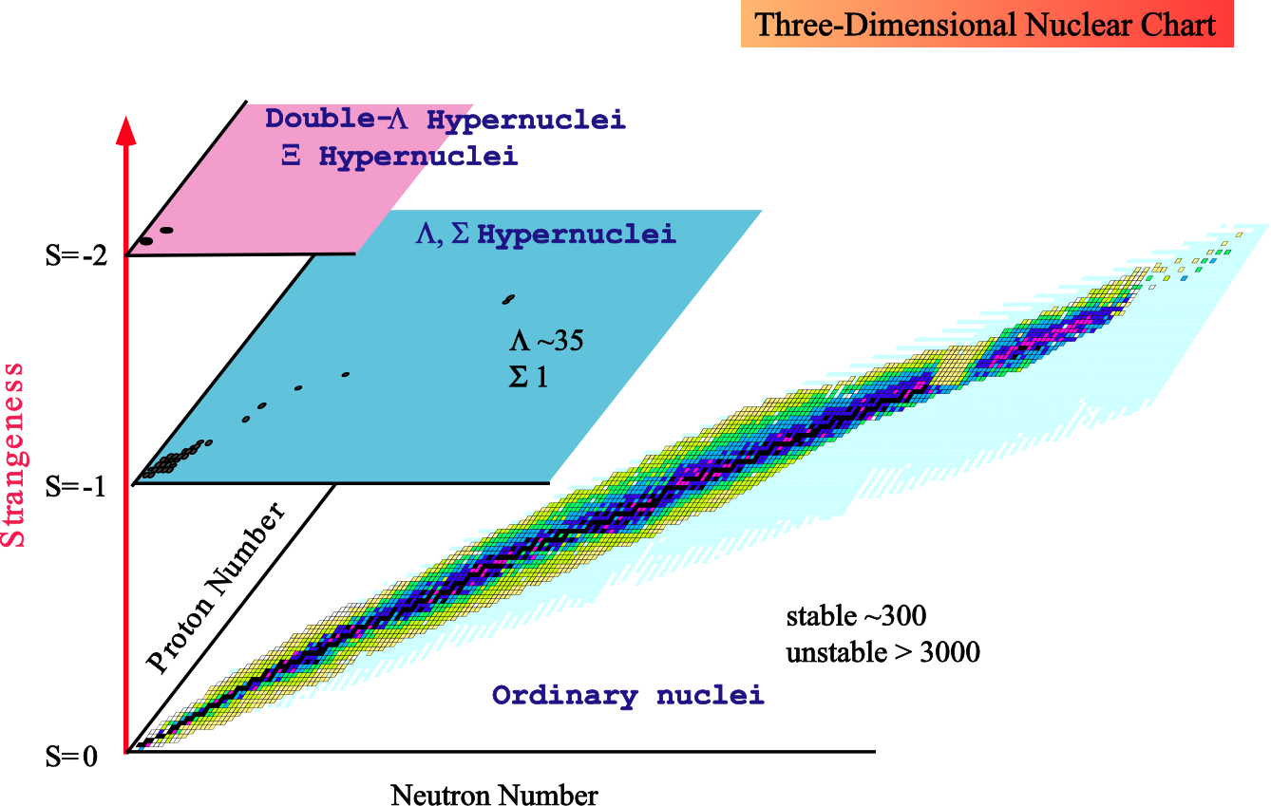
Nuclear chart with “strangeness”
Large area un-explored!
Glue-like role of Λ hypernuclei
Expand hypernuclear chart by using new spectroscopic tools
2

Slide 3
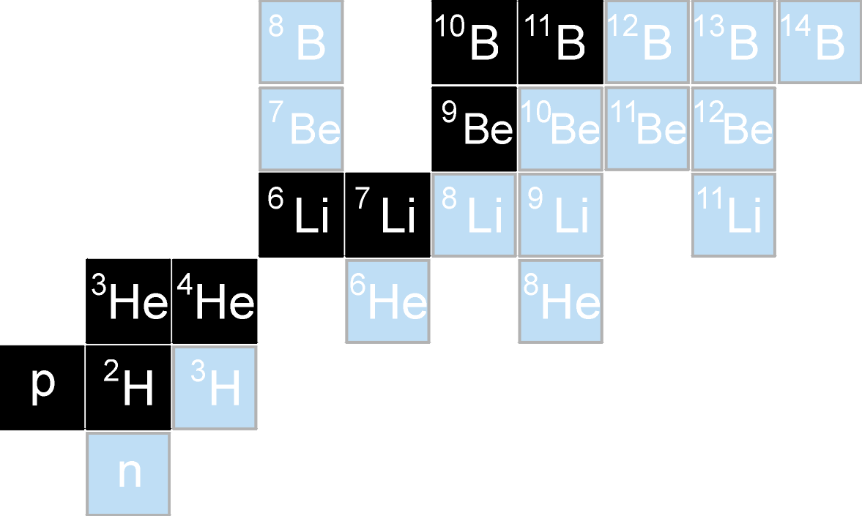
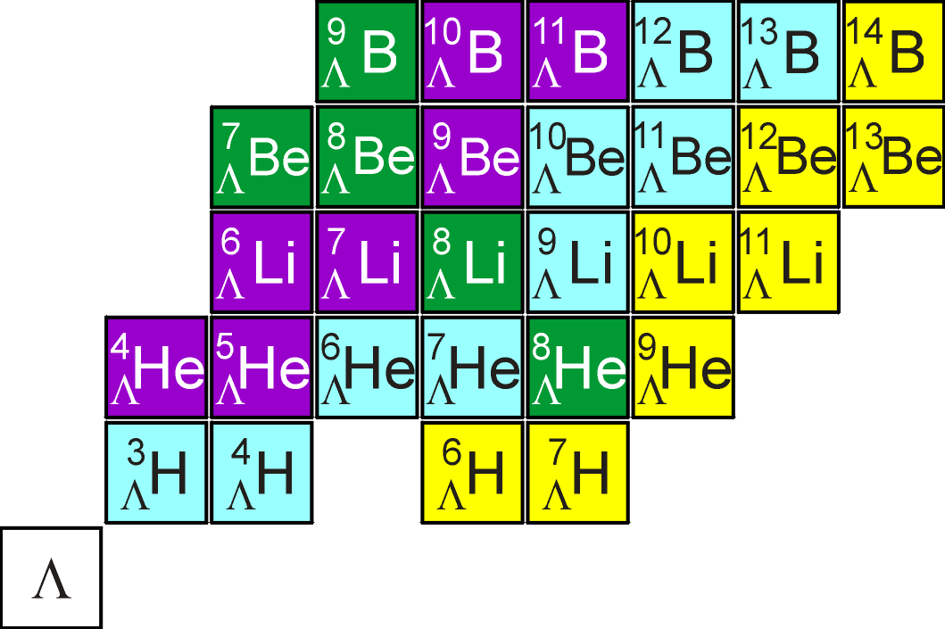
Production reactions
Missing-mass spectroscopy
Non-CX reactions (NCX)
(K⁻,π⁻), (π⁺,K⁺)
Single CX reactions (SCX)
(e,e’K⁺)
thin target available
(K⁻,π⁰), (π⁻,K_{S})
new spectrometer
Double CX reactions (DCX)
(π⁻,K⁺), (K⁻,π⁺)
access neutron-rich hypernuclei
L. Majling NP A585 (1995) 211c
possible with existing setup
very low cross section !
roughly 1/1000 of NCX
SCX
DCX
J-PARC E10

Slide 4
Interests of ⁶_{Λ}H
By the glue-like effect of Λ, would ⁶_{Λ}H be bound from resonance state of core nucleus (⁵H)?
Very large isospin(p=1,n=4,Λ=1)
Possible to approach to the neutron star
ΛN-ΣN coupling effect
DCX mechanism
n
p
n
n
n
p
Λ
n
n
n
n
⁵H
⁶_{Λ}H
Unstable
Stable?

Slide 5
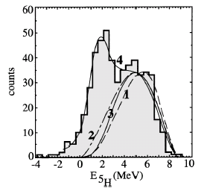
Super Heavy Hydrogen ⁵H (1)
Resonance state in ⁵H system
Missing-mass spectroscopy at Dubna
p(⁶He,pp)tnn (tnn=⁵H)
PRL 87 (2001) 092501.
³H(t,p)⁵H
PLB 566 (2003) 70.
²H(⁶He,³He)⁵H
NPA 719 (2003) 229c.
Resonant state of 1.7±0.3 MeV
Width of 1.9±0.4 MeV
p(⁶He,pp)X

Slide 6
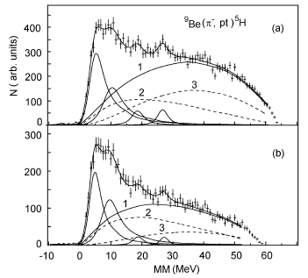
Super Heavy Hydrogen ⁵H (2)
Other studies at GSI and LAMPF
p(⁶He,²He)⁵H
NPA 723 (2003) 13.
⁹Be(p⁻,pt)⁵H & ⁹Be(p⁻,dd)⁵H
EPJ A24 (2005) 231.
⁶_{Λ}H structure ↔ ⁵H structure
Feedback to structure of normal neutron-rich nuclei
Four broad resonance states were observed.
Er = 5.5±0.2 MeV
Γ = 5.4±0.6 MeV

Slide 7
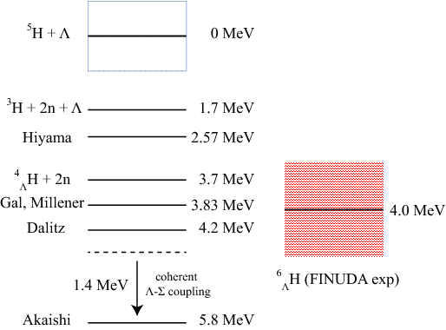
Theoretical calculations
E.Hiyama et al., NPA 908(2013)29.
R.H.Dalitz et al., Nuovo Ciment 30(1963)489.
Y. Akaishi et al., PRL 84(2000)3539.
E. Hiyama
4-body calculation of tnnΛ
R. H. Dalitz, Gal and Millener
ΛN interaction
Y. Akaishi
Coherent ΛNN interaction
There are several different calculation methods.
To confirm experimental mass value precisely,
we need to measure more ⁶_{Λ}H events.

Slide 8
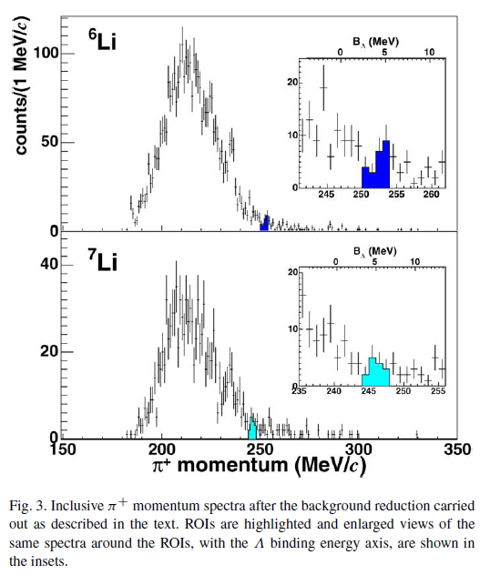
Studies of Neutron-rich Hypernuclei
DAΦNE (FINUDA)
M. Agnello et al. PLB640 (2006) 145
(stopped K⁻,π⁺) reaction
(K⁻ abs.)-π⁺ vertex cut
reject in-flight Σ⁺ decay
Production upper limit
π⁺
π⁺
π⁻
production
Σ⁺
Acceptance Cut?
K⁻
K⁻
Signal
Background
⁶_{Λ}Li: < 2.5x10⁻⁵ /(stopped K⁻)
⁷_{Λ}Li: < 4.5x10⁻⁵ /(stopped K⁻)

Slide 9
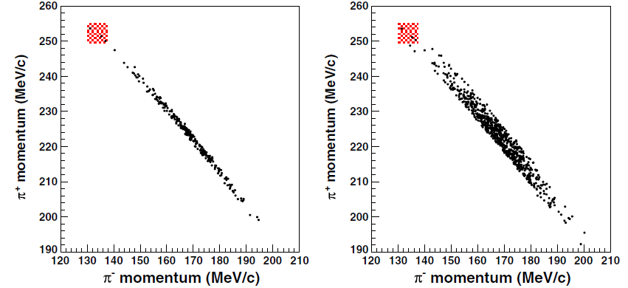
Studies of Neutron-rich Hypernuclei (3)
DAΦNE (FINUDA)
M. Agnello et al. PRL 108 (2012) 042501.
⁶Li(stopped K⁻,π⁺) reaction
measure also weak decay
cut on T(π⁺)+T(π⁻)
3 events of candidates
2.9±2.0×10⁻⁶/(stopped K⁻)

Slide 10
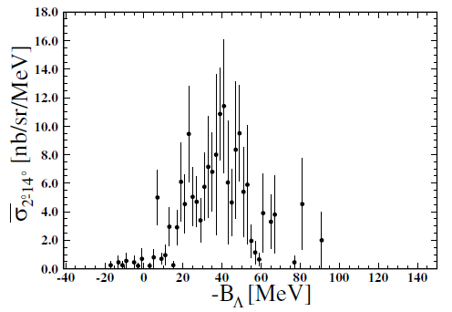
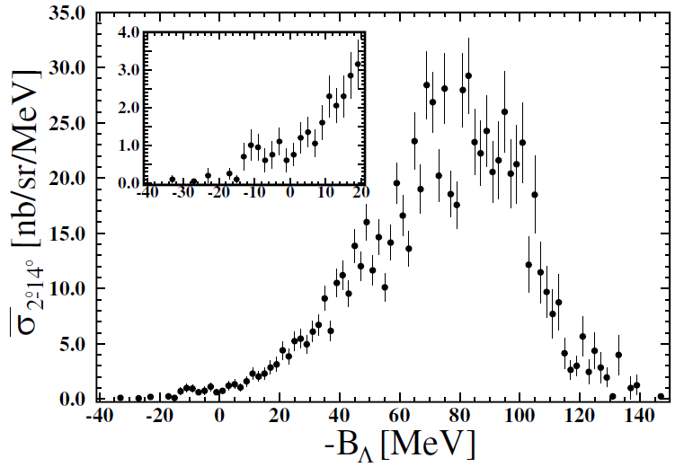
Studies of neutron-rich Hypernuclei
¹⁰B(π⁻,K⁺)¹⁰_{Λ}Li reaction at KEK
P.K.Saha et al. PRL 94 (2005) 052501.
Pion beam momentum
1.2 GeV/c → 11.3 nb/sr
1.05 GeV/c → 5.8 nb/sr
47 events in Λ bound region
1.05GeV/c
1.2GeV/c

Slide 11
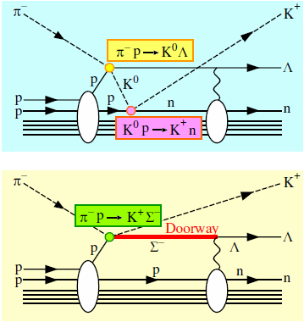
(π⁻,K⁺) Reaction Mechanism
two-step reaction
One-step reaction
pion beam momentum |  | 1.05 GeV/c | 1.2 GeV/c
Theory | Harada et al. | ~1.6 nb/sr | ~1.2 nb/sr
I=0
I=1
Λ
Σ
pion beam momentum |  | 1.05 GeV/c | 1.2 GeV/c
Theory | Harada et al. | 2.4 nb/sr | 5.4 nb/sr
I_{A}≠0
I_{A}≠0
It is important to study ΛN-ΣN mixing for DCX reaction

Slide 12
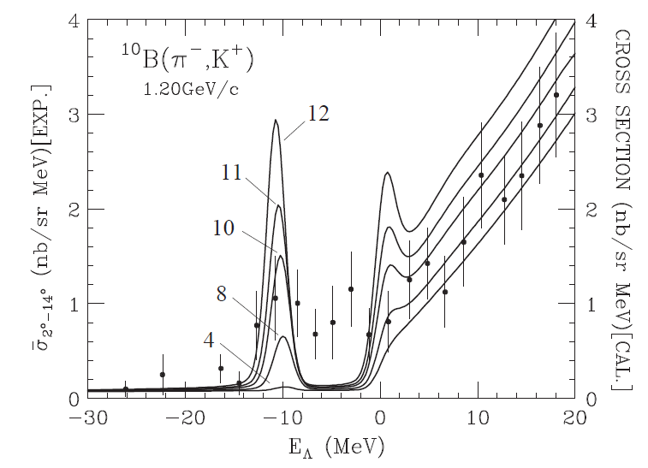
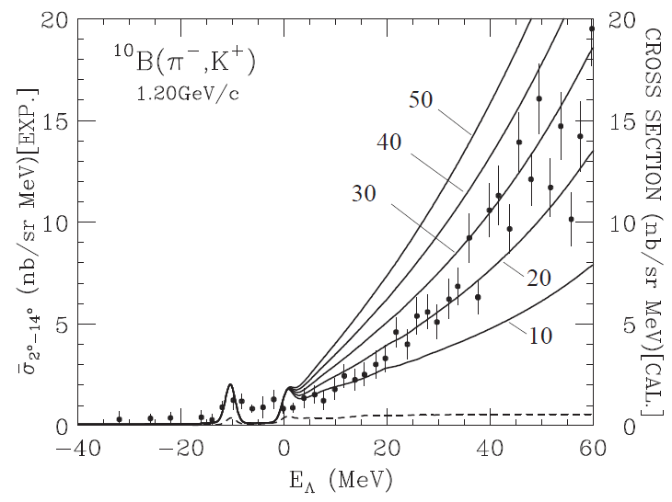
One Step DCX Mechanism
ΛN-ΣN coupled channel calculation by Harada et al.
Spectrum is sensitive to mixing interaction V_{ΛΣ} and Σ-N interaction W_{Σ}
Bound region → V_{LS}
Continuum region → W_{Σ}
W_{Σ}
V_{ΛΣ}
More yield is necessary to make detailed discussions

Slide 13
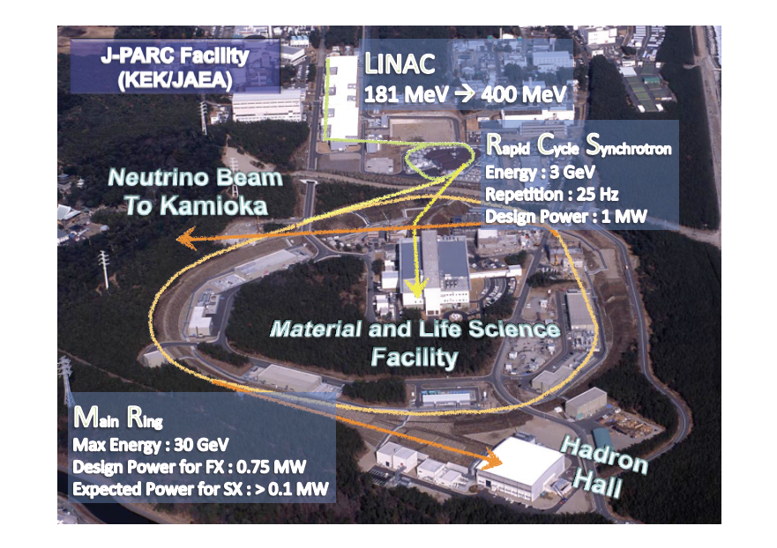
J-PARC E10 experiment
Production of ⁶_{Λ}H hypernucleus

Slide 14
Aim of Experiment
Production of neutron-rich hypernuclei
higher statistics than previous experiments
Information of effect of ΛN-ΣN mixing in neutron-rich hypernuclei
precise measurement of binding energies
Method
Missing-mass spectroscopy by (π⁻,K⁺) reaction
method has been established at KEK-PS E521

Slide 15
Yield estimation
Parameters | Values
Pion beam momentum Pion beam intensity Total number of pions (6 s acc. cycle) Target thickness (⁶Li) DCX cross section (assumed) SKS acceptance Spectrometer efficiency (due to K decay) Analysis efficiency | 1.2 GeV/c 10M/spill 3x10¹²pion 3.5 g/cm² 10 nb/sr 100 msr 0.5 0.5
Estimated ⁶_{Λ}H yield in 3 weeks | 265

Slide 16
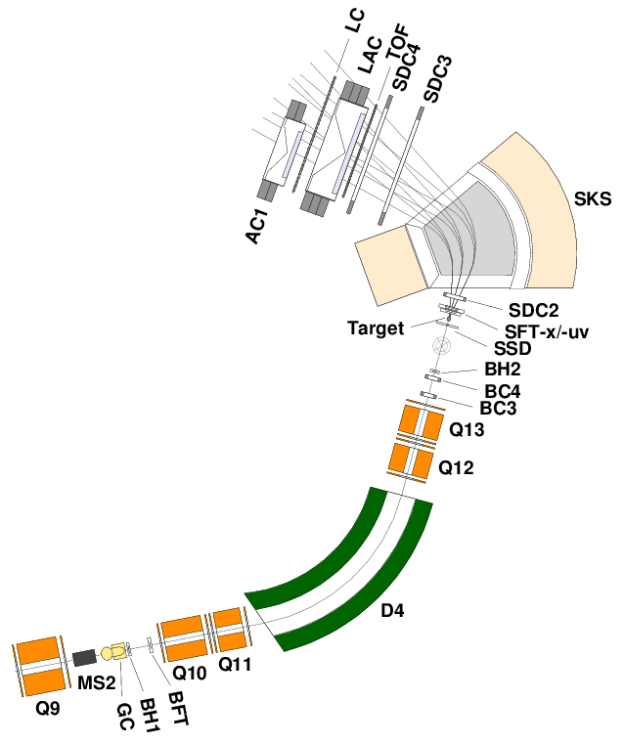
Experimental Setup
K1.8 Beam Analyzer
-1.2GeV/c π⁻ Beam
Δp/p ~3.3×10⁻⁴
SKS Spectrometer
0.9GeV/c scattered K⁻
Δp/p~1.0×10⁻³
dΩ = 120 msr
Target
⁶Li (95.54% enriched)
C and (CH2)_{n}

Slide 17
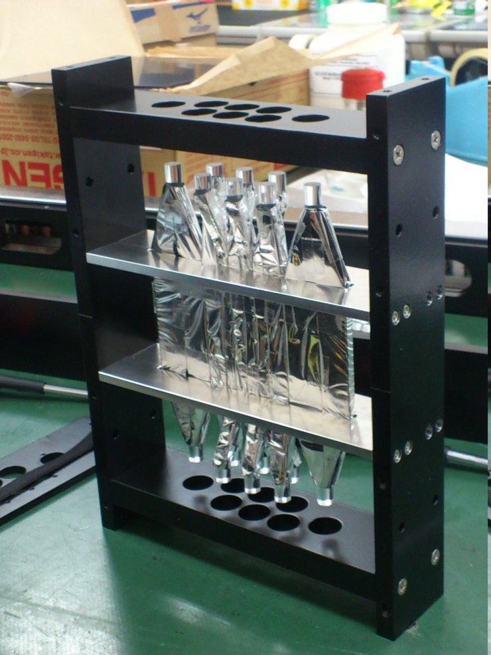
Beam Hodoscope (BH2)
Identify the triggered beam particles.
Horizontal width was adjusted for single counting rate to be uniform
Time resolution : ～90 ps (rms)
Top view
35
10
7
7
7
7
10
35
beam
horizontal

Slide 18
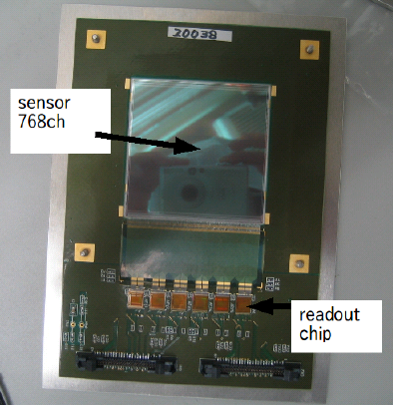
Silicon Strip Detectors (SSD)
80μm-pictch, 768-strips
Effective area : 61^{H}×61^{W}mm
Thickness : 300μm
Time resolution : ~4ns
Position resolution : 20μm
APVDAQ readout system
Zero suppression
Double buffer
High speed readout

Slide 19
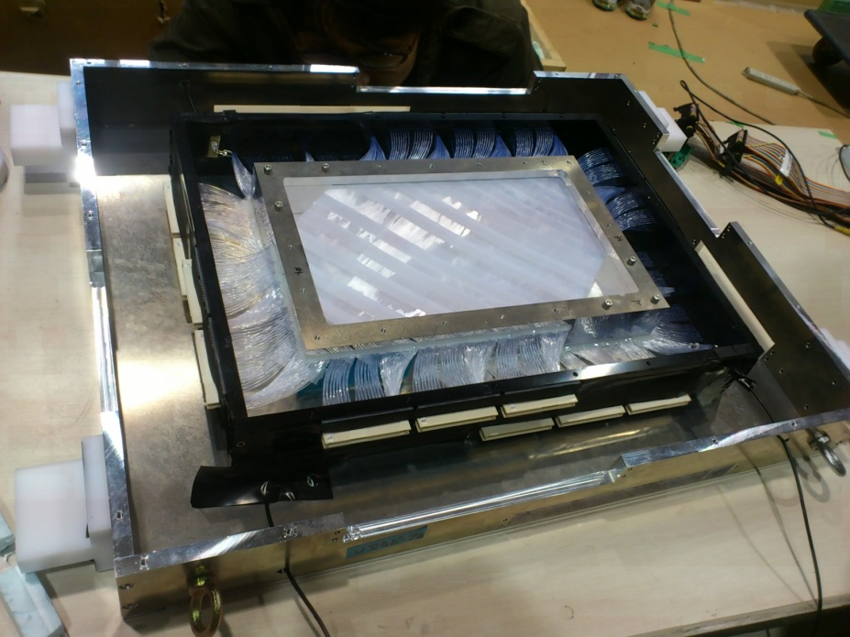
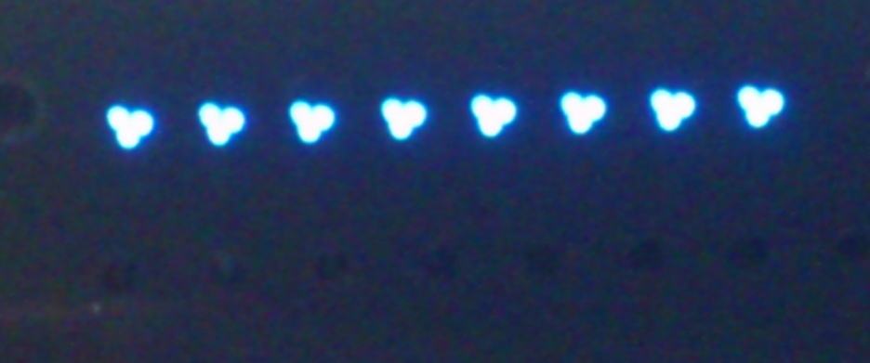
Fiber Tracker (SFT)
xx’uv structure
Diameter :
φ0.5mm(u,v),φ1.0mm(xx’)
3 fibers are read by the same MPPC.
EASIROC readout system
Amp, descri – controlled by SiTCP connection
Multi-hit TDC with an accuracy of 1 ns.
End face

Slide 20
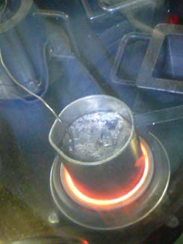
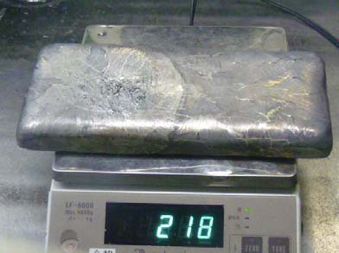
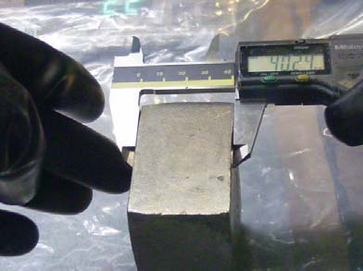
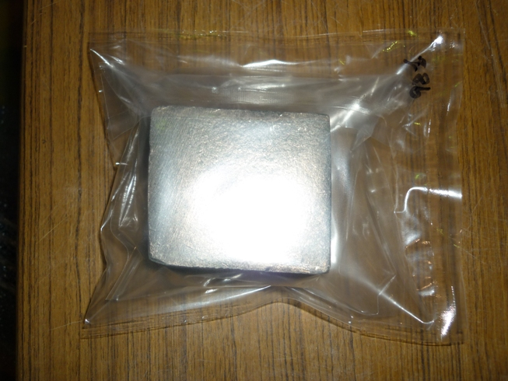
⁶Li target preparation
melting ⁶Li
⁶Li target was newly made
3.5 g/cm² in thickness (95.54% enriched)
melted to separate ⁶Li metal
shaped to fit beam profile
sealed with dry Ar gas
⁶Li metal ingot
shaping
sealing

Slide 21
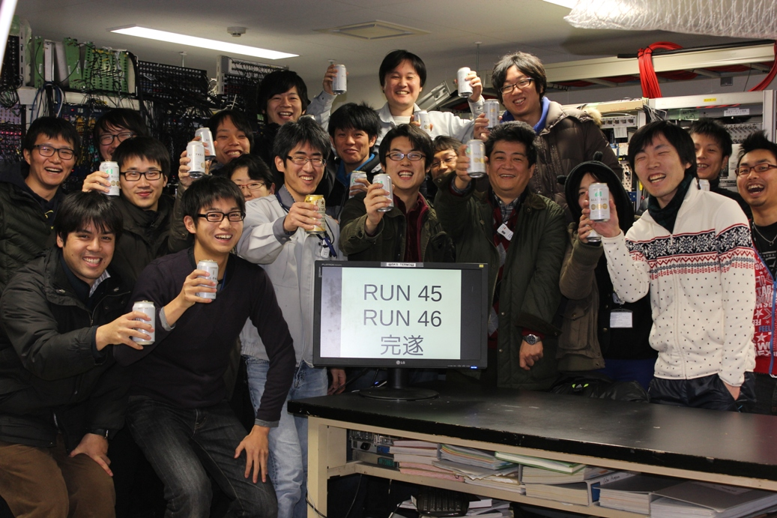
Beam time in Dec. and Jan.
Beam time allocated for E10
15-27 Dec 2012 and 8-16 Jan 2013

Slide 22
Run conditions of E10
reaction | Momentum | Intensity (pions/spill) | time
Production Run -> Total number of pions reached to 2.1x10¹²
⁶Li(π⁻,K⁺)⁶_{Λ}H | -1.2 GeV/c | 1.2-1.4×10⁷ | 11.5 days
Calibration Run – To confirm the performance of SKS system, calibrate the absolute mass value and measure magnet polarity change effect
p(π⁻,K⁺)Σ⁻ | -1.37 GeV/c | 1.3×10⁷ | 4 hours
p(π⁺,K⁺)Σ⁺ | +1.37 GeV/c | 3.5×10⁶ | 1 hour
¹²C(π⁺,K⁺)¹²_{Λ}C | +1.2 GeV/c | 4.1×10⁶ | 1 day
Beam Through Run – To measure target energy loss and its straggling, and momentum offset between beam and SKS
 | +1.2,+1.0,+0.9, +0.8GeV/c |  | 2 hours
Production run
-1.2GeV/c ⁶Li(π⁻,K⁺)⁶_{Λ}H run -11.5days(10,12Mpions/spill)
Integrated pion beam reached to 1.65x10¹² pions
Calibration run
-1.37GeV/c p(π⁻,K⁺)Σ⁻ run - 4hours(10Mpions/spill)
+1.37GeV/c p(π⁺,K⁺)Σ⁺ run - 1hour (3.5Mpions/spill)
+1.2GeV/c ¹²C(π⁺,K⁺)¹²_{Λ}C run - 1day (3.5Mpions/spill)
Beam through run
+1.2,+1.0,+0.9,+0.8GeV/c (w/ and w/o target)

Slide 23
analysis

Slide 24
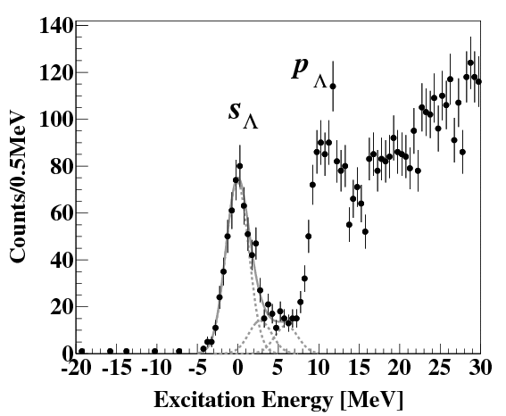
Missing-mass spectrum of ¹²_{Λ}C(π⁺,K⁺)¹²_{Λ}C reaction
The peak structures (p_{Λ,} s_{Λ}) were clearly observed.
Fitted with three Gaussian function
0, 2.833, 6.050 MeV
Missing-mass resolution
3.2MeV (FWHM)

Slide 25
Missing-mass spectra of p(π±,K⁺)Σ± reactions
Check the SKS spectrometer performance
Calibrate the mass value.
Mass resolution is 2.5 MeV

Slide 26
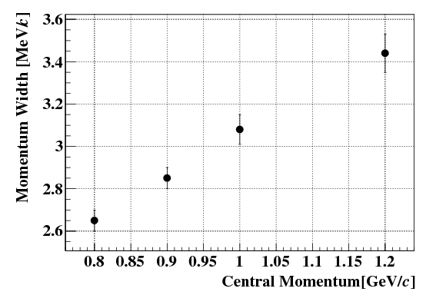
Momentum Resolution
Measured momentum difference (pK1.8-pSKS) from Beam through runs
Momentum width of Δp, sqrt(σ²_{psks}+σ²_{pK1.8}), increases with momentum
Reasonable tendency
p/dp~3×10^{－3}

Slide 27
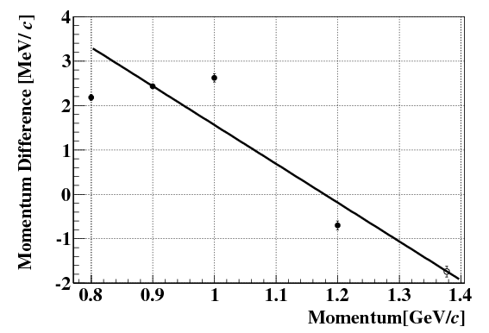
Momentum calibration
 | Beam momentum | Scattered momentum
Beam Through | +0.8 | +0.8
 | +0.9 | +0.9
 | +1.0 | +1.0
 | +1.2 | +1.2
Σ⁺ | +1.37 | +0.9
Σ⁻ | -1.37 | +0.9
⁶_{Λ}H | -1.2 | +0.9
SKS magnetic field is same of
all calibration runs
Correct momentum difference
Correct 1st polynomial
function
Same momentum
-> Fix
Correct momentum difference
from obtained mass
Polarity effect

Slide 28
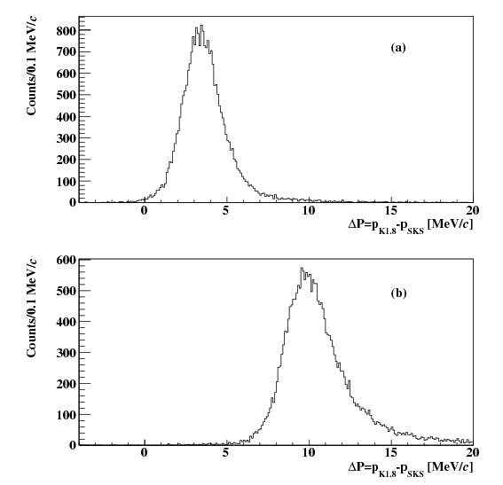
Energy Loss effect
Checked by using beam through run with and without ⁶Li target.
Energy loss is consistent with Bethe Bloch formula within 0.1MeV.
6.47±0.18MeV

Slide 29
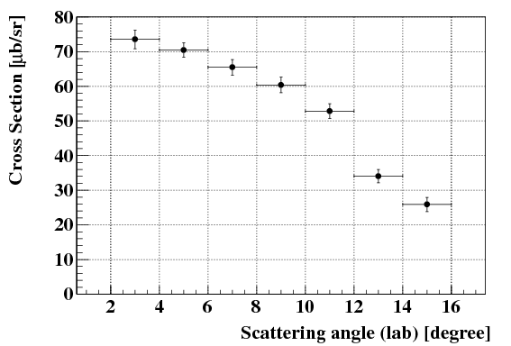
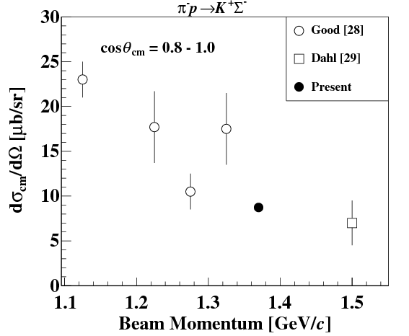
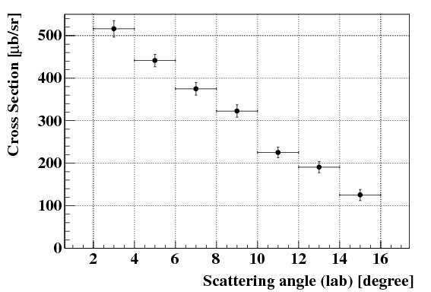
Cross Section of Σ±
Good et al.,
Phys. Rev. 183 (1969) 1142.
Dahl et al.,
Phys. Rev. 163 (1967) 1430.
Candlin et al.,
Nucl. Phys. B 226 (1983) 1.

Slide 30
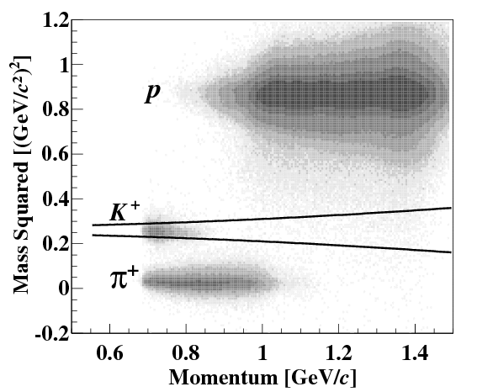
Particle identification - Mass Squared
M²=$\frac{p}{β}\sqrt{1−β^{2}}$
Applied momentum dependent cut
π
K
P
Mass Squared
Scattered kaon is selected less than 2σ of mass squared resolution.
The contamination of proton and pion are less than 1% level.

Slide 31
Results : Missing-mass spectrum
Select scattering angle from 2 deg to 14 deg <- No acceptance ambiguity
In the missing mass region around ⁴_{Λ}H+2n , no peak structure was observed.
If the production crosection is ~10nb/sr, the events should be measured more than 60 events.
Data is not favored FINUDA’s data.

Slide 32
Upper Limit estimation
Step-1 – count base upper limit
There was 3 events around the 5801.74 MeV with the missing mass window of 2 sigma (5.2 MeV) of mass resolution.
6.68 events 90% confidence level from Poisson statistics as a background less assumption.
Step-2 – cross section upper limit
0.18 nb/sr per 1 event in the case of flat the angular distribution.
Differential cross section was estimated to be 1.2 nb/sr.

Slide 33
Discussion
⁶Li(π⁻,K⁺) reaction populates 1⁺ state of ⁶_{Λ}H <- ⁶Li(1⁺) at forward angle
It needs spin-flip to generate 0⁺ state
In the case of Scenario-1,2, width of 1+ state is narrow (Gal and Millener). -> data is not seen any narrow peak structures.
In the case of scenario-3, wave function is broad. If state is exist, it would not be measured(Hiyama).

Slide 34
Summary
Performed the measurement of ⁶Li(π⁻,K⁺) reaction at p_{π-} = 1.2 GeV/c.
In the missing-mass spectrum of ⁶Li(π⁻,K⁺) reaction, no significant peak was observed.
An upper limit of production cross section was estimated to be 1.2 nb/sr.
It is indicated that 0+ and 1+ states are unbound if cross section is about 10 nb/sr.
Need reconsideration of ⁶_{Λ}H structure

Slide 35
Back up

Slide 36
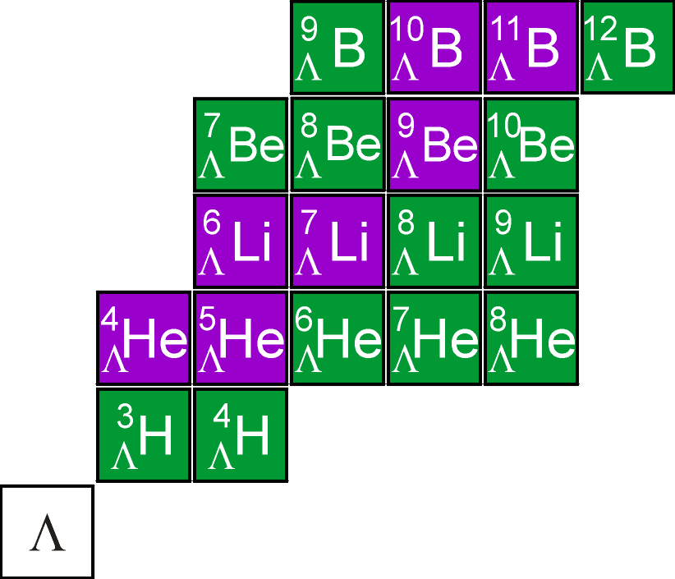
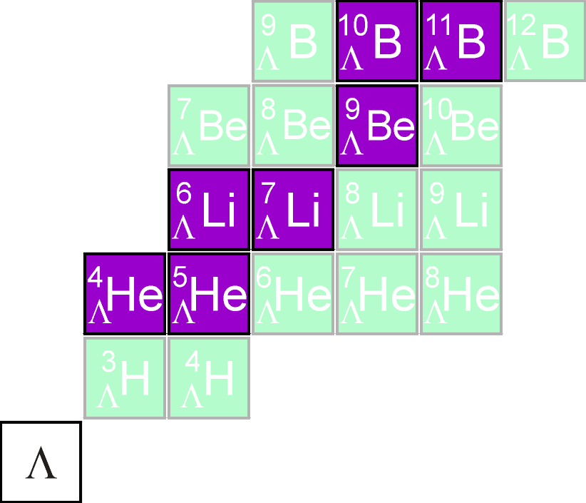
Production reactions(1)
Emulsion experiment
K⁻ beams stopped in target
Produce “hyperfragment”
Information of BE of g.s.
precise energy determination
but low statistics
Missing-mass spectroscopy
“identified” hypernuclei
K⁻ or π⁻ beams
Obtain level structure
high statistics
Mainly Non Charge-eXchange (NCX)
available targets restricted
NCX

Slide 37
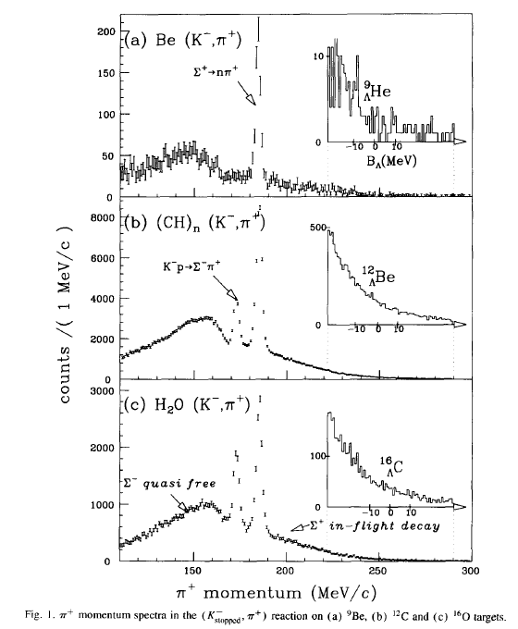
Studies of Neutron-rich Hypernuclei (1)
KEK-PS (SKY)
K. Kubota et al. NPA602 (1996) 327.
(stopped K⁻,π⁺) reaction
Production upper limit
⁹_{Λ}He: < 2.4x10⁻⁴ /(stopped K⁻)
¹²_{Λ}Be: < 6.1x10⁻⁵ /(stopped K⁻)
¹⁶_{Λ}C: < 6.2x10⁻⁵ /(stopped K⁻)
¹²_{Λ}C g.s.: 9.8±1.2 x10⁻⁴ /(stopped K⁻)
H. Tamura et al. PTPS 117 (1994) 1

Slide 38
ΛN-ΣN Mixing in Λ Hypernuclei
B.F. Gibson et al. PRC 6 (1998) 433c.
ordinary
nuclei
hypernuclei
if core isospin=0
ΔN
A(I=0)
A(I=0)
ΣN
Λ
Σ
77MeV
290MeV
ΛN
Small wave
function overlap
A*(I≠0)
Σ
if core isospin≠0
NN
S=0
S= -1
A(I≠0)
A(I≠0)
Λ
OK!
Σ
Important in neutron-rich Λ-hypernuclei (large isospin)

Slide 39
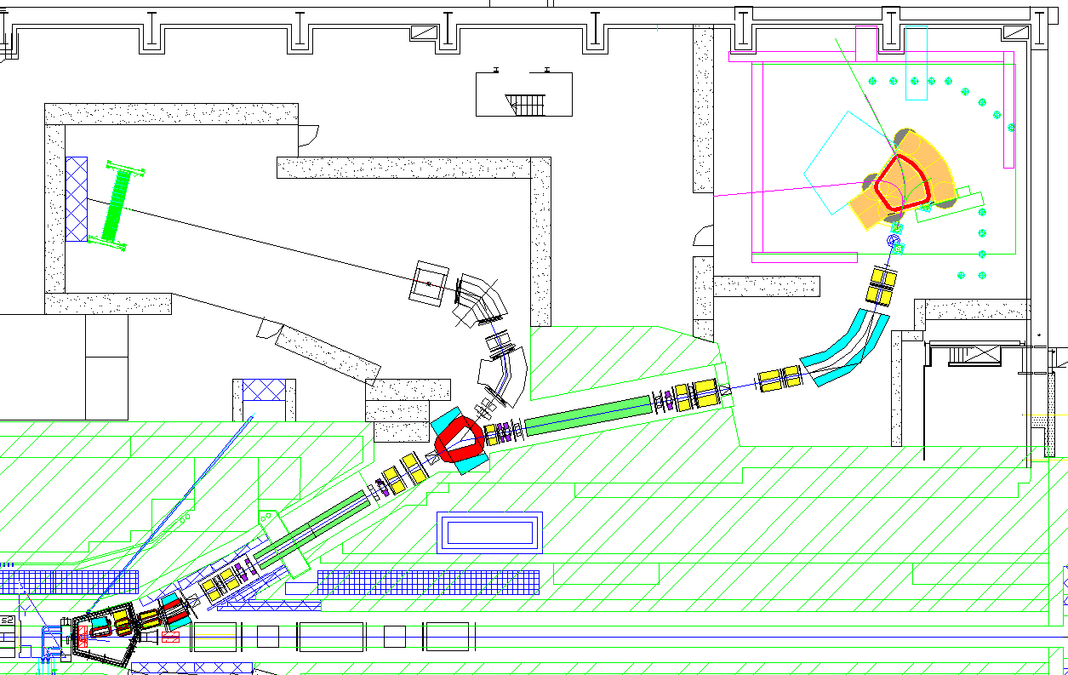
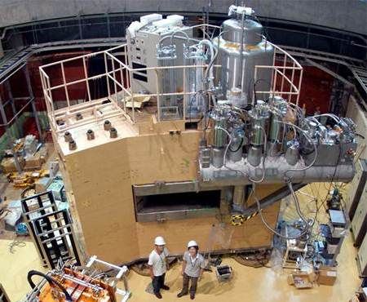
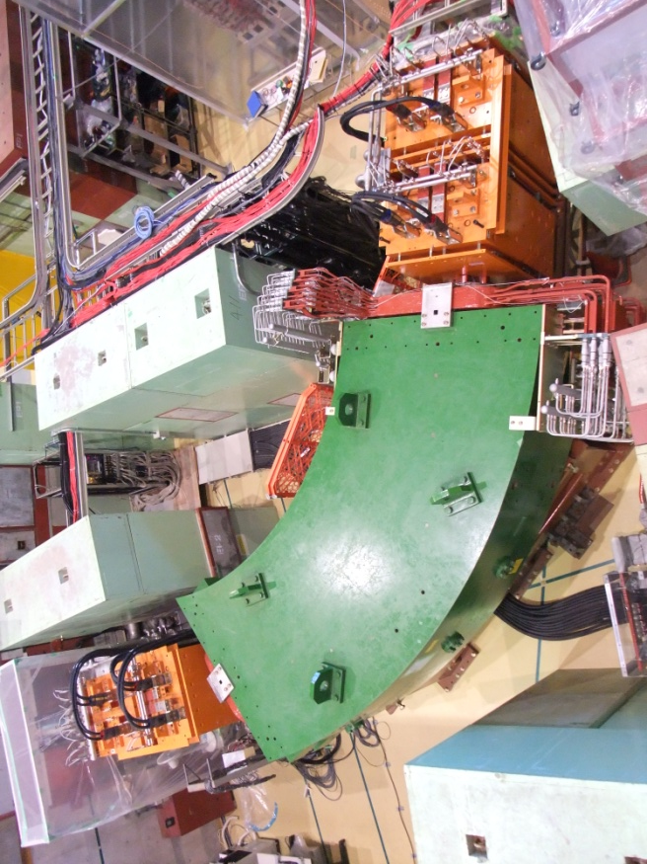
Experimental Setup
K1.8 beam line
1.2 GeV/c π⁻ beams
Good momentum resolution: Δp/p~3.3x10⁻⁴
Superconducting Kaon Spectrometer(SKS)
Good momentum resolution: Δp/p~1.0x10⁻³
Large acceptance : ΔΩ~100msr
SKS
D3
ESS2
D4
D4
D1,D2
ESS1
K1.8 beam line
SKS

Slide 40
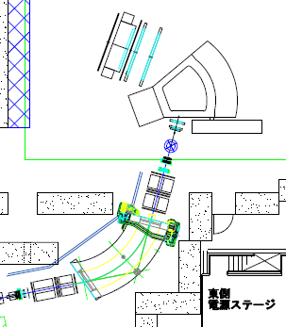
Experimental Setup
LC
SDC4
K1.8 Beamline
-1.2GeV/c π⁻ Beam
Δp/p ~3.3x10⁻⁴
Momentum is measured by the
Transfer Matrix
BFT(x)-BC3,4(x,y,x’,y’)
SKS Spectrometer
Central Momentum 0.9GeV/c
Δp/p~1.0x10⁻³
Momentum is calculated or estimated
Runge-Kutta method
SFT,SDC2(x,y,x’,y’)-SDC3,4(x,y,x’,y’)
Scattered Kaon identified TOFxLCxAC in
online trigger
SDC3
K⁺
SKS
AC
SDC2
TOF
BH2
SFT
BC4
SSD
BC3
GC
BFT
π⁻
BH1
J-PARC
K1.8 Beam Line

Slide 41
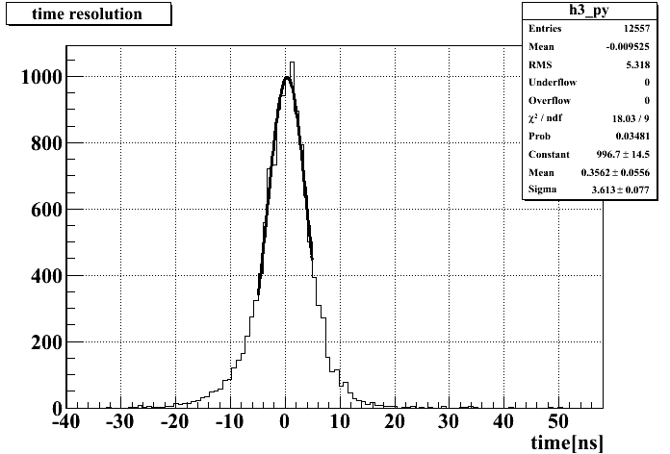
SSD design and performance
vertex SSD design
80μm pitch, 6cm×6cm×300μm
Read out: APV25 chip (128 strips/chip)
Accept 10⁵ Hz/strip
Typical K1.8 beam 5×10⁵ hits/mm/(10M beam)
2 s beam spill, duty factor 25% → work at 10M/spill beam
vertex SSD performance
Timing resolution: about 4ns
S/N ratio for MIP: about 20
Zero-suppression: data size → 2%
Developed by K. Tanida, R. Kiuchi, H. Asano , J. Cahng Woo and
H. Sugimura (SNU and Kyoto U.)
σ≈3.6ns (rms)
Time (ns)

Slide 42
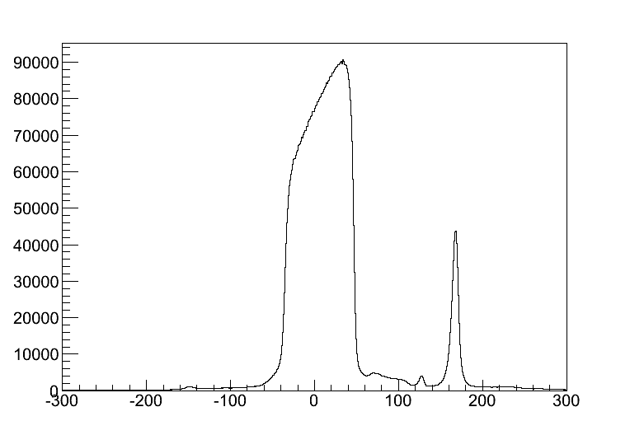
Vertex reconstruction
SSD(x,y)
Pitch:80μm
Thickness:300μmx2
SFT(xuv)
(x:1mmφ,uv0.5mmφ)
π⁻
K⁺
Li
77mm(3.5g/cm²)
Fiber Tracker(SFT)
Silicon strip detector(SSD)
We used SFT instead of the Wire chamber
in order to handle with high beam intensity.
And used SSD to measure vertex position
Precisely.
SFT
Li
SSD
mm

