Slide 1
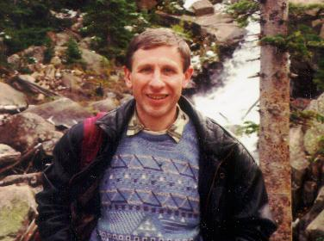
Welcome!
Muon g-2 theory initiative workshop in memoriam of Simon Eidelman
June 28 - July 2, 2021
Naohito SAITO
IPNS, KEK

Slide 2
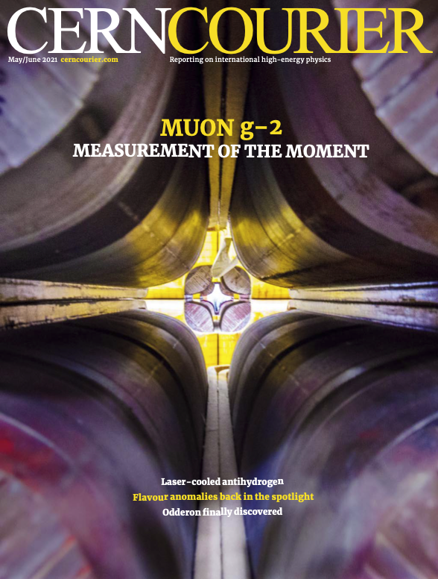
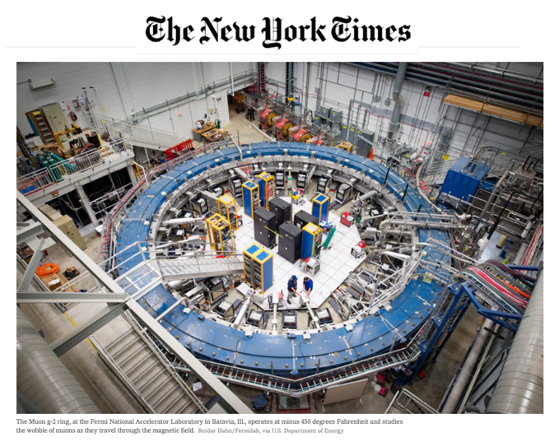
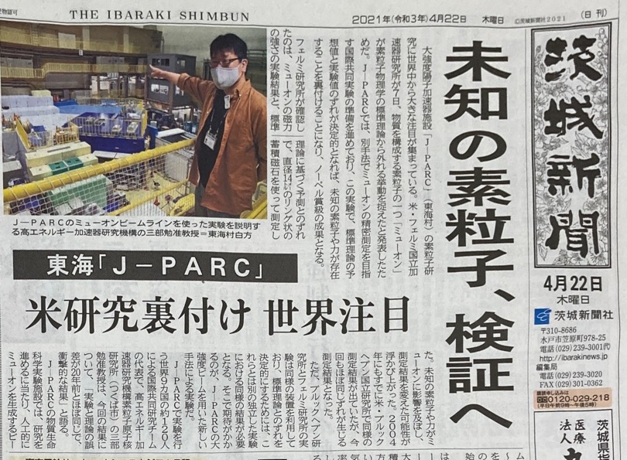
Muon g-2 on Media!

Slide 3
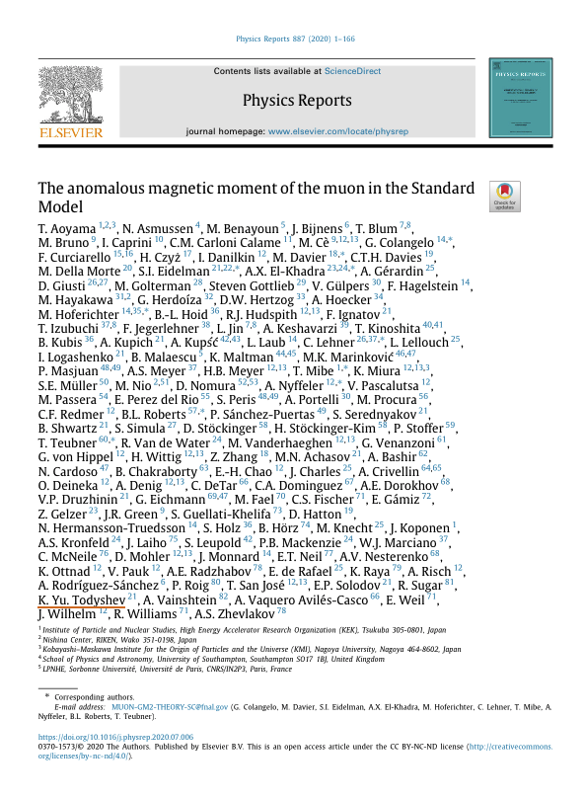
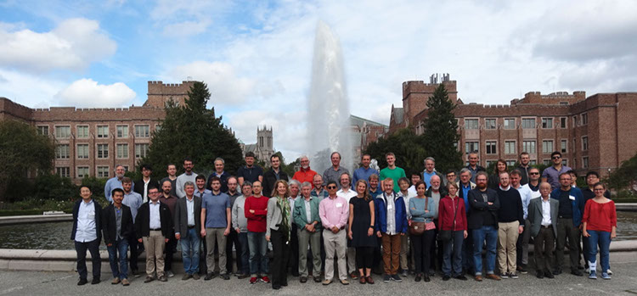
Another Great Achievement!
Congratulation for the very successful collaboration to build a solid basis of the best knowledge on particle physics!

Slide 5
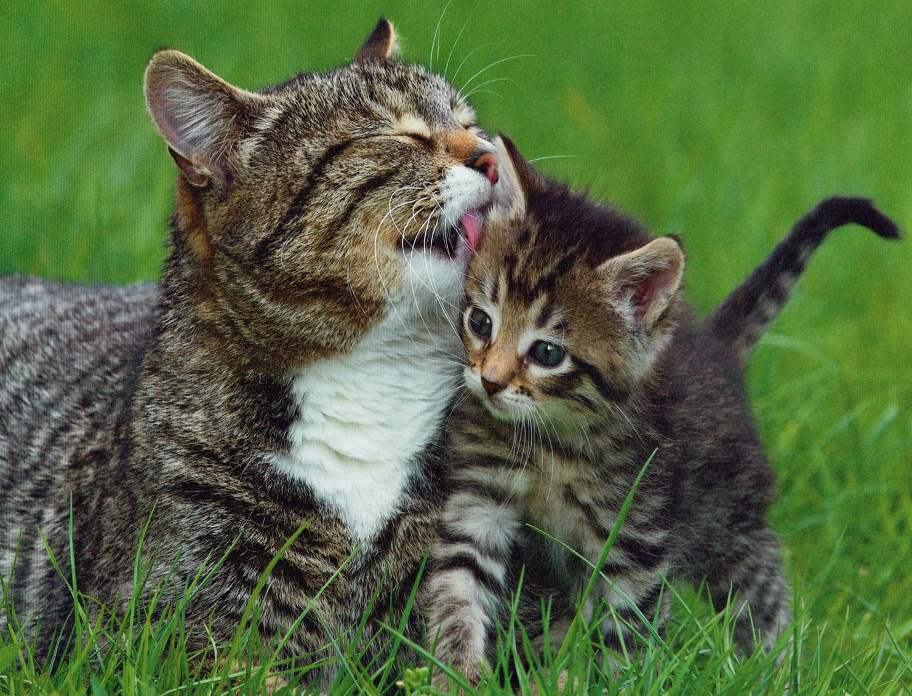
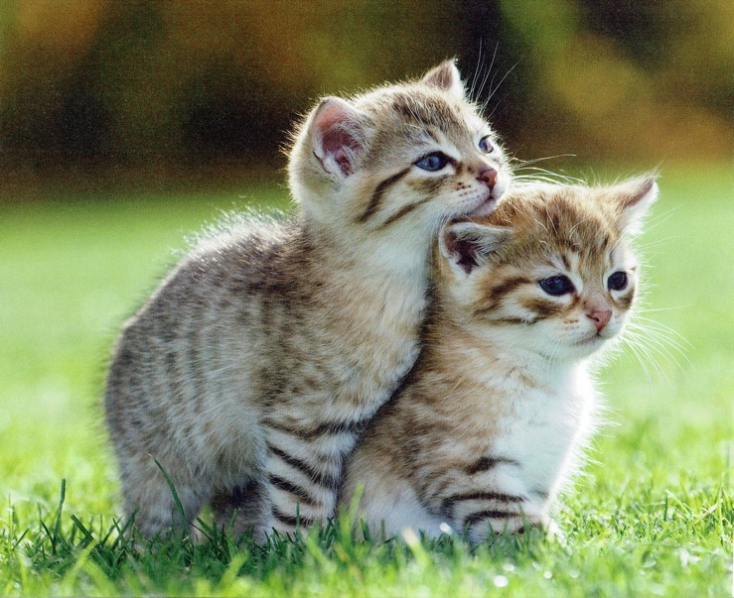
Hi-Energy Frontier
New phenomena may exist in the unprecedented energy region
→LHC and ILC
Cosmic Frontier
Precision measurements of CMB revealing the dawn of our universe → CMB
Hi-Intensity Frontier
Ultra-precision measurements may provide a hint for New Physics!
Hi-Density Frontier
Ultra-high density matter may provide a hint for the origin of diverse nuclear elements.
→ J-PARC Hadron and WNSC
→SuperKEKB/Belle II and
J-PARC experiments

Slide 6
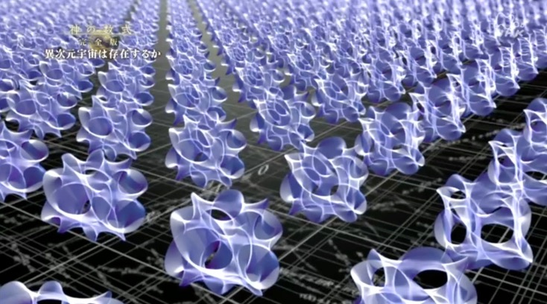
Why three generations?
What is the origin(s) of CP violation?
Why the mass of particles distributed this way?
Baryon number, lepton number, lepton flavors are conserved?
What is Dark-Matter, and Dark Energy?
How we should understand gravity?
Super-symmetry exists?
~100 heavier
Mysteries of Flavor Structure are
embedded in the Space-time?

Slide 7
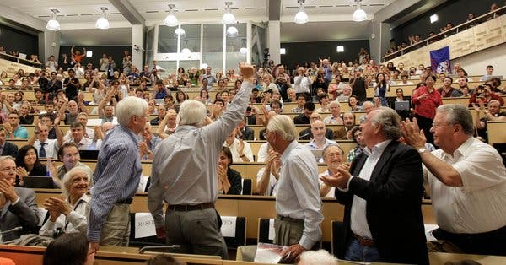
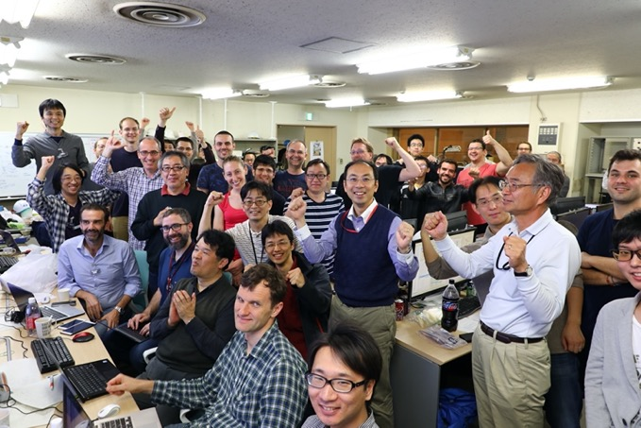
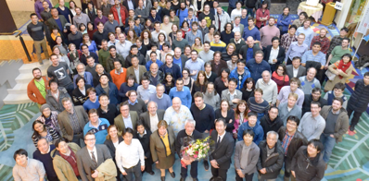
Let’s share more excitements! Power to the People

