Slide 1
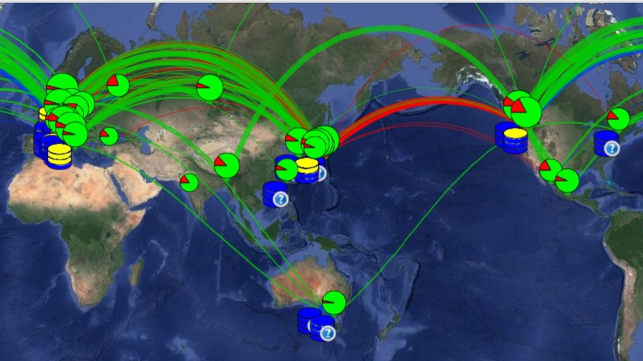
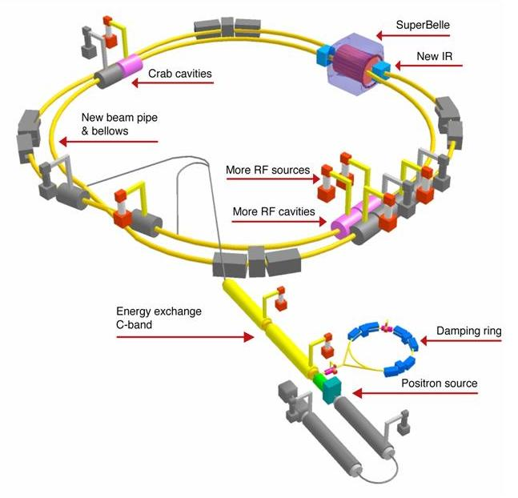
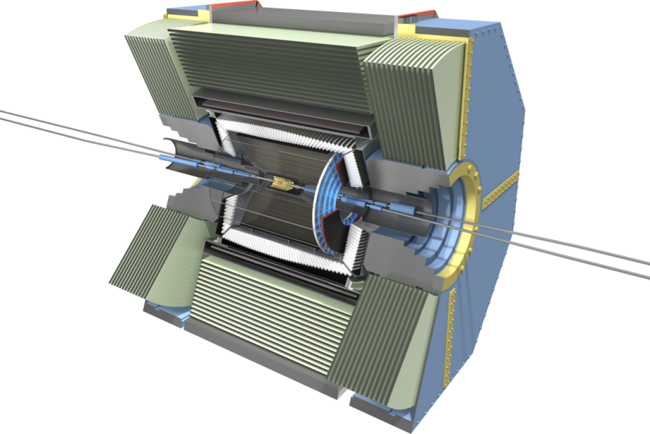
Overview of the Belle II computing
Y. Kato (KMI, Nagoya)

Slide 2
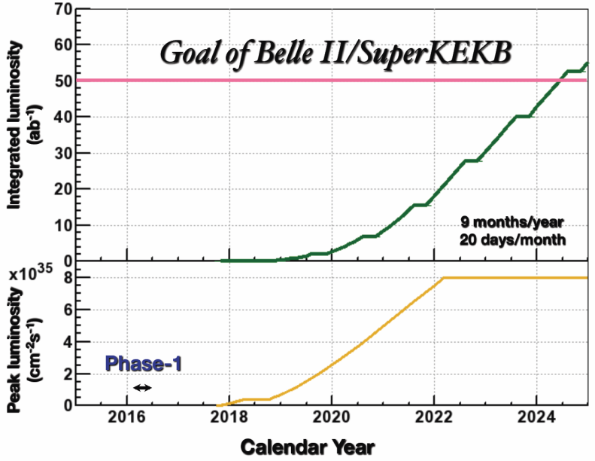
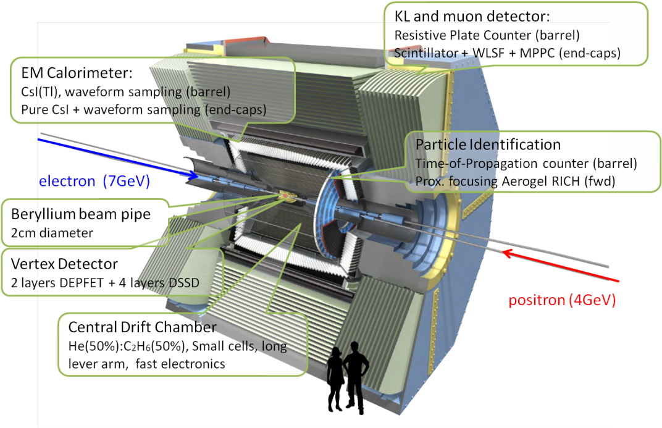
Belle → Belle II
KEKB→SuperKEKB
Belle → Belle II
・~40 times luminosity (8×10³⁵ cm⁻²s⁻¹)
・~50 times integrated luminosity (50 ab⁻¹)
・ Fine segmentation.
・ Waveform sampling.
Huge data sample
for large collaboration
→ Huge computing resource

Slide 3
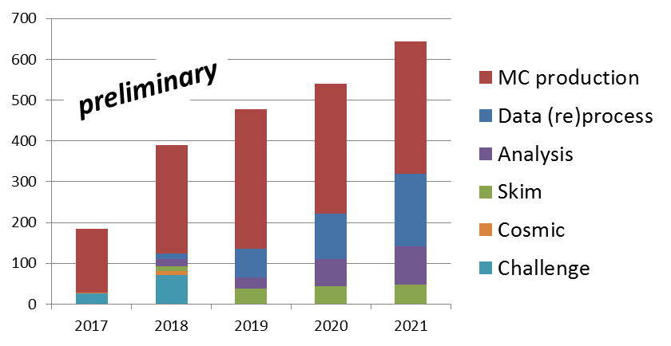
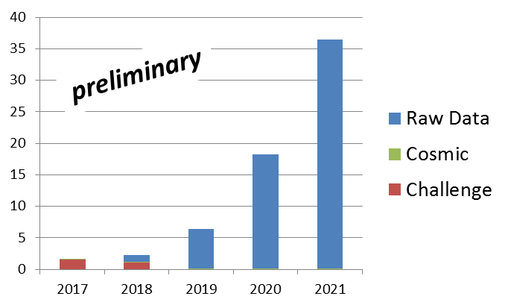
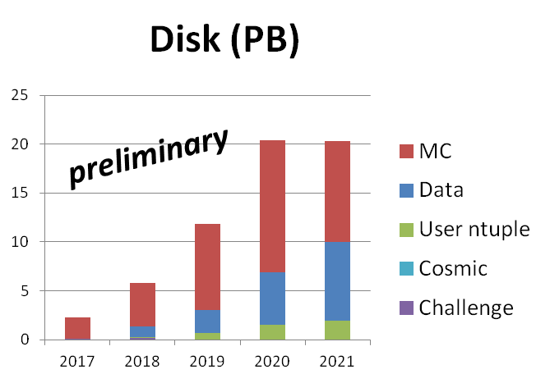
Computing resource for Belle II
CPU (kHEPSpec)
**1core~=10 HepSpec
Tape (PB)
~10⁴ cores
・ Estimation until 2021 (~20 ab⁻¹).
・At the end of data taking (50 ab⁻¹), more than
- 100000 core CPU
- 100 PB storage
are expected to be needed to store and analyze
data in a timely manner.

Slide 4
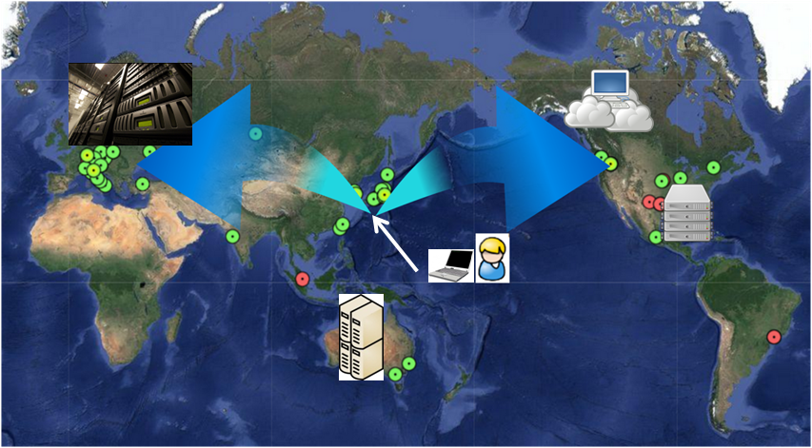
More than 100 PB?
Big data in 2012
LHC
(2012)
15PB
・Similar to Google search index or
Contents uploaded to Facebook (per year).
・Impossible to be hosted by a single institute.
→ Distributed computing
Each institute prepare the resources.
Connect by network.
Census Bureau
3.7PB
Business e-mail
3000PB/year
Google search index
100PB/year
Climate DB
6PB
NASDAQ
3PB
YouTube video
15PB/year
Library of Congress
3PB
Contents of Facebook
180PB/year
Digital Health
30PB
https://www.wired.com/2013/04/bigdata

Slide 5
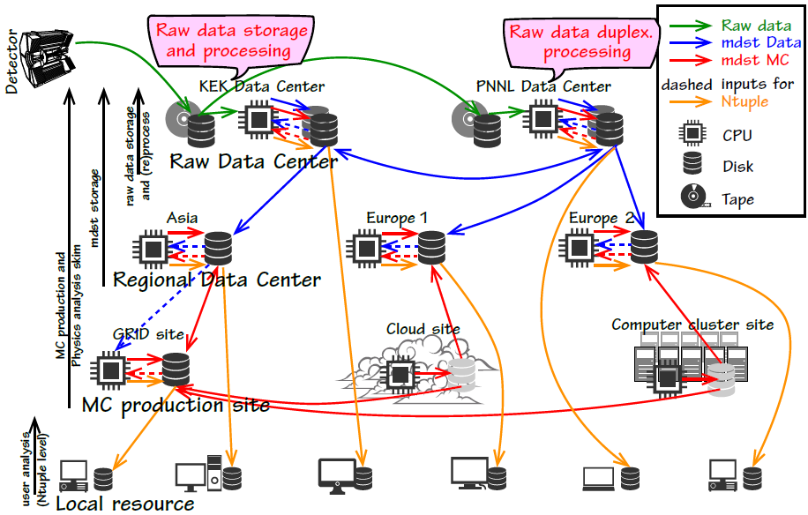
Belle II computing model
First 3 years

Slide 6
Belle II computing system
What we need is..
Resource
-Grid:
Relatively big sites.
Store data/MC sample (and produce).
Cloud
“Commercial resource”
MC production
Local computing cluster
Relatively small resource in universities.
MC production
Extension to meet experimental requirements
- Automation of MC production,
raw data processing
→ Production system
- User interface.
- Analysis framework
- etc
Interface for different resource type=DIRAC
(Distributed Infrastructure with Remote Agent Control)
Originally developed by LHCb
The open source, good extensibility
Used in many experiments:
LHCb, BES III, CTA, ILC, and so on
BelleDIRAC
Grid
Cloud
Local cluster
….

Slide 7
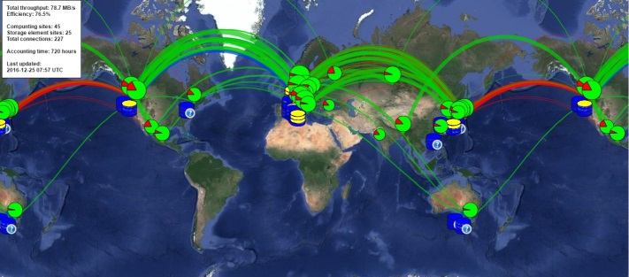
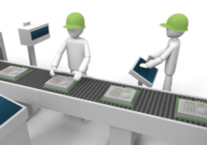
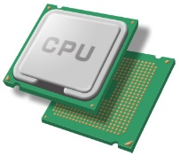
Production system and its development
Definition
・ MC prod / data process
・ Type (BB, ττ, ccbar..)
・ # of events
・ software version
・ etc..
PS
-Production
-Distribution
-Merge
Production manager (human)
Define “Production”
Belle
DIRAC
Distributed data management system
Fabrication system
output info
・Gather outputs to major storage
(and distribute over the world)
・Check status of storages
・Define “Transfers”
・ Define jobs
・ Re-define failed job
・ Verify output files
Monitor
DIRAC
DIRAC Transfer management
DIRAC Job management
Submit job on site
Resource
Destination storage
Temporary storage
Computing site

Slide 8
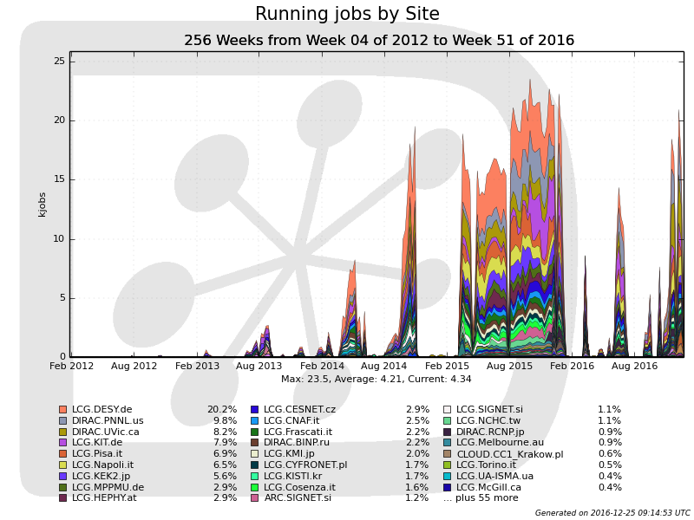
MC production campaigns
・ Test the validity of the computing model/system.
・ Provide simulation samples for the sensitivity study.
Auto job submission
Automatic Issue detection (5th)
Data distribution
by DDM
20 kjobs
4th
5th
6th
7th(ongoing)
Manual job submission
3rd
2nd
1st
・ ~50 computing sites join in the latest campaign.
・ More than 20k jobs can be handled now.
・ Gradually automating the production procedure.
・ Belle II colleagues take computing shifts from 4th campaign as an official service task.

Slide 9
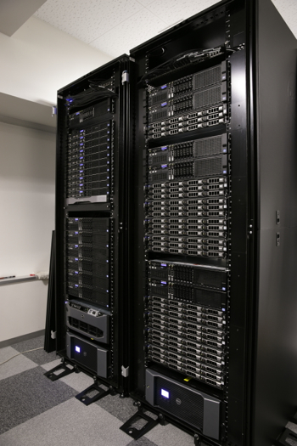
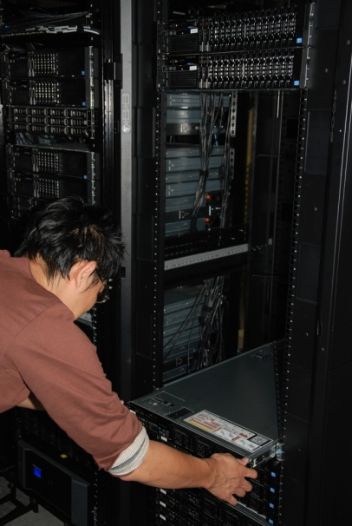
KMI contributions
Significant contribution from KMI
・ Resource
Belle II dedicated resource in KMI
・ 360 (+α) CPU cores.
・ 250 TB storage.
・ Grid middleware (EMI 3) installed.
・ DIRAC server.
・ Operation by physicists
→ Learned a lot on operation of
a computing site.
・ Development of monitoring system
- To maximize the availability of resources
- Automatic detection of the problematic sites
- Operation and development of the shift manual

Slide 10
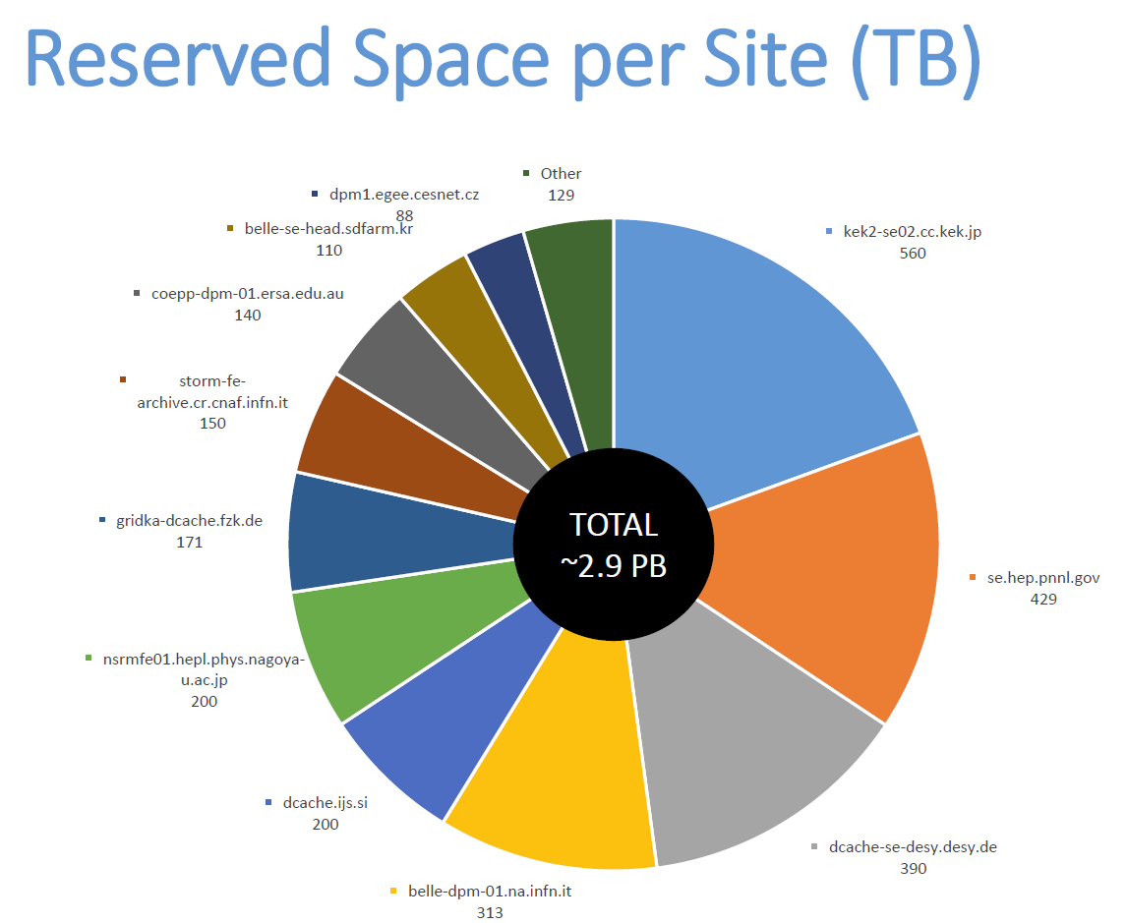
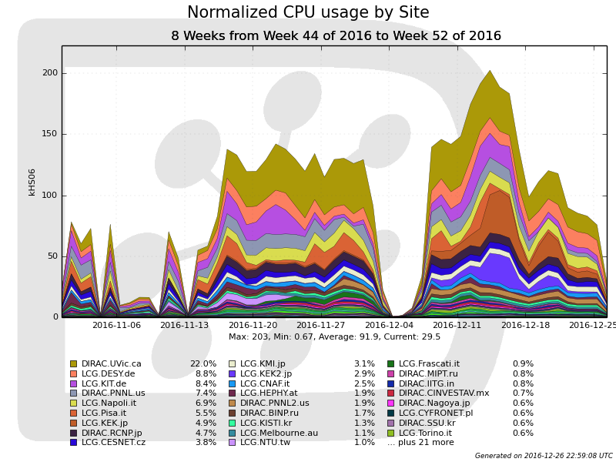
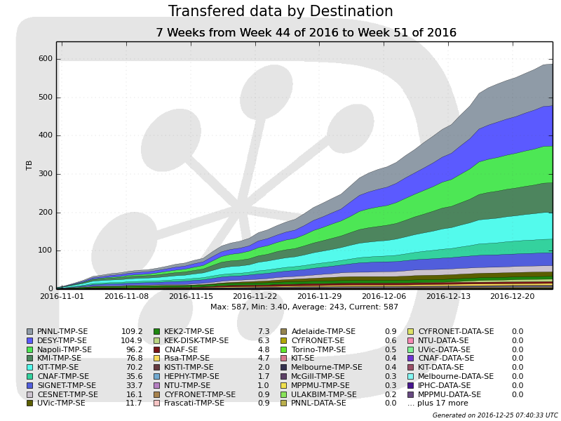
Contribution of KMI resources
CPU usage during MC7
~7%
Data transferred during MC7
・ Serving as destination storage.
・ Executed more than 1×10⁵ jobs in MC 7
・ We will purchase ~200 cores CPU in this year (~1.5 times).

Slide 11
Monitoring system
・Many interfaces → Need to identify “where the trouble happens”
・ Store and process information of each step in database.
・ Analyze log file to identify the origin of problem further.
・ Show the list of problems on the web, if detected.
Automatic issue detector

Slide 12
Monitoring system (active way)
Actively collect site status by submitting diagnosis job.
SiteCrawler:
Check the site environment to execute Belle II job
Job Submission check:
As DIRAC does not record failure reason,
job submission is tried and record the result.
Our activities maximize the availability of the resource !

Slide 13
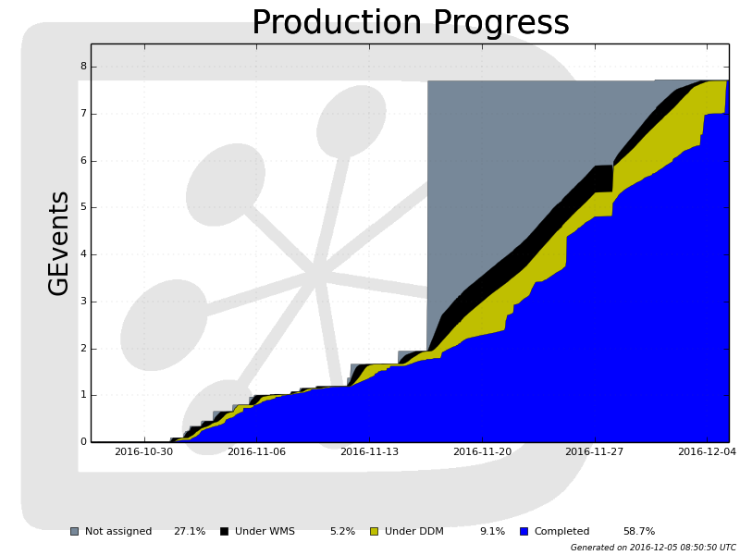
Production progress monitoring
・Submitted
・Under job
・Transfer
・Finished

Slide 14
Future prospects and coming events
・ Continue to improve the system
- Maximize the throughput.
- More automated monitoring/operation.
・ Cosmic ray data processing (2017)
- First real use case to try raw data processing workflow.
・ System dress rehearsal (2017): before Phase-2 runs
- To try the full chain workflow from raw data to skim.
・ Start of the phase 2 run in 2018.

Slide 15
Summary
・ Belle II adopted the distributed computing model to cope with
required computing resource (first experiment hosted at Japan).
・ "BelleDIRAC" is being developed to meet experimental requirements and validated at the MC production campaigns.
・ KMI has a huge contribution on distributed computing:
- Resources
- Development of the monitor
and upgrade the resource in this year
.
・ In 2017, the processing of comic ray data and System dress rehearsal
will be performed.

Slide 16
Backup

Slide 17
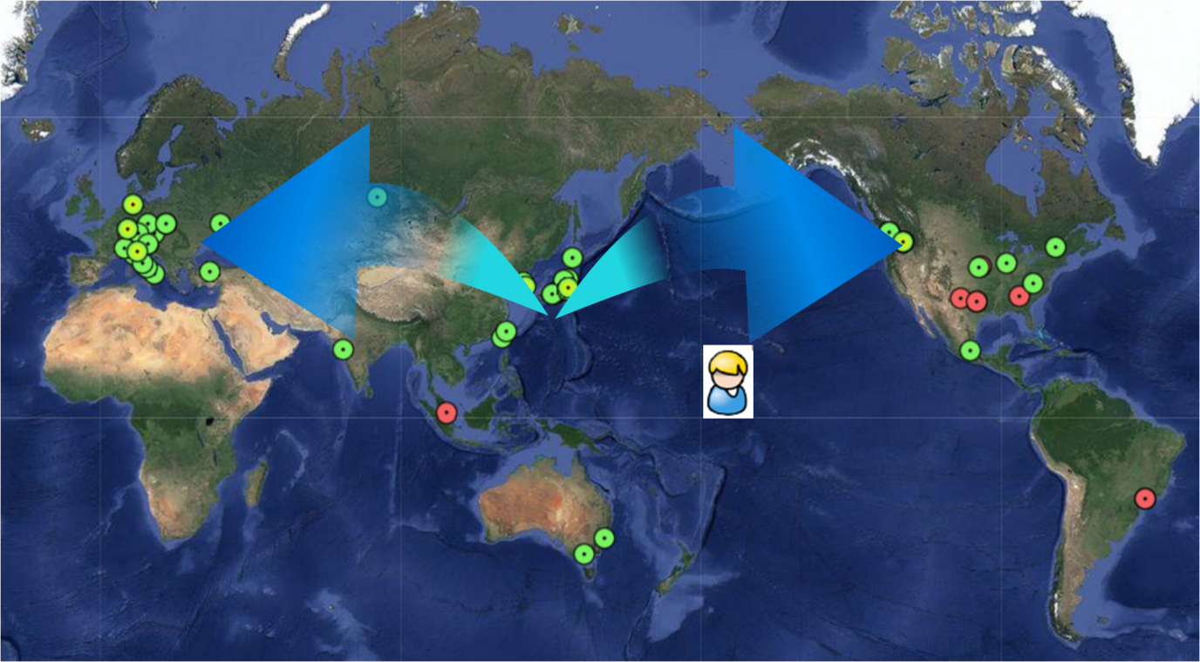
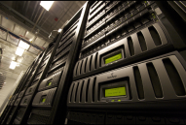
Distributed computing
Local computer:
-Interactive
-Data on local disk.
Computer cluster (Belle case):
Send “job”
“Homogeneous” resource in single place.
Data on shared disk
Distributed computing:
- Send Job (to central service)
“Heterogeneous” resource
distributed over the world.
- Data distributed over the world.

Slide 18
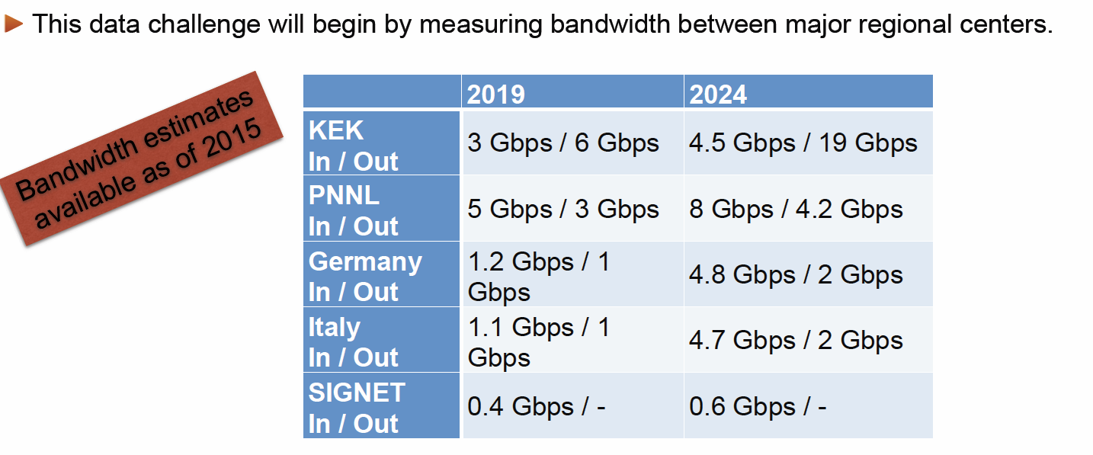
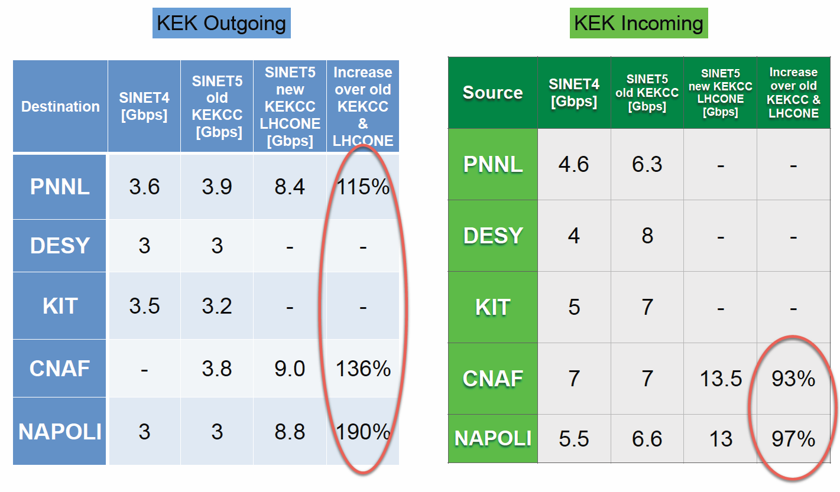
Network data challenge result
Network challenge results

Slide 19
User analysis in Belle II
Physics gurus perform bulk MDST Production
Skimming group makes skims from MDST
Almost all user analysis will originate from skims
(Data samples > 1 ab⁻¹ require this)
We should plan for at least 200 simultaneous analyses
Skim production will require an automated Fabrication system
Options for Physics skims from bulk MDST
Output skimmed MDST
Output Physics Objects + MDST (μDST) <= Baseline solution
Direct copy to WN using DIRAC
Stream data using XRootD/http
Output Index files which point to skimmed events <= Under investigation
Access bulk MDST directly via root on large cluster
Stream from bulk MDST using XRootD/http
Local Cluster/Workstation root
Validated by Physics group

Slide 20
μDST
E
E
T
T
T
B
B
E
T
E
T
T
MDST, Keep
T
E
E
T
T
T
E
T
T
μDST, Keep
T
E
E
T
T
T
E
T
T
B

Slide 21
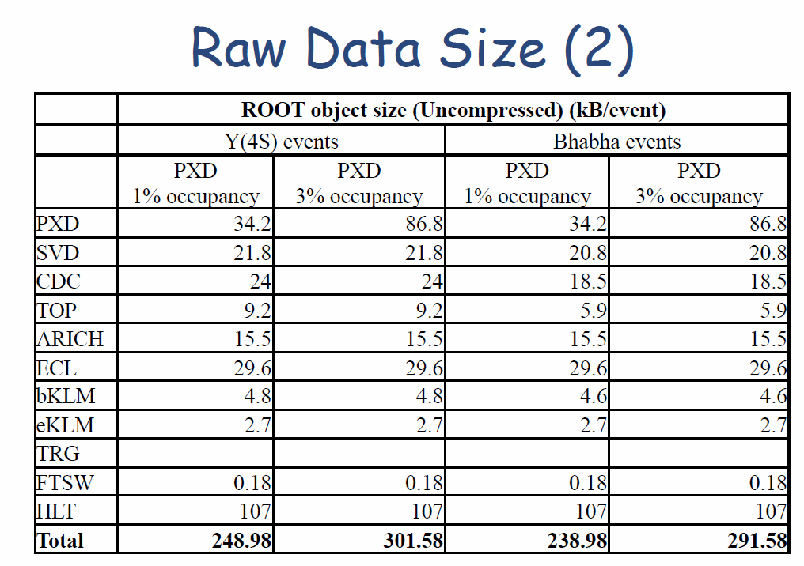

Slide 23
