Slide 1
Probing Dark Matter with Cosmic Messengers
Andrea Albert
Los Alamos National Lab
3rd KMI International Symposium
January 6, 2017

Slide 2
Outline
Indirect Detection Overview
evidence for dark matter
dark matter candidates
indirect detection messengers
Recent Dark Matter Results
unexplained anomalies
current constraints
Future Gamma Ray Prospects

Slide 3
Dark Matter and Dark Matter Particle Candidates

Slide 4
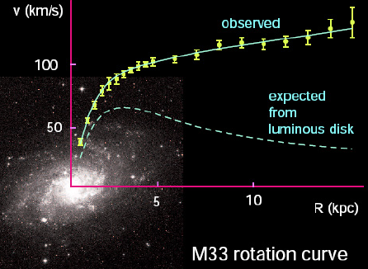
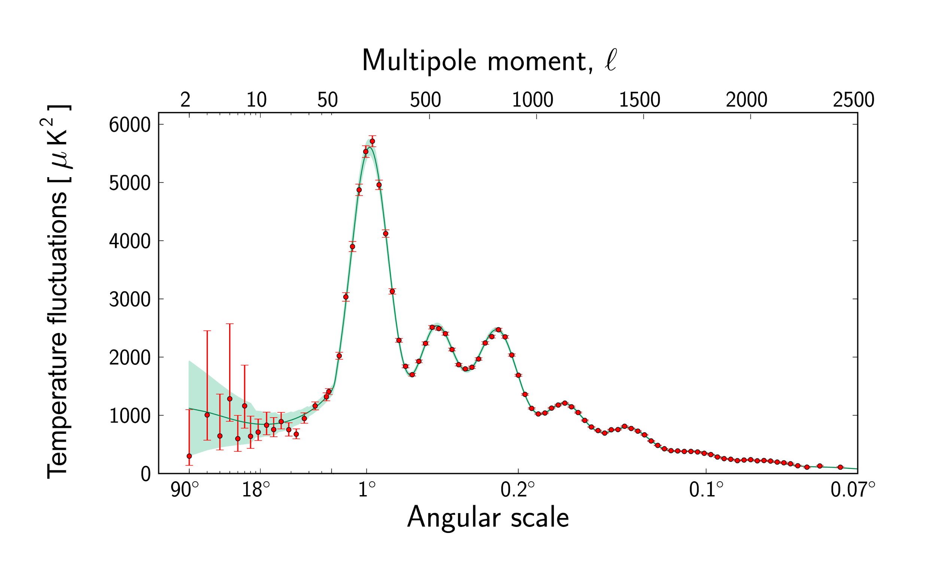
Dark Matter Primer
Galaxies form in large Dark Matter halos, which make up most of their mass
Coma Cluster + Virial, F. Zwicky (1937)
Rotation Curves, V. Rubin et al 1980)
Dark Matter is virtually collisionless
The Bullet Cluster, D. Clowe et al (2006)
www4.nau.e
Dark Matter is non-baryonic
CMB acoustic oscillations
Big Bang nucleosynthesis

Slide 5
Dark Matter Primer
Galaxies for in large Dark Matter halos, which make up most of their mass
Coma Cluster + Virial, F. Zwicky (1937)
Rotation Curves, V. Rubin et al 1980)
simulation of a spiral galaxy created with UniverseSandbox 2
Dark Matter is virtually collisionless
The Bullet Cluster, D. Clowe et al (2006)
www4.nau.e
Dark Matter is non-baryonic
CMB acoustic oscillations
Big Bang nucleosynthesis

Slide 6
Dark Matter Primer
Galaxies for in large Dark Matter halos, which make up most of their mass
Coma Cluster + Virial, F. Zwicky (1937)
Rotation Curves, V. Rubin et al 1980)
Dark Matter is virtually collisionless
The Bullet Cluster, D. Clowe et al (2006)
www4.nau.e
Dark Matter is non-baryonic
CMB acoustic oscillations
Big Bang nucleosynthesis

Slide 7
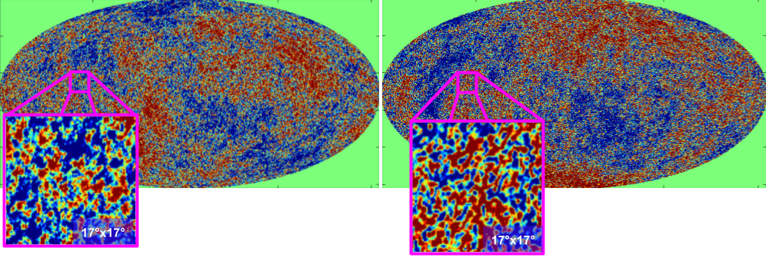
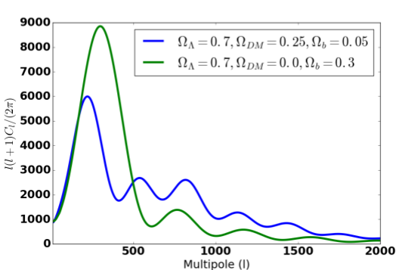
Dark Matter Primer
Galaxies for in large Dark Matter halos, which make up most of their mass
Coma Cluster + Virial, F. Zwicky (1937)
Rotation Curves, V. Rubin et al 1980)
No Dark Matter
ΛCDM
CMB temp fluctuations simulated with CAMB https://lambda.gsfc.nasa.gov/toolbox/tb_camb_form.cfm
Dark Matter is virtually collisionless
The Bullet Cluster, D. Clowe et al (2006)
www4.nau.e
CAMB simulations
Planck measurement
Dark Matter is non-baryonic
CMB acoustic oscillations
Big Bang nucleosynthesis

Slide 8
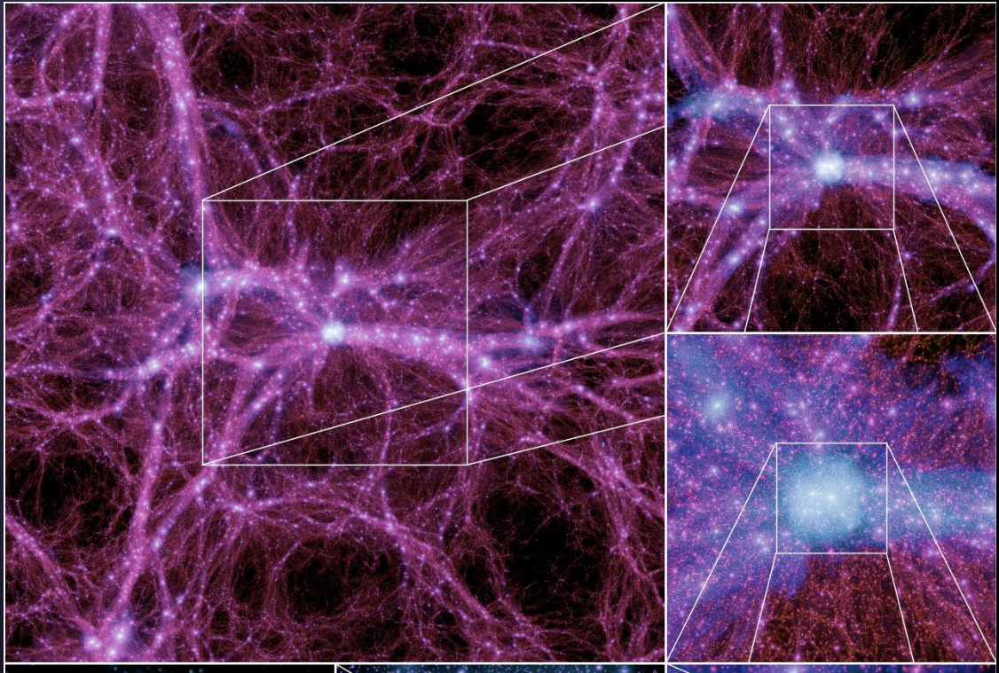
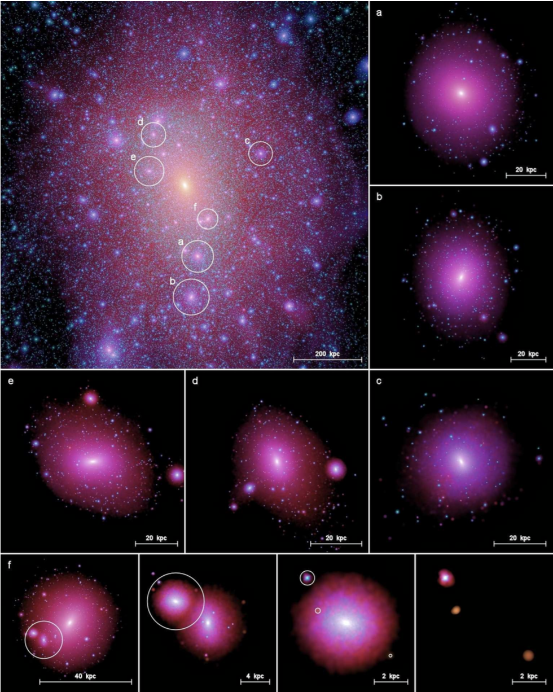
DM Structures are Present on Many Scales
Zoom Sequence of DM Structure on 100 Mpc Scales
Milky Way-like Halo and Several Sub-Halos
DM clumps :
On cosmological scales (left)
In the Milky Way virial radius (~300 kpc = ~1 MLY, right)
(Visible size of MW = ~ 20 kpc) (M31 is ~800 kpc away)
Left: Boylan-Kolchin+ 2009MNRAS.398.1150B
Right: Springel+ 2008MNRAS.391.1685S
slide credit: Eric Charles (SLAC)

Slide 9
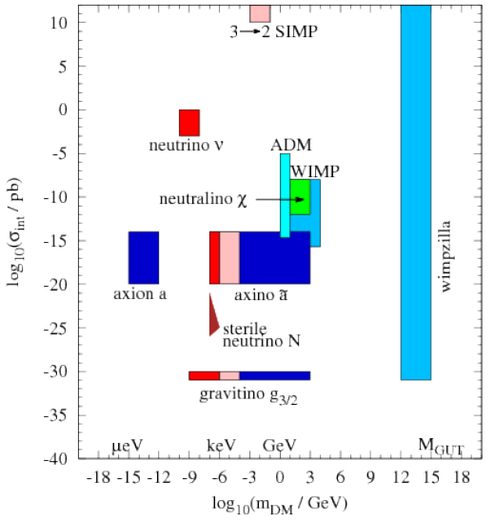
Dark Matter Candidates
Wide variety of particle DM candidates in beyond SM theories
Large scale structure and galactic formation seem to require cold (non-relativistic) DM
Tend to focus on 100 GeV WIMPs
but lack of detection at e.g. LHC and LUX motivates need for other candidates with m_{DM} >10 TeV
Baer+ PR 555 (2015)

Slide 10
Dark Matter Candidates
I will focus on WIMP results, but other DM candidates can leave cosmic signatures
axion and axion-like-particles couple to 𝛄 rays in B fields
x-ray lines from sterile 𝛎
𝛄-ray lines from gravitinos
Recall all DM results are derived from firm measurements
DM limits from flux limits
Important for experiments to publish measured limits and fluxes that are not convolved with DM model assumptions
Baer+ PR 555 (2015)

Slide 11
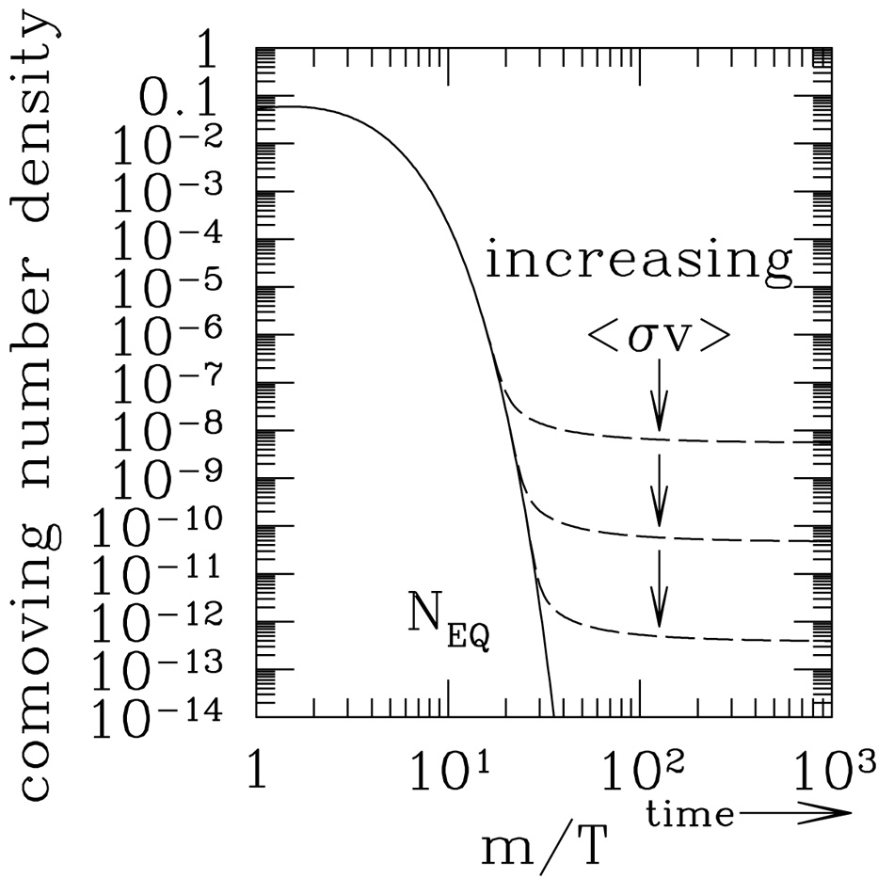
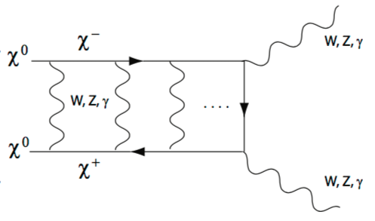
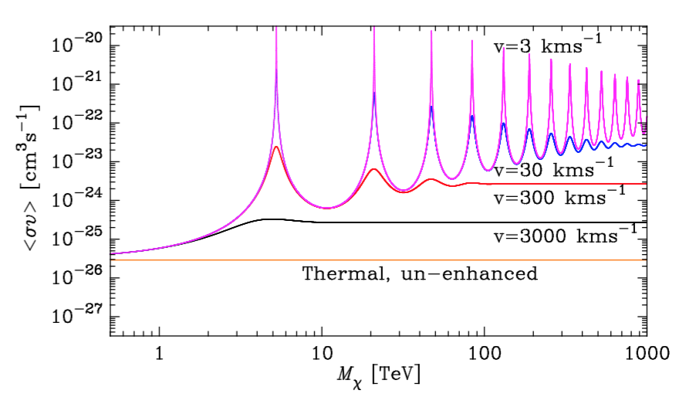
WIMP Dark Matter
Weakly Interacting Massive Particle (WIMP, 𝛘)
GeV - TeV mass scale
WIMPs may be thermal relics
e.g. neutralino (SUSY, electrically neutral, stable)
Assuming a weak scale 𝛔_{ann} at freeze out yields observed relic abundance
<𝛔v>_{ann} ~ 3x10⁻²⁶ cm³/s
time in early Universe when amount of DM freezes out
E. Kolb and M. Turner, The Early Universe, Westview Press (1994)
arXiv:1202.1170
arXiv:1405.1730
Sommerfeld enhancement
relevant for high DM masses (>~1 TeV)
enhanced at low WIMP velocities
this effect was suppressed at time of freeze out
high mass thermal relics have present <𝛔v>_{ann} larger than 3x10⁻²⁶ cm³/s in some models

Slide 12
Various Dark Matter Search Techniques
time
χ
SM
Production
(collider)
?
Direct Detection
(underground detectors)
time
χ
Indirect Detection
SM
time

Slide 13
Various Dark Matter Search Techniques
time
χ
SM
Production
(collider)
?
Direct Detection
(underground detectors)
time
χ
Indirect Detection
SM
time

Slide 14
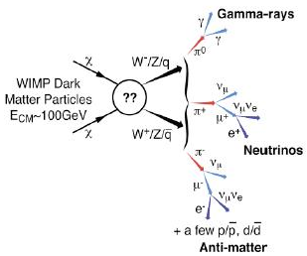
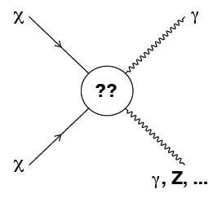
Indirect Dark Matter Detection
Spectral line
Broad spectrum
The Milky Way sits in a large halo of cold DM (v_{DM} << c)
Expect additional DM overdensities (halos / subhalos)
e.g. Milky Way dwarf galaxies
e.g. Galaxy Clusters
WIMP annihilations (decays) may produce gamma rays

Slide 15
Indirect Dark Matter Detection
Spectral line
Broad spectrum
Pro: Gamma rays and neutrinos point back to their source so we can look for excesses from known DM targets.
Con: Can be difficult to disentangle from non-DM sources (e.g. pulsars) from those targets
The Milky Way sits in a large halo of cold DM (v_{DM} << c)
Expect additional DM overdensities (halos / subhalos)
e.g. Milky Way dwarf galaxies
e.g. Galaxy Clusters
WIMP annihilations (decays) may produce gamma rays

Slide 16
Indirect Dark Matter Detection
Spectral line
Broad spectrum
Pro: Positrons and antiprotons come from relatively nearby DM interactions, so are only subject to local DM density uncertainties
Con: Charged matter/antimatter lose source direction information in Galactic magnetic field. Difficult to disentangle from non-DM sources
The Milky Way sits in a large halo of cold DM (v_{DM} << c)
Expect additional DM overdensities (halos / subhalos)
e.g. Milky Way dwarf galaxies
e.g. Galaxy Clusters
WIMP annihilations (decays) may produce gamma rays

Slide 17
Overview of Recent Results

Slide 18
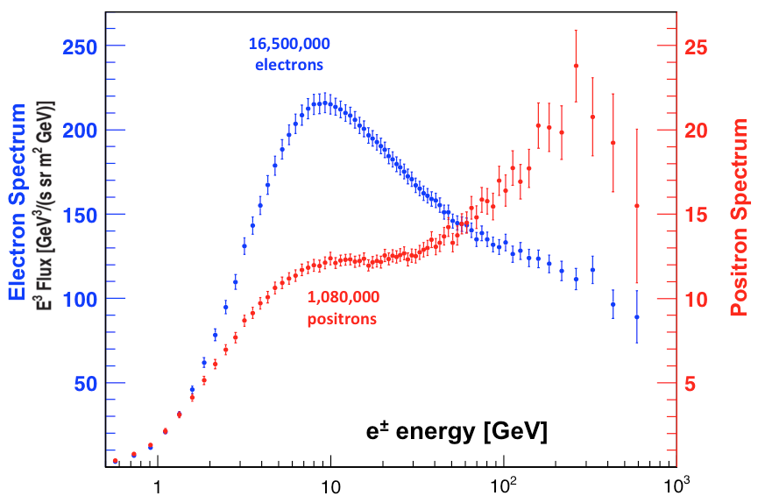
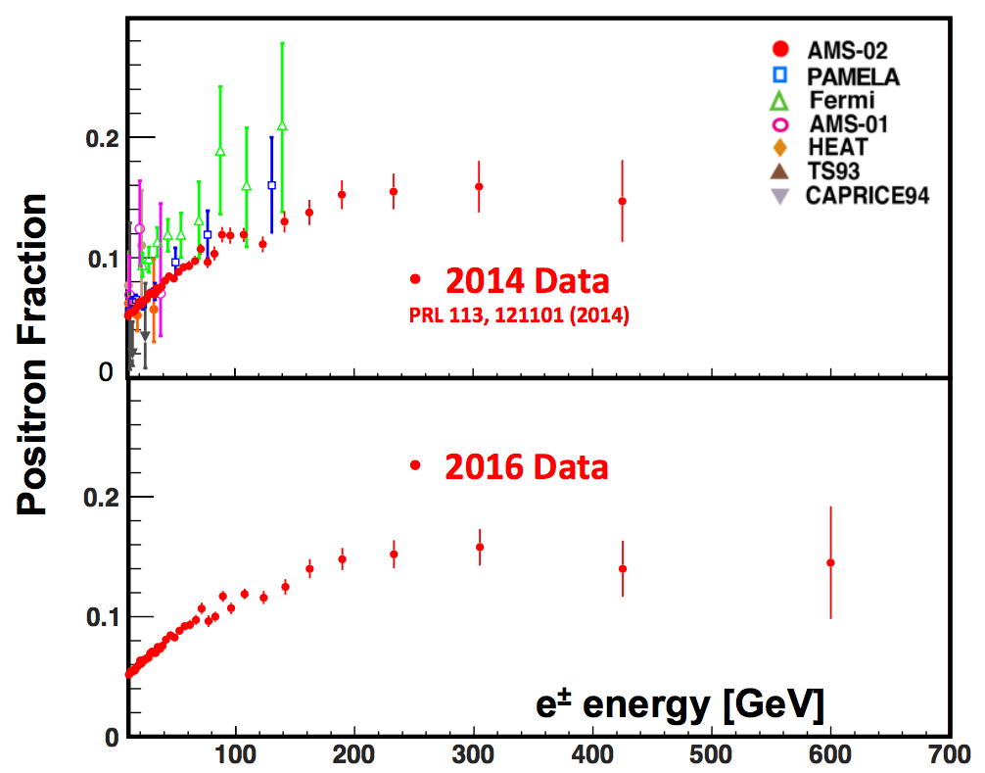
Local Positron Fraction
S.Schael (AMS Coll) TeVPA 2016
AMS Collaboration (2016) http://www.ams02.org/wp-content/uploads/2016/12/Fig2.png
AMS-02 on board the International Space Station observes local cosmic rays since 2011
excellent charge resolution and particle species discrimination
TeV e⁻e⁺ lose energy quickly and therefore must be produced locally (d < ~100 pc)
secondaries produced by cosmic ray interactions with ISM (spallation)
primaries produced by local source
local cosmic accelerator (e.g. Geminga)? local dark matter interactions?
Larger positron flux observed above ~10 GeV than expected from secondaries
First observed by Pamela in 2009, since confirmed by Fermi LAT and AMS-02
Are they from a local cosmic accelerator or dark matter?
If they are from dark matter, other annihilation products should be produced

Slide 19
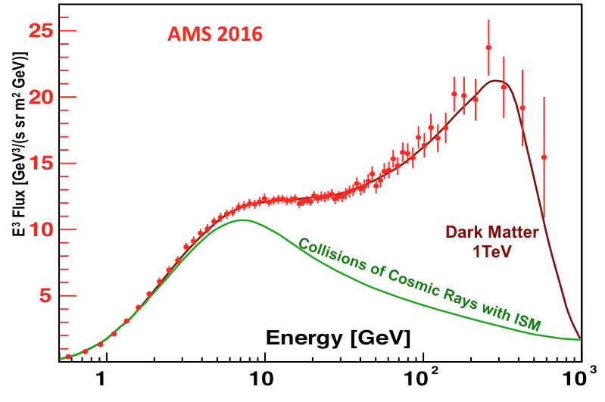
Local Positron Fraction
http://www.ams02.org/wp-content/uploads/2016/12/Fig4.png
S.Schael (AMS Coll) TeVPA 2016
AMS-02 on board the International Space Station observes local cosmic rays since 2011
excellent charge resolution and particle species discrimination
TeV e⁻e⁺ lose energy quickly and therefore must be produced locally (d < ~100 pc)
secondaries produced by cosmic ray interactions with ISM (spallation)
primaries produced by local source
local cosmic accelerator (e.g. Geminga)? local dark matter interactions?
Larger positron flux observed above ~10 GeV than expected from secondaries
First observed by Pamela in 2009, since confirmed by Fermi LAT and AMS-02
Are they from a local cosmic accelerator or dark matter?
If they are from dark matter, other annihilation products should be produced

Slide 20
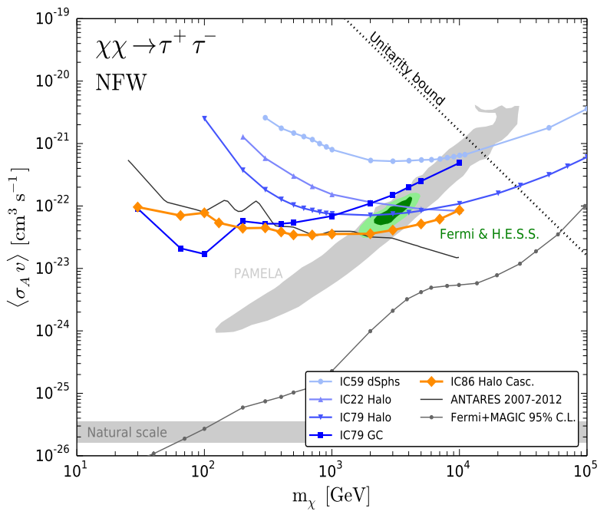
Cosmic Neutrinos
“Bert”
“Ernie”
Aartsen+ [IceCube Collab] EJPC 76, 531 (2016)
With the detection of Bert and Ernie by IceCube in 2014, we entered the era of cosmic neutrino astronomy
before the only extra-solar neutrinos came from SN1987a
Expect brightest neutrino signal from DM annihilations from the Galactic Center
no neutrino excess observed towards the GC
Recent limits from IceCube constrain DM models proposed to explain local positrons
gamma ray limits from dwarf galaxies (more later) are more constraining, but it’s important to have multi-messenger constraints from various targets

Slide 21
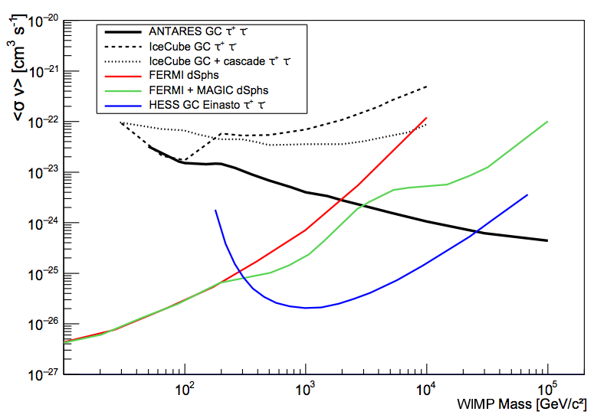
Cosmic Neutrinos
“Bert”
“Ernie”
Aartsen+ [IceCube Collab] EJPC 76, 531 (2016)
Albert+ [ANTARES Collab]
submitted to Phys B Lett
arXiv:1612.04595
With the detection of Bert and Ernie by IceCube in 2014, we entered the era of cosmic neutrino astronomy
before the only extra-solar neutrinos came from SN1987a
Expect brightest neutrino signal from DM annihilations from the Galactic Center
no neutrino excess observed towards the GC
Recent limits from IceCube constrain DM models proposed to explain local positrons
gamma ray limits from dwarf galaxies (more later) are more constraining, but it’s important to have multi-messenger constraints from various targets

Slide 22
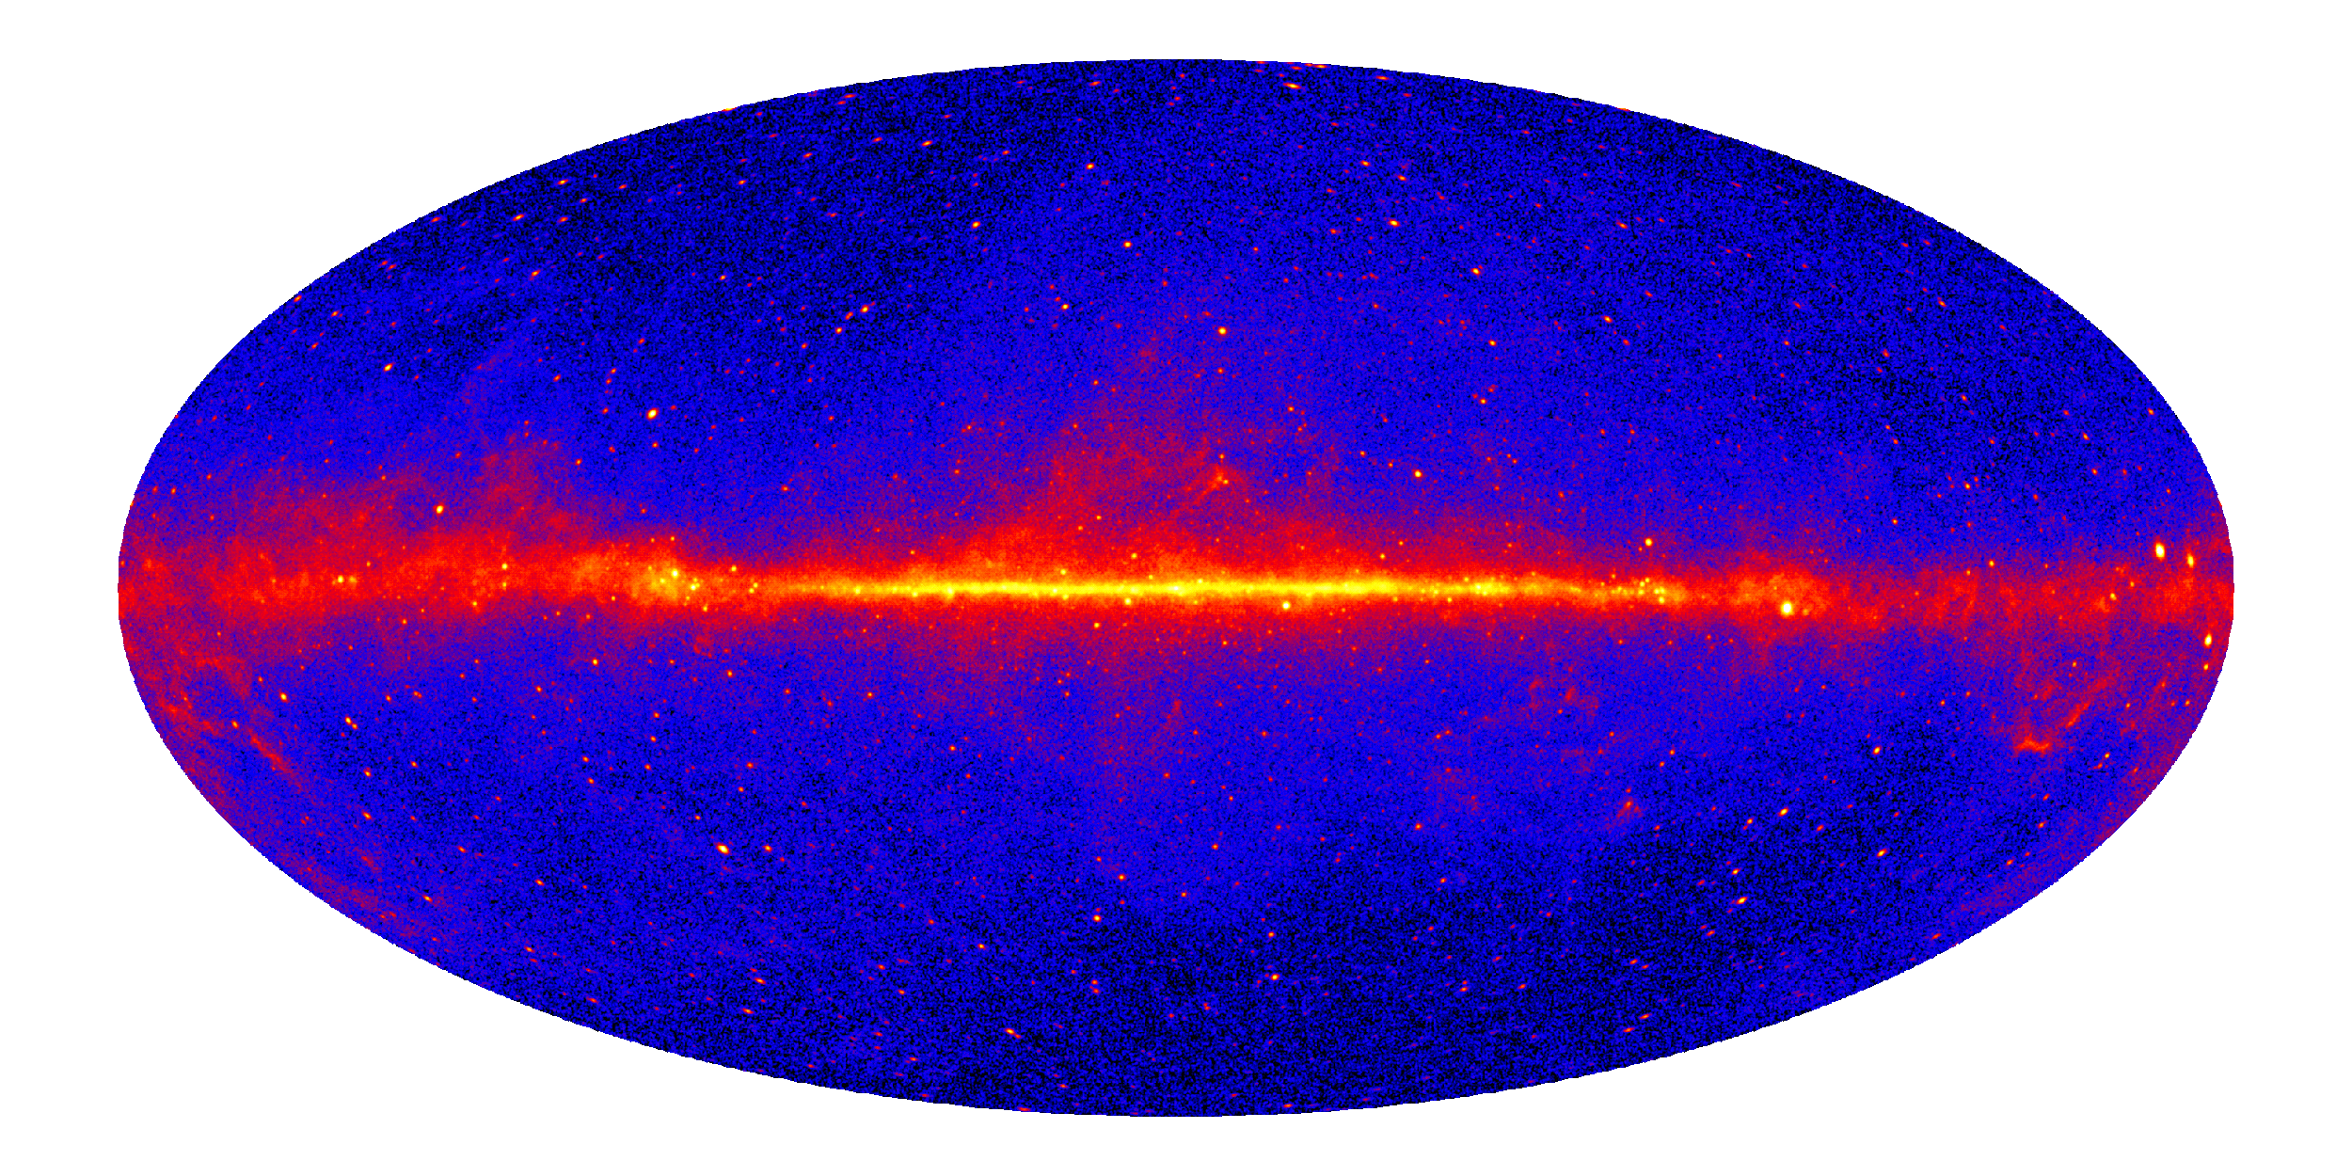
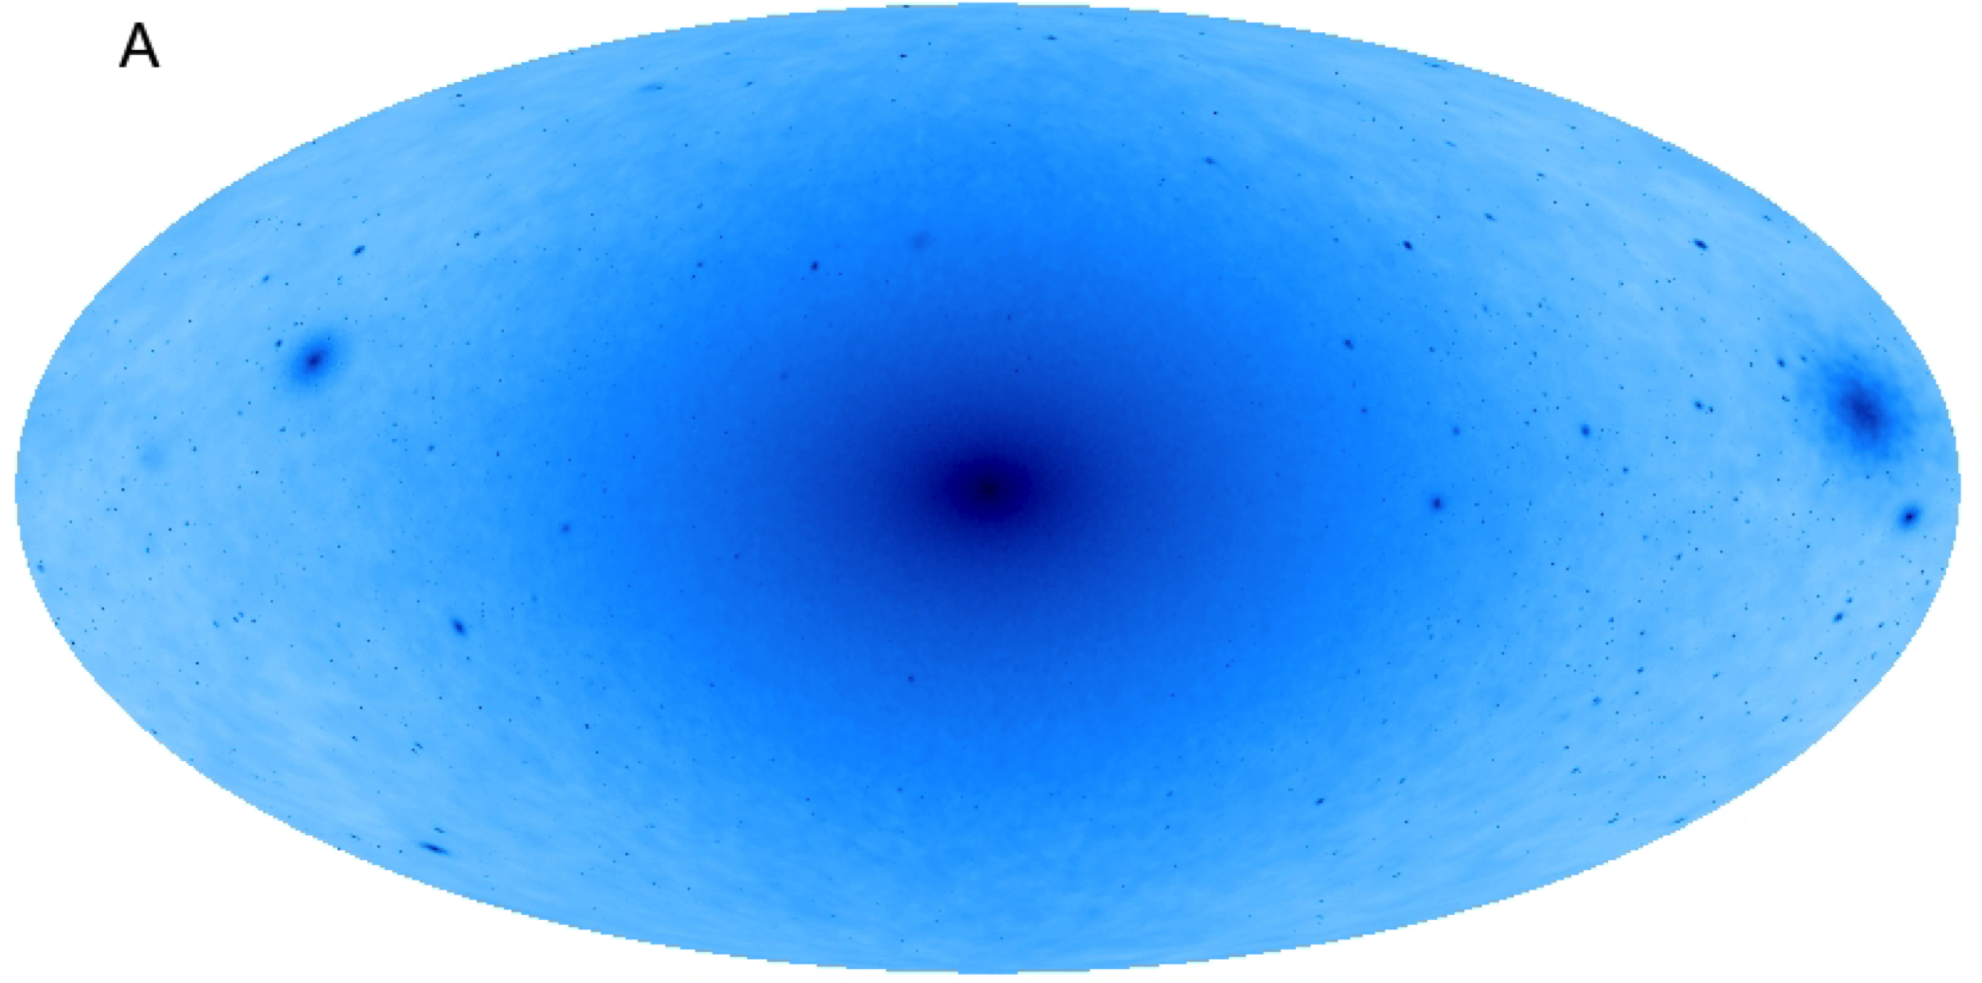
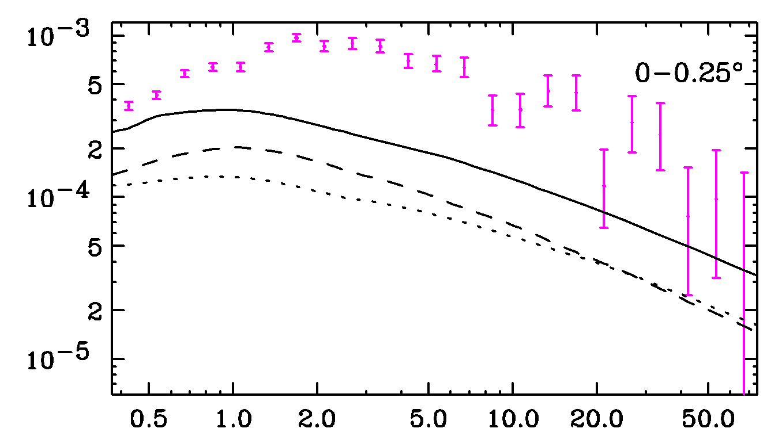
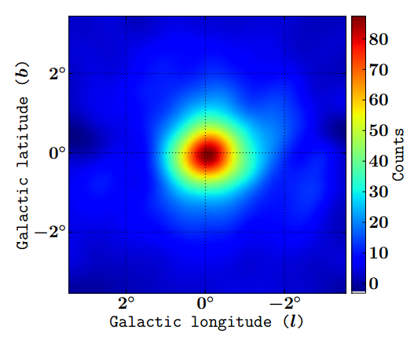
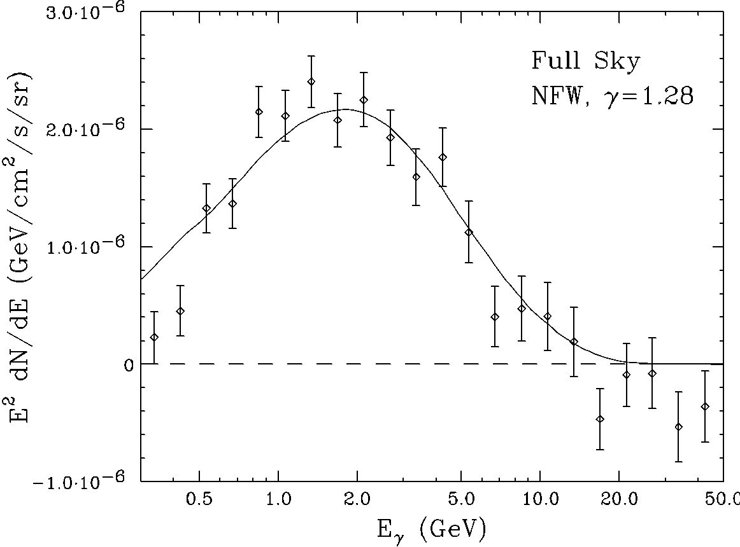
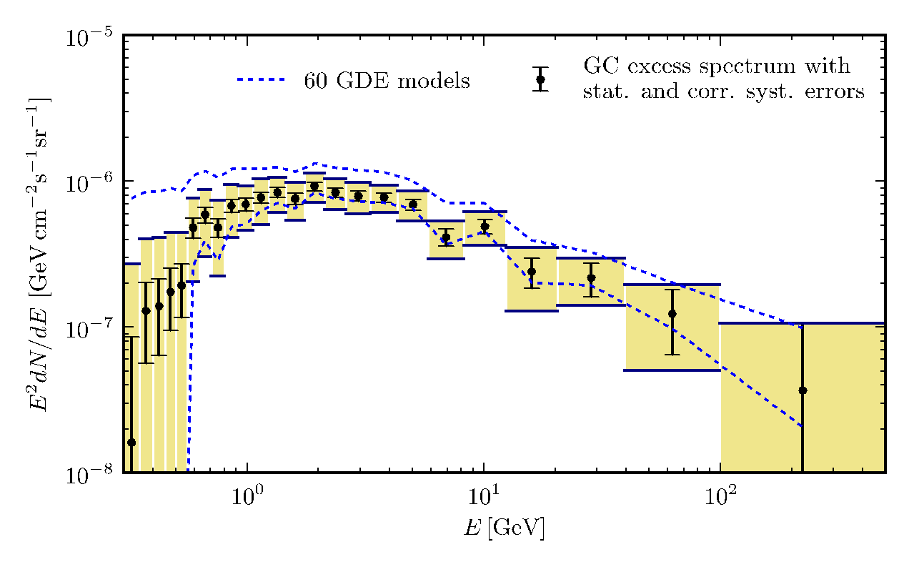
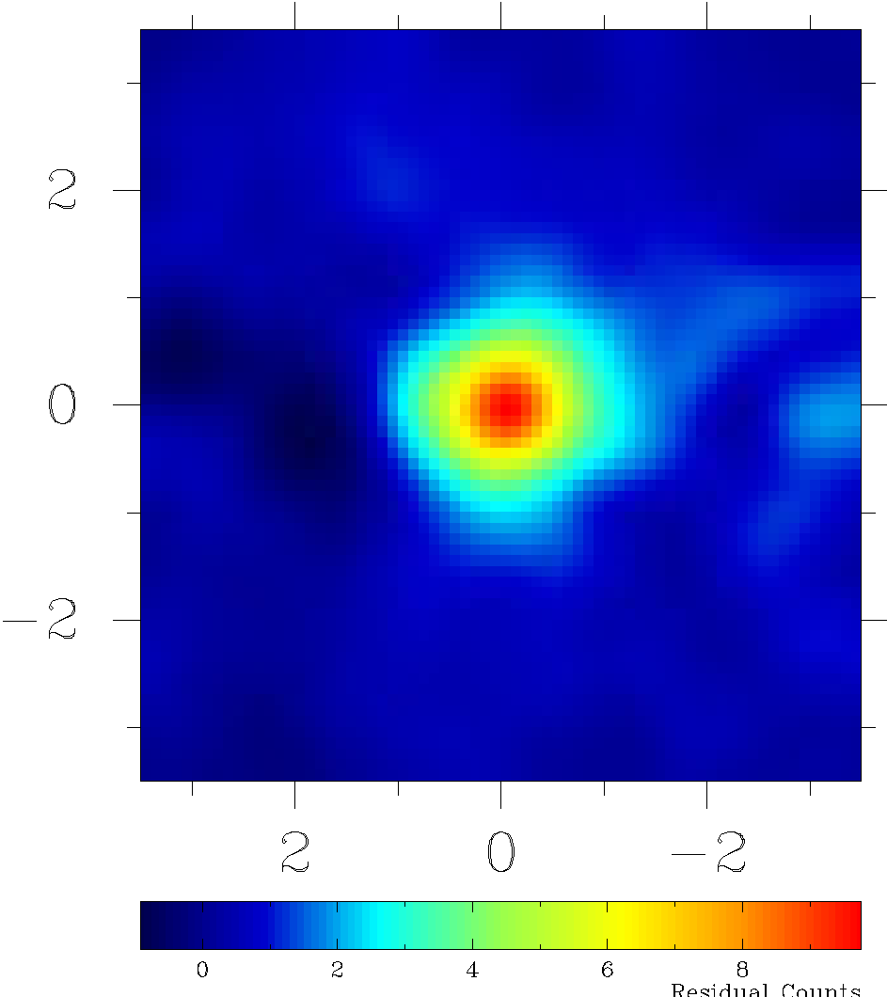
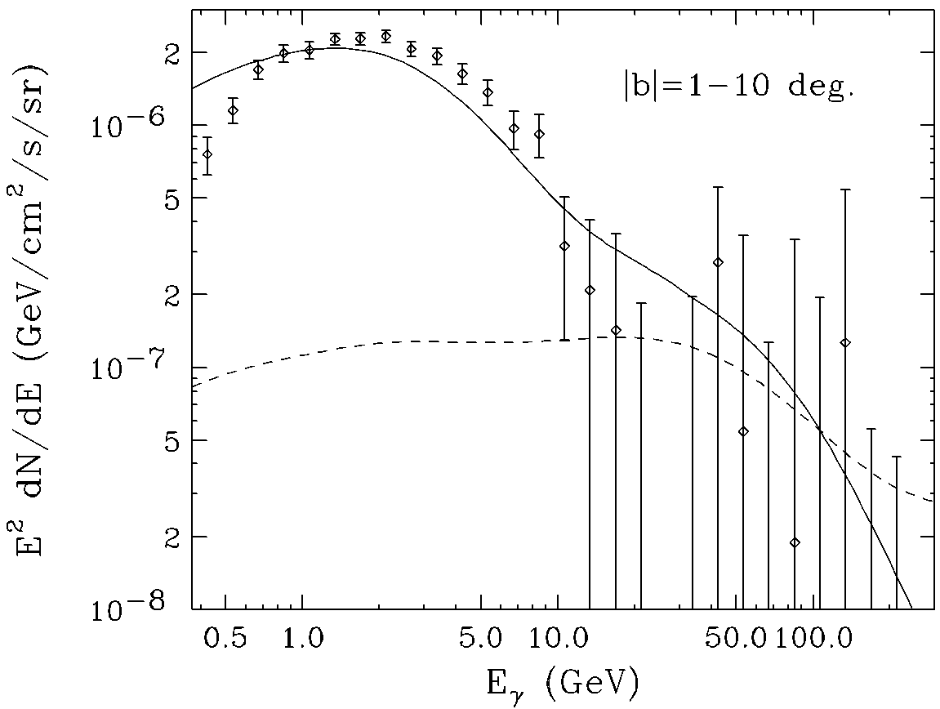
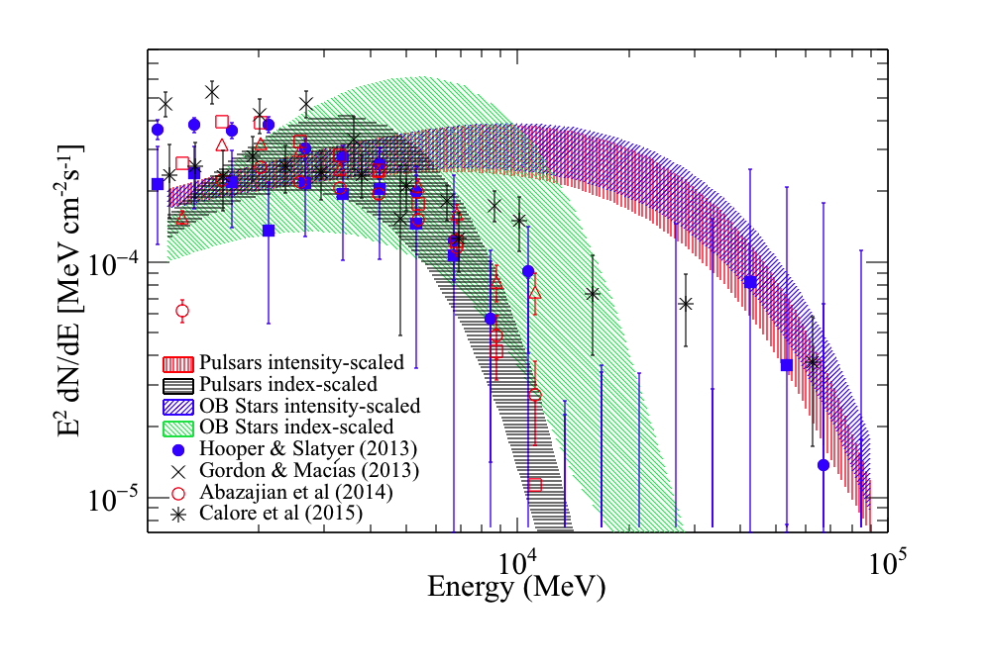
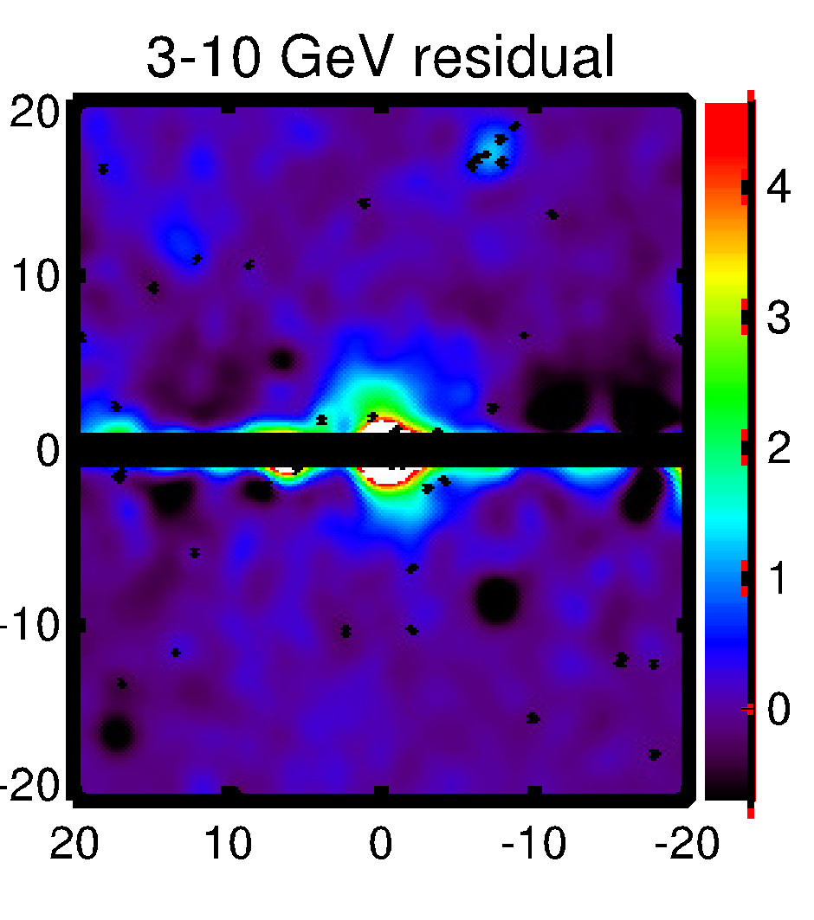
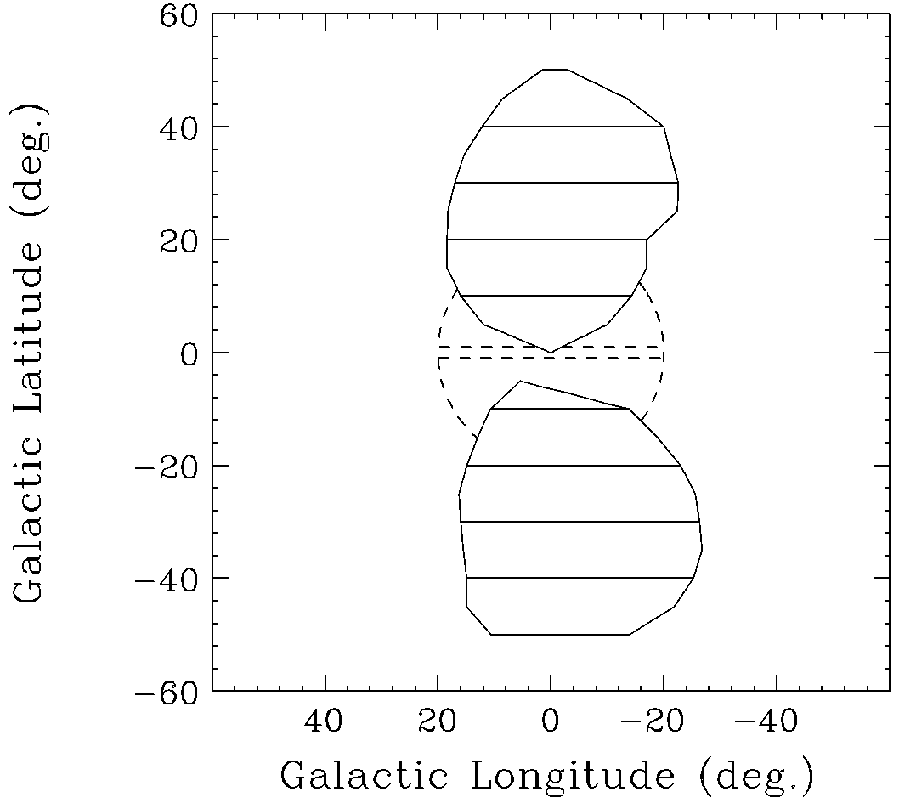
“GeV Excess” in the Galactic Center
?
Excess emission spectrum peaks around 3 GeV
Dark matter annihilation, unresolved sources, CR electrons?
Mirabal (MNRAS 436 (2013) 2461), Petrovic et al. (JCAP 1502 (2015) 02,023), Cholis et al. (JCAP 1512 (2015) 12, 005), Lee et al. (PRL 116 051103 (2016)), Bartels et al. (PRL 116 051102 (2016)), Brandt & Kocsis (ApJ 812 (2015) 1, 15), Carlson et al. (arXiv:1510.04698) etc.
Via Lactea II, Kuhlen et al.,
Science 325:970-973,2009
Fermi LAT >1 GeV, 6 years, Pass 8 data
Goodenough &
Hooper
Phys.Lett. B697 (2011)
Calore et al.
JCAP 1503 (2015)
Gordon & Macias
PRD 88, 083521 (2013)
Ajello et al. (The Fermi-LAT Collaboration)
ApJ 819 1 44 (2016)
Abazajian &
Kaplinghat
PRD 87 129902 (2012)
Hooper & Slatyer
Phys.Dark Univ. 2 (2013)
Daylan et al.
Phys. Dark Univ. 12 (2016)

Slide 23
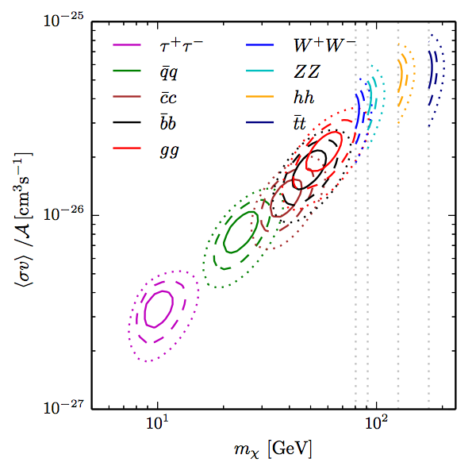
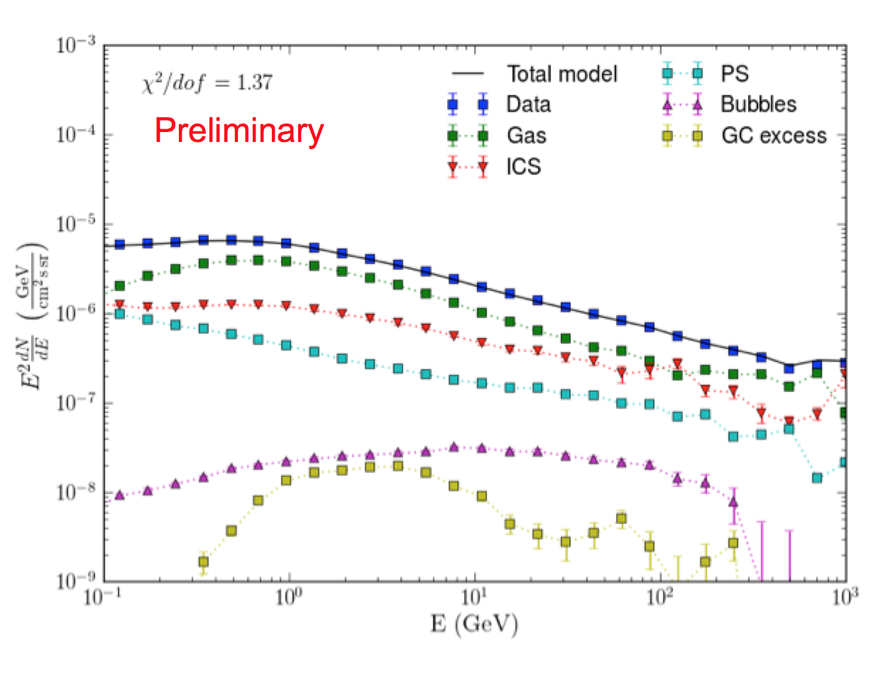
“GeV Excess” in the Galactic Center
Spectra averaged over entire sky
A.Albert+ [Fermi LAT Collab] IAU GC 2016 galacticcentre.space/index.php/programme/
Calore+ PRD 91 063003 (2015)
Excess of GeV gamma rays from the GC above standard models first detected by Goodenough & Hooper in 2009 in the Fermi Large Area Telescope data
If interpreted as DM annihilation, m_{DM} ~ 50 GeV with ‘WIMP miracle’ cross section value
Currently not clear if it is from DM or non-DM sources
Complicated region of the sky and the community is working hard to disentangle a potential DM component
~85% of the gamma rays at 1 GeV are from fore/backgrounds
DM is a small component of the gamma-ray sky, so precision modeling of the non-DM components is necessary to tease out DM component in the Galactic Center

Slide 24
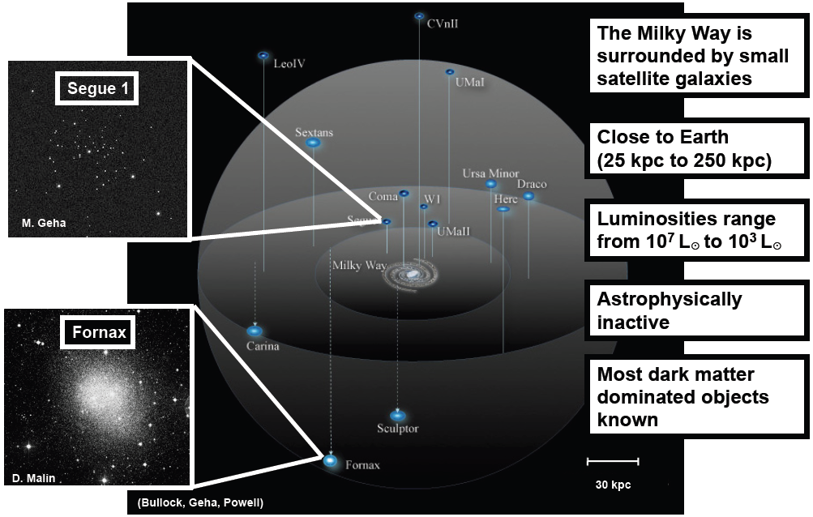
Milky Way Dwarf Spheroidal Galaxies
Optical Luminosities from 10³L⍟ to 10⁷L⍟
A.Drlica-Wagner DPF 2013
Notes:
optical luminosities

Slide 25
6 year Fermi LAT dSphs Results
The Fermi LAT Collab PRL 115, 23 (2015)
Joint likelihood analysis of 15 well characterized dwarf galaxies
Limits exclude thermal relic <𝛔v>_{ann} in bƃ channel for 5 GeV < m_{𝛘} < 100 GeV
Notes:
Removes overlapping dwarfs (so independent) in ROIs (10 degrees, keep dwarf with largest J factor). Also only use dwarfs with mass estimates from stellar kinematics

Slide 26
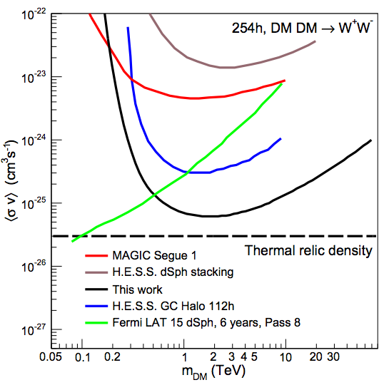
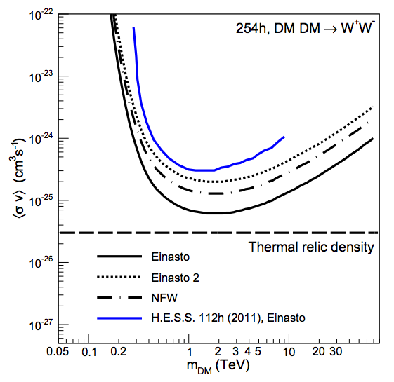
TeV Gamma-ray DM Constraints
uncertainty on DM density in the GC
Abdallah+ [H.E.S.S. Collab] PRL 117 11 (2016)
For gamma-rays from 500 GeV to 5 TeV, best sensitivity comes from Air Cherenkov Telescopes (ACTs, e.g. H.E.S.S.)
H.E.S.S. located in the southern hemisphere can observe the Galactic Center
No DM-like excess observed, strong constraints placed
Limits for DM annihilation to tau leptons now constrain ‘WIMP miracle’ models (assuming Einasto profile)

Slide 27
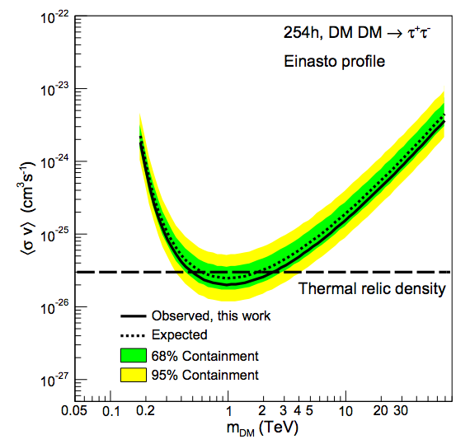
TeV Gamma-ray DM Constraints
uncertainty on DM density in the GC
Abdallah+ [H.E.S.S. Collab] PRL 117 11 (2016)
For gamma-rays from 500 GeV to 5 TeV, best sensitivity comes from Air Cherenkov Telescopes (ACTs, e.g. H.E.S.S.)
H.E.S.S. located in the southern hemisphere can observe the Galactic Center
No DM-like excess observed, strong constraints placed
Limits for DM annihilation to tau leptons now constrain ‘WIMP miracle’ models (assuming Einasto profile)

Slide 28
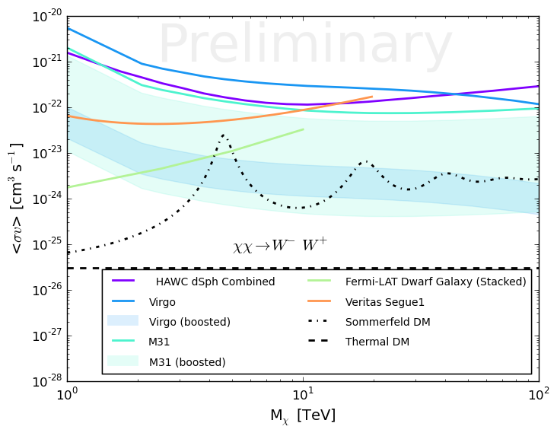
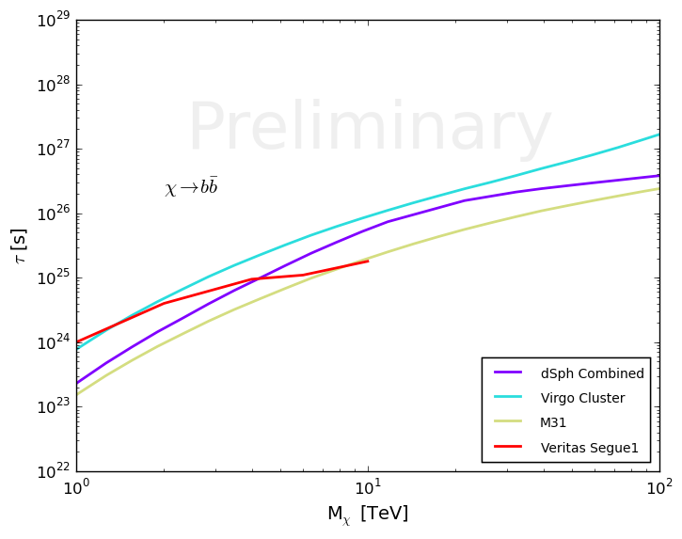
>TeV Gamma-ray Constraints
1 year HAWC limits
excluded
For gamma-rays >5 TeV, best sensitivity comes from the High Altitude Water Cherenkov Observatory (HAWC)
HAWC has a wide field of view making it sensitive to extended objects
HAWC surveys ⅔ of the sky every day, including several DM targets
No excesses observed, limits extend out to the highest DM masses
will be able to test DM decay models proposed to explain the IceCube neutrinos
Typically PeV mass DM with lifetime ~ 1e27 s e.g. A. Esmaili+ (2013) arXiv:1308.1105, K. Murase+ (2015) 1503.04663v2

Slide 29
Future Gamma Ray Prospects

Slide 30
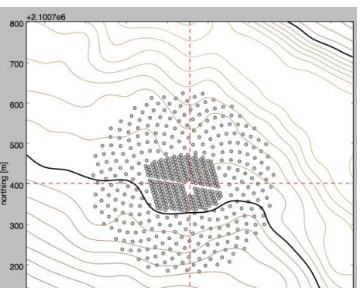
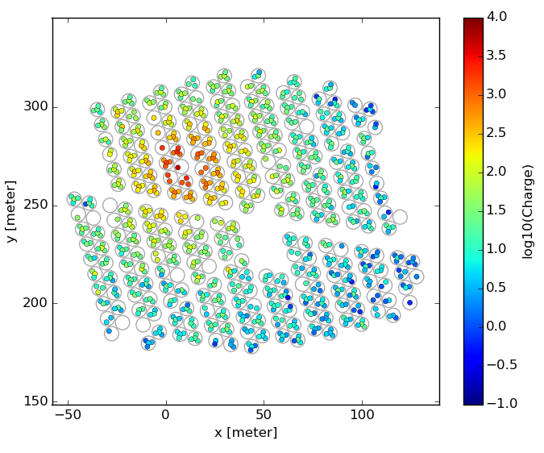
Upgrade to HAWC Observatory
A. Sandolval arXiv:1509.04269
~60 TeV gamma ray event from the Crab Nebula
Upgrade to HAWC array is underway
increase collection area with sparse array of small tanks
Provide better measure of highest energy air showers
expected gain in sensitivity above 10 TeV of 3-4
will allow HAWC to search for the highest energy gamma-ray ever observed

Slide 31
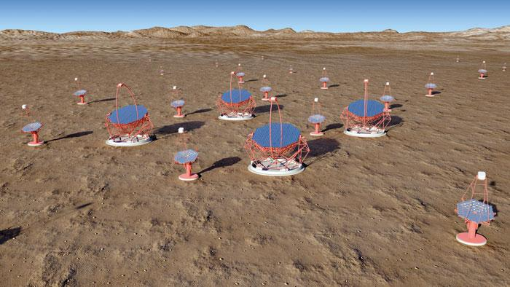
The Cherenkov Telescope Array
CTA is a next-generation gamma-ray observatory
International Consortium combines existing ACT expertise
Plan for Northern and Southern array -> full sky coverage
sites will be La Palma, Spain and Paranal, Chile
Will increase TeV point source sensitivity by ~10x relative to current instruments

Slide 32
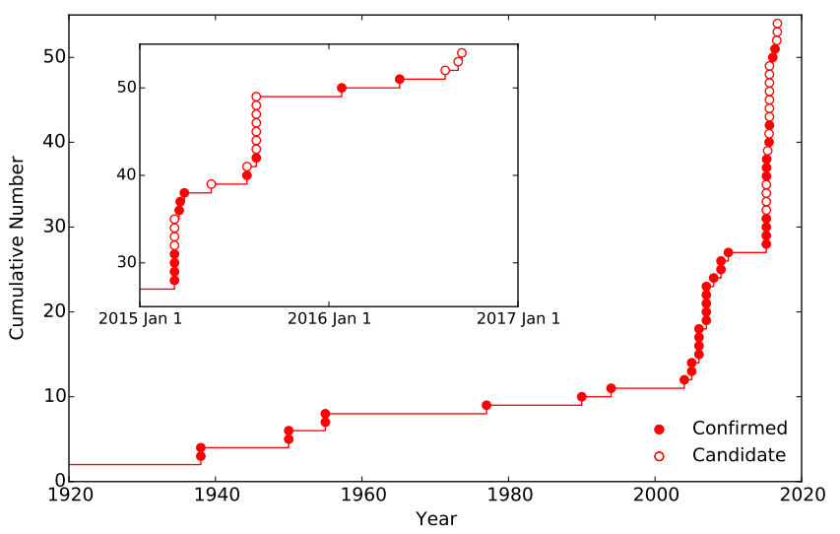
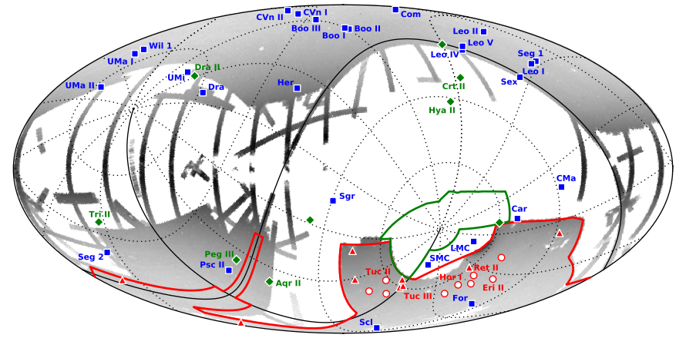
Growing Number of Known Dwarf Galaxies
DECam
SDSS
Dark Energy Survey Year 2 Data: Drlica-Wagner+, 2015ApJ...813..109D
Dark Energy Survey Year 1 Data: Bechtol+, 2015ApJ...807...50B
Koposov+, 2015ApJ...805..130K
Deep photometric surveys in optical astronomy have led to the discovery of numerous new Milky Way-satellites
Spectroscopic follow up necessary to determine if they are DM-dominated dwarf galaxies. Many new dwarf galaxies have already been spectroscopically confirmed
LSST & other surveys will continue to find new dwarf galaxies
Wide field of view survey instruments (e.g. Fermi LAT, HAWC) will have already observed these new DM targets

Slide 33
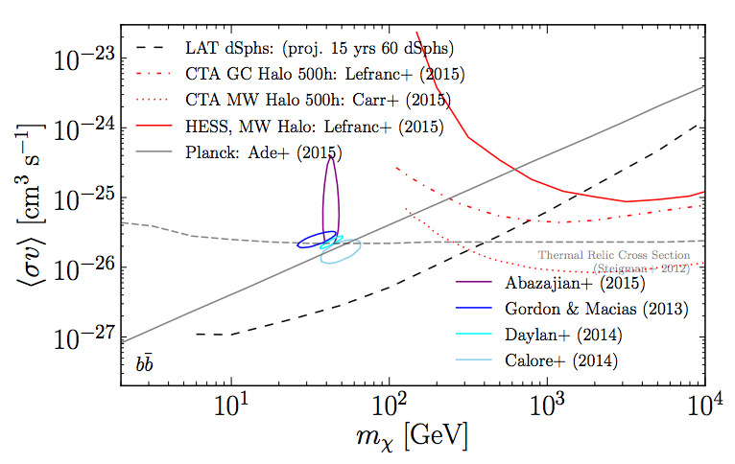
Expected Future Sensitivity
Charles+ [LAT Clb] PR 636 (2016)

Slide 34
Summary
Evidence for DM exists on all cosmic scales
all observational evidence for dark matter comes from space; we must continue investigating dark matter in its cosmic setting
Dark matter annihilations (decay) are predicted to produce a cascade of secondary standard model particles
We can search for these cosmic messengers with a network of ground-based and space-based observatories
Some intriguing anomalies exist that require extensive follow up work from all experiments to complete the picture
The fundamental particle properties of DM (e.g. mass) must be the same from all messengers and targets
The future is bright and full of exciting questions!
We need to continue our multimessenger indirect detection quest to complement terrestrial experiments and gain a complete picture of the DM puzzle

Slide 35
Extra Slides

Slide 36
Gamma rays from DM Annihilation
Andrea Albert (SLAC)
r_{sun} = 8.5 kpc

Slide 37
Gamma rays from DM Annihilation
Charles+ [LAT Collab]
PR 636 (2016)
Andrea Albert (SLAC)
r_{sun} = 8.5 kpc

Slide 38
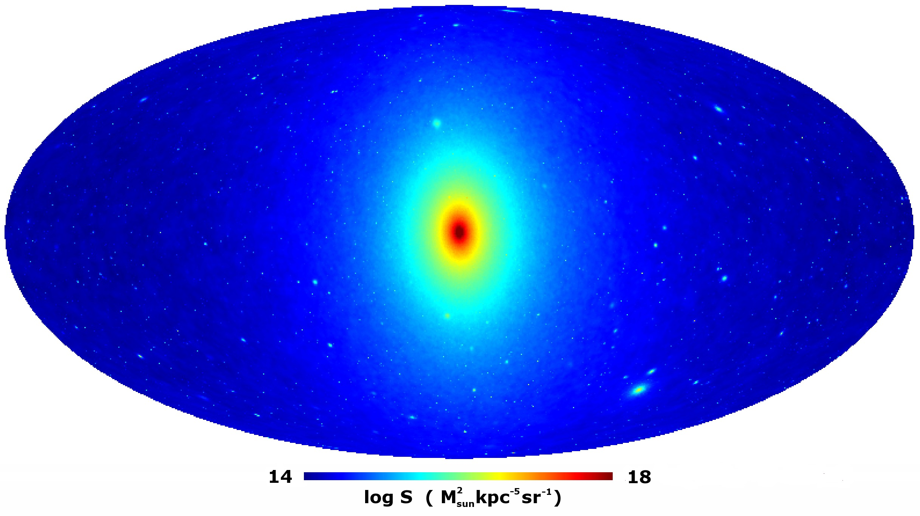
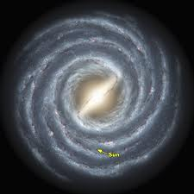
Expected Gamma rays from Dark Matter
DM clumps in Halo
Few backgrounds
Unknown location
Galactic Center
Large statistics
Complex astrophysical fore/backgrounds
Galactic latitude
(looking above Galactic plane)
Extragalactic
All galaxies
Isotropic
Spectral Lines
Smoking gun
Small signal
Galactic Halo
Large statistics
Complex astrophysical fore/backgrounds
Galactic longitude
(looking away from Galactic center)
Galaxies Clusters
e.g. Virgo
DM enriched
likely astrophysical fore/backgrounds
Satellite Galaxies
dSph DM enriched
Known location
Smoking gun
Aquarius (A1) simulation
Notes:
http://wwwmpa.mpa-garching.mpg.de/aquarius/

Slide 39
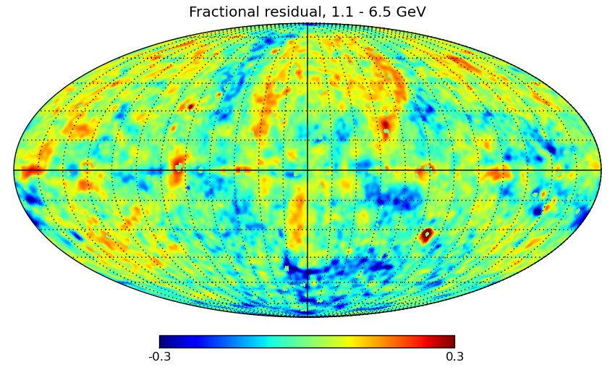
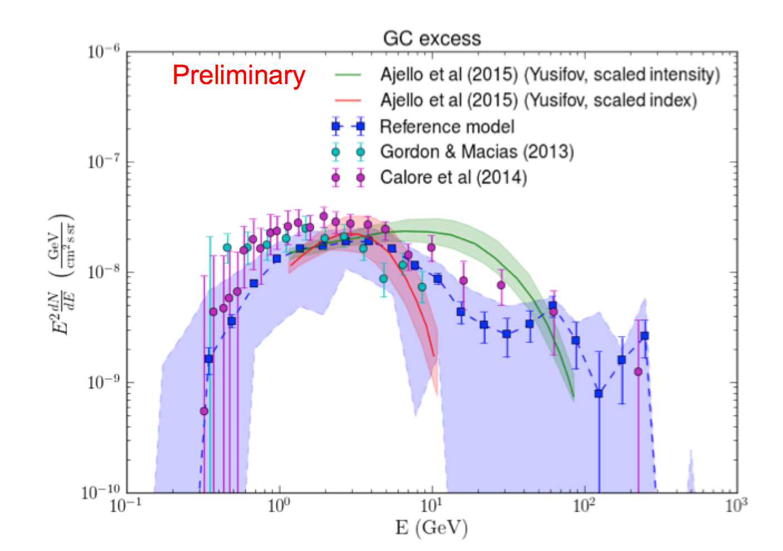
Characterization of the GeV Excess
Preliminary results from new Fermi GC analysis have been shown
A. Albert, D. Malyshev, A. Franckowiak, L. Tibaldo, E. Charles, et al
Goal: study the effects of varying diffuse emission modeling on the GeV excess
see backup slides for modeling details
Results: Excess persists, large spectral uncertainties at low and high energies
Fractional residual, 1.1 – 6.5 GeV
Preliminary
Spectra are normalized to 4π sr
Fractional residual, 1.1 -- 6.5 GeV no excess template included in fit
Preliminary

