Slide 1
Welcome to Shonan (^_^).
Many thanks for coming over long distance.

Slide 2
History of RICH workshop
1st RICH1993: Bari
2nd RICH1995: Uppsala
3rd RICH1998: Ein Gedi
4th RICH2002: Pylos
5th RICH2004: Playa del Carmen
6th RICH2007: Trieste
7th RICH2010: Cassis
8th RICH2013: Shonan
time
八

Slide 3
# of participants: 118+16 accompanied
# of talks (incl. review): 56
One invited talk was cancelled due to his illness.
# of posters: 28
# of exhibitions: 7 companies

Slide 4
Excursion: on Dec-3.
Kamakura city
Weather: will be fine.
Arrange three groups : A, B,C
Group which you assigned is
indicated in your name cards.

Slide 5
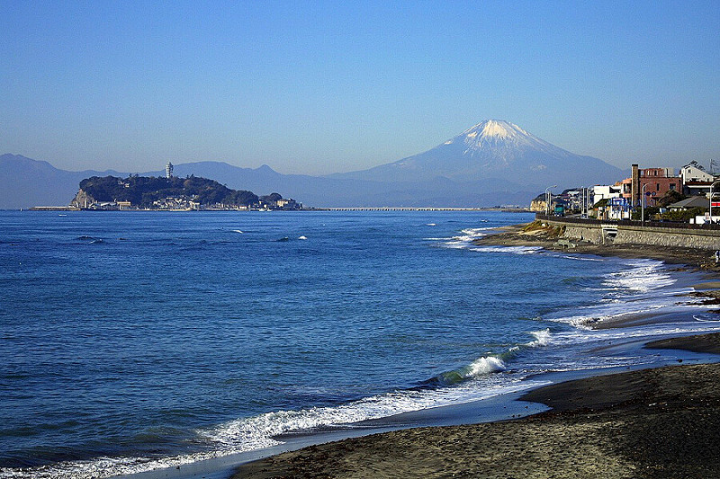

Slide 6
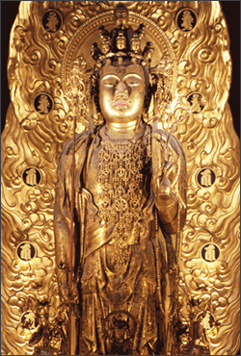
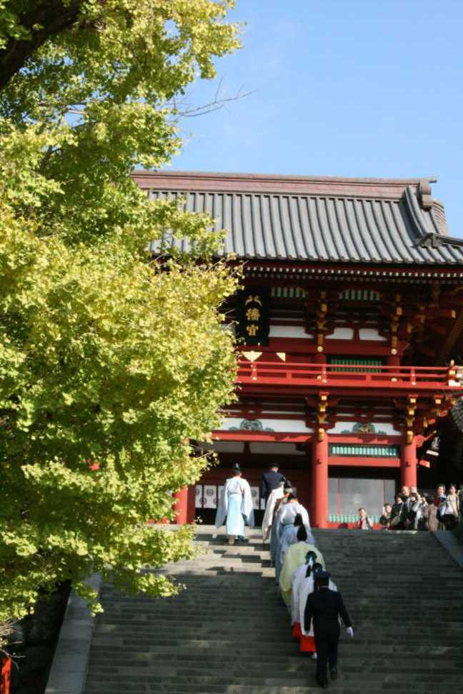
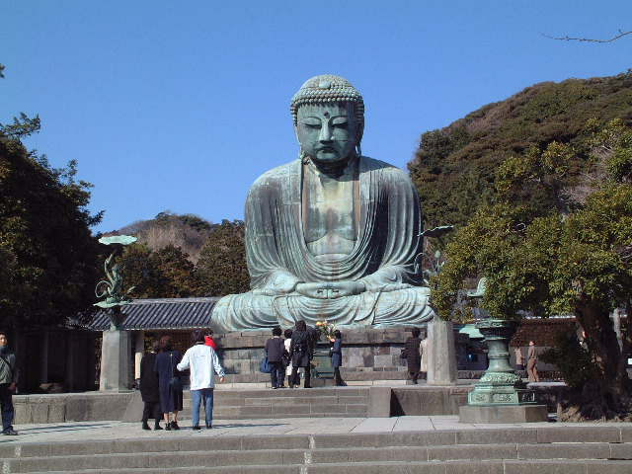
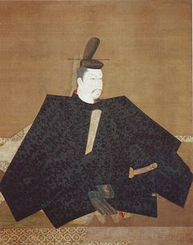
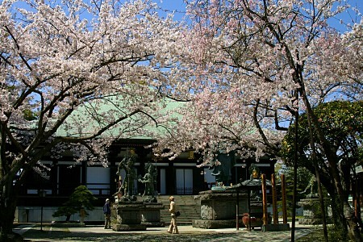
Old capital in Japan (1192~1330)
1st Shogun’s government established here
More than 65 Buddhist temples and 15 Shinto shrines in a delightful town
1st Shogun: Yoritomo Minamoto

Slide 7
Excursion: on Dec-5.
Hakone: A part of National park
near Mt. Fuji
Weather: will be fine

Slide 8
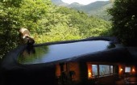
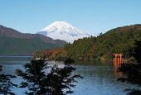
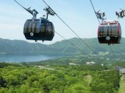
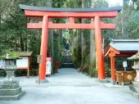
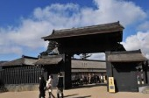
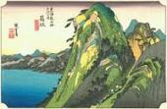
Collection of Hakone’s photo.

Slide 9
e
Morning session will start from 8:30.
Breakfast is available from 7:00.
For those who are not staying at SVC;
If you want to eat lunch together, you can
ask at the JTB desk.
JTB desk is opened during the whole
workshop;
You can consult with them about any
travels in Japan.

Slide 10
e
Special Talk by Prof. Koshiba: this afternoon.
Conference photo with Prof. Koshiba.
Before lunch get together in front of this building.
ISAC meeting: Dec-4, after dinner @ Azalea
Sorry for vegetarians that the dishes at
the yesterday’s welcome party were not suitable.
Any inquiries; come to the headquarters.

Slide 11
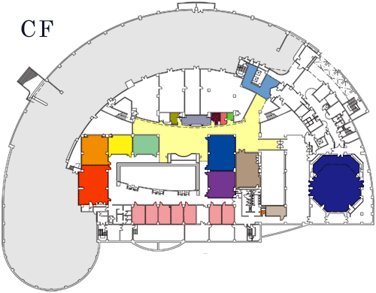
e
Headquarters
Company Exhibitions

