Slide 1
Side Rail Sag Measurement
T. Hayakawa, K. Inami, K. Suzuki (Nagoya) and T. Kohriki (KEK)

Slide 2
Purpose (1)
A large sag was observed at the panel-enclosure joint of the Prototype-IV.
Observed by Inami-san and Hayakawa-san, during the mechanical inspection on the Module01.
~0.1 mm sag for 10 kg weight.
~0.5 mm rise at the bwd end of the enclosure without rising the Honeycomb panel part.
It would damage a detector module during its installation to the Belle spectrometer.
After mounting to the ECL flanges and before connecting to the adjacent modules using z-beams.
The shear force at the panel-enclosure joint would be ~40% of its total weight.
Total module weight is ~100 kg including a Strong Back.

Slide 3
Purpose (2)
A large sag was observed at the panel-enclosure joint of the Prototype-IV. (cont’d)
Extension of a Strong Back to the enclosure part is being considered to solve this problem.
A question was raised if side rails can really sag that much.
Side rails should be very rigid in vertical direction.
A measurement has carried out to answer the question.

Slide 4
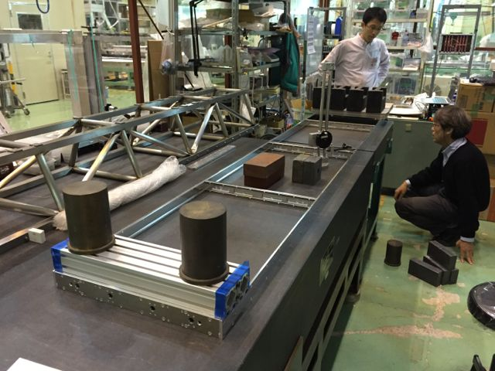
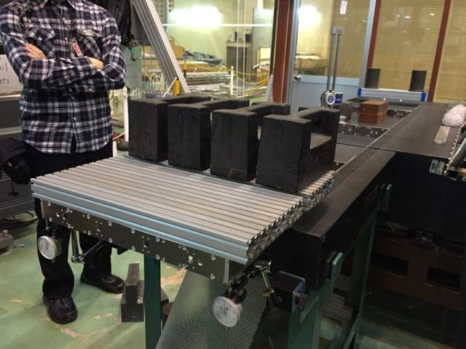
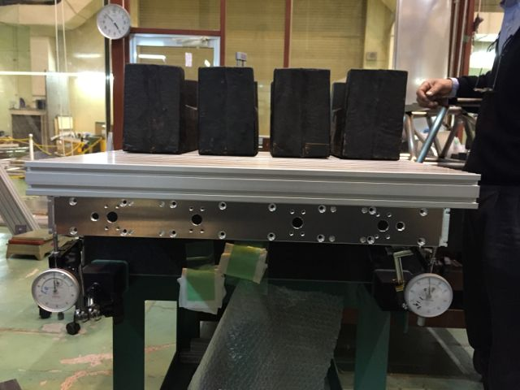
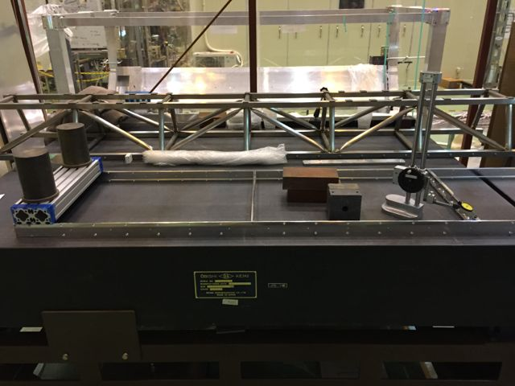
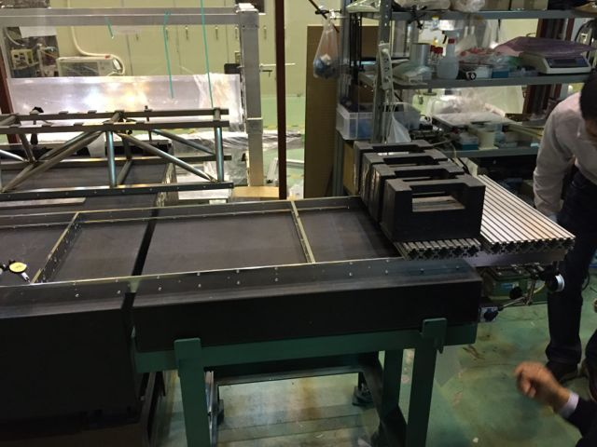
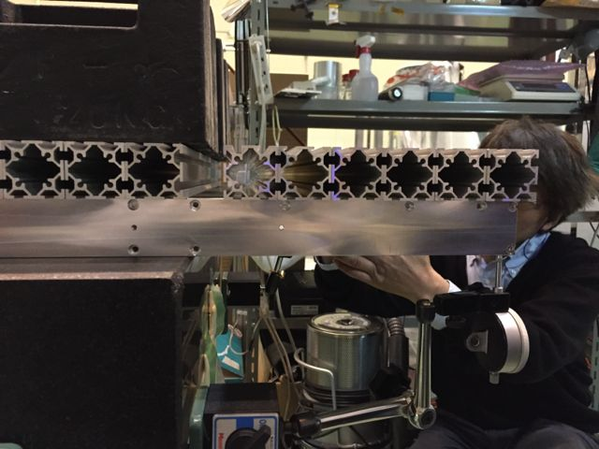
Set-up (1)
Emulating a cantilever beam with a distributed load in the enclosure region of the side rails.
Based on Jim’s suggestion using the side rails for Module02.
8 kg x 2 on the center “end-plate” and side rails.
20 kg x 4 at the granite table edge.
10 kg x 2 at the fwd end.
Dial gauges on the side rails at around the bwd end.
Side rails are connected with 5 end-plates at the fwd end, ~1/4, ~1/2, ~3/4 and bwd end to prevent from unwanted bending of the rails, e.g. twisting.
6 Al frames were used to apply distributed load.
750 mm
700 mm
265 mm
1450 mm
1410 mm

Slide 5
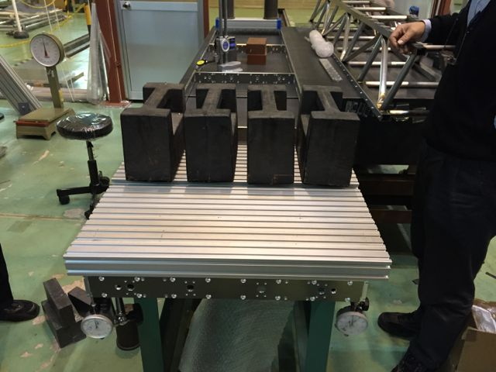
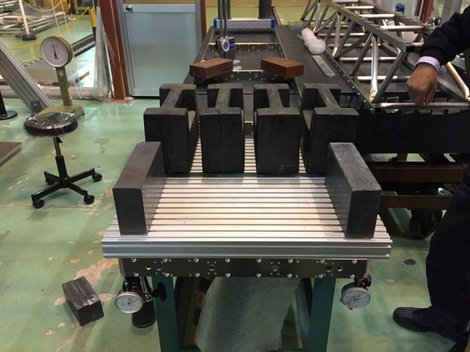
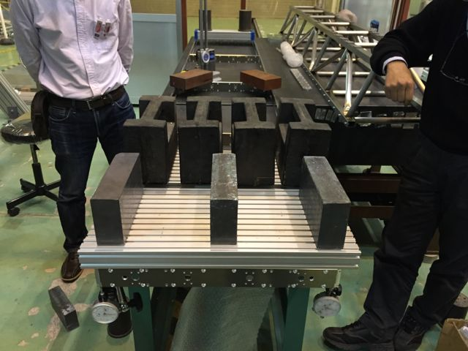
Set-up (2)
Sag for a given load was measured using dial gauges.
Lead blocks (11.5 kg/block) were used as load.
Measured loads: 0, 1, 2, 3 and 4 blocks.
6 Al frames (3.75 kg in total) were used to distribute the load over the enclosure region.
3.75 kg
26.75 kg
38.25 kg

Slide 6
Results (1)
Distributed load
Max. sag = Wl³/(8EI)
Approx. cross-section
1. Square shape
I = bh³/12,
where b= 6 mm, h= 45.6 mm.
B. Concentrated load
Max. sag = Wl³/(3EI)
2. C-shape
I = [ad³ – h³(a-t)]/12,
where a= 7.5 mm, t= 6 mm,
d= 45.6 mm, h= 27.6 mm.
l= 265 mm, E(Al)= 7199.2 kgf/mm².
Data agree with the concentrated load case unexpectedly.
Square shape seems better.
Dial gauges were zero-adjusted with Al frame weight.
Need corrections.

Slide 7
Results (2)
Corrected the data by adding the expected sag of B1 for the Al frame weight (3.75 kg) .
Measurement agrees with the concentrated load expectation for the square shape cross-section within ±0.025 mm.
The reason not to agree with the distributed load expectation is unknown.
Extension of the strong back is necessary.
40 % of the module+SB weight (~100 kg) would bend the side rail by 0.73 mm.

