Slide 1
チャーム/ボトムが開く 新しいハドロン物理の世界
KEK
安井 繁宏
新学術領域「新ハドロン」第１回評価委員会@名古屋大学 4 Aug 2011

Slide 2
Contents
Introduction
2. New Charmed Exotic Hadrons and Nuclei
3. Experimental Researches
4. Summary

Slide 3
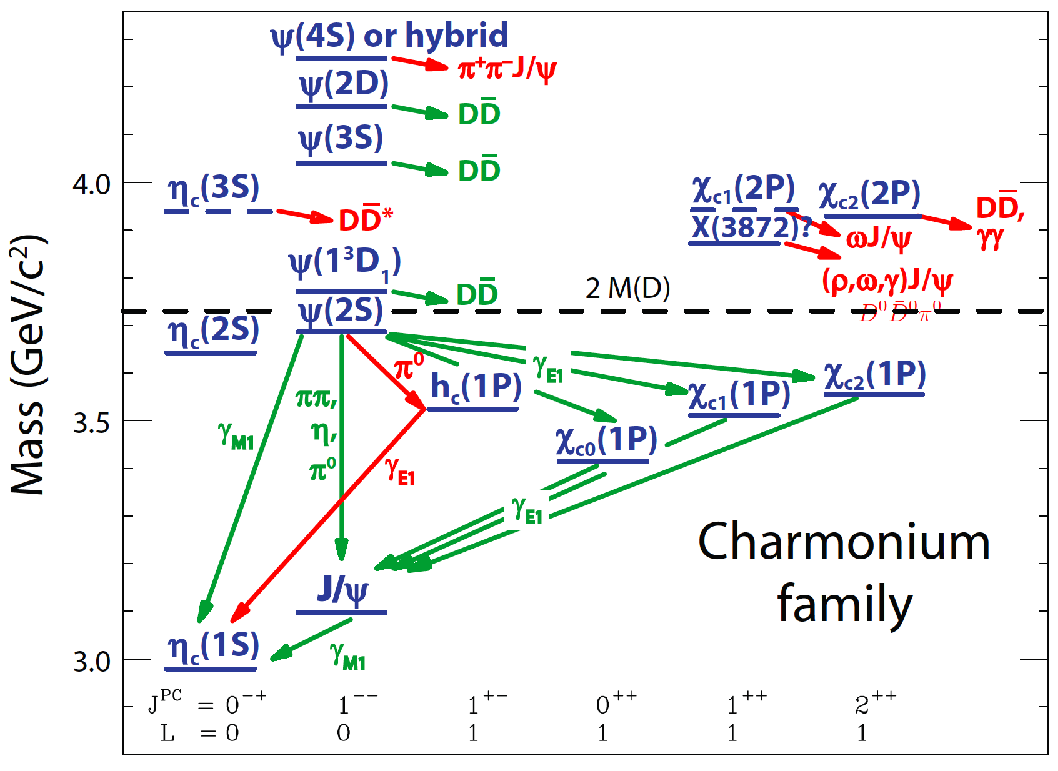
1. Introduction
Many new cc states above threshold
quarkonium cc
+ exotic states
quarkonium cc
Eichten in QWG 2008 Nara

Slide 4
1. Introduction
Many new cc states above threshold
quarkonium cc
+ exotic states
quarkonium cc
Eichten in QWG 2008 Nara

Slide 5
1. Introduction
Many new cc states above threshold
quarkonium cc
+ exotic states
quarkonium cc
Eichten in QWG 2008 Nara

Slide 6
1. Introduction
X(3872), X(3940), Y(4260), Z(4430)⁺, ... Y_{b} , Z_{b}⁺, ...
Why are they exotic?
unusual decay widths and branching ratios
unexpected states different from cc quark model
X(3872)
Y(4260)
Z(4430)⁺ (Z_{b}⁺)
T_{cc}¹
c
u
c
u
c
u
c
c
c
g
c
u
c
d
c
d
c
Cornel potential
Coulomb 1/r + confinement kr
DD* (ccuu) molecule
Tornqvist (1991)
ccg hybrid
S. L. Zhu (2005)
ccud (bbud)
really tetraquark
ccud
really tetraquark
DD* threshold ?
gluon dynamics ?
new correlation ?
diquark correlation ?

Slide 7
1. Introduction
Mass scales and Symmetries
3 5
150
200
1500
4700
[MeV]
m
u d
s
Λ_{QCD}
c
b
Chiral Symmetry
SU(3)_{L} x SU(3)_{R}
π, K as Nambu-Goldstone bosons
Chiral multiplets (ρ-a₁, N-N*, ...)
Nuclei formed by tensor force
Λ(1405) and K nuclei
...

Slide 8
1. Introduction
Mass scales and Symmetries
3 5
150
200
1500
4700
[MeV]
m
u d
s
Λ_{QCD}
c
b
Chiral Symmetry
SU(3)_{L} x SU(3)_{R}
π, K as Nambu-Goldstone bosons
Chiral multiplets (ρ-a₁, N-N*, ...)
Nuclei formed by tensor force
Λ(1405) and K nuclei
...

Slide 9
1. Introduction
Mass scales and Symmetries
3 5
150
200
1500
4700
[MeV]
m
u d
s
Λ_{QCD}
c
b
???
Chiral Symmetry
Chiral Symmetry
SU(3)_{L} x SU(3)_{R}
SU(4)_{L} x SU(4)_{R}
π, K as Nambu-Goldstone bosons
Chiral multiplets (ρ-a₁, N-N*, ...)
Nuclei formed by tensor force
Λ(1405) and K nuclei
...

Slide 10
1. Introduction
Mass scales and Symmetries
3 5
150
200
1500
4700
[MeV]
m
u d
s
Λ_{QCD}
c
b
Heavy Quark
Symmetry
Chiral Symmetry
SU(3)_{L} x SU(3)_{R}
SU(2)_{spin} x SU(N_{h})
π, K as Nambu-Goldstone bosons
Chiral multiplets (ρ-a₁, N-N*, ...)
Nuclei formed by tensor force
Λ(1405) and K nuclei
...

Slide 11
1. Introduction
Mass scales and Symmetries
3 5
150
200
1500
4700
[MeV]
m
u d
s
Λ_{QCD}
c
b
Heavy Quark
Symmetry
Chiral Symmetry
SU(3)_{L} x SU(3)_{R}
SU(2)_{spin} x SU(N_{h})
π, K as Nambu-Goldstone bosons
D-D* (Σc-Σc*, Ξcc-Ξcc*) mass degeneracy (heavy quark sym.)
Chiral multiplets (ρ-a₁, N-N*, ...)
Nuclei formed by tensor force
More exotics? (like Tcc with no pion decay)
Λ(1405) and K nuclei
Charmed/Bottomed nuclei ?
...

Slide 12
2. New exotic hadrons and nuclei
D and nucleon
D bound nuclei
D
D
N
✓ no strong annihilation
✓ no strong annihilation
tetraquark T_{cc}¹
Z_{b} (isospin 1)
u
c
B
B
c
d
I=1
✓ no strong annihilation

Slide 13
2. New exotic hadrons and nuclei
D and nucleon
D bound nuclei
D
D
N
✓ no strong annihilation
✓ no strong annihilation
tetraquark T_{cc}¹
Z_{b} (isospin 1)
PRELIMINARY
u
c
B
B
c
d
I=1
✓ no strong annihilation

Slide 14
2. New exotic hadrons and nuclei
Strangeness, Charm, Bottom, ...
K
N
D
N
B
N
K
N
D
N
B
N
SU(3)
SU(4)
SU(5)
Weinberg-Tomozawa
Lutz-Kolomeitsev (2004), Hoffmann-Lutz (2005), Mizutani-Ramos (2006), Gamermann-
Oset-Strottman-Vacas (2007), Haidenbauer-Krein-Meissner-Sibirtsev (2007), Tolos-
Molina-Gamermann-Gracia-Reico-Nieves-Oset-Ramos (2010) ...

Slide 15
2. New exotic hadrons and nuclei
Strangeness, Charm, Bottom, ...
K*
K* is almost irrelevant in dynamics...
vector
400 MeV
But D* and B* are new ingredients!
D*
B*
pseudo-
scalar
140 MeV
45 MeV
K
D
B
500 MeV
1870 MeV
5280 MeV
Chiral Symmetry
Heavy Quark Symmetry

Slide 16
2. New exotic hadrons and nuclei
Strangeness, Charm, Bottom, ...
KN interaction D(B)N interaction
K
N
D⁽*⁾
N
B⁽*⁾
N
π, ω, ρ
π, ω, ρ
π, ω, ρ
K
N
D⁽*⁾
N
B⁽*⁾
N
One pion is absent.
(short range force)
One pion is present.
(long range force)
Weinberg-Tomozawa
One pion exchange potential
(OPEP)
S. Y. and K. Sudoh, PRD80, 034008 (2009)
Y. Yamaguchi, S. Ohkoda, S. Y., A. Hosaka, PRD84, 014032 (2011)

Slide 17
2. New exotic hadrons and nuclei
D and nucleon
Heavy Quark Symmetry
D⁽*⁾
N
G. Burdman and J.F. Donoghue (1992)
M.B. Wise (1992)
T.-M. Yan, H.-Y. Cheng, C.-Y. Cheung,
G.-L. Lin, Y.C. Lin and H.-L. Yu (1997)
π, ω, ρ
with
vector + pseudoscalar
P=D, B
D⁽*⁾
N
π-exchange potential
S. Y. and K. Sudoh, PRD80, 034008 (2009)
✓ no annihilation
ω and ρ-exchange potential
Y. Yamaguchi, S. Ohkoda, S. Y., A. Hosaka,
PRD84, 014032 (2011)

Slide 18
2. New exotic hadrons and nuclei
D and nucleon
I(J^{P})=0(1/2⁻)
DN(²S_{1/2}), D*N(²S_{1/2}), D*N(⁴D_{1/2})
+ ρ, ω potential
I(J^{P})=0(3/2⁻)
DN(²D_{3/2}), D*N(⁴S_{3/2}), D*N(⁴D_{3/2}), D*N(²D_{3/2})
+ ρ, ω potential
All parameters are fixed (no free parameter).

Slide 19
2. New exotic hadrons and nuclei
D and nucleon
D*N
140 MeV
B*N
45 MeV
DN
BN
DN bound state
B.E. 2 MeV
BN bound state
I(J^{P})=0(1/2⁻)
B.E. 22 MeV
I(J^{P})=0(1/2⁻)
S. Y. and K. Sudoh, PRD80, 034008 (2009)
Y. Yamaguchi, S. Ohkoda, S. Y., A. Hosaka,
PRD84, 014032 (2011)

Slide 20
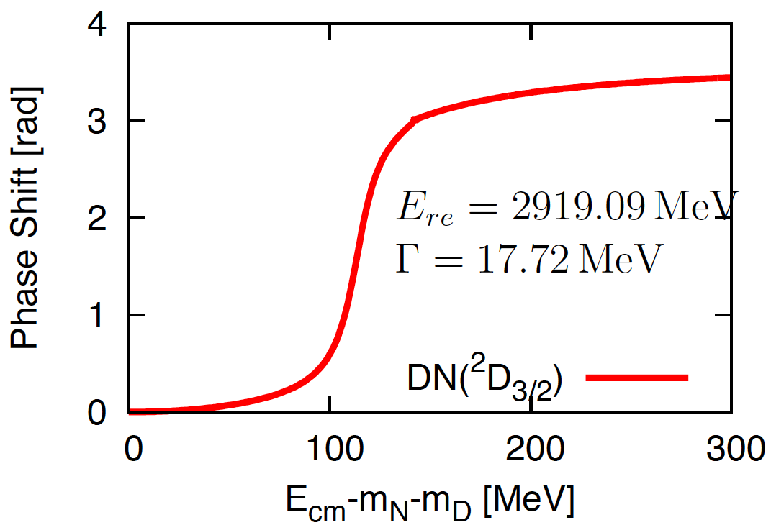
2. New exotic hadrons and nuclei
D and nucleon
D*N
20 MeV
DN resonance
Γ = 17 MeV
140 MeV
I(J^{P})=0(3/2⁻)
DN
Y. Yamaguchi, S. Ohkoda, S. Y., A. Hosaka,
PRD84, 014032 (2011)

Slide 21
2. New exotic hadrons and nuclei
D and nucleon
D*N
20 MeV
DN resonance
Feshbach resonance
Γ = 17 MeV
140 MeV
I(J^{P})=0(3/2⁻)
DN
Y. Yamaguchi, S. Ohkoda, S. Y., A. Hosaka,
PRD84, 014032 (2011)

Slide 22
2. New exotic hadrons and nuclei
D and nucleon
D*N
20 MeV
DN resonance
Γ = 17 MeV
140 MeV
I(J^{P})=0(3/2⁻)
B*N
8 MeV
45 MeV
BN resonance
DN
Γ = 0.13 MeV
BN
I(J^{P})=0(3/2⁻)
Y. Yamaguchi, S. Ohkoda, S. Y., A. Hosaka,
PRD84, 014032 (2011)

Slide 23
2. New exotic hadrons and nuclei
D and nucleon
D*N
20 MeV
DN resonance
Γ = 17 MeV
140 MeV
I(J^{P})=0(3/2⁻)
B*N
8 MeV
45 MeV
BN resonance
DN
Γ = 0.13 MeV
BN
I(J^{P})=0(3/2⁻)
I(J^{P})=0(1/2⁻)
bound state
I(J^{P})=0(3/2⁻)
narrow resonance state
Y. Yamaguchi, S. Ohkoda, S. Y., A. Hosaka,
PRD84, 014032 (2011)

Slide 24
2. New exotic hadrons and nuclei
DN state
BN state
6263 MeV
2946 MeV
D*N
B*N
6217 MeV
BN
H dibaryon
2255 MeV
ΞN
2807 MeV
DN
ΛΛ
2230MeV
Λ(1405)
1433 MeV
KN
πΣ
1330 MeV

Slide 25
2. New exotic hadrons and nuclei
DN state
BN state
6263 MeV
2946 MeV
D*N
B*N
6217 MeV
BN
H dibaryon
B nuclei
2255 MeV
ΞN
2807 MeV
DN
ΛΛ
D nuclei
2230MeV
Λ(1405)
Hypernuclei
1433 MeV
KN
K nuclei
πΣ
1330 MeV

Slide 26
2. New exotic hadrons and nuclei
Carlson, Heller, Tjon (1988)
Silvestre-Brac and Semay (1993)
Manohar and Wise (1993)
Lee, SY, Liu and Ko (2008)
Lee and SY (2009)
tetraquark T_{cc}¹
„explicitly“ exotic
T_{cc}¹
✓ no annihilation
D⁰
D*⁻
?
u
c
c
u
+
c
d
I(J^{P})=0(1⁺)
c
d
Spin-color int. s•Bª (a=1,..,8) induces
cc pair
1/m_{Q}²
further suppressed
cu pair
1/m_{Q}¹
suppressed
ud pair
1/m_{Q}⁰
dominant attraction (3_{c}, 3_{f}, s=0)

Slide 27
2. New exotic hadrons and nuclei
Carlson, Heller, Tjon (1988)
Silvestre-Brac and Semay (1993)
Manohar and Wise (1993)
Lee, SY, Liu and Ko (2008)
Lee and SY (2009)
tetraquark T_{cc}¹
„explicitly“ exotic
T_{cc}¹
✓ no annihilation
D⁰
D*⁻
u
c
c
u
+
c
d
I(J^{P})=0(1⁺)
c
d
No strong decay
Spin-color int. s•Bª (a=1,..,8) induces
cc pair
1/m_{Q}²
further suppressed
cu pair
1/m_{Q}¹
suppressed
ud pair
1/m_{Q}⁰
dominant attraction (3_{c}, 3_{f}, s=0)

Slide 28
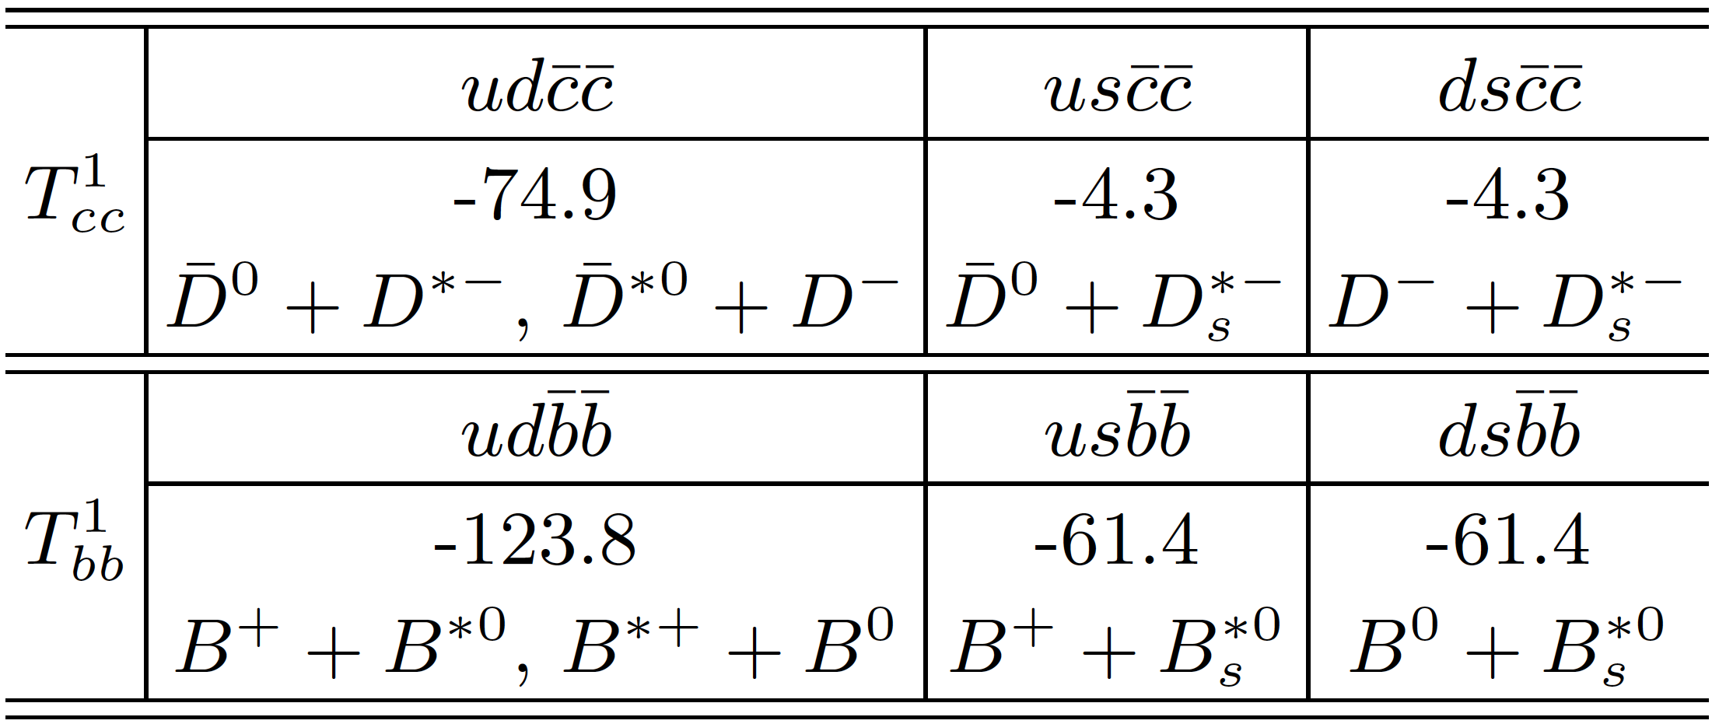
2. New exotic hadrons and nuclei
Carlson, Heller, Tjon (1988)
Silvestre-Brac and Semay (1993)
Manohar and Wise (1993)
Lee, SY, Liu and Ko (2008)
Lee and SY (2009)
tetraquark T_{cc}¹
„explicitly“ exotic
T_{cc}¹
✓ no annihilation
D⁰
D*⁻
u
c
c
u
+
c
d
I(J^{P})=0(1⁺)
c
d
No strong decay
Binding energy of T_{cc(bb)}¹ [MeV]
→ T_{cc(bb)}¹ are stable as 3_{f} multiplet of SU(3)_{f}.

Slide 29
2. New exotic hadrons and nuclei
D and nucleon
D bound nuclei
D
D
N
tetraquark T_{cc}¹
Z_{b} (isospin 1)
u
c
B
B
c
d
I=1

Slide 30
2. New exotic hadrons and nuclei
D and nucleon
D bound nuclei
D
D
e⁺e⁻ collisions
pp (pp^{bar}) collisions
Heavy ion collisions
N
tetraquark T_{cc}¹
Z_{b} (isospin 1)
u
c
B
B
c
d
I=1

Slide 31
3. Experimental researches
Exotic hadrons from heavy ion collisions at RHIC and LHC

Slide 32
3. Experimental researches
Exotic hadrons from heavy ion collisions at RHIC and LHC
Nucleus
Nucleus

Slide 33
3. Experimental researches
Exotic hadrons from heavy ion collisions at RHIC and LHC
QGP
Nucleus
Nucleus

Slide 34
3. Experimental researches
Exotic hadrons from heavy ion collisions at RHIC and LHC
Hadron phase
p, Λ, ...
QGP
π, K, ...
f₀, a₀, ...
STAR (2003)
_{Λ}³H
STAR (2010)
Exotics?

Slide 35
3. Experimental researches
Exotic hadrons from heavy ion collisions at RHIC and LHC
Hadron phase
p, Λ, ...
π, K, ...
f₀, a₀, ...
STAR (2003)
_{Λ}³H
STAR (2010)
Exotics?

Slide 36
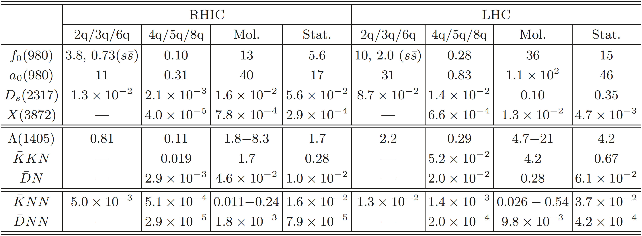
3. Experimental researches
Yields of exotic hadrons at RHIC and LHC
S. Cho et al. (the ExHIC collaboration), PRL106, 212001 (2011)
ExHIC (Exotics from Heavy Ion Collisions) collaboration
S. Cho (Yonsei U.), T. Furumoto (YITP and RIKEN), T. Hyodo (Tokyo Inst. Technology), D. Jido (YITP), C.-M. Ko (Texas A&M U.), S. H. Lee (Yonsei U. and YITP), M. Nielsen (U. de Paulo), A. Ohnishi (YITP), T. Sekihara (YITP and Kyoto U.), K. Yazaki (YITP and RIKEN), S. Y. (KEK)

Slide 37
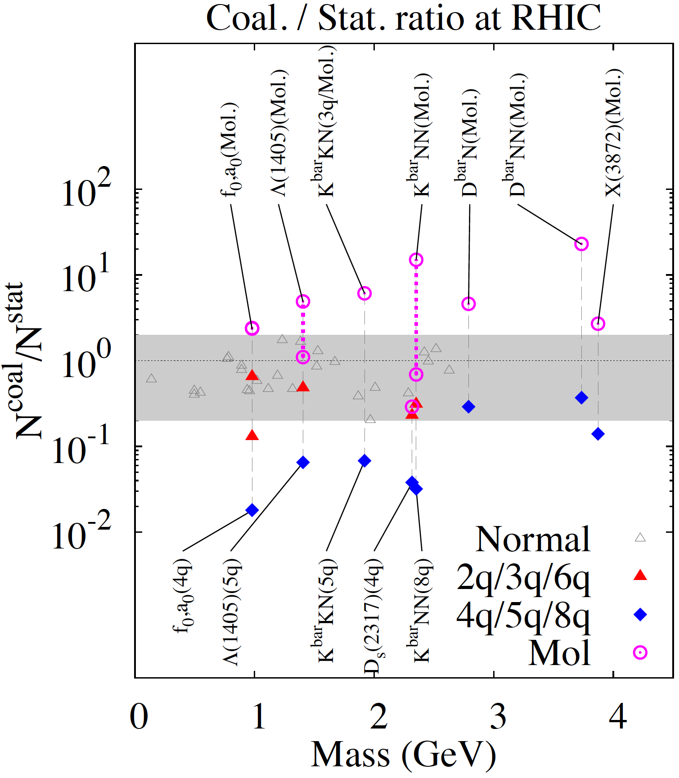
3. Experimental researches
Hadron molecule vs. Multi-quark
ExHIC collaboration,
PRL106, 212001 (2011)
Hadron molecule
1
Normal hadron
0.2
Multi-quark

Slide 38
4. Summary
・ Heavy quarks have new symmetry and dynamics.
Heavy quark symmetry
D-D* mixing
...
・ Many exotic heavy hadrons, nuclei and atoms.
D^{bar}N bound/resonance states
D^{bar} bound nuclei
T_{cc}¹
Z_{b} (I=1)
...
・ Searches in e⁺e⁻, pp (pp^{bar}) and heavy ion collisions.

